Slide 1
Think Tax Reform Won’t Impact your Business? Think Again!
November 29, 2018
Presented by:
Robert B. Henderson II, CPA, MST

Slide 2
Robert B. Henderson II, CPA, MST Partner, Tax & Accounting Services
Range of Experience
Rob joined Windes in 2013 and is a Partner in the firm’s Tax & Accounting Services department.
Rob specializes in providing tax advisory, accounting, and compliance services to middle market businesses and their owners with emphasis on assisting clients plan for, and manage, their income tax liabilities.
He serves various industries, including manufacturing, resell and distribution, technology, real estate, service companies, online retailers, franchise owners, restaurant owners, as well as, high-net- worth individuals.
Education
Bachelor of Science, Business Administration
San Diego State University
Master of Science, Taxation
San Diego State University
Community and Professional Affiliations
American Institute of Certified Public Accountants, Member
California Society of Certified Public Accountants, Member
Resident Office
18201 Von Karman Avenue Suite 1060
Irvine, CA 92612
Telephone
949.271.2600
Email
rhenderson@windes.com

Slide 3
Introduction

Slide 4
Introduction
The IRS has passed the Tax Cuts and Jobs Act, but how exactly does this impact you as an entrepreneur? Today, we are going to provide a high-level understanding of the tax changes along with takeaways and strategies you can implement to help your business.
General changes to all businesses.
Changes to C corporations
Changes to Pass-through entities including LLCs
General changes to all individuals including trusts, estates and gifts
Questions & Answers

Slide 5
Businesses

Slide 6
Businesses
Lower federal tax rates for businesses!!!

Slide 7
Businesses
Expensing and cost recovery
Double first-year bonus depreciation for five years – 100% bonus depreciation for asset placed in service after Sept. 27, 2017 and before Jan. 1, 2023, and then:
80% in 2023
60% in 2024
40% in 2025
20% in 2026
Used property qualifies (if new to taxpayer)
Property cannot be acquired from a related party
Qualified Improvement Property (the new name for Qualified Leasehold Improvements) does not qualify

Slide 8
Businesses
Expensing and cost recovery
IRC Section 179 - $1 million maximum with phase-out beginning at $2.5 million total purchases
Expands definition of qualified property for Section 179 deduction to include:
Qualified Leasehold Improvements
Qualified Real Property (roofs, heating ventilation and air-conditioning property, fire suppression and alarm systems)
Qualifying Residential Property (furniture, refrigerators, ranges, and other appliances)
Like-kind exchanges
Limit to real property not held primarily for sale

Slide 9
Businesses
Net operating losses (NOL) incurred after 12/31/2017
No carryback
Unlimited carryforward
Can only offset 80% of taxable income in the year it is utilized

Slide 10
Businesses
Business interest deduction limitation
Tax deduction on net interest (interest expense – interest income) is limited to 30% of adjusted taxable income
Adjusted taxable income:
2018 – 2021: Roughly equivalent to EBITDA (without depreciation, amortization or depletion)
2022 and forward: Roughly equivalent to EBIT
Unused interest expense can be carried forward indefinitely
Exceptions: Utilities, electing real estate, and businesses with average annual gross receipts $25 million or less

Slide 11
Businesses
Business interest deduction limitation (continued)
Exceptions: Real property trade or business can elect out of this rule if they use ADS to depreciate applicable real property used in a trade or business (40 years for nonresidential, 30 years for residential and 20 years for qualified improvements)

Slide 12
Businesses
Deductions repealed
Section 199 (domestic production activity) deduction
Local lobbying expenses deduction (IRC Section 162(e))
Employee achievement awards exclusion (IRC Section 74(c) and 274(j))
Meals and entertainment expenses – Entertainment expenses are 100% disallowed and all meals are limited to 50% (including meals that were 100% tax deduction under the old laws) for taxable years beginning after December 31, 2017
Tax deduction on transportation fringe benefits (e.g., parking and mass transit) provided to employees are disallowed, but the exclusion from income for such benefits received by an employee is retained

Slide 13
Businesses
Tax credits
Research and development (R&D) credit – no change
Low income housing credit – no change
Employer-provided child care credit – no change
Work opportunity tax credit – no change
New markets tax credit – no change
Rehab credit – retained for historical buildings except for pre-1936 buildings
Orphan drug credit – reduced from 50% to 25%
Employer-paid family or medical leave – NEW!

Slide 14
Businesses
Accounting methods
C corporations can use cash method if average annual gross receipts do not exceed $25 million (increase from $5 million).
Not required to capitalize inventories if average annual gross receipts do not exceed $25 million and report “inventories” as non-incidental materials and supplies or conform to financial accounting treatment.
Unicap (Sec. 263A) – does not apply to wholesaler or retailer if average annual gross receipts do not exceed $25 million (increase from $10 million).
Long-term contracts – Taxpayers are allowed to use the Completed Contract method or other permissible method if average annual gross receipts do not exceed $25 million.

Slide 15
Businesses
Other
Disposition of self-created patents and invention, model or design (whether or not patented), a secret formula or process is ordinary income and not a capital gain
Five-year amortization period applies to research and experimental expenditures incurred after December 31, 2021, including software development costs

Slide 16
C Corporation

Slide 17
Businesses
C Corporation
Corporate tax rates are reduced to a flat 21% rate
No difference for Personal Service Corporations
AMT is eliminated
Existing AMT credit can be used with no limitation
If AMT credit exceeds regular tax by 50% or more, it is refundable for tax years 2018 – 2020
All AMT credit is refundable in tax year 2021

Slide 18
Businesses
C Corporation – Dividend Received Deductions (DRDs)
Prior to 1/1/2018, DRDs are as follows:
Effective for years beginning after 12/31/17, the 70% DRD will be reduced to 50% and the 80% DRD will change to 65%
Stock Ownership % | DRD%
<20% | 70%
20% < 80% | 80%
>80% | 100%

Slide 19
Pass-through Entities

Slide 20
Businesses
Pass-through entities – new IRC Section 199A deduction
In general…
Applies to Sole proprietorship, Partnership, S Corporation, Trust or Estates
Provides a deduction up to 20% of combined Qualified Business Income (QBI) from domestic business operated as relevant pass-through (RPE) entities
Provides a deduction up to 20% of combined qualified REIT Dividends and qualified PTP income.
The combined deduction is then subject to an overall limitation equal to 20% of the excess of:
Taxable income, over
Net capital gain as determined under S1(h).
20% deduction is not taken against income taxed at preferential tax rates
Expires after 2025.

Slide 21
Businesses
Pass-through entities – new IRC Section 199A deduction (continued)
Must be a IRC Section 162 trade or business, other than the trade or business of performing services as an employee.
QBI excludes certain service provider income. Specialized Service Trade or Business (SSTB) include medical services, law, accounting, actuarial science, performing arts, consulting, athletics, financial services and brokerage services.
Engineers and architects qualify and were removed from the original definition of SSTB.

Slide 22
Businesses
Pass-through entities – new IRC Section 199A deduction (continued)
SSTB Catch-all:
A business will only be a “trade or business where the principal assets of such trade or business is the reputation or skill of one or more of its employees or owners” if:
a person receives fees, compensation, or other income for endorsing products or services,
a person licenses or receives fees, compensation or other income for the use of an individual’s image, likeness, name, signature, voice, trademark, or other symbols associated with the individual’s identity, or
a person receives fees, compensation, or other income for appearing at an event on radio, television, or another media format.

Slide 23
Businesses
Pass-through entities – new IRC Section 199A deduction (continued)
Threshold amount: this is the dividing line, below which:
Section 199A will be easy to administer, but above which
Section 199A will be nightmare.
The prohibition on specified service businesses and the W-2 and property-based limitations do not apply when the owner’s taxable income (before the S199A deduction) is less than:
$315,000 in the case of MFJ
$157,500 for all other taxpayers
Phase-in range:
The prohibition on specified service business and the W-2 and property based limitations are phased in over the next:
$100,000 in the case of MFJ
$50,000 for all other taxpayers.
Thus, the prohibition and limitations apply in full once taxable income exceeds:
$415,000 in the case of MFJ
$207,500 for all other taxpayers.

Slide 24
Businesses
Pass-through entities – new IRC Section 199A deduction (continued)
When the owner’s taxable income is above the thresholds, we have to apply the SSTB rules and the W-2 and property-based limitations.
QBI from each entity is 20% of QBI limited to the greater of
50% of owner’s share of W-2 wages paid by pass-through entity or
25% of owner’s share of W-2 wages plus 2.5% of the unadjusted basis immediately after acquisition (UBIA) of qualified property
Deduction from taxable income: not AGI, not Schedule A deduction
Only applies to income tax – not self-employment tax
Carryover net negative QBI to subsequent tax year

Slide 25
Businesses
Pass-through entities – new IRC Section 199A deduction (continued)
What’s the point of the Section 199A deduction?
Under 2018 law, the double taxation rate on owners of C corporation is down to 39.8% (21% corporate rate; 23.8% dividend tax)
Allowing a 20% deduction will reduce the effective top rate on non-corporate business income to 29.6%
Business owners will keep a 10% advantage over C corporation shareholders; otherwise, it would have shrunk down to 0.2%.

Slide 26
Businesses
Pass-through entities – new IRC Section 199A deduction (continued)
Planning tips:
Shareholder/employee wages optimum is 28.5714% of business profits before W2 wages
Dial down guaranteed payments
Convert 1099 contractors to employees
Incorporate sole proprietorship as a Subchapter S corporation
Move an offshore entity back to US
Determine if aggregating businesses makes sense

Slide 27
Businesses
Pass-through losses – excess business losses limitation for non-corporate taxpayers
Total business loss deduction is limited to no more than
Business income and gains
+
$500,000 (married filing jointly) or $250,000 (single)
Limit applies at the partner / shareholder level
Limit applies after passive loss rules under IRC Section 469
Excess disallowed loss carried forward as NOL under IRC Section 172

Slide 28
Businesses
Pass-through losses - excess business losses limitation for non-corporate taxpayers continued

Slide 29
Businesses
Other Partnership provisions
Carried interests
New holding period for long-term capital gains recognition – 3 years
Built-in loss upon transfer of partnership interest applies to loss greater than $250,000
Technical termination is repealed

Slide 30
Businesses
Other S Corporation provisions
Conversions from S corporation to C corporation
Special rules apply for two years, beginning with date of enactment
Must have same owners
Distributions are deemed pro-rata from accumulated adjustment account (AAA) and earnings and profits (E&P)

Slide 31
Individuals

Slide 32
Individuals
New tax rates and brackets
10% retained
15% reduced to 12%
25% reduced to 22%
28% reduced to 24%
33% reduced to 32%
35% retained
39.6% reduced to 37%
No change to the long-term capital gains and qualified dividend tax rates
No change to the 3.8% Net Investment Income tax or the additional 0.9% Medicare tax on high wage earners

Slide 33
Individuals
Standard deduction increased
Single - $12,000
Married filing jointly - $24,000
Head of Household - $18,000
Personal exemption(s) suspended through December 31, 2025

Slide 34
Individuals – Itemized deductions
Deductions | New Laws
Medical expenses | Retained and Adjusted Gross Income (AGI) limit reduced to 7.5% for 2017 and 2018
State and local taxes | $10,000 limit for state income taxes and property taxes combined
Mortgage interest | Capped at $750,000 in acquisition debt for debt incurred after 12/15/2017 – no deduction for “home equity indebtedness”
Charitable contributions | Limit increased from 50% of AGI to 60% of AGI for contributions to public charities
Miscellaneous itemized deductions in excess of 2% adjusted gross income (AGI) | Suspended through 12/31/2025 – includes professional fees, unreimbursed employee expenses, investment management fees, etc.
Other miscellaneous itemized deductions | Retained if specifically exempt from 2% AGI floor (e.g., investment interest)
Personal casualty losses | Suspended unless in federally declared disaster zone

Slide 35
Individuals
Itemized deductions continued
3% AGI phase-out of total allowable itemized deductions is suspended through December 31, 2025
Other deductions / income
Moving expense deduction suspended through December 31, 2025 – does not apply to active duty Armed Services members
Alimony payment deduction and income inclusion repealed – applies to divorce or separation agreements executed after December 31, 2018

Slide 36
Individuals
Child / education incentives
Child tax credit increased to $2,000
Kiddie tax
Tax rates applicable to estates and trusts apply
Unearned income will be unaffected by the parents’ or siblings’ taxable income or tax rates
Internal Revenue Code (IRC) Section 529 plans
Elementary and high school tuition expenses now allowed (no home schooling)
Distributions limited to $10,000 per year

Slide 37
Individuals
Alternative Minimum Tax (AMT)
Increase exemption and exemption phase-out thresholds
From $78,750 to $109,400 for married filing joint
Phase-out from $498,900 to $1,000,000 for married filing joint
No change to the following:
Student loan interest
Dependent care accounts
Employer-paid tuition
Electric car credits
Gain exclusion on personal principal residence sale

Slide 38
Individuals
Affordable Care Act (ACA)
Individual mandate repealed after 2018
Retirement accounts
Can still convert traditional IRA to Roth IRA, but can no longer be recharacterized to “unwind” the conversion

Slide 39
Trusts / Estates / Gift taxes
Unified Exclusion Amount (UEA)
Increased to $10,000,000 and indexed for inflation
$11,200,000 in 2018 (from $5,490,000 in 2017), thus
$22,400,000 in 2018 for a married couple
40% maximum estate tax rate remains unchanged

Slide 40
Trusts / Estates / Gift taxes
Generation-Skipping Tax Exemption
Same as the Unified Exclusion Amount
$11,200,000 per person or $22,400,000 per couple
GST tax rate remains at 40%
New tax act does not impose limitation on duration of trust

Slide 41
Trusts / Estates / Gift taxes
Step-Up in Income Tax Basis at Death
The asset basis adjustment to “fair market value” at the date of death remains the same.
May want to retain assets until death of the first spouse to utilize estate tax exemption and receive step-up in basis.

Slide 42
Trusts / Estates / Gift taxes
Annual Gift Tax Exclusion
Remains the same, indexed for inflation
$15,000 for 2018, per donee
$30,000 per couple, per donee

Slide 43
Suggestions
for other tax topics
Please send to info@windes.com

Slide 44
Rob Henderson, CPA, MST
Tax & Accounting Partner
Email: rhenderson@windes.com
Tel: 949.271.2600

Slide 45
Appendix
New Income Tax Rates & Brackets

Slide 46
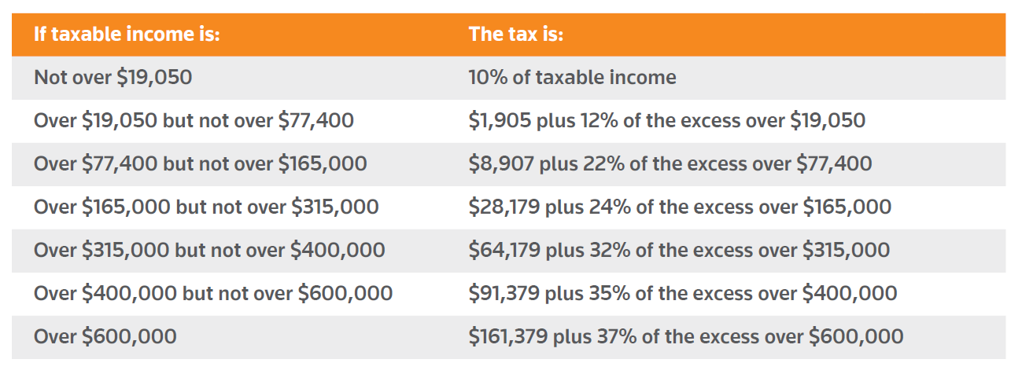
Married Individuals Filing Jointly and surviving spouses

Slide 47
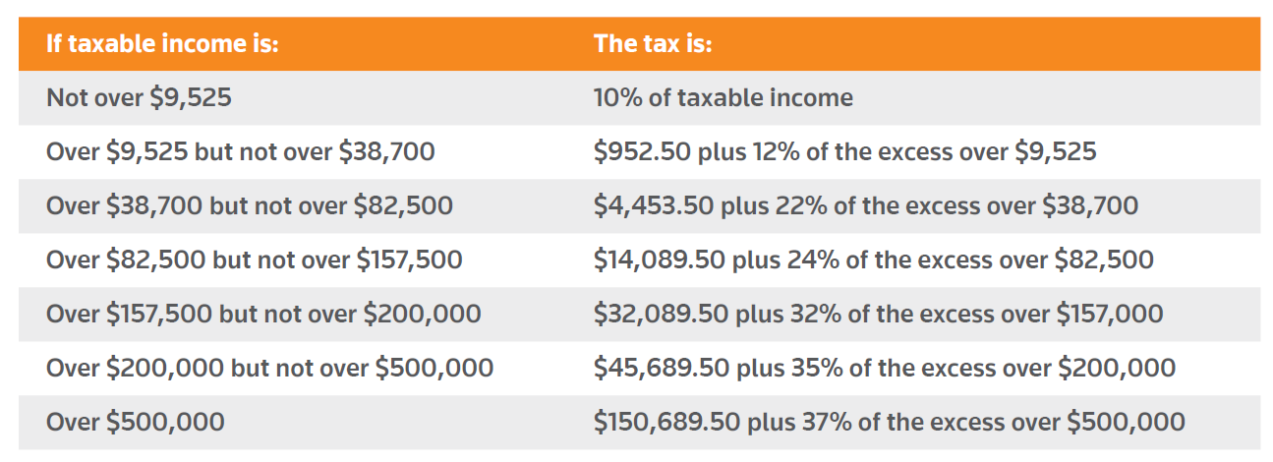
Single individuals (other than heads of households and Surviving spouses)

Slide 48
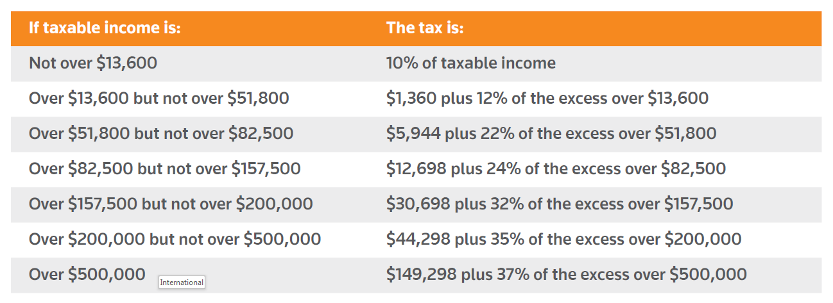
Heads of households

Slide 49
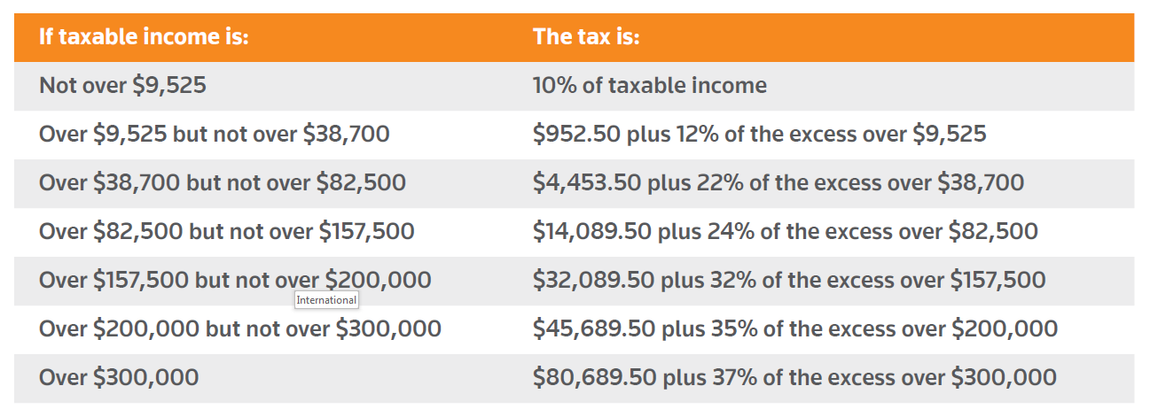
Married filing separately

Slide 50
International

Slide 51
International
Deferred foreign earnings transition tax (one-time tax)
Undistributed foreign earnings at the beginning of the 2018 tax year
Income tax rate at 15.5% on cash & cash equivalents and 8% on other (reinvested earnings)
US shareholders of specific foreign corporations are subject to this tax
US shareholder is any US person who holds at least a 10% voting interest in a specified foreign corporation
US shareholder is not limited to “C” corporation

Slide 52
International
Deferred foreign earnings transition tax (one-time tax)
Specified foreign corporation are:
Controlled foreign corporations with more than 50% US ownership
Certain foreign corporations (10%-50% US ownership)
Do not include Passive Foreign Investment Companies (PFICs) in general

Slide 53
International
Deferred foreign earnings transition tax (one-time tax)
Payable over eight-year period
1st 5 years 8%
6th year 15%
7th year 20%
8th year 25%
Tax must be paid by the due date of the return (without regard to any extensions).
Certain acceleration provision may apply
S corporation shareholders may elect to defer the tax (deferral not available to partnerships or individuals)

Slide 54
International
Foreign source dividends received deduction (DRD)
100% DRD on certain foreign income
Must be a specified 10%-owned foreign corporation
Must be a U.S. shareholder who is a domestic “C” corporation (not RICs or REITs)
No foreign tax credit on either deemed paid foreign taxes or direct (i.e. withholding) paid foreign taxes
One-year holding period requirement

Slide 55
International
Foreign intangible income inclusion
A US shareholder of any CFC must include in gross income for a taxable year its global intangible low-taxed income (“GILTI”) in a manner similar to inclusion of Subpart F income
GILTI means the excess of the shareholder’s net CFC-tested income over the shareholder’s net deemed tangible income return
The shareholder’s net deemed tangible income return is an amount equal to 10% of the aggregate of the shareholder’s pro rata share of the qualified business asset investment (“QBAI”) of each CFC with respect to which it is a US shareholder
Lower corporate tax rate via deduction
GILTI 10.500%

Slide 56
International
Foreign tax credit (FTC) system
The deemed-paid credit with respect to dividends received by a domestic corporation that owns 10% or more of the voting stock of a foreign corporation is repealed
Separate FTC basket for foreign branches
Foreign branch income is the business profits of a US person which are attributable to one or more qualified business units (QBUs) in one or more foreign countries
Interest Charge Domestic International Sales Corporation (IC-DISC) remains

