Slide 1
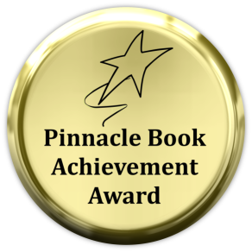
Puttin’ cologne on the Rickshaw
A Guide to Dysfunctional Management
William Bouffard
March 26, 2013

Slide 2
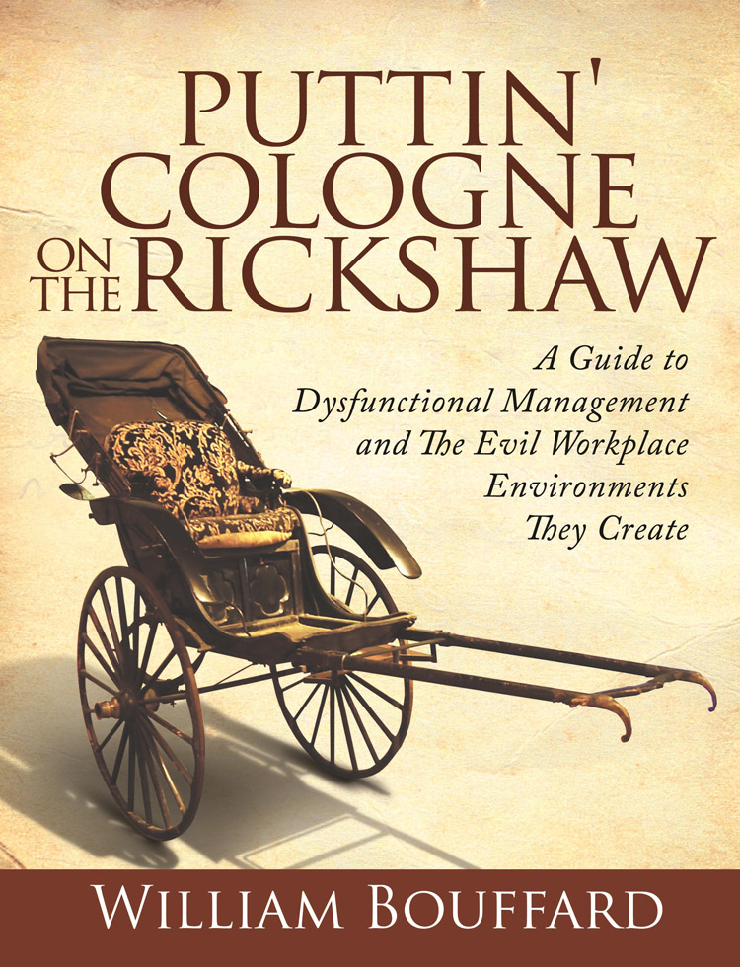
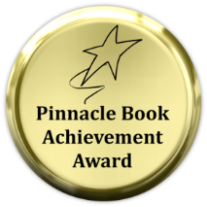
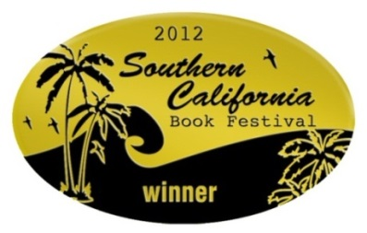
Puttin’ Cologne on the Rickshaw
A Guide to Dysfunctional Management and the Evil Workplace Environments They Create
Teaches what’s not taught in business school…
“How the workplace really works”

Slide 3
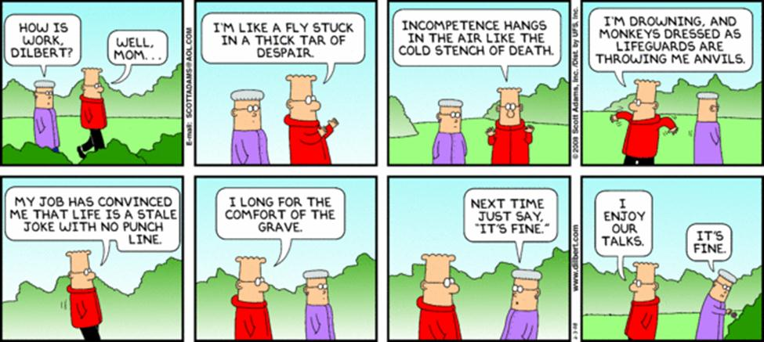
Have you ever felt like this?

Slide 4
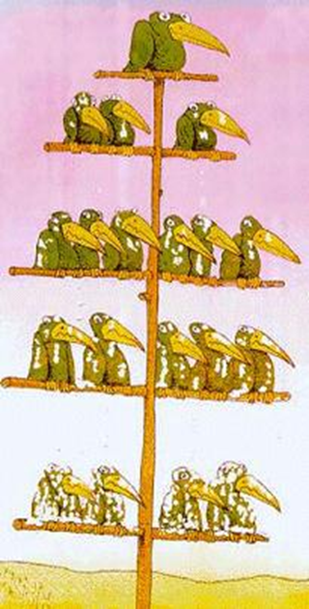
Organizational Life Can Be Tough
Organizations evolve into dysfunction because of:
Basic Human Nature
The Growth of Bureaucracy
Office Politics
The Games People Play
Simply The Way Business is Conducted
The higher you go on the org chart the more these factors intensify
The modern workplace is basically a command and control hierarchy
It’s been that way since the dawn of the industrial age
The key is it doesn’t have to be this way

Slide 5
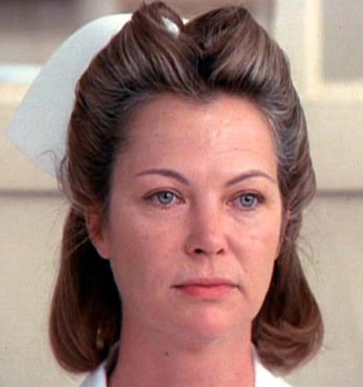
Do the Inmates Really Run the Asylum?
Irving Goffman’s 1960s book, Asylums: Essays on the Social Situation of Mental Patients and Other Inmates, convinced me otherwise…
“In total institutions there is a basic split between a large managed group, conveniently called inmates, and a small supervisory staff. Each grouping tends to conceive of the other in terms of narrow hostile stereotypes, staff often seeing inmates as bitter, secretive, and untrustworthy, while inmates often see staff as condescending, highhanded, and mean. Staff tends to feel superior and righteous; inmates tend, in some ways at least, to feel inferior, weak, blameworthy, and guilty. Social mobility between the two strata is grossly restricted”
Just make a few word substitutions…
“Worker” for “inmate”
“Management” for “staff”
…and you have the perfect description of the typical workplace

Slide 6
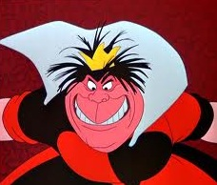
The Red Queen Effect
In 1973, evolutionary biologist, Leigh Van Valen of the University of Chicago, devised what he called the “Red Queen Effect” from Lewis Carroll's Through the Looking Glass
It’s based on a Red Queen comment to Alice
Basic underlying phenomenon at work in organizational dysfunctionality
“In this place it takes all the running you can do to keep in the same place”
What does that mean to the workplace?
To survive you have to actively play the games that we’ll learn about tonight

Slide 7
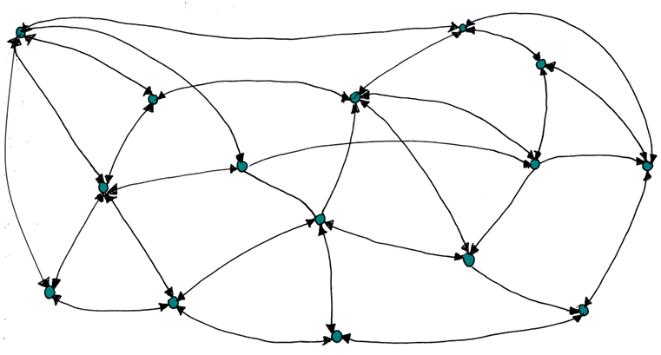
Farce Majeure–Organizational Evolution
“the mix of intricate plotting and sheer silliness combining to blissful comic effect”
The beginning of the evolution of organization structures can best be depicted with the typical start-up organizational structure
All have equal standing and are focused on the business interest
Teamwork is close to universal
Communication functions virtually unhindered
There’s minimal interpersonal gamesmanship

Slide 8
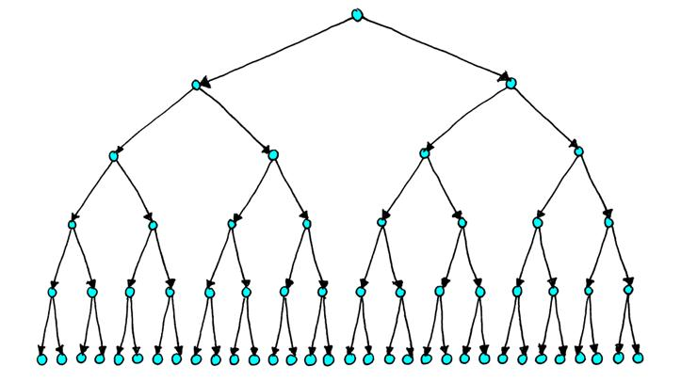
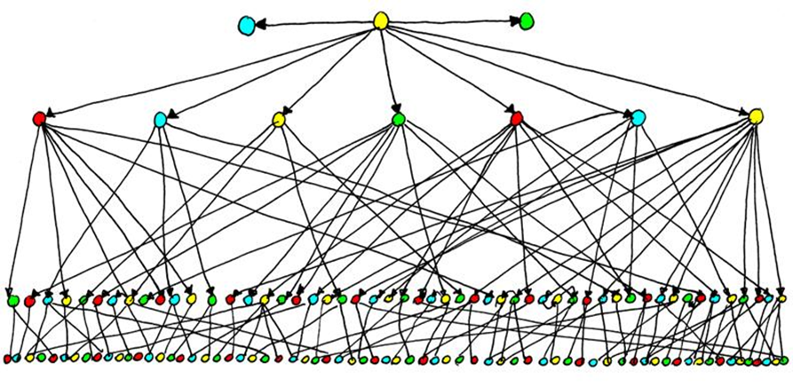
The Vertical Organizational Structure
The intent of the published organizational chart is to depict the way the organization functions
That’s not completely true
It primarily reflects how blame is administered
It identifies the responsibility chain for performance reviews
While just a piece of paper it begets organizational dysfunction
The real organization revolves around the “power” structure

Slide 9
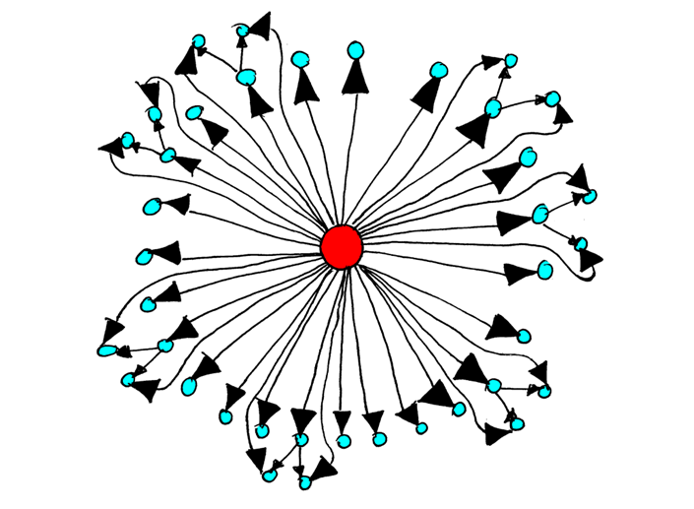
An Organization at it’s Worst–The Kingdom
The daily calling for the inhabitants of the kingdom organization is tied to the “throne-room agenda”
Leadership is dictatorial
Teamwork is nonexistent
Communication is unilateral (only goes down the chain of command)
Command and Control Management
Micromanaging is the norm
Everything becomes an 11th hour crises
Firefighting runs rampant

Slide 10
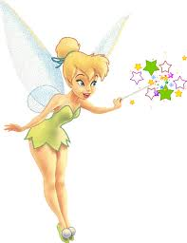
Kayfabe
“The facts are unimportant. It’s what they are perceived to be that determines the course of events” R. Earl Hadady
Everyone perceives their surroundings, themselves and others differently
Just like in professional wrestling the wrestlers assume a false persona yet strive to give an appearance of legitimacy
Also described as “The Rashomon Effect” derived from Rashomon, a 1950s Japanese crime mystery
Everyone witnesses the same crime but tells a different story
Also referred to as “The Tinkerbell Effect”
There are things that exist only because people believe in them
This phenomenon affects the workplace because perceptions become self-fulfilling prophecy

Slide 11
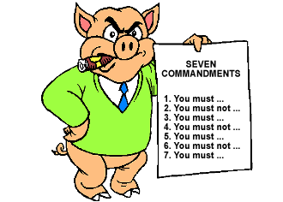
Animal Farm
In Animal Farm, when the animals revolted and took over the farm, they developed seven commandments
The most important of all was: “All animals are equal”
Animal Farm perfectly describes the evolution of organizational politics and culture
Pigs in charge
Dogs serve as the police force
All other animals were subordinate
The farm started out altruistic but quickly disintegrated into chaos
Ultimately the commandments were all reduced to a single phrase:
“All animals are equal, but some animals are more equal than others.”

Slide 12
Images of Organization–Culture Defined
In Images of Organization Gareth Morgan sets the cultural framework;
“When we view organizations as cultures, we see them as mini-societies with their own distinctive values, rituals, ideologies, and beliefs. The fundamental nature of an organization rests as much in its corporate culture as in the more formal organization chart and codes of procedure.”
Morgan looks at organizations through eight metaphors
Psychic Prisons–one that has gotten trapped in its own thoughts and actions. It involves both conscious and unconscious processes of repression, ego, denial, coping and defense mechanisms, pain, pleasure, dysfunctionality, workaholism, and micromanagement
Instruments of Domination–alienation, repression, imposing values, compliance, charisma, maintenance of power, force, exploitation, divide and rule, discrimination, and corporate interest

Slide 13
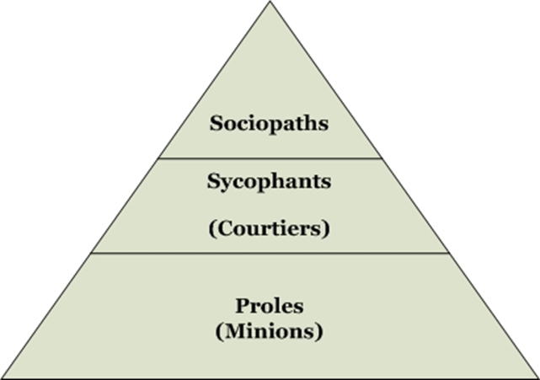
True Organizational Hierarchy
In Medieval times you had the humble beginnings of the three levels of today’s organizational hierarchy
The Lords = top management
The Barons = middle-management
The peasants = everyone else
Management
Resembles the Animal Farm Structure
Pigs, Dogs and Everyone else
We also see this structure in Orwell’s 1949 novel 1984
Inner Party, Outer Party, and the Proles
This is the true organizational hierarchy

Slide 14
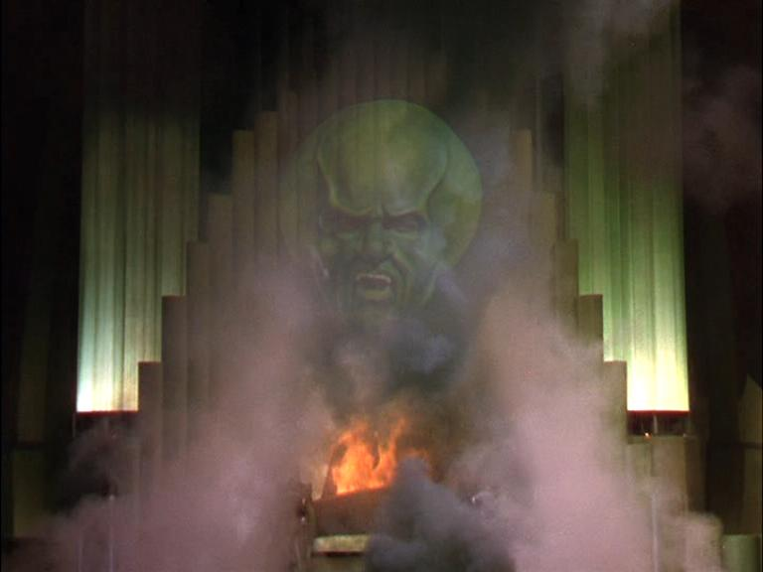
Man Bites Dog
In the movie Man Bites Dog a film crew follows the escapades of a serial killer named Ben on his sadistic adventures
The camera crew begins to get involved and even take an active part in the murders
Offers an inside look at our culture and how we make heroes of people who don't deserve it
The typical workplace sociopath is just like the Wizard of Oz
They will show a different face to each person:
To the organization as a whole, they are the giant head
To the loyal sycophants they are like a beautiful woman
To those being bullied they’re a horrible monster
To all others who get in their way they are a ball of fire

Slide 15
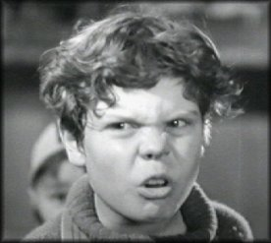
Fee, Fi, Foe, Fum
~35% of Americans report personally being bullied
Bullying comes in many different forms:
Physical
Verbal
Emotional
Cyber
Micromanaging
Workaholism
Gaslighting
It’s a distinct problem in many workplaces
“The higher you go the more your problems are behavioral.” Marshal Goldsmith

Slide 16
Are You Being Bullied?
Do you suffer any of these symptoms?
You feel like throwing up the night before the start of your work week
You can’t sleep because you’re worrying about what you’ll face at work the next day
Your frustrated family wonders why you act so depressed all the time
You try to deny the reality and rationalize your situation
You have skyrocketing blood pressure
You feel ashamed because you’re being controlled by another person and you don’t know how to stop it
You can’t enjoy your time off, and days off are spent exhausted and lifeless; your desire to do anything is gone
You begin to believe that you actually are inferior and have lost your self-respect
You constantly feel agitated and anxious, and experience a sense of impending doom

Slide 17
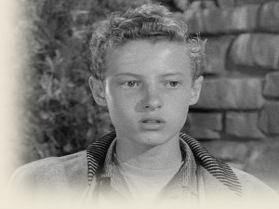
Eddie Haskell
A Sycophant - “one who approaches greatness on his belly so that he may not be commanded to turn and be kicked” -Ambrose Bierce
Baldassare Castiglione’s The Book of the Courtier, published in 1528, perfectly describes the sycophants that surround the top levels of management in modern organizations
Courtier - A person who fawns and flatters in order to gain favor or advantage
They exist because of “The Selfish Herd Theory” - Sociopaths surround themselves with these “expendables”

Slide 18
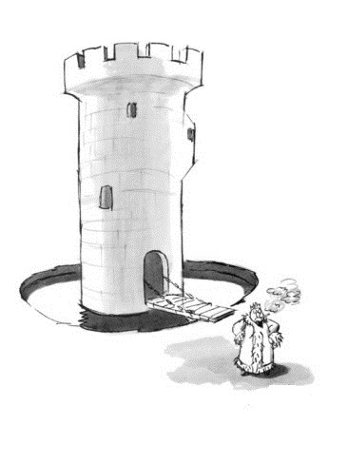
The Oath of Fealty – The Fiefdom Syndrome
During the Middle-Ages, feudalism (fiefdoms) was the law of the land, the basis by which the upper nobility class maintained control over the lower classes
This method of governance was the foundation of the overall society and defined the culture at the time
The promise of faithful service to the king was called the “oath of fealty”
In business “The Fiefdom Syndrome” was first identified by Robert Herbold
Types of organizational fiefdoms:
Personal - organizational head, executive management
Peer group - e.g., engineering
Group or departmental
Protected
The reality is fiefdoms exist in all organizations

Slide 19
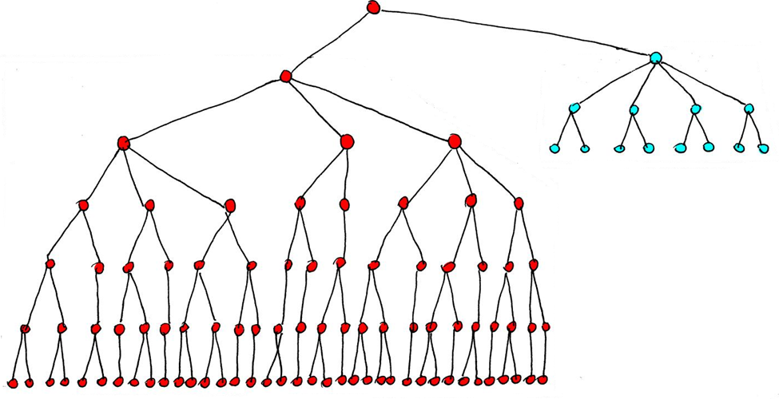
The Protected Fiefdom
A protected fiefdom is probably the most sinister of all and the one that can have a profoundly negative impact on the overall organization
This fiefdom operates as it wishes with full acknowledgment and blessing of the top management
It forms due to Collective Narcissism
A condition in which one group has an inflated image of itself
They are typically validated by the Top Management Team
They lead to “Second-Class Citizenship” for the rest of the organization

Slide 20
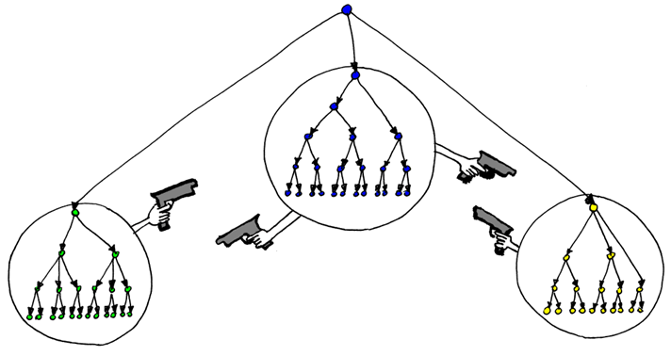
The Fiefdom Syndrome at it’s Worst
When The Fiefdom Syndrome infects the entire organization we have what’s called “group fiefdom syndrome”
The organization is splintered along departmental lines straight from the organization chart
Each sycophantic middle manager “rules” his/her department
The power structure and pecking order within a group fiefdom often mirrors the power structure of the overall organization
The bottom line: Management sets the entire tone of the organization

Slide 21
Does your Organization Suffer the Fiefdom Syndrome?
Senior management reviews and approves nearly all actions and decisions
Management micromanages the day-to-day activities to minute detail
Meetings are at epidemic frequency and are needed for even the most inconsequential action to be taken or problem to be solved
People who do try to make changes or innovate are chastised or removed from the organization
Each group executes on their own objectives with little teamwork or coordination between groups or thought of whether it supports the overall organizational goals
Organization-wide goals (like mission or vision) that require coordination between groups suffers
Alienation and suspicion exist between people and departments

Slide 22
Waiting for Rigor Mortis
In his book, Games People Play, Dr. Eric Berne postulated that in everyday interactions, people will demonstrate one of two basic unconscious predilections, or life plans, that he calls “scripts:
Constructive
Destructive
He calls the destructive script “Waiting for Rigor Mortis”
It is the most prevalent in the workplace
One who is destructively driven will play the more disagreeable games
The Constructive script he called “Waiting for Santa Claus”
One who is constructively driven will be pleasant to deal with
I’ll bet that’s only a handful of people you work with?

Slide 23
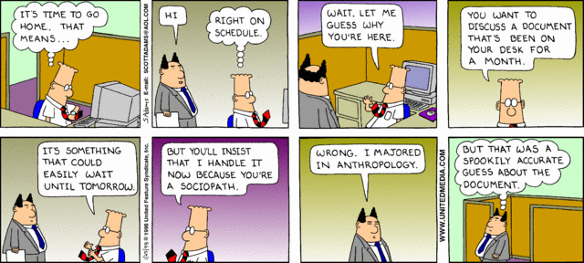
Nattering Nabobs of Negativity
“In the United States today, we have more than our share of the nattering nabobs of negativism” -Spiro T. Agnew
The Games People Play
Divide & Conquer
Stump the Dummy
Thrown under the Bus
Gaslighting
Blamestorming
Plausible deniability
Pyromania
Withholding resources
Selective Amnesia

Slide 24
Together Everyone Annoys Me
“These are no more a team than people staying at the same hotel are a team” -Dwight Schrute, The Office
Why is teamwork so tough to realize?
In his book, The Five Dysfunctions of a Team, Patrick Lencioni details the reason that teamwork is such a difficult concept for many organizations:
“There’s a natural absence of trust between workers”
In his book The Power of Stupidity, Giancarlo Livraghi tells us:
“Teamwork often fails due to the inability to meld the collective intelligence into one consciousness that can accomplish the team’s goal–this is because in a group environment stupidity takes over”

Slide 25
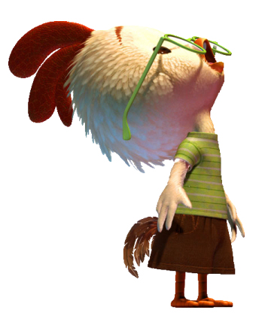
Chicken Little Syndrome
“Chicken Little” is a story for teaching courage–don’t be a chicken little–don’t be afraid, the sky is not falling
No one wants to work for a “sky is falling” sort of boss
In his 2007 article, “Are You a Pyromaniac?” Michael Watkins explains:
“These are the organizational pyromaniacs; leaders with impulse-control issues who start the fires that waste so much precious time and energy in their organizations”
Nathan Bennett, a Georgia Tech management Professor, coined what he called “Munchausen at Work:”
“A similar pathology in work when employees create fictitious organizational problems, only to solve them”
Is your organization always in fire-fight mode?

Slide 26
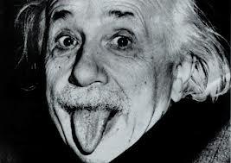
Zemblanity – The Fear of Surprise
“Insanity: doing the same thing over and over again and expecting different results” -Albert Einstein
“The four most expensive words in the English language are: this time is different” -Sir John Templeton
Zemblanity is “the inevitable discovery of what we would rather not know” aka a surprise
“Stuff” happens and surprises get flung your way every day - our decisions and best-laid plans rarely work out the way we expect
The real challenge for management is not being able to forecast problems; it’s learning how to react to them without panic
Organizations expound about being proactive, but being reactionary is how you’ll spend most of your career

Slide 27
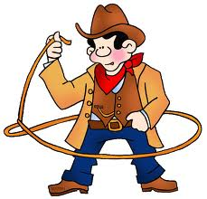
All Hat and No Cattle
“If you had to identify in one word the reason why the human race has not achieved, and never will achieve, its full potential, that word would be ‘meetings’” -Dave Barry
Most meetings are held for basically the same reason that Arbor Day is observed, namely, tradition
Most meetings are rodeos taken over by the organizational cowboys
Most don’t have an agenda
All suffer from P_{d} = 1/2^{n}
Is your organization mired down in useless meetings?

Slide 28
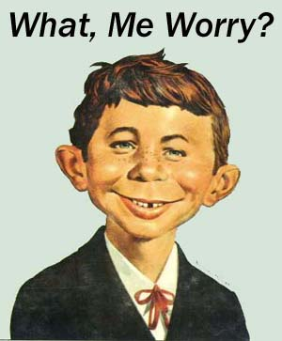
What Me Worry?
MAD editor Harvey Kurtzman described Neuman as “a face that didn't have a care in the world, except mischief.”
Neuman's famous motto is “What, Me Worry?”
“I don't have to worry about anything”
That’s what plausible deniability is all about
Relates back to The Selfish Herd Theory
Also called “Blamestorming”
Results in:
People hiding mistakes
Lack of Truth
Culture of fear

Slide 29
Drinkin’ the Kool Aid
In Lewis Carroll’s Alice’s Adventures in Wonderland…
Alice asks, “Cheshire puss, would you tell me, please, which way I ought to go from here?”
“That depends a good deal on where you want to get to,” said the cat.
“I don’t much care where,” said Alice.
“Then it doesn’t matter which way you go,” said the cat.”
Is your Vision statement bought into by the entire organization?
Are your Values really practiced?
Do you suffer from “Leadership by Lamination?”
Does management just TTT or do they WTW?

Slide 30
Lake Wobegon
Todd: Rajiv, Jerry wants us to do employee evaluations
Rajiv: Wonderful, sir. I’ll bring the tissues for the tears that will follow our reviews
Todd: No one will be crying
Rajiv: Well, not if you do it right
Todd: You know, I think I’m just going to do it myself
Rajiv: Just remember, sir, fear is the best motivator. Sometimes I think shame, but mostly fear
Todd: If they ever build another death star, there’s a captain’s chair with your name on it
Rajiv: Is that a management position?

Slide 31
Lake Wobegon Effect – The Performance Review
Lake Wobegon is a fictional location where “all the women are strong, all the men are good looking, and all the children are above average”
-The Prairie Home Companion, Garrison Keillor
The Halo Effect–the propensity to want to forget everything negative about yourself
The Reverse Halo Effect–individuals judged to have a single undesirable trait are subsequently judged to have many undesirable traits
Other factors;
Subjective Measurements
Myth of Pay-for-Performance
20/70/10 policies

Slide 32
Jumpin’ on the Bandwagon
It means to figuratively jump on whatever the latest fad may be, or to succumb to the herd mentality
Is your organization plagued with Metrics collection or in following the latest management fads like Six-Sigma or Lean Manufacturing?
Should an organization remain focused on doing things just like everybody else?
Or, should it do something original, i.e., “do something remarkable.”
Includes the Buzzwords:
Think outside the box
Low-hanging fruit
Multi-tasking
Accountability
And don’t forget resume buzzwords (creative, effective problem solver, etc.)

Slide 33
Is Your Organization Dysfunctional?
Leadership by Lamination
Quality and Quantity are both job one
Lessons Learned sessions…but they never change future events or actions
People keep Pearl Harbor files
Internal competition is encouraged and rewarded
The word “teamwork” is batted around like a softball at a company picnic
Fiefdoms and favoritism run rampant
Blamestorming, Firefighting, 11th hour crises
Decisions are made at the highest levels
Delegation without the power to do it
The Goal, Seven Habits of Highly Effective People, Good to Great and Who Moved My Cheese are bantered about to create the illusion that they reflect the leadership’s abilities
Resources are tightly controlled
You’re told you’re lucky to have a job
The overused threat of accountability
No sense of humor
Workaholism & micromanaging

Slide 34
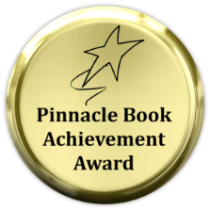
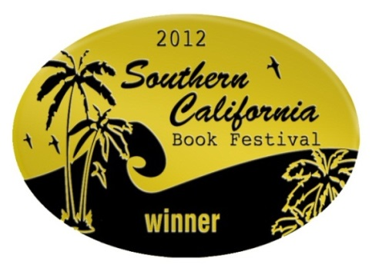
Puttin’ Cologne on the Rickshaw
Available @ Amazon and Barnes and Noble in paperback, Kindle and Nook versions
$29.95 paperback
$14.99 eBook

Slide 35
Puttin’ Cologne on the Rickshaw
A Guide to Dysfunctional Management and the Evil Workplace Environments They Create
Discount offer to attendees of this IEEE meeting…
Purchase a copy of my book for the price of the eBook
$14.99 and $4.00 shipping
Deposit $18.99 at PayPal @ bouffard.william@gmail.com
Send me an email with name and mailing address
Follow my blog at: www.puttincologneontherickshaw.com
Twitter: colognerickshaw

Slide 36
Q&A
“Workplace veteran Bouffard has such a light touch that some readers may think that this broadside against the everyday working milieu will be fueled solely by colorful, comical anecdotes. Actually, the author delivers a spirited, peppery attack, examining a wide variety of issues: the globalization of rudeness, the death of empathy, the eradication of humility, the drive to bond and to secure scarce goods, to master the world and protect against its threats, to defend self-esteem and protect against shame. Bouffard leisurely ambles through workplace environments to vividly provide evidence of its sociopathic dynamics. He provides plenty of footnotes and scientific studies and knows when to deploy the wisdom of Erving Goffman or Scott Adams, Moliere’s Harpagon or Ralph from The Lord of the Flies. The real strength of the book, however, is its communality—may of the ills are universal, and readers will continually nod along with the critique. Bouffard provides a fine synthesis of most of what is wrong with how we conduct our business lives: the feudalism of organizational structures, mob violence, communication as a game, vile acts of posturing, organizational amnesia, plausible deniability, the development of oligarchies, subjective perception, the elimination of irregulars, the performance-review process, etc. His book is an early distant warning, with tools of recognition to know the enemy. Ace preparation for the emotional abuse that comes in heaping helpings from today’s dysfunctional workplace.”

