Slide 1
Adding SystemC TLM to a
RTL Design Flow
Bill Bunton
Principal Engineer
LSI Networking Components Group
Austin, Texas

Slide 2
Electronic System Level (ESL) Design
Raises the level of design abstraction
Early performance model validates architecture concepts
Allows engineers to create, change, and validate concepts without implementing RTL
Supports hardware/software co-design
Virtual Prototype for early software bring-up
ESL is supported by a collection of Accellera standards, tools, and concepts
  SystemC & TLM
  SystemRDL (Register Description Language)
  Control and Status Register code generators
  SystemC & RTL co-simulation
  RTL to SystemC conversions

Slide 3
What is SystemC
IEEE Standard 1666-2011 SystemC
It’s not an RTL (SystemVerilog or VHDL)
SystemC allows higher level of abstraction than RTL
SystemC allows much faster simulation
SystemC extends C++ with classes, macros, and adds a scheduler, providing
  Hierarchy and structure familiar to hardware designers
  Block-to-Block communications
  Hardware data types
  Event driven scheduler that allows concurrent execution
SystemC and RTL co-simulation is supported by all suppliers
Existing IP
New IP
Vendor IP
TLM2 Sockets & Generic Protocol
Primitives Mutexs, FIFOs, Signals
Simulation
Kernel
Threads
&
Methods
Channels
&
Interfaces
Data Types
Logic
Integers
Fixed Point
Events
Modules
&
Hierarchy
C++
STL

Slide 4
What is Transaction-Level Modeling (TLM)
TLM is a high-level approach to modeling digital systems that separates:
  Details of interconnect (communication)
  Details of functionality (computation)
OSCI SystemC TLM-2 available June 2008
IEEE 1666–2011 includes TLM-2:
  Sockets for block-to-block interconnect
  Generic protocol (memory mapped bus)
SystemC TLM defines two modeling styles
  Loosely-timed (LT)
    Sufficient timing detail for Virtual Prototypes
    Temporal decoupling (run ahead)
    Uses direct memory interface (DMI)
  Approximately timed (AT)
    Sufficient timing detail for architecture exploration
    Processes run in lock-step with simulation time
RTL
Performance
Models
CA
CA
Interconnect Accuracy
AT
AT
Virtual Prototype
LT
LT
UT
UT
LT
AT
CA
Functional Accuracy
UT -- Untimed
LT -- Loosely timed
AT -- Approximately timed
CA -- Clock & Pin Accurate
(D Gajski 2003)

Slide 5
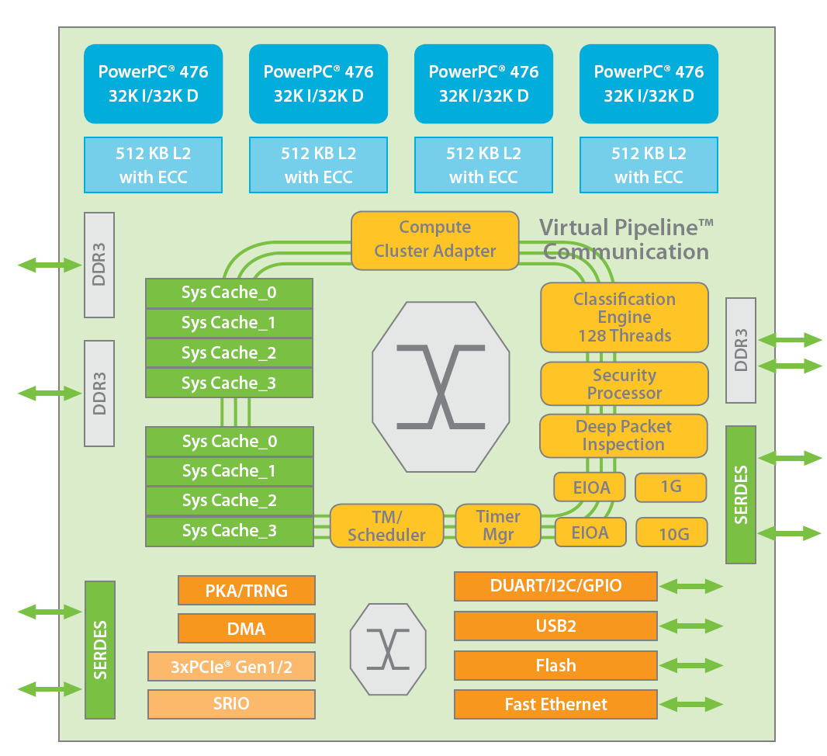
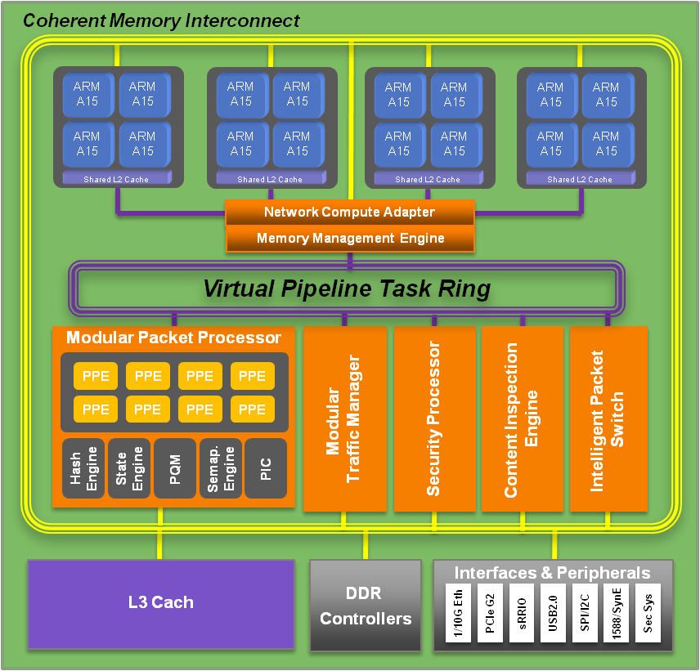
Initial Conditions: RTL and
Software Design Flows Exist
Your development process is proven
You have customers using generations of your chips
Chip complexity is growing more processors and more RAMs, all running faster
Re-spins will be very costly
Customers need the next generation systems sooner
Each new system has more and more software
Software is always the last to finish

Slide 6
Example Project Design Flow
System On a Chip (SoC)
Requirements
Specification
Hardware Design
FPGA Prototype
Bring-Up
Software
Ship
Tape-out
First Si

Slide 7
Example Project Design Flow
System On a Chip (SoC)
Requirements
Requirements
Specification
Specification
HW
Hardware Design
Hardware Design
FPGA Prototype
FPGA Prototype
FPGA Prototype
Bring-Up
Bring-Up
Software
Software
Ship
Ship
Tape-out
First Si

Slide 8
Where Can You Start ?
Three Common SystemC TLM Use-Cases
System Architecture
  Architecture exploration
  System performance models
  Functional block development
  System architecture validation
Software Bring-Up
  Virtual Prototype
  Early software development
  System-level performance modeling
  Software performance optimizations
Logic Design
  Design of High Level Synthesis (HLS)
  Replace RTL for design entry
  Tools optimize structure
  Power aware synthesis

Slide 9
System Architecture

Slide 10
Traditional System Architecture
Requirements provided by marketing
New algorithms developed using MATLAB, C, or C++
System architecture
  Requirements and specification
  Block-level partitioning
  Interconnect selection or definition
  Performance requirements for blocks and shared resources
  Power and area allocation
  Identify needed IP (build or buy)
  Block-level design specification
Documents & email
Algorithm Details Requirements
System Specification
Block Level Requirements
Experience, Reviews &
Spreadsheets
Design Specification
Design Reviews

Slide 11
System Architecture Modeling
Objectives
Architecture Optimization
  Validated system-level block diagram
  Optimized interconnect structure
  Bottleneck analysis
  Establish interconnect behavior
    Bandwidth
    Latency
    Priority
  Allocate system resources
    Bandwidth
    Priority
Validate Requirements
  Performance
  New functions
  Buffering Requirements

Slide 12
Performance Model Block Diagram
Traffic Generator
Traffic Generator
Traffic Generator
Traffic Generator
Traffic Generator
Traffic Generator
Coverage and Performance Metrics Protocol-Checker
Memory Subsystem Interconnect
Cache
Cache
Cache
Cache
Cache
Cache
Cache
Cache
DDR3
Controller
DDR3
Controller

Slide 13
SystemC Performance Model
Construction
SystemC Approximately Timed (AT) modeling style
  Non-blocking transport with multiple timing points
  Processes run in lock-step with simulation time
Probably does not include Software
Specialized traffic generators model functional blocks and software
IP blocks come from multiple sources
  New and Existing AT models
  Supplier’s AT models
  RTL Converted to SystemC (faster than RTL)
  RTL (very slow simulation)
Includes simulation instrumentation
  Performance
  Functional coverage
  Protocol-checker

Slide 14
SystemC Performance Modeling
Results
Optimized interconnect structure
Bottlenecks identified and corrected
System resource allocation
  Bandwidth
  Latency
  Priority
Block-level performance requirements
Test bench for tracking performance
Foundation for future system sodels
Domain-specific traffic generators
Products
Reusable
Notes:
popup question --- Can you trust the model results?
Answer – It depends

Slide 15

SystemC Performance Modeling
Results
You can’t trust Performance Models
Optimized interconnect structure
Bottlenecks identified and corrected
System resource allocation
  Bandwidth
  Latency
  Priority
Block-level performance requirements
Test bench for tracking performance
Foundation for future System Models
Domain Specific Traffic generators
Products
Reusable
Notes:
popup question --- You can’t trust Performance Models
Answer – It depends

Slide 16
New Functional Block Architecture Modeling
Objectives
Capture executable functional description
Verify functional behavior
Verify functional performance
Define hardware and software interfaces
  Control and Status Registers
  Shared data structures
Explore block-level structures, functions, and storage
Identify and model resource contention
Size FIFO and buffer memories
Eliminate low-level details from paper specification
SystemC Test Bench

Slide 17
Functional Block Architectural Modeling
Bus
Initiator
Ethernet MAC
Functional
Logic Block
PHY
FIFO
FIFO
Bus Functional
Model
Ethernet
Environment
Model
FIFO
Ethernet MAC
Functional
Logic Block
FIFO
CSR
Block
SystemC Test Bench

Slide 18
New Functional Block Architectural Modeling
Construction
SystemC Approximately Timed (AT) modeling style
SystemC environment provides C++, SystemC, and TLM library components
  C++ Standard template library
  SystemC data types
  FIFO
  Payload event queues (PEQ)
Model implementation using
  New functions
  Sub-block reuse (arbiters and pipeline models)
  Known accurate TLM interfaces
Vender supplied sub-block models
Mix of TLM generic & system unique TLM protocols
Code generator provided SystemC Control and Status Registers (CSR)
Configurable delays allow exploration and tracking of RTL implementation
Test bench models hardware and software environment
Test bench includes directed and constrained random tests

Slide 19
New Functional Block Architectural Modeling
Results
Executable functional model of the new design
Documentation and test for the most active CSRs
Functional test bench
Performance parameters for feedback to system performance model
Complete and detailed structure for RTL design
Design base for High Level Synthesis (HLS)
Near-complete model for a Virtual Prototype
Functional test for RTL and HLS implementation
Reference model for SystemVerilog RTL test bench
System unique TLM protocols
New sub-components for future models
Products
Reusable

Slide 20
Software Bring-Up

Slide 21
Traditional Software Bring-Up
Hardware team implements RTL
Software team continues working on previous project
Initial Software bring-up waits for a Hardware Prototype
  Hardware emulation
  FPGA prototypes
Hardware prototype shortcomings
  Only a limited number of prototype systems available
  Difficult to fit complete SoC on prototyping hardware
  Prototypes run at a reduced clock rate
  I/O clock-rates may be fast or slow relative to prototype core clock
  Low-level physical interfaces may not be the same as ASIC
Final software bring-up and debug requires complete System on a Chip
Design Specification
Communication
Requires Completed
RTL
Not Complete
SoC
Timing & Function
Not 100% Accurate
Always True
Notes:
Q -- It may be too late to fix defect if they’re found in hardware prototype
SW bubba -- Hardware said it’s too late to change

Slide 22
Virtual Prototype Model
Objectives
Minimize post-silicon software delays (deliver product sooner)
Allow time for interface refinement
before RTL design freeze
Start software bring-up and debug as early as possible
Provide a superior software debug environment
Provide a bit-accurate prototype of the system
Favor execution speed over fine-grain operation ordering
May have performance-accurate mode
Notes:
HWQ- Do virtual prototypes need all the registers?

Slide 23
SystemC Virtual Prototype Model
ISS
ISS
ISS
ISS
Packet Processor
Packet
Content
Inspection
Security
System
Processor
Ethernet
&
Switch
Memory Subsystem Interconnect
Cache
Cache
Cache
Cache
Cache
Cache
Cache
Cache
DDR3
Controller
DDR3
Controller

Slide 24
Virtual Prototype Model
Construction
SystemC Loosely Timed (LT) modeling style
  Blocking transport with only two timing points
  Temporal decoupling to allow processes to run ahead of simulation time
  Direct memory interface (DMI) for high-speed memory access
Use vendor-supplied processor models (ISS)
Reuse system performance model structure and memory subsystem
Speed up AT functional block by adding
  Blocking transport
  Debug transport
  Direct memory interface
  Optimized functional implementations for speed
Implement new LT models as needed for a complete system simulation
Use a code generator to implement complete CSRs for all blocks
Provide configuration options to select AT or LT simulation mode

Slide 25
Virtual Prototype Model
Results
Pre-silicon full system model of software for software bring-up
Full system model for customer application development
Application performance optimization
Simulation prototypes are less expensive than hardware emulation
LT only block can be converted LT/AT for future performance modeling
AT and LT blocks are a design base for High Level Synthesis (HLS)
Virtual Prototype can be configured for performance modeling
Foundation for next generation Virtual Prototype
Products
Reusable
Notes:
Popup question --- Can I boot Linux
Answer --- Yes, loosely timed models can be thousands of times faster than RTL
Some models of low power system run faster than real time in simulation
Always TRUE “Your mileage may vary”

Slide 26
Virtual Prototype Model
Results
Can this thing really boot Linux?
Pre-silicon full system model for software for software bring-up
Full system model customer application development
Application performance optimization
Simulation prototypes are less expensive the hardware emulation
LT only block can be enhanced (AT) for future performance modeling
AT and LT blocks are a design base for High Level Synthesis (HLS)
Virtual Prototype could be configured for performance modeling
Foundation for next generation Virtual Prototype
Products
Reusable
Notes:
Popup question --- Can this thing really boot Linux?
Answer --- Yes, loosely timed models can be thousands of times faster than RTL
Some models of low power system run faster than real time in simulation
Always TRUE “Your mileage may vary”

Slide 27
Logic Design

Slide 28
Traditional Logic Design
System architecture team defines requirements
  Function
  Performance
  Power and area allocation
  bandwidth & priority
RTL team creates design specification
  HW/SW interface definition
  Functional sub-block description
  Buffer and FIFO sizing
RTL team implements micro-architecture
Verification team creates test environment
Hardware team achieves design closure by iterating
  Micro-architecture changes
  RTL-to-gates compilation
Requirements
RTL
Design Specification
RTL & Test Bench
Implementation
Design Closure
Iterations

Slide 29
Design of High Level Synthesis (HLS)
Objectives
Let the tool do the implementation of RTL micro-architecture
Use architecture or Virtual Prototype model as design base
Use algorithms written in C or C++ as functional base
Eliminate RTL implementation of micro-architecture
  Pipelining and state-machines
  FIFO and arbiters
Create design that can be easily optimized
  Speed
  Area
  Power
SystemC Test Bench

Slide 30
Design of High Level Synthesis (HLS)
Bus
Initiator
Ethernet MAC
Functional
Logic Block
PHY
FIFO
FIFO
Bus Functional
Model
Ethernet
Environment
Model
FIFO
Ethernet MAC
Functional
Logic Block
FIFO
CSR
Block
SystemC Test Bench

Slide 31
Design of High Level Synthesis (HLS)
Construction
Existing SystemC models should be used as a design base.
  Paper spec – not the best option
  C C++ algorithm – better
  An existing SystemC LT model – better still
  AT models may over constrain – may be good
Synthesis tools cannot support the full richness of SystemC and C++
  Capabilities differ from vender to vendor
SystemC models may require restructuring for synthesis
Synthesis is controlled by directives and a technology library
Synthesis results can be optimized for
  Speed
  Power
  Area
Synthesis-generated RTL merges with existing RTL design flow

Slide 32
Design of High Level Synthesis (HLS)
Results
Optimized RTL implementation
Synthesizable SystemC code for reuse
  Different ASIC technologies
  Different optimizations of speed, area and power
SystemC models for future use
  Performance modeling
  Architectural exploration
SystemC models for functional design evolution
Product
Reusable

Slide 33
Observations and
Recommendations

Slide 34
Recap
Each use-case is beneficial when used independently
  System Performance Models
    Optimized system structure
    Improved block-level requirements
  Block-level Architecture Modeling
    Executable functional description
    Early functional validation
  Virtual Prototype
    Minimize post-silicon software delays
    Allow early software feedback
  High Level Synthesis
    Focus on function, not micro-architecture
    Easy optimization of speed, area and power
A single model implementation can be used by multiple use-cases
SystemC models are reusable across projects and technologies
Benefits multiply as more use-cases are incorporated into a design-flow

Slide 35
Example RTL Project Design Flow
System On a Chip (SoC)
Requirements
Specification
Hardware Design
FPGA Prototype
Bring-Up
Software
Ship
Tape-out
First Si

Slide 36
Example ESL Project Design Flow
System On a Chip (SoC)
Architecture
Specification
Performance Modeling
Hardware Design
FPGA Prototype
Virtual Prototype
Bring-Up
Software
Tape-out
Ship
First Si

Slide 37
What To Do At DAC
Attend Accellera sponsored events at DAC
  Breakfast and Town Hall Meeting
  IP XACT Tutorial
  Multi-Language Birds-of-a-Feather Meeting
  IP Protection / P1735 Birds-of-a-Feather Meeting
  North American SystemC User Group (NASCUG) meeting
Get involved with the Accellera design standards activities
Look for more SystemC presentations
Visit the DAC exhibitors and investigate
  SystemC training
  SystemC development environments
  SystemC & RTL co-simulation environments
  RTL to SystemC conversion tools
  IP packages with SystemC models
  IP packages with SystemRDL
  Code generators for CSR (SystemC and RTL)
  High Level Synthesis (HLS)

Slide 38
Visit the Accellera Members
DAC Exhibitors
ARM Ltd.
Atrenta, Inc.
Cadence Design Systems
Doulos Ltd.
Duolog
Forte Design Systems
Fraunhofer IIS/EAS
IBM
Intel Corporation
Jasper Design Automation
Magillem Design Services
Mentor Graphic
Semifore, Inc.
Synopsys
Vayavya Labs

Slide 39
After DAC
Convince your organization that ESL and SystemC will
  Increase productivity
  Improve quality
  Shorten schedules
Select tools suppliers
Schedule SystemC training for hardware and software engineers
Identify and implement an ESL pilot-project
Use SystemC code reviews as a training tool
Document your ESL design-flow based on best practices
Define SystemC code guidelines for each design style
  Transaction-Level modeling interfaces
  Loosely timed models
  Approximately timed models
  High Level Synthesis
Continue improving the ESL flow and update documentation
Merge the ESL flow with the existing design-flow

Slide 40
Questions?

