Slide 1

Storage in Big Data Systems
And the roles Flash can play
Tom Hubregtsen
Notes:
Thanks for coming
Start with personal anecdote, that will be used as example to explain throughout the presentation

Slide 2
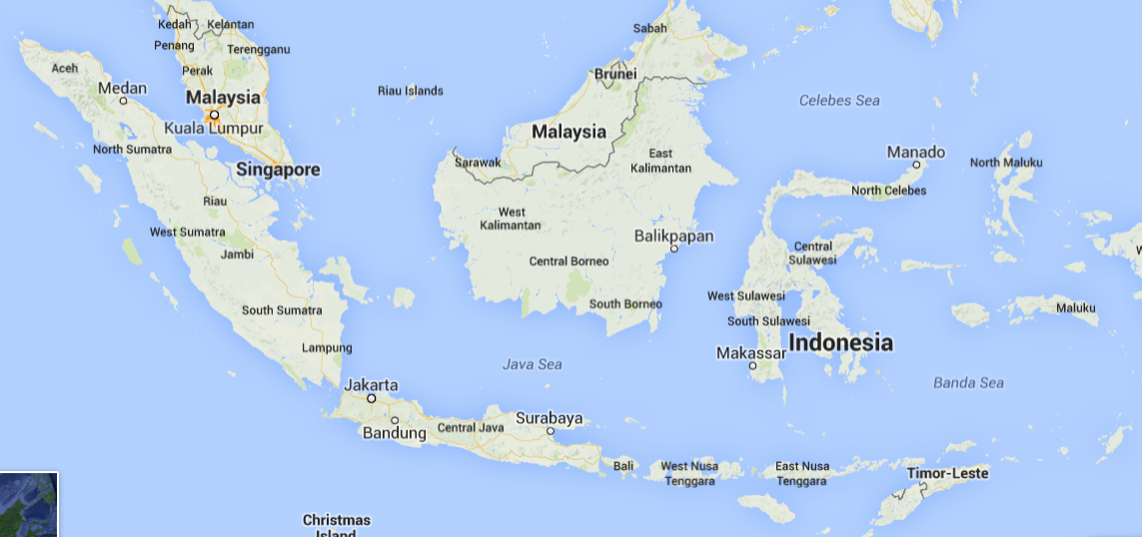

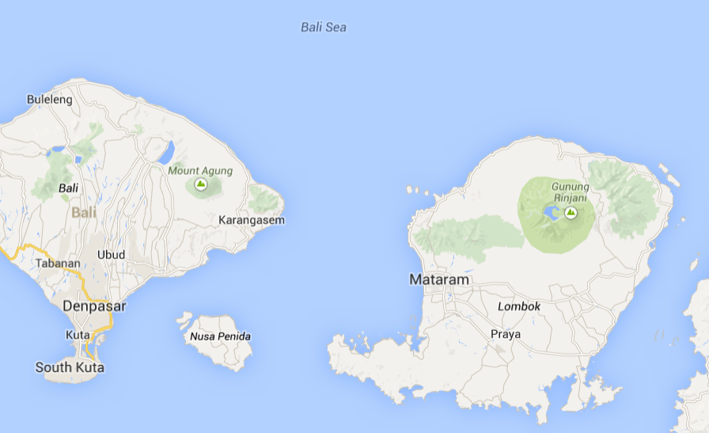
Subtitle
Notes:
Gili
Thinking how small the world has become
Game to see connection by means of letter
Done by social media
Big data problem because you “take a big input set, and process it in parallel in order to extract information from it”

Slide 3
Table of contents
Evolution of Big Data Systems
Research questions
Background information and experiments
Conclusion and future work
Discussion

Slide 4
Evolution of Big Data Systems
Big Data Systems are:
Scalable
Resilient
Easy to use
High Performance Computing
Scalable: Yes
Resilient: Yes
Easy to use: No
Notes:
Explain the difference with HPC
Map, reduce and job configuration

Slide 5
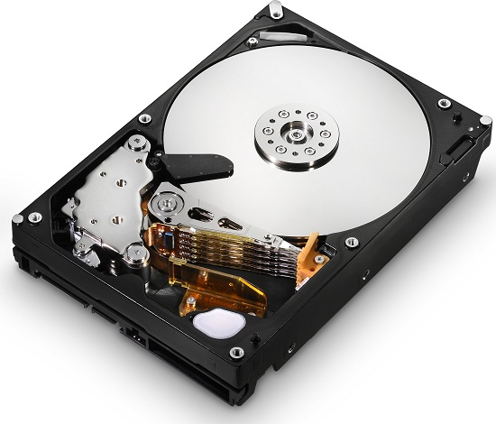
Evolution of Big Data Systems
Big Data Systems are:
Scalable
Resilient
Easy to use
Generation 1: MapReduce
Workload:
Batch/Unstructured
Resiliency (Hadoop):
through data replication
Key parameter:
Disk bandwidth
Notes:
Popularised by Google in 2003
Introduce Apache Hadoop
Batch: off-line task
Interactive: soccer match
Iterative: Machine learning

Slide 6
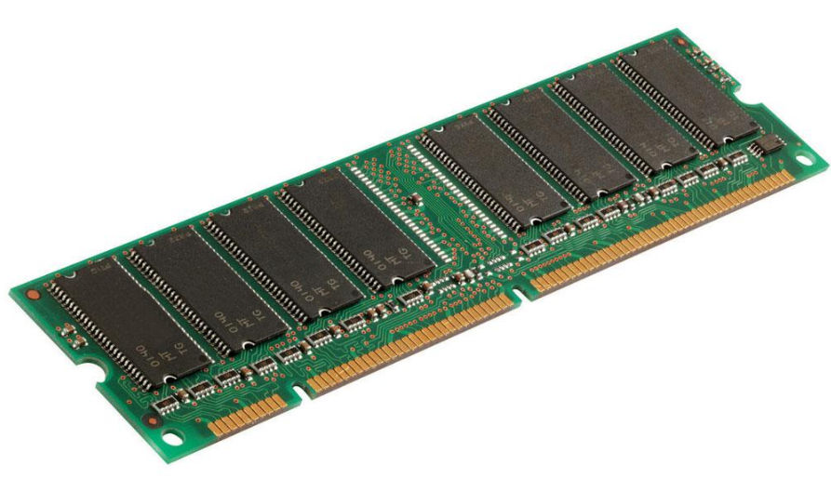
Evolution of Big Data Systems
Big Data Systems are:
Scalable
Resilient
Easy to use
Generation 1: MapReduce
Workload:
Batch/Unstructured
Resiliency (Hadoop):
through data replication
Key parameter:
Disk bandwidth
Generation 2
Workload:
Interactive/Iterative
Resiliency (Spark):
through in-memory
re-computation
Key parameter:
Memory capacity
Notes:
Popularised by Google in 2003
Introduce Apache Spark
Batch: off-line task
Unstructured -> read all -> as fast as the HDD allows -> bandwidth limited
Semi structured (through broad tagging) -> read parts -> overall faster, but read individual slower because disk reader -> IOPS limited
Interactive: soccer match
Iterative: Machine learning

Slide 7
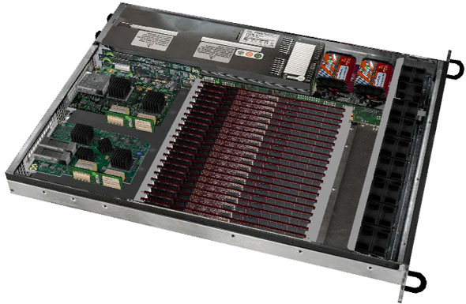
How could Flash fit in?
Big Data Systems are:
Scalable
Resilient
Easy to use
Generation 1: MapReduce
Workload:
Batch/Unstructured
Resiliency (Hadoop):
through data replication
Key parameter:
Disk bandwidth
Generation 2
Workload:
Interactive/Iterative
Resiliency (Spark):
through in-memory
re-computation
Key parameter:
Memory capacity
Notes:
Mention key parameters/bottleneck

Slide 8
How could Flash fit in?
Big Data Systems are:
Scalable
Resilient
Easy to use
Generation 1: MapReduce
Workload:
Batch/Unstructured
Resiliency (Hadoop):
through data replication
Key parameter:
Disk bandwidth
Generation 2
Workload:
Interactive/Iterative
Resiliency (Spark):
through in-memory
re-computation
Key parameter:
Memory capacity

Slide 9
How could Flash fit in?
Big Data Systems are:
Scalable
Resilient
Easy to use
Generation 1: MapReduce
Workload:
Batch/Unstructured
Resiliency (Hadoop):
through data replication
Key parameter:
Disk bandwidth
Generation 2
Workload:
Interactive/Iterative
Resiliency (Spark):
through in-memory
re-computation
Key parameter:
Memory capacity
Notes:
But TB -> comes with extraordinary bandwidth, not space
DRAM has 2 orders of magnitude higher bandwidth per dollar
Almost 3 orders less capacity per dollar

Slide 10
Difference
 | DRAM | Flash | HDD | Unit
Type | DDR 1600 | SATA | SATA
Bandwidth/$ | 1 | 0.1 | 0.01 | Gb/s/$
IOPS/$ | 1,000,000 | 1,000 | 1 | IOPS/$
Capacity/$ | 100 | 1000 | 10,000 | GB/$
Notes:
DRAM has the higher bandwidth and IOPS, but less capacity.
This performance might be overkill, as Spark can not supply enough data
Flash performs in between which might be sufficient, and is cheaper per bit

Slide 11
Research questions
Can Flash be used to further optimize Big Data Systems?
How does Spark relate to Hadoop for an iterative algorithm?
How does Spark perform when constraining available memory?
Can we improve Spark by using Flash connected as file storage?
Can we improve Spark by using Flash connected as secondary object store?
Notes:
What are we looking for
Before we can answer questions, we need to be familiar with Spark.

Slide 12
Placeholder
Notes:
Thereby leaving room for improvement

Slide 13
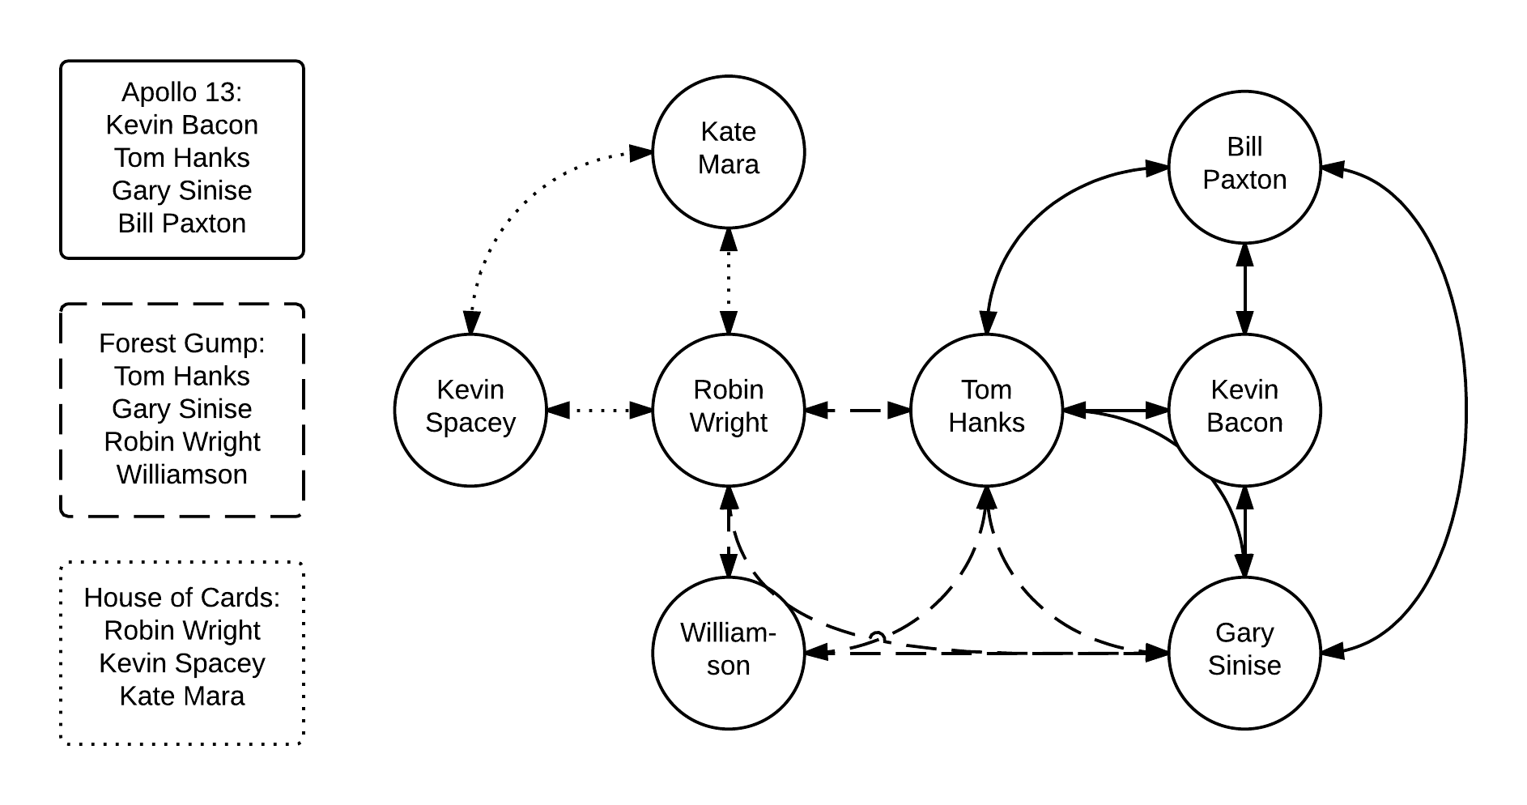
Single Source Shortest Path
Notes:
Calculate everybody who is within a distance of 6 degrees from Kevin Bacon
Construct graph during initialization step from omdb.org
Distances
Use this graph as input data for the six iterative steps

Slide 14
Single Source Shortest Path
∞
∞
∞
∞
∞
0
∞
∞
Notes:
Calculate everybody who is within a distance of 6 degrees from Kevin Bacon
Construct graph during initialization step from omdb.org
Distances
Use this graph as input data for the six iterative steps

Slide 15
Single Source Shortest Path
∞
1
∞
∞
1
0
∞
1
Notes:
Calculate everybody who is within a distance of 6 degrees from Kevin Bacon
Construct graph during initialization step from omdb.org
Distances
Use this graph as input data for the six iterative steps

Slide 16
Single Source Shortest Path
2
1
∞
2
1
0
2
1
Notes:
Calculate everybody who is within a distance of 6 degrees from Kevin Bacon
Construct graph during initialization step from omdb.org
Distances
Use this graph as input data for the six iterative steps

Slide 17
Single Source Shortest Path
2
1
3
2
1
0
2
1
Notes:
Calculate everybody who is within a distance of 6 degrees from Kevin Bacon
Construct graph during initialization step from omdb.org
Distances
Use this graph as input data for the six iterative steps

Slide 18
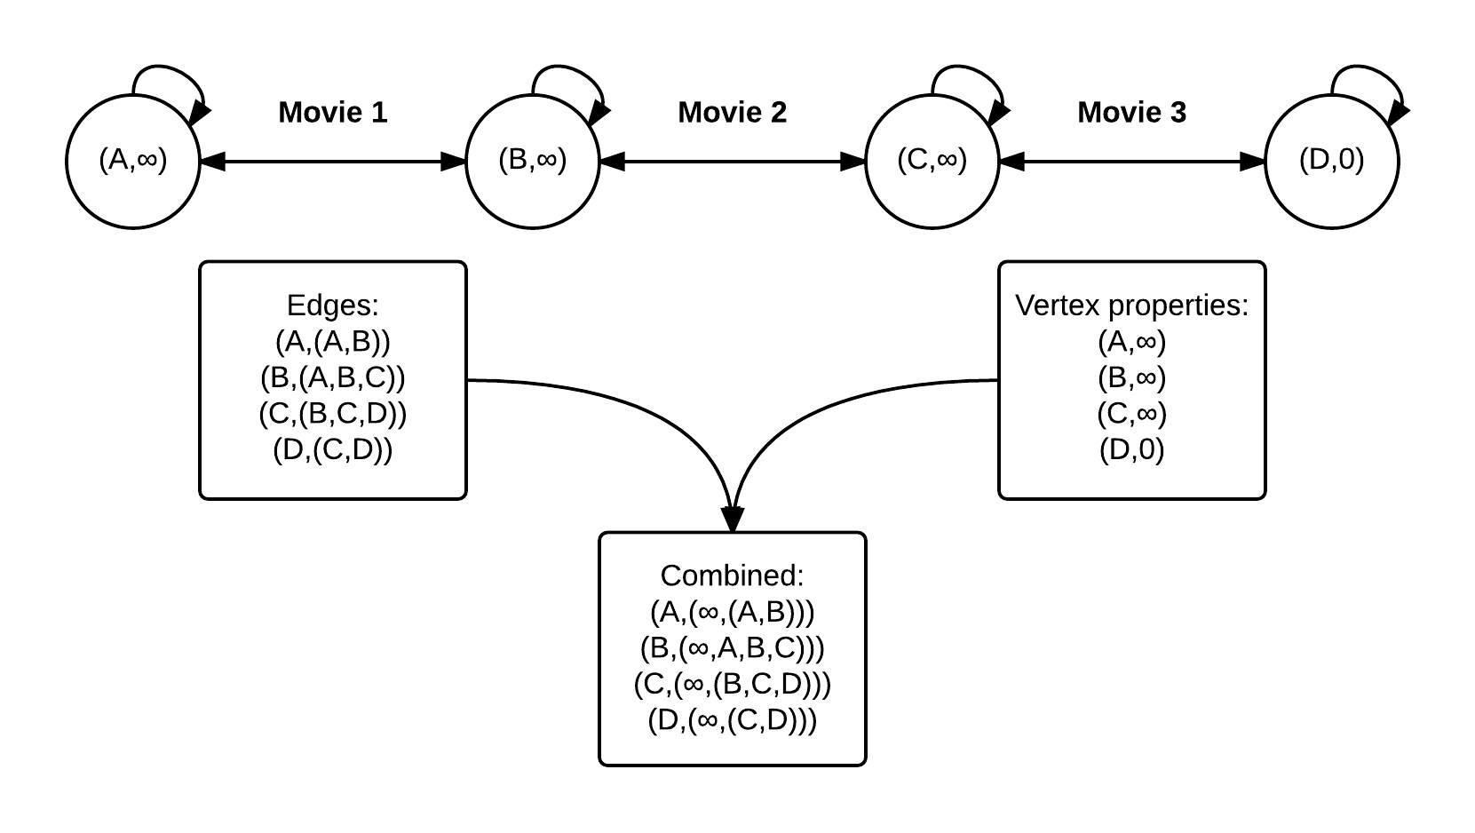
Single Source Shortest Path
Apache
Spark
Apache
Hadoop
Notes:
Apache Hadoop: combined list -> 1 file with key, distance, collaborating actors
Apache Spark: Static and Dynamic list ->
STATIC: 1 file with key, collaborating actors
DYNAMIC: 1 file with key, distance

Slide 19
Single Source Shortest Path
- Generation 1: Apache Hadoop

Slide 20
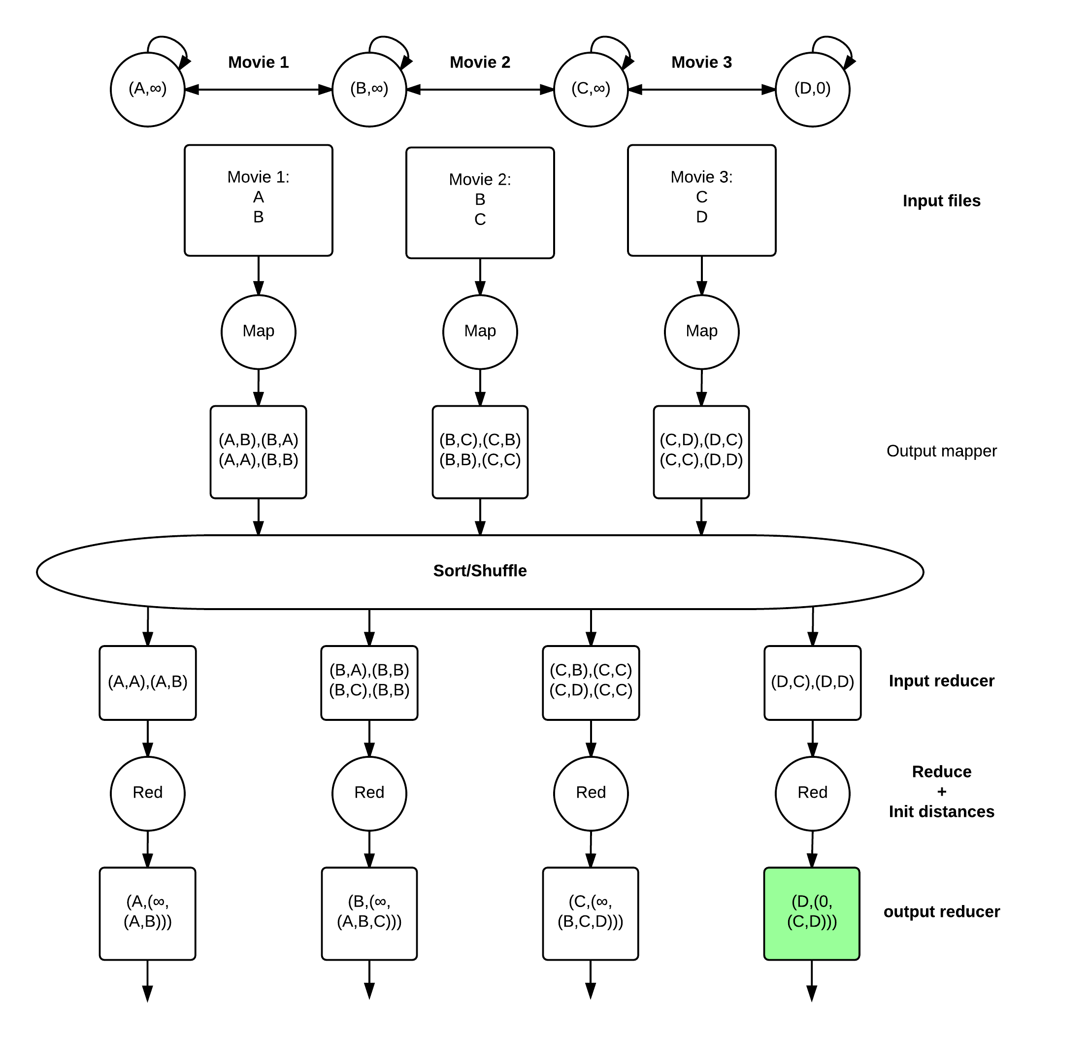
H
Hadoop:
Initialization
step
Notes:
Load and store to hard disk

Slide 21
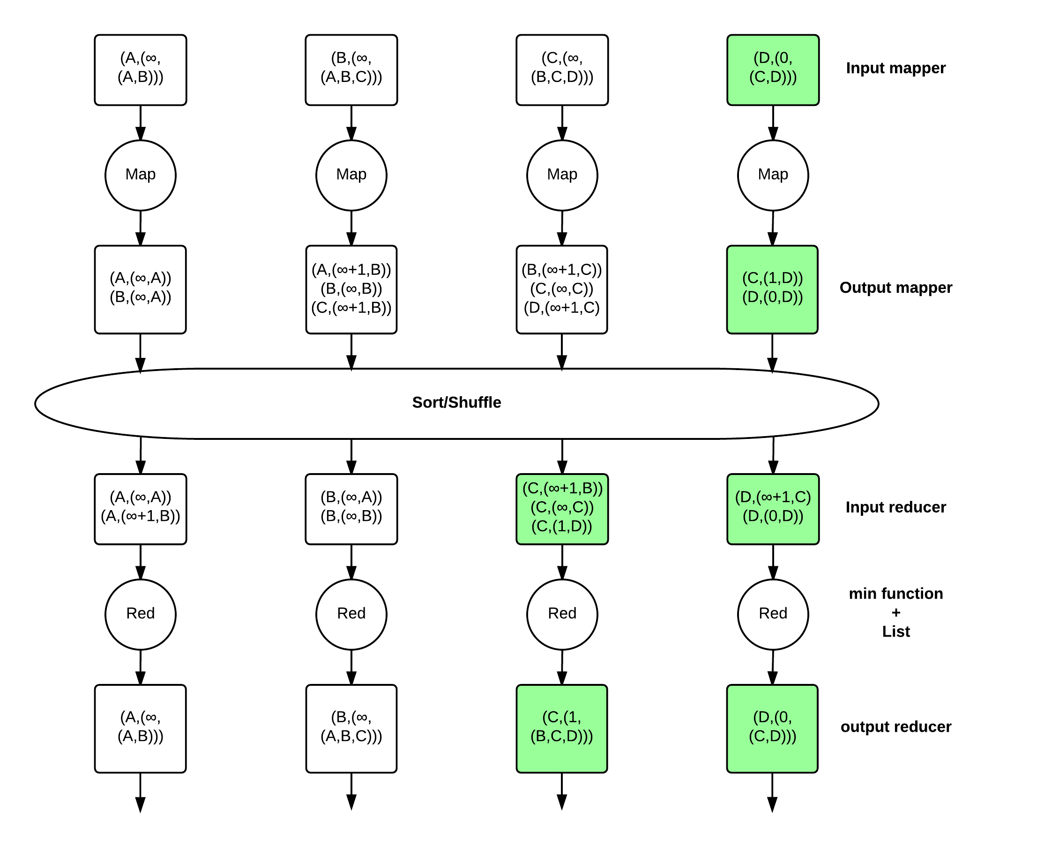
Hadoop:
Iterative
step
Notes:
Load and store to hard disk
Static information flows through the computation

Slide 22
Single Source Shortest Path
- Generation 2: Apache Spark

Slide 23
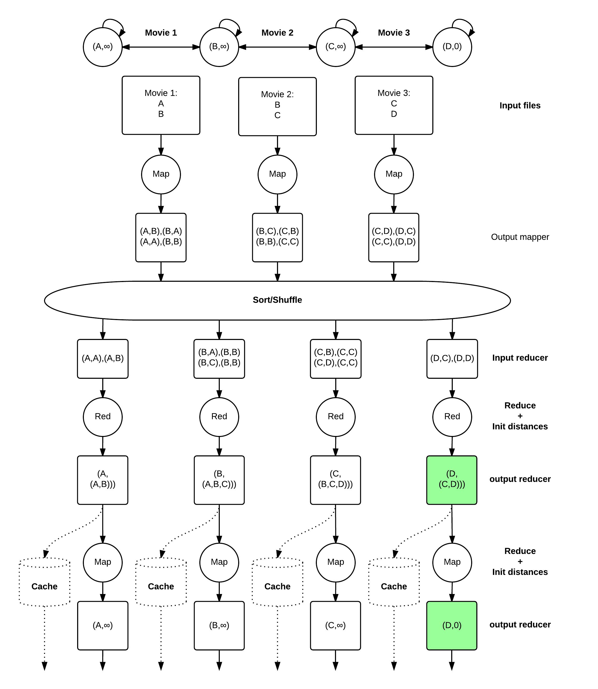
Spark:
Initialization
step
Notes:
As we have a DIRECTED ACYCLIC GRAPH with a RICHER SET OF TRANSFORMATIONS and NO STRICT map-sort-reduce PATTERN, we can SPLIT the static and dynamic DATA
Also, only load from HDD, rest IN-MEMORY

Slide 24
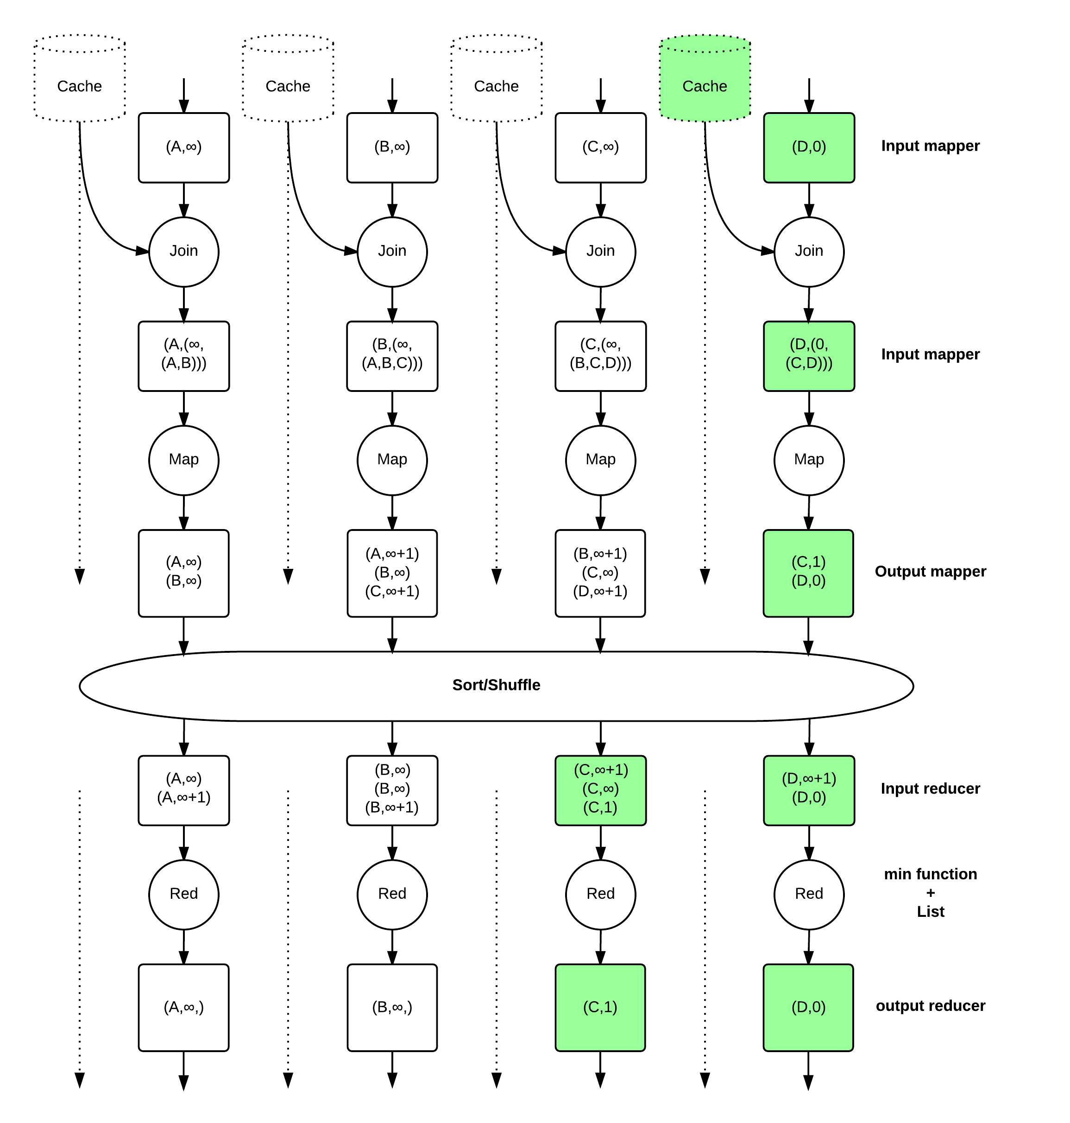
Spark:
Iterative
step
Notes:
Inexpensive join, as DATA is LOCALLY, after first map STATIC data is FORGOTTEN
Data is kept in-memory

Slide 25
Difference
Main difference:
In-memory computation
Effects:
- No use of HDFS on HDD other than input and output
- No need to keep static data in data flow

Slide 26
Experiment 1a: Spark vs Hadoop
- Overview
Research question: How does Apache Spark relate to Apache Hadoop for an iterative algorithm?
Limitation: Under normal conditions
Expectations:
Initialization step: Apache Spark 2x faster
Iterative step: Apache Spark 20x-100x faster
Notes:
Limitation: Under normal conditions
Goal: Justify our focus on second generation big data systems

Slide 27
Experiment 1a: Spark vs Hadoop
- Setup
Algorithm: Six degrees of separation from Kevin Bacon
Input set: 10,000 movies, 1-101 actors per movie
Hardware: IBM Power System S882L
- two 12-core 3.02 GHz Power8 processor cards
- 512 GB DRAM
- Single Hard Disk Drive
Software:
- Ubuntu 14.04 Little Endian
- Java 7.1
- Apache Hadoop 2.2.0
- Apache Spark 1.1.0
Notes:
Power8: June 2014
Spark 1.0: May 2014

Slide 28
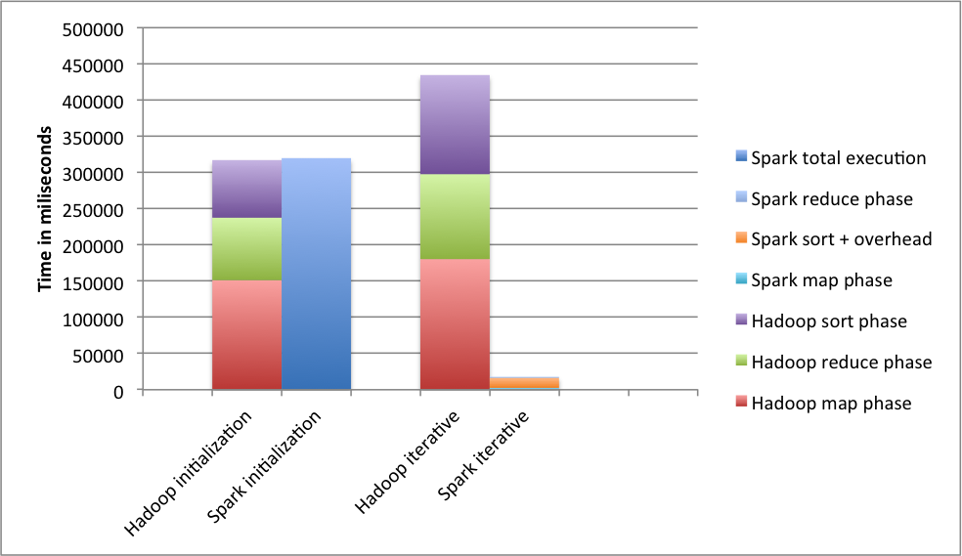
Experiment 1a: Spark vs Hadoop
Notes:
Split out in phases where possible
CLICK FOR 2x
Initialization: First glance same, but actually 2x. Still same order of magnitude
Iterative: 30x, bridge to zoom

Slide 29
Experiment 1a: Spark vs Hadoop
~2x
Notes:
Initialization: First glance same, but actually 2x. Still same order of magnitude
CLICK FOR 30x
Iterative: 30x, bridge to zoom

Slide 30
Experiment 1a: Spark vs Hadoop
~30x
Notes:
Iterative: 30x, bridge to zoom

Slide 31
Experiment 1a: Spark vs Hadoop
- Iterative step per phase
~90x
~10x
~105x
* sort+overhead
Notes:
90x and 105x as expected, sort lower because of overhead which is not MASKED anymore

Slide 32
Experiment 1a: Spark vs Hadoop
- Conclusion
Research question: How does Apache Spark relate to Apache Hadoop for an iterative algorithm?
Expectations:
Initialization step: Apache Spark 2x faster
Iterative step: Apache Spark 20x-100x faster
Results:
Initialization step: Apache Spark 2x faster
Iterative step: Apache Spark 30x-100x faster
Conclusion: Apache Spark performs equal-or-better than Apache Hadoop under normal conditions
Notes:
MENTION: under normal conditions
CONCLUSION: equal-or-better
GOAL: Thereby justifying our focus on second generation big data systems
TIME CHECK, anders door

Slide 33
Placeholder
Notes:
Thereby leaving room for improvement

Slide 34
Spark RDDs
Definition: Read-only, partitioned collection of records
RDDs can only be created from
Data in stable storage
Other RDDs
Consist of 5 pieces of information:
Set of partitions
Set of dependencies on parent RDD
Function to transform data from the parent RDD
Metadata about its partitioning scheme
Metadata about its data placement
Notes:
Resilient distributed datasets
CREATED: Directed Acyclic graph
TIME CHECK
-> 36

Slide 35
Spark RDDs: Lineage
Definition: Read-only, partitioned collection of records
RDDs can only be created from
Data in stable storage
Other RDDs
Consist of 5 pieces of information:
Set of partitions
Set of dependencies on parent RDD
Function to transform data from the parent RDD
Metadata about its partitioning scheme
Metadata about its data placement
Lineage
Notes:
How lineage allows in-memory computation
Time check, anders 34

Slide 36
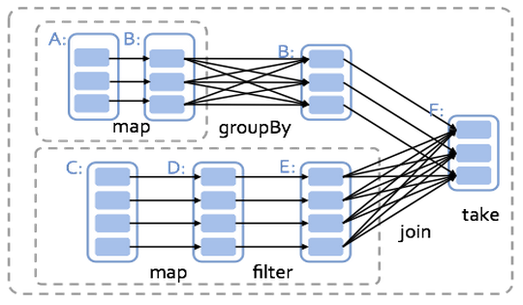
Spark RDDs: Dependencies
Notes:
Narrow and wide dependencies
Wide: sort/grouped or store
Spark works from last RDD
Pipelines stages because data is LOCAL

Slide 37
Spark: Memory management
General
20%
Shuffle
20%
RDD
60%
Notes:
Different regions
Data is shuffle, as all is pipelined onto sorts
Caching will move to LARGER RDD region

Slide 38
Experiment 1b: Constrain memory
- Overview
Research question: How does Apache Spark perform when constraining available memory?
Expectations:
Degrade gracefully to the performance of Apache Hadoop
Notes:
Goal: Show the room for improvement
SPILLING
CONSTRAIN BECAUSE memory capacity is bottleneck

Slide 39
Experiment 1b: Constrain memory
- Setup
Algorithm: Six degrees of separation from Kevin Bacon
Input set: 10,000 movies, 1-101 actors per movie
Hardware: IBM Power System S882L
- two 12-core 3.02 GHz Power8 processor cards
- 512 GB DRAM
- Single Hard Disk Drive
Software:
- Ubuntu 14.04 Little Endian
- Java 7.1
- Apache Spark 1.1.0 with varying memory sizes
- Apache Hadoop 2.2.0 with no memory constrains
Notes:
-> 43

Slide 40
Experiment 1b: Constrain memory
- No explicit cache
Notes:
Peaks because RDDs are either stored or not, heuristics decide

Slide 41
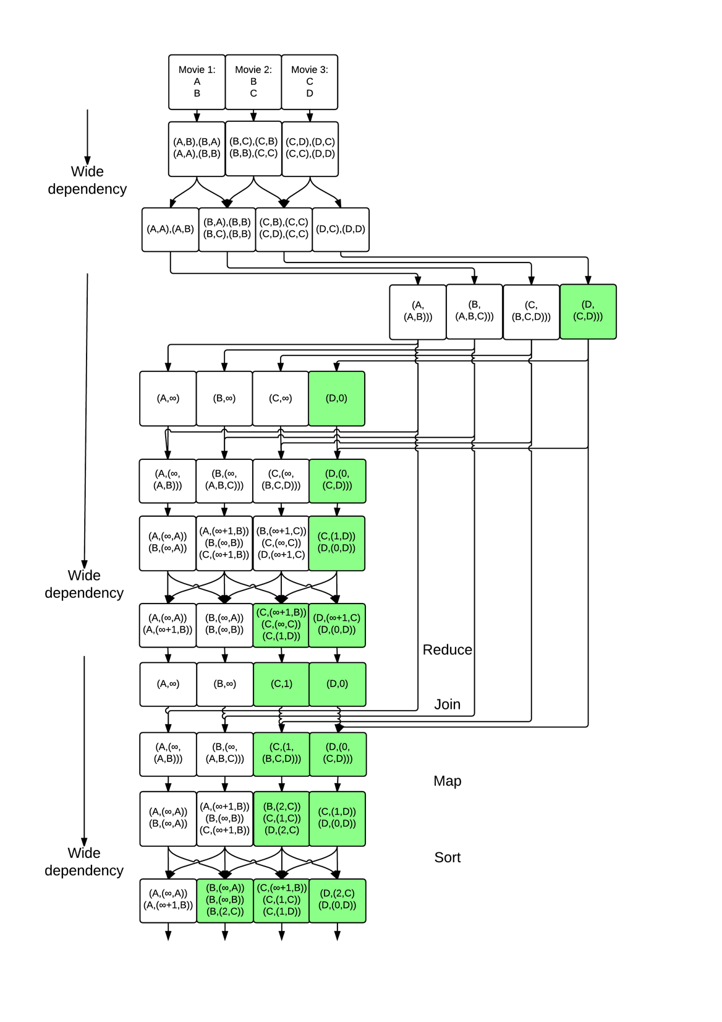
Spark: RDD caching
RDD region
Shuffle region
Notes:
Give Spark hint that the iterative list is going to be reused

Slide 42
Experiment 1b: Constrain memory
- Cache the iterative RDD
Notes:
Better performance
BRIDGE: now all narrow dependencies will also be STOP-THE-WORLD

Slide 43
Experiment 1b: Constrain memory
- Cache all RDDs
Notes:
All narrow dependencies are also STOP-THE-WORLD
Still faster because we are now in the 60% region, not spilling as much

Slide 44
Experiment 1b: Constrain memory
- Hadoop vs Spark constrained
Notes:
Trager omdat:
FILO -> everything from a stage (various map, reduce and sort) is pushed into memory -> memory is full and after that every object is spilled
Hadoop only uses HDD after reduce and before sort

Slide 45
Experiment 1b: Constrain memory
- Hadoop vs Spark constrained
Room for
improvement!
Notes:
But still room for improvement

Slide 46
Experiment 1b: Constrain memory
- Conclusion
Research question: How does Apache Spark perform when constraining available memory?
Expectations:
Degrade gracefully to the performance of Apache Hadoop
Conclusion:
Performance degrades gracefully to a performance worse than Apache Hadoop
Notes:
Expectations not met, but even after inefficiency we believe there is room for improvement

Slide 47
Placeholder
Notes:
Thereby leaving room for improvement

Slide 48
Data storage: General ways to store
 | Serialization | OS involvement
Serialized in the file system | yes | yes
Key_value store in OS | semi | yes
Key_value store in user space | semi | no
User space object store | no | no
Notes:
FS: Serialization: aggregate to minimize overhead and move data in right format, OS involvement (general clock cycles + context switches due, possibly due to interrupts)
KV in OS: Less aggregation because kv store, but still OS involvement
KV UA: Less aggregation, no OS involvement
OS (in memory): No aggregation, no OS involvement

Slide 49
Data storage: General ways to store
 | Serialization | OS involvement
Serialized in the file system | yes | yes
Key_value store in OS | semi | yes
Key_value store in user space | semi | no
User space object store | no | no
Notes:
FS: aggregate to minimize overhead, OS involvement (general clock cycles + context switches due, possibly due to interrupts)
KV in OS: Less aggregation because kv store, but still OS involvement
KV UA: Less aggregation, no OS involvement
OS (in memory): No aggregation, no OS involvement

Slide 50
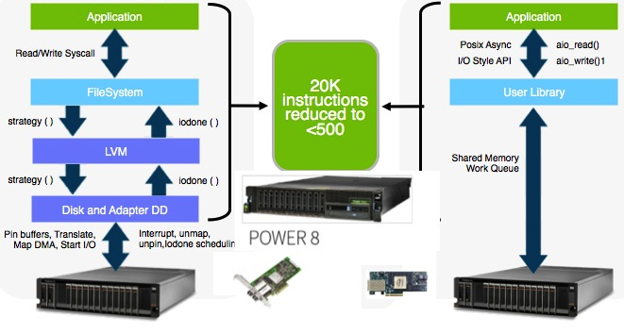
Data storage: CAPI interface
Notes:
FPGA that communicates with Flash has direct access to the user level address space, without OS or file system involvement

Slide 51
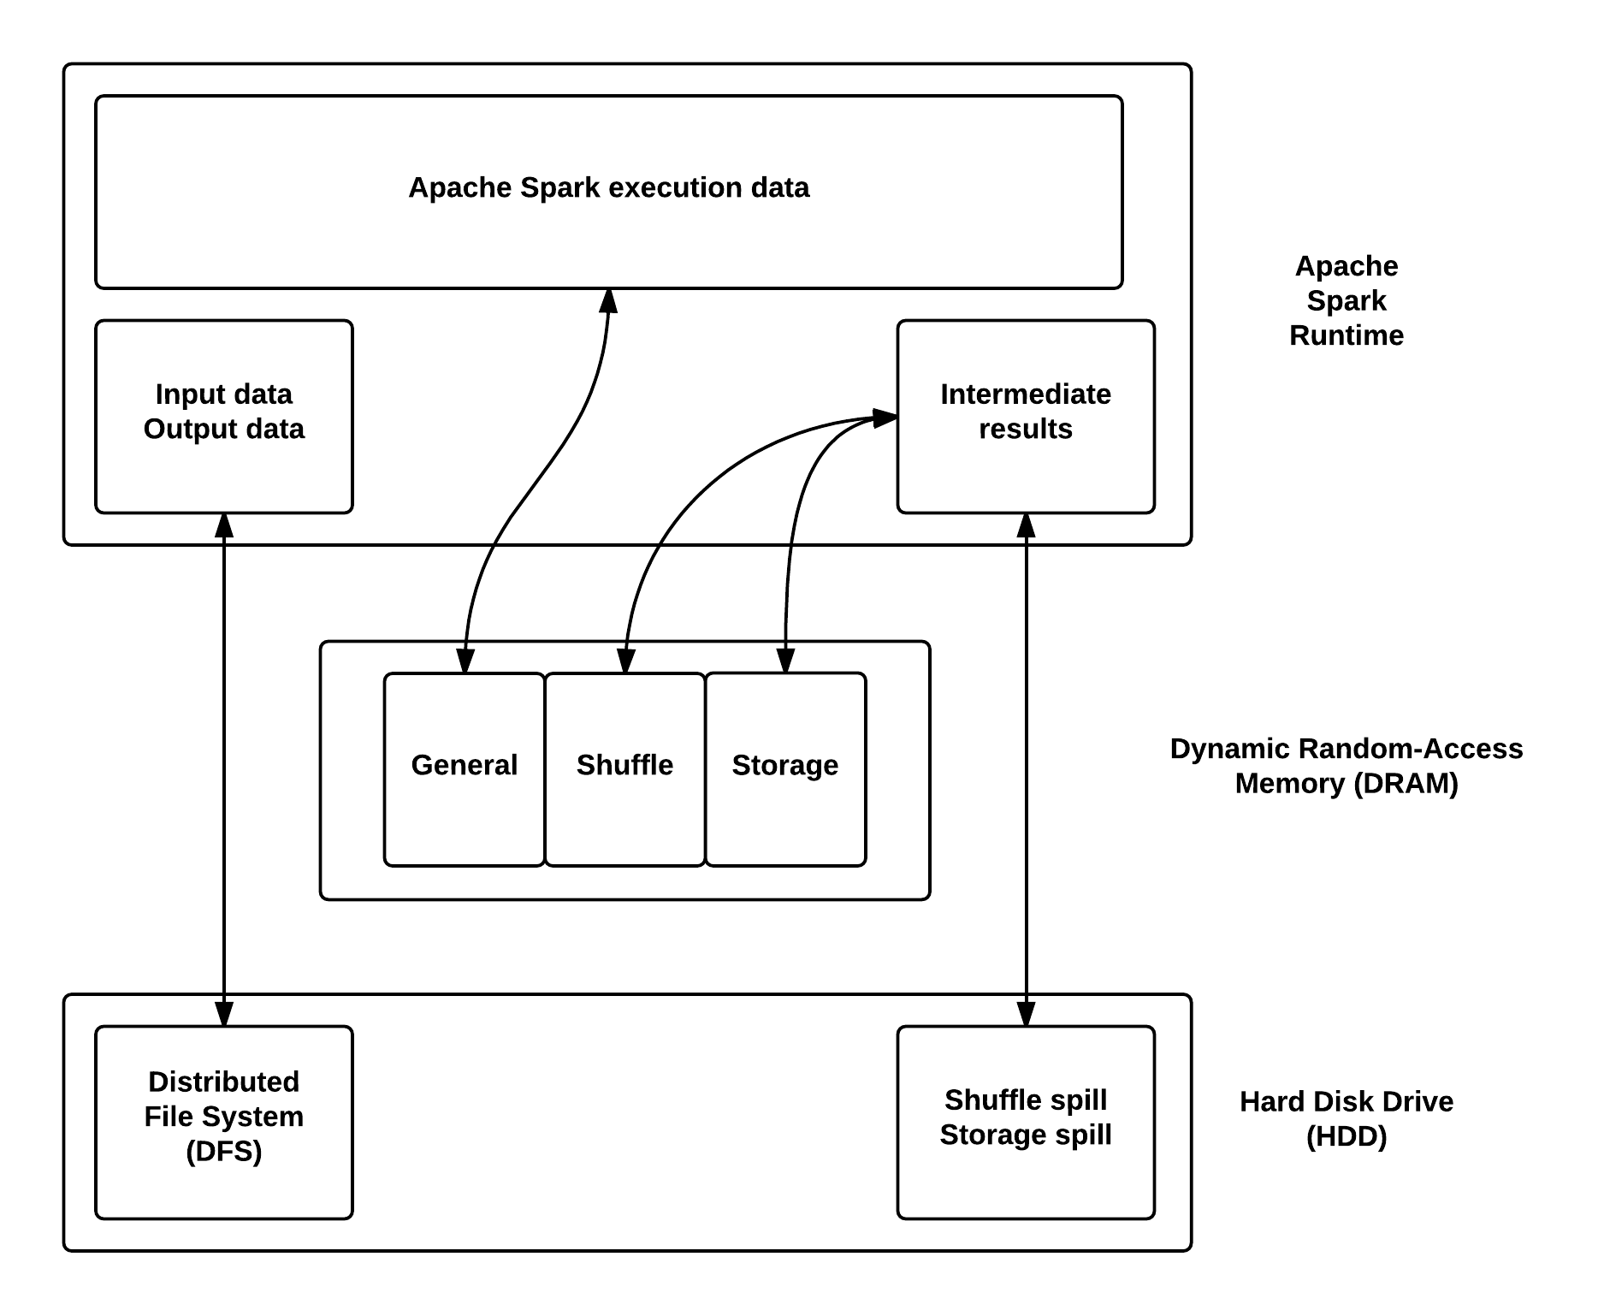
Data storage: Data in Apache Spark
Notes:
Mounted FS: Replace DFS and Shuffle
SECONDARY object store: Could but don’t less aggregation, but direct because no OS
FS: aggregate to minimize overhead, OS involvement (general clock cycles + context switches due, possibly due to interrupts)
KV UA: Less aggregation, no OS involvement

Slide 52
Data storage: Data in Apache Spark
2
1
1
Notes:
Mounted FS: Replace DFS and Shuffle
SECONDARY object store: Could but don’t less aggregation, but direct because no OS
FS: aggregate to minimize overhead, OS involvement (general clock cycles + context switches due, possibly due to interrupts)
KV UA: Less aggregation, no OS involvement

Slide 53
Experiment 2a: Flash with a file system
- Overview
Research question: Can we improve Spark by using Flash connected as file storage?
Expectations:
Speedup when loading/storing I/O, and when spilling
Sanity check:
Ram-disk before Flash as File System
Notes:
Goal: Find speedup
Expectations: Loading input and writing output, and when memory is constrained

Slide 54
Experiment 2a: Flash with a file system
- Setup
Algorithm: Six degrees of separation from Kevin Bacon
Input set: 10,000 movies, 1-101 actors per movie
Hardware: IBM Power System S882L
- two 12-core 3.52 GHz Power8 processor cards
- 256GB DRAM
- Single Hard Disk Drive
Software:
- Ubuntu 14.04 Little Endian
- Java 7.1
- Apache Spark 1.1.0 with varying memory sizes
Notes:
New hardware
Varying memory sizes

Slide 55
Experiment 2a: Flash with a file system
- Sanity check: ram-disk
1.01x
Notes:
Graph is done with Spark no cache
(more data written to HDD)

Slide 56
Experiment 2a: Flash with a file system
- Discussion
+ Faster writing speeds
- Data aggregation
- OS involvement
Notes:
OS: general clock cycles and context switches, maybe due to interrupts

Slide 57
Experiment 2a: Flash with a file system
- Conclusion
Research question: Can we improve Spark by using Flash connected as file storage?
Expectations:
Speedup when loading/storing I/O, and when spilling
Sanity check:
Ram-disk before Flash as File System
Results: No noticeable speedup
Conclusion: No, as it did not show a noticeable speedup
Notes:
Thereby leaving room for improvement

Slide 58
Placeholder
Notes:
Thereby leaving room for improvement

Slide 59
Data storage: Data in Apache Spark
2
1
1
Notes:
Make text larger? Also, create new image for where we are going to place Flash
Mounted FS: Replace DFS and Shuffle
SECONDARY object store: Could but don’t less aggregation, but direct because no OS

Slide 60
Experiment 2b: Flash as object store
- Overview
Research question: Can we improve Spark by using Flash connected as secondary object store?
Expectations:
Noticeable speedup due to lack of Operating System involvement and faster writing speeds
Notes:
Expectations: Speedup

Slide 61
Experiment 2b: Flash as object store
- Setup
Algorithm: Six degrees of separation from Kevin Bacon
Input set: 10,000 movies, 1-101 actors per movie
Server: IBM Power System S882L
- two 12-core 3.52 GHz Power8 processor cards
- 256GB DRAM
- Single Hard Disk Drive
Flash storage: IBM FlashSystem 840 with CAPI
Software:
- Ubuntu 14.04 Little Endian
- Java 7.1
- Apache Spark 1.1.0 with 3GB of memory
Notes:
Same Power8 as last
New FlashSystem, connected using CAPI

Slide 62
Experiment 2b: Flash as object store
- Results
1.01x
Execution mode | Execution time in seconds | Overhead in seconds
Normal execution | 208 | -
Constrained memory | 262 | 54
Constrained using CAPI Flash | 225 | 17

Slide 63
Experiment 2b: Flash as object store
- Results
1.01x
Execution mode | Execution time in seconds | Overhead in seconds
Normal execution | 208 | -
Constrained memory | 262 | 54
Constrained using CAPI Flash | 225 | 17
1.15x
~70%
reduction
Notes:
70% reduction
1.16 speedup

Slide 64
Experiment 2b: Flash as object store
- Discussion
+ Faster writing speeds
+ No OS involvement
- Data aggregation (future work)
Notes:
OS: general clock cycles and context switches, maybe due to interrupts

Slide 65
Experiment 2b: Flash as object store
- Conclusion
Research question: Can we improve Spark by using Flash connected as secondary object store?
Expectations:
Noticeable speedup due to lack of Operating System involvement and faster writing speeds
Results: 70% reduction in overhead, 1.16x speedup
Conclusion: Yes, as it showed a noticeable speedup
Notes:
Thereby leaving room for improvement

Slide 66
Placeholder
Notes:
Thereby leaving room for improvement

Slide 67
Conclusion
Can Flash be used to further optimize Big Data Systems?
How does Spark relate to Hadoop for an iterative algorithm?
How does Spark perform when constraining available memory?
Can we improve Spark by using Flash connected as file storage?
Can we improve Spark by using Flash connected as secondary object store?
Notes:
What are we looking for
Before we can answer questions, we need to be familiar with Spark.

Slide 68
Conclusion
Can Flash be used to further optimize Big Data Systems?
How does Spark relate to Hadoop for an iterative algorithm?
- Equal-or-better
How does Spark perform when constraining available memory?
Can we improve Spark by using Flash connected as file storage?
Can we improve Spark by using Flash connected as secondary object store?
Notes:
What are we looking for
Before we can answer questions, we need to be familiar with Spark.

Slide 69
Conclusion
Can Flash be used to further optimize Big Data Systems?
How does Spark relate to Hadoop for an iterative algorithm?
- Equal-or-better
How does Spark perform when constraining available memory?
- Degrade gracefully to a performance worse than Apache Hadoop
Can we improve Spark by using Flash connected as file storage?
Can we improve Spark by using Flash connected as secondary object store?
Notes:
What are we looking for
Before we can answer questions, we need to be familiar with Spark.

Slide 70
Conclusion
Can Flash be used to further optimize Big Data Systems?
How does Spark relate to Hadoop for an iterative algorithm?
- Equal-or-better
How does Spark perform when constraining available memory?
- Degrade gracefully to a performance worse than Apache Hadoop
Can we improve Spark by using Flash connected as file storage?
- No, as it did not show a noticeable speedup
Can we improve Spark by using Flash connected as secondary object store?
Notes:
What are we looking for
Before we can answer questions, we need to be familiar with Spark.

Slide 71
Conclusion
Can Flash be used to further optimize Big Data Systems?
How does Spark relate to Hadoop for an iterative algorithm?
- Equal-or-better
How does Spark perform when constraining available memory?
- Degrade gracefully to a performance worse than Apache Hadoop
Can we improve Spark by using Flash connected as file storage?
- No, as it did not show a noticeable speedup
Can we improve Spark by using Flash connected as secondary object store?
- Yes, as it showed a noticeable speedup
Notes:
What are we looking for
Before we can answer questions, we need to be familiar with Spark.

Slide 72
Conclusion
Can Flash be used to further optimize Big Data Systems?
Our measured noticeable speedup gives a strong indication that Big Data Systems can be further optimized with CAPI Flash
Notes:
As regular Flash showed no big improvement

Slide 73
Future work
Remove overhead
Flash as primary
object store
Notes:
Flash as primary object store: Less aggregation, no OS involvement, slower writing speed
Replacing the default storage location for intermediate data from DRAM to Flash hopefully allows use to solve larger problems while having less cost.
Use to solve larger problems while having less cost.
Voorbeeld: Reddis key_value store. Gaat al over netwerk naar Flash
OS and file system overhead small (CAPI)1
Capacity advantages over DRAM and good enough latency

Slide 74
Discussion
Notes:
Thereby leaving room for improvement

Slide 75
Contact details
Tom Hubregtsen
Email: tom@hubregtsen.com
Linkedin: www.linkedin.com/in/thubregtsen
Notes:
Thereby leaving room for improvement

Slide 76
Placeholder
Notes:
Thereby leaving room for improvement

Slide 77
Backup slides
Notes:
Thereby leaving room for improvement

Slide 78
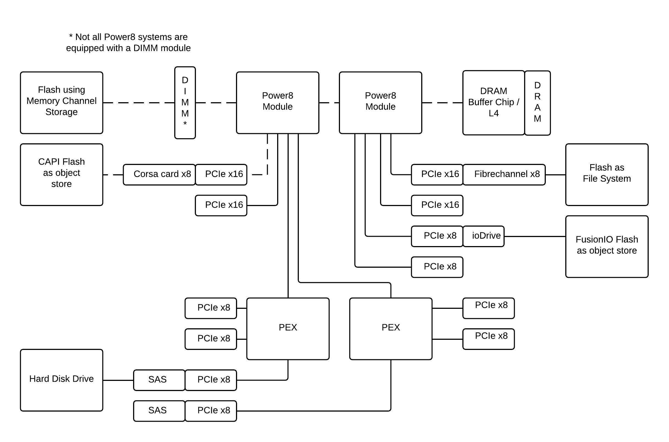
Data storage: Flash in the Power8
Notes:
Mem Flash Disk
Cost per GB 10 1 0.1

Slide 79
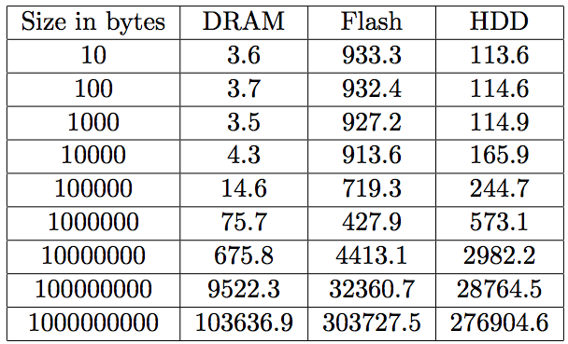
Writing speeds in us
Notes:
Mem Flash Disk
Cost per GB 10 1 0.1

Slide 80
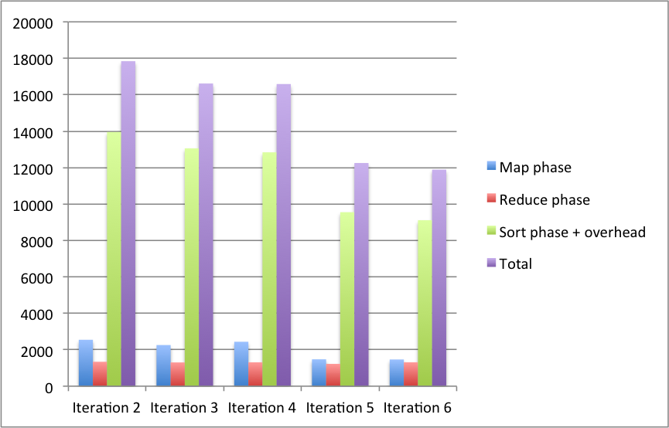
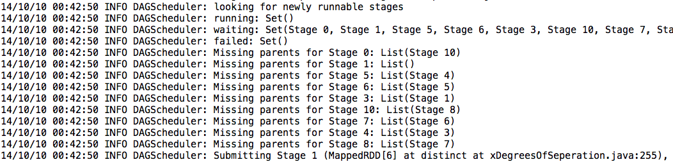
Experiment 1: Spark vs Hadoop
~30x
Notes:
Error in Spark init: distinct version takes 50% of the time
Results:
Initialization: Spark 2x because only load
Iterative

Slide 81
Experiment 1: Spark vs Hadoop
~30x
Notes:
Error in Spark init: distinct version takes 50% of the time
Results:
Initialization: Spark 2x because only load
Iterative

Slide 82
Experiment 1: Staged timing
- Spark iterative (log scale)

Slide 83
Experiment 1: Staged timing
18s

Slide 84
Experiment 1: Staged timing
18s
12s

Slide 85
Experiment 1: Staged timing
Mapper: ~2.0s => 180/2=90x
Reducer: ~1.3s => 137/1.3=105x
Sorter: 15-3.3-overhead => ?
Overhead: 15-3.3-sorter => ?
18s
12s

Slide 86
Spark: Execution
RDD Objects
DAGScheduler
TaskScheduler
Worker
Cluster
manager
Threads
DAG
TaskSet
Task
Block manager
rdd1.join(rdd2)
.groupBy(…)
.filter(…)
split graph into stages of tasks
launch tasks via cluster manager
execute tasks
submit each stage as ready
retry failed or straggling tasks
store and serve blocks
build operator DAG
agnostic to operators!
stage
failed
doesn’t know about stages
Source: Matei Zaharia, Spark
Notes:
So once we have this graph, we can split execution in stages and send them per stage to the taskScheduler
Kleuren en layout nog fixen

Slide 87
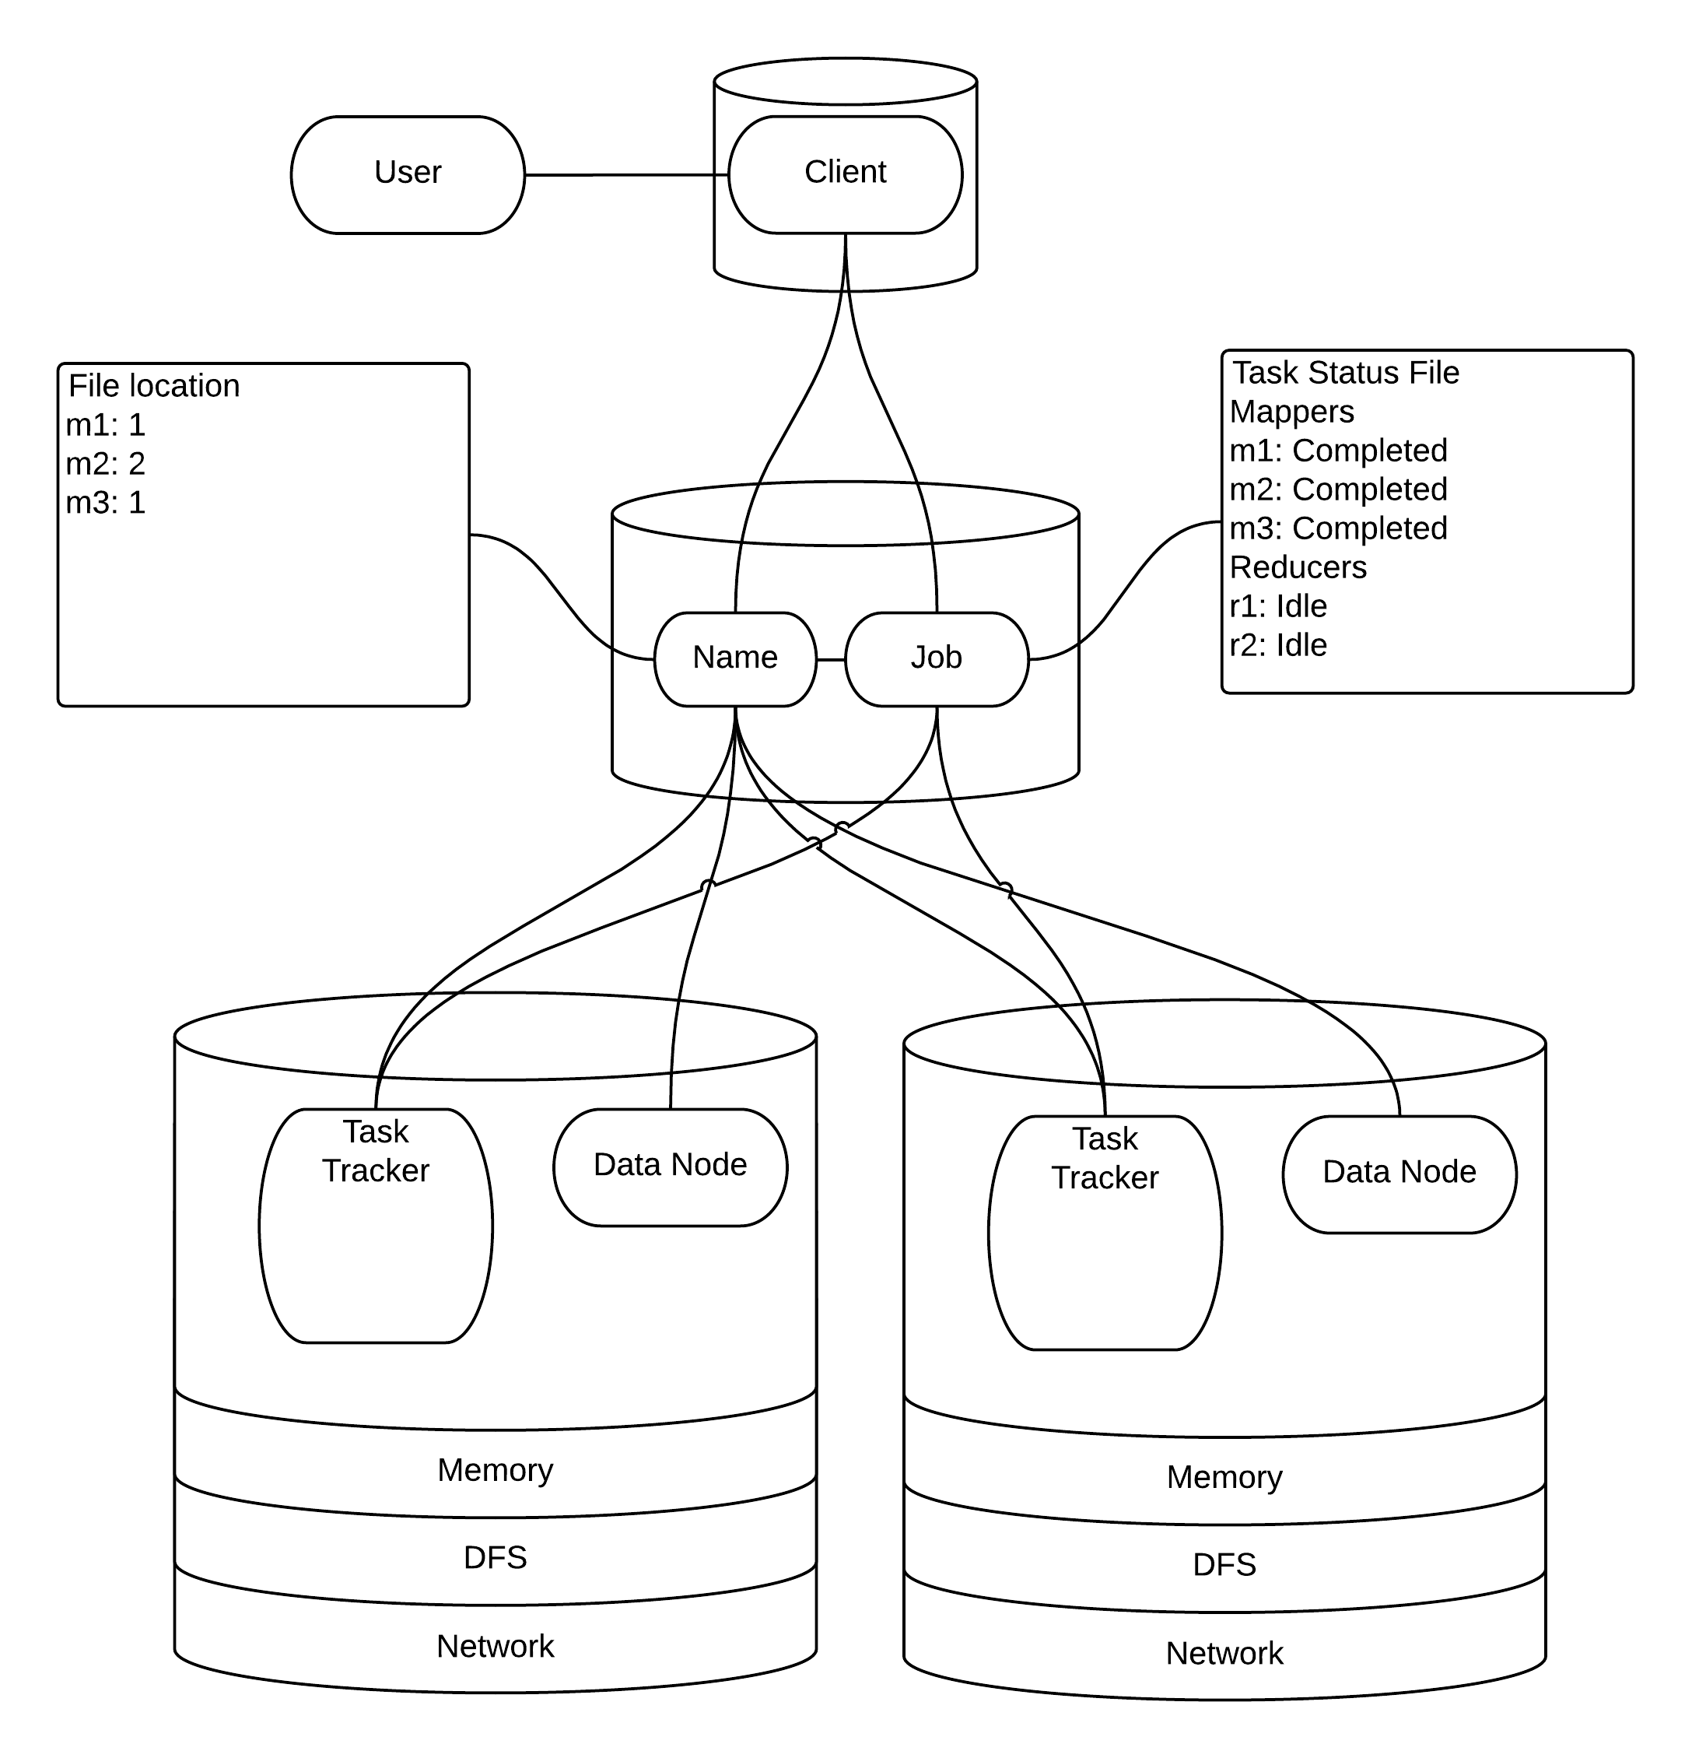
Hadoop
- Execution
Notes:
How many are familiar with Job Execution
Sequence file

Slide 88
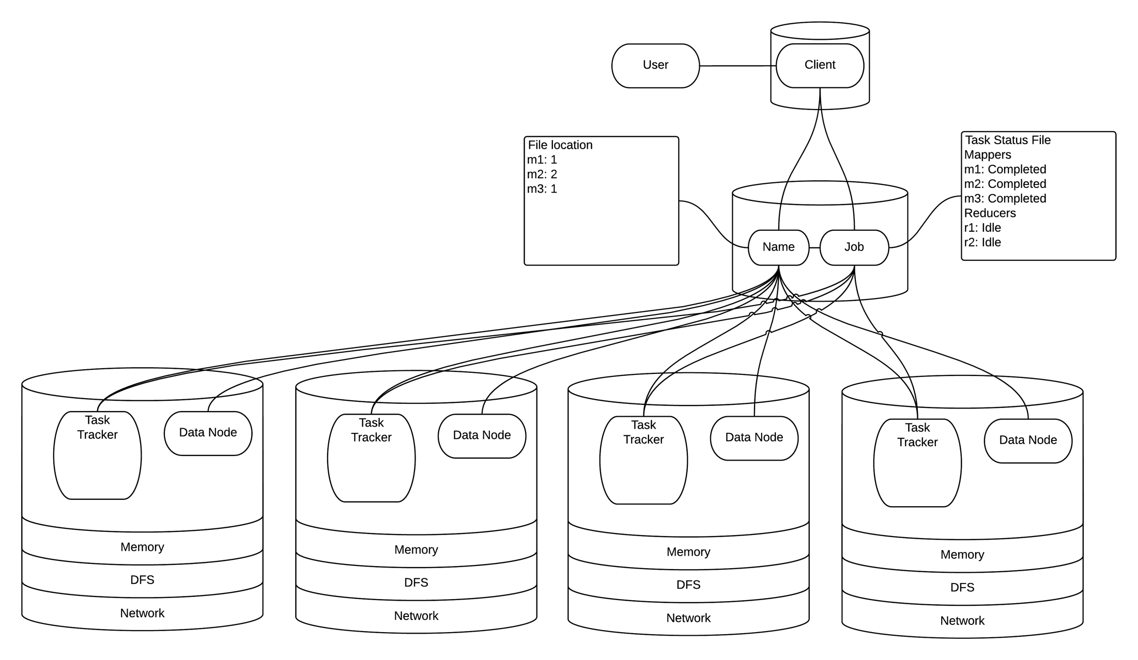
Hadoop
- Scalable

Slide 89
Hadoop
- Resilient

Slide 90
Hadoop
- Ease of use

Slide 91
Spark
- Execution
Notes:
Pretty much the same, but

Slide 92
Spark
- Execution
Notes:
Not strict MapReduce. Exectuion based on RDDs

Slide 93
Spark RDDs: Resiliency and lazy evaluation
Notes:
Only the sort is wide dependency leading to a STOP-THE-WORLD, everything else is pipelined

Slide 94
Notes:
Different from Hadoop, as it uses HDD which is also wide

Slide 95
Characteristics of different storage
 | DRAM | Flash | HDD
Type | DDR3 1600 | SATA | SATA
Bandwidth | 102.4 Gb/s | 12 Gb/s | 1 Gb/s*
Bandwidth/$ | 1.5*10⁰ Gb/s/$ | 0.9*10⁻² Gb/s/$ | 0.7*10⁻³ Gb/s/$
IOPS | 100,000,000 | 100,000 | 100
IOPS/$ | 1.4*10⁶ IOPS/$ | 7.7*10² IOPS/$ | 0.7*10⁻¹ IOPS/$
Capacity | 8 GB | 240 GB | 4,000 GB
Capacity/$ | 1.1*10² GB/$ | 1.8*10³ GB/$ | 2.8*10⁴ GB/$
Cost | $70 | $130 | $140
*: Actual writing speed
Notes:
DRAM has the higher bandwidth and IOPS, but less capacity.
This performance might be overkill, as Spark can not supply enough data
Flash performs in between which might be sufficient, and is cheaper per bit

