Slide 1
CEDA Chapter
Current chapter officers (2012 and 2013)
  Chair: Zhuo Li, IBM
  Vice Chair: Magdy Abadir, Freescale
  Secretary: Cliff Sze, IBM
  Webmaster: Natarajan Viswanathan, IBM
Send email to zhuoli@ieee.org to be added in CEDA chapter email list
The chapter website: http://ewh.ieee.org/r5/central_texas/ceda/index.html

Slide 2
CAS/SSC Chapter
Current chapter officers (2012 and 2013)
  Chair: Zhuo Li, IBM
  Vice Chair: Nan Sun, UT Austin
  Secretary: Mikel Ash, Texas Instruments
Send email to zhuoli@ieee.org to be added in CAS/SSC chapter email list
The chapter website: http://ewh.ieee.org/r5/central_texas/cas_ssc/index.html

Slide 3
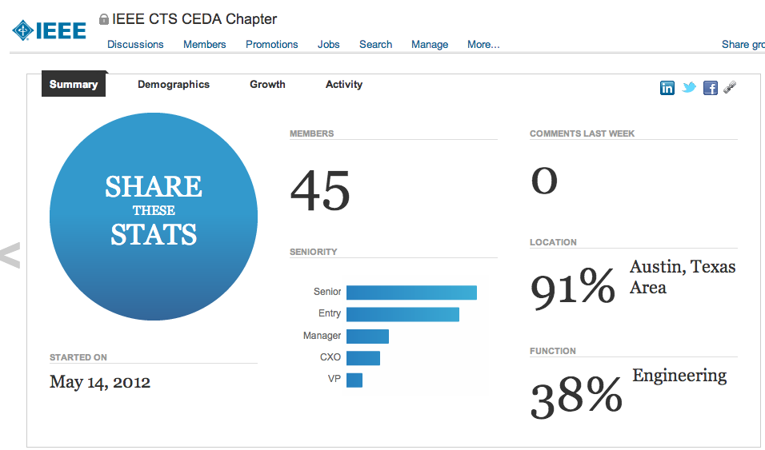
Linked In Group
Good for networking, jobs, news, …. Minimize CEDA email list traffic

Slide 4
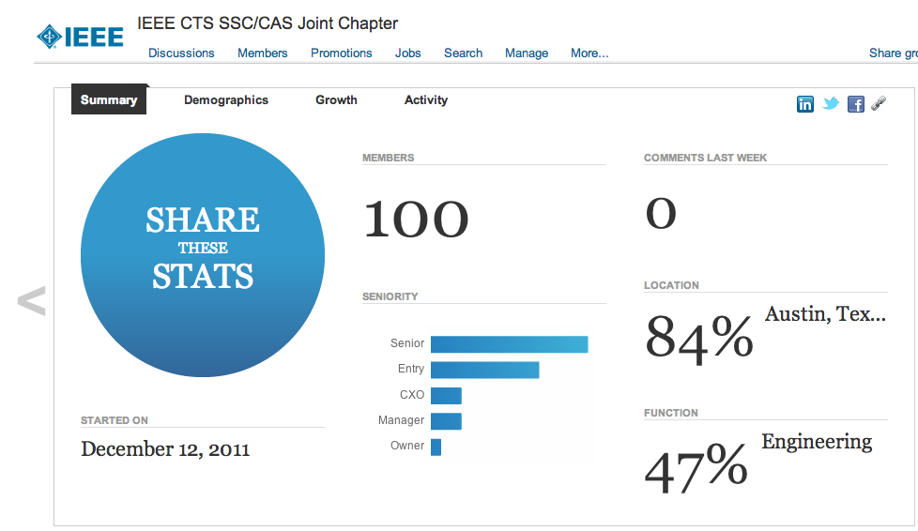
Linked In Group
Good for networking, jobs, news, …. Minimize CAS/SSC email list traffic

Slide 5
Events Update
October 24: IEEE CTS CTCN/CAS/SSC/CEDA/WIE/LM Joint meeting, “Legendary Engineering Success Stories” by Gary Daniels.
October 27: IEEE CTS CAS/SSC/CEDA workshop on data parallelism/multi-core/GPU. Speakers are from IBM, AMD, Altera, ARM and Texas A&M University
  You can register on IEEE vTools.

Slide 6
DAC 2013
50th DAC will be in Austin, 2013. Go to www.dac.com and sign up for DAC Austin 2013 email list http://www.dac.com/austin+mailing+list.aspx (I will include all people who signed up today. Please let me know if you do not want to be included)
Please pick up a flyer before you leave the building today!
Let us know if there any EDA/Embedded System related events in town.
User Track Submission.

Slide 7
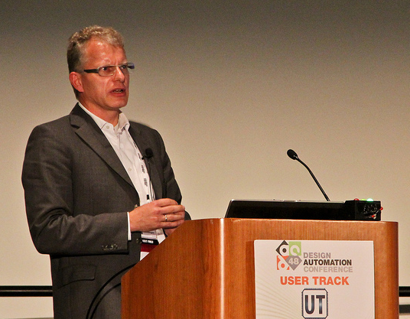
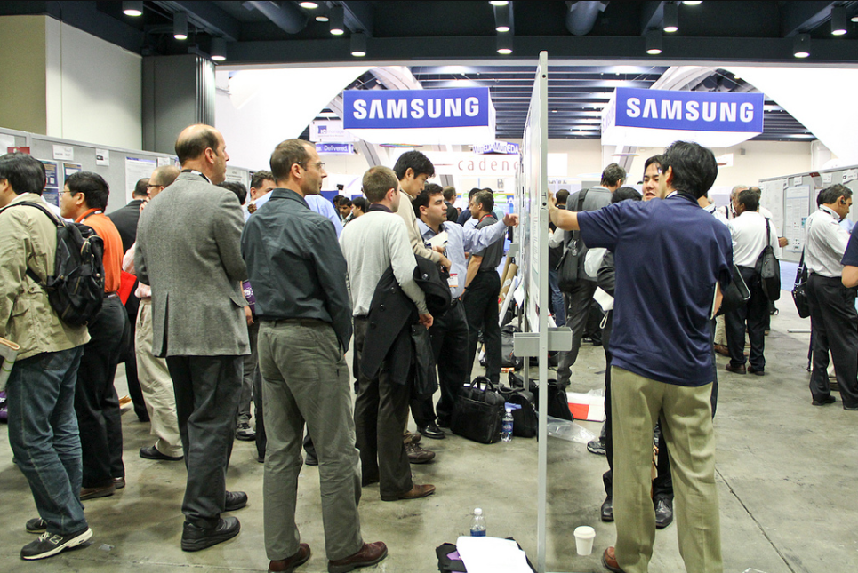
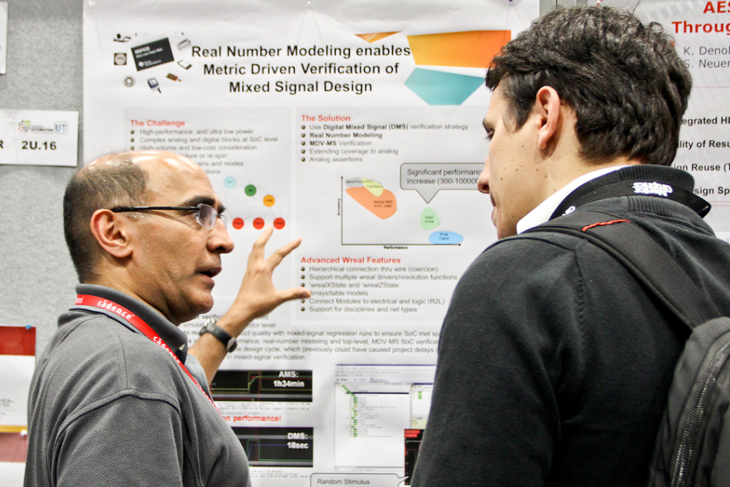
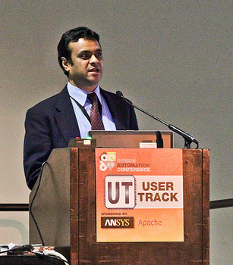
Designer/User Track

Slide 8
DUT Publicity Flyer

Slide 9
Designer/User Track
Low-overhead way for designers and developers to participate directly in DAC
Turns the table
Traditional DAC: “EDA talks/sells” and designers listen
We want designers to talk and EDA to listen!
Easy: submit a 15-slide presentation
Fast: four months from submission to conference
Authors will participate in (very well-attended) poster sessions
A subset will also give presentations during DUT sessions

Slide 10
What Makes a Good DUT Submission?
Design reports, case-studies, and retrospectives; design flows; tool strengths & challenges
If you’ve been working on a project for the last year, you have what you need! Tell us…
  What’s working
  What’s not
  What the tools (don’t) do well
Cover topics you would like to hear about from your peers

Slide 11
Examples from 2011/12
Two for the Price of One - An Affordable Solution that Bridges the Gap Between Firmware and RTL Implementations
Proven Techniques for a Seamless Power-Aware Verification Framework
Statistical Characterization of a High-K Metal Gate 32nm ARM926 Core Under Process Variability Impact
A Holistic Pre-To-Post Solution for Post-Si Validation of SOCs
Power Gate Optimization Method for In-Rush Current and Power-Up Time
How we Verified 5000 Lines of a Complex Multiplexing Code with Three Assertions
PowerMixer-IP: Instruction-Level Power Modeling for Processors

Slide 12

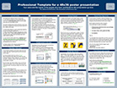

Designer/User Track Timeline
Submission
Feb 6, 2013
Notification
Mar 18, 2013
DAC
Jun 2-6, 2013
+
accept:
presentation & poster
present slides
(includes poster)
accept:
poster
present poster
reject

Slide 13
Submission Guidelines
Title
&
Authors
Slide 1: Title and Authors
Only slide where logo is allowed
Author Details
Slide 2: Detailed author information
(submission only)
or
Slide 3: 1-2 paragraph abstract
(submission only)
Abstract
Slides 4-17: Presentation Content
Must include speaker notes for program committee evaluation
Extra slides will not be evaluated
Details

Slide 14
Tracks
D1: Embedded Systems and Software
D2: Silicon Design: Front-end
D3: Silicon Design: Back-end

Slide 15
D1: Embedded Systems and Software
Design reports and case studies
Architectural exploration, design, and optimization
Software specification, models, and frameworks
Security for embedded systems and software
Validation and verification
Design methodologies and flows

Slide 16
D2: Silicon Design: Front-End
System and high-level hardware synthesis
Power/area/performance trade-offs and low-power design
Bus and network communication
Logic simulation
Validation, test planning, and coverage
FPGAs and emulation
Formal verification

Slide 17
D3. Silicon Design: Back-End
Physical synthesis tools and techniques
Floorplanning
Timing and circuit analysis; circuit optimization
Reliability
Interconnect simulation and analysis
Physical design and manufacturability
Manufacturing test and silicon debug
Analog, mixed-signal, and RF design
Custom, standard cell, and FPGA design flows
Tool control and integration

Slide 18
IEEE CEDA/CAS/SSC December Meeting
Refreshment is in Cafeteria
Please sign up
Placement for Next Decade
Chuck Alpert

Slide 19
Placement for Next Decade
Chuck Alpert, IBM Fellow, Design Productivity Group Manager in IBM Austin Research Lab
Abstract:The gate-level placement has been around for several decades and is considered a core traditional problem in electronic design automation. Its classic and modular formulation has led to the perception that placement is no longer a particularly interesting or hot topic to work on. Nothing could be further from the truth: placement is at the heart of design quality in terms of timing closure, routability, area, power and most importantly, time-to-market. This session describes many opportunities for research in placement for the next ten years and makes the case that more investment in this fundamental technology would benefit the design community.
Biography: Charles (Chuck) Alpert received two undergraduate degrees from Stanford University in 1991 and his doctorate from UCLA in 1996 in Computer Science. Upon graduation, Chuck joined IBM's Austin Research Laboratory where he remains still. He currently manages the Design Productivity Group, whose mission is to architect design automation tools and methodologies to improve designer productivity and reduce design cost. Chuck has published over 100 conference and journal papers and has thrice received the Best Paper Award from the ACM/IEEE Design Automation Conference. He has been active in the academic community, serving as chair for the Tau Workshop on Timing Issues and the International Symposium on Physical Design. For the last decade, he has served as associate editor of IEEE Transactions on Computer-Aided Design, before stepping down in 2012. For his work in mentoring, he received the Mahboob Khan Mentor Award in 2001 and 2007. He was also named IEEE Fellow in 2005.

