Slide 1
CEDA Chapter
The petition to form the CEDA chapter was submitted on Dec, 31, 2011 and the chapter was approved on June, 8, 2012.
Current chapter officers:
  Chair: Zhuo Li, IBM
  Vice Chair: Magdy Abadir, Freescale
  Secretary: Cliff Sze, IBM
  Webmaster: Natarajan Viswanathan, IBM
Send email to zhuoli@ieee.org to be added in CEDA chapter email list
The chapter website: http://ewh.ieee.org/r5/central_texas/ceda/index.html

Slide 2
CEDA Chapter
CAS/SSC chapter is organizing a workshop on October 27 on data parallelism/multi-core/GPU.
  Send an email to me if you are interested, or you can find it on IEEE vTools.
We plan to have monthly seminars (stay tuned for September/October seminars).
Please RSVP for every meeting (we did great today!)

Slide 3
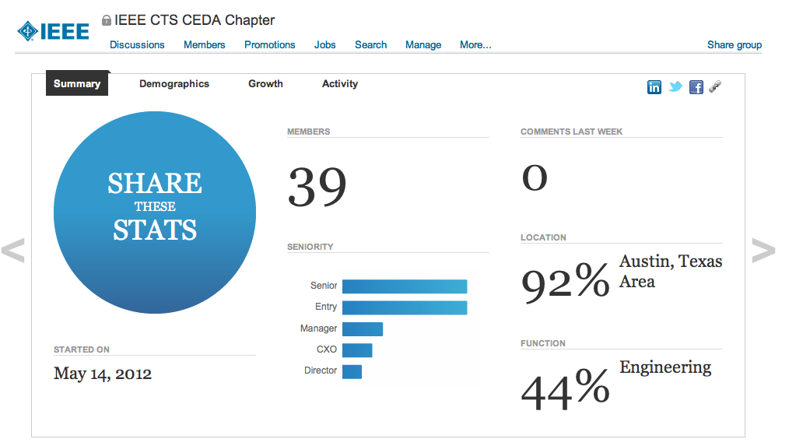
Linked In Group
Good for networking, jobs, news, …. Minimize CEDA email list traffic

Slide 4
POWERTM Processor Design And Methodology Directions
Joshua Friedric, IBM
Abstract: Processor designs and the EDA tools that support them stand at a key inflection point. The era of Dennard scaling and exponential single thread performance growth is a distant memory. Multi-thread performance continues to grow. However, the gain from simply adding more cores to a die by stepping to the next process node is diminishing due to technology challenges, application bottlenecks, and power/packaging constraints. To continue to deliver the cost-performance gains that drive our industry, designers will need to bring significant innovation to bear by integrating heterogeneous system components and accelerating key portions of the software stack in hardware. This transformation from technology-driven design to innovation-driven design defines new priorities for EDA development compared to prior eras. While timing optimization, power reduction, and support for modular designs remain necessary, differentiation will be achieved by enabling designer productivity through technology simplification, design abstraction, and robust support for heterogeneous IP.
Biography: Joshua Friedrich is a Senior Technical Staff Member and Senior Manager of POWERTM Technology Development in IBM’s Server and Technology Group. In his role, Josh leads the physical design, technology direction, and methodology of IBM’s future POWERTM processors. Josh has been part of the POWER development team since POWER4TM, and on past POWERTM designs, Josh has led multiple design disciplines including power estimation and reduction, hardware characterization, memory subsystem circuit development, and core execution units. Before joining IBM, Josh received his Bachelor of Science in Electrical Engineering from the University of Texas at Austin.

Slide 5
Overview of Accellera Systems Initiative and IEEE Design Technology Committee
Bill Read, Freescale
Abstract: Accellera Systems Initiative (ASI) – Overview of ASI, current activities/standards and future directions. IEEE Design Technology Committee (DTC) - Overview of the DTC and current activities.
Biography: Over 30 years experience in research and development of EDA tools, methodologies, flows and standards. Currently, a Distinguished Member of Technical Staff in the Design Technology organization within Freescale Semiconductor, Vice Chair of the SRC CAD & Test science area coordinating committee, Chair of the IEEE Design Technology Committee and on the Board of Directors of Accellera Systems Initiative. Previously worked in CAD departments at AT&T Bell Laboratories and MCC. Received a PhD in Electrical Engineering from the University of Texas at Austin.

Slide 6
DAC 2013
50th DAC will be in Austin, 2013. Go to www.dac.com and sign up for DAC Austin 2013 email list.
Please pick up a flier before you leave the building today!
Go to facebook, like DAC, post some pictures and share your thoughts. Follow on twitter.
Let us know if there any EDA/Embedded System related events in town.
Submit regular papers, special session / tutorial proposals, user track papers. User track submission may just need few slides of your work.

