Slide 1
Mobile Devices
A brief history, Smart Phones, Tablets, and Wearable Technology.
By: Michael Glaberman

Slide 2
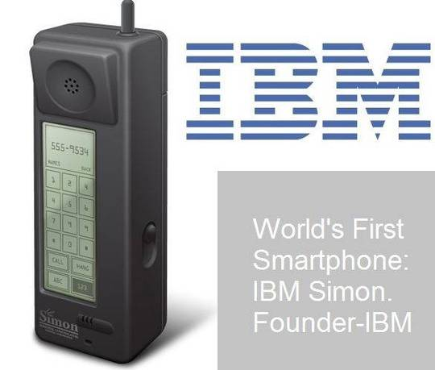
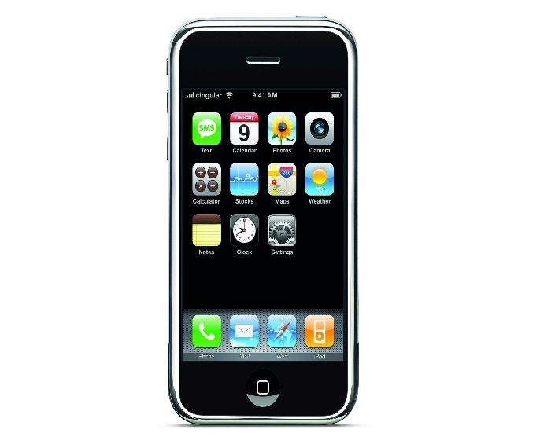
A Look Back in the United States
1946 Bell Labs deploys Service System
1949 AT&T commercializes MTS to 5,000 customers
1965 AT&T introduces IMTS to 40,000 customers
Mid 1960’s RCC introduced by competing carriers to respond to IMTS.
1973 The first truly Mobile Device is produced by Motorola.
1984 Motorola DynaTAC becomes he first Commercially Available Mobile Phone
1993 Simon is the First Smart Phone produced by IBM
2007 Apple iPhone launched with Apple iOS

Slide 4
Meanwhile Across the Pond
1924 Wireless telephone service was offered to first class travelers on train services between Berlin and Hamburg.
1957 Prototypes of hand held mobile devices were made in USSR, but were never made publicly available.
1959 UK launches Post Office Radiophone Service in Manchester allowing users to make calls from their vehicles to any provider through an operator.
1965 UK expands these services to London.

Slide 5
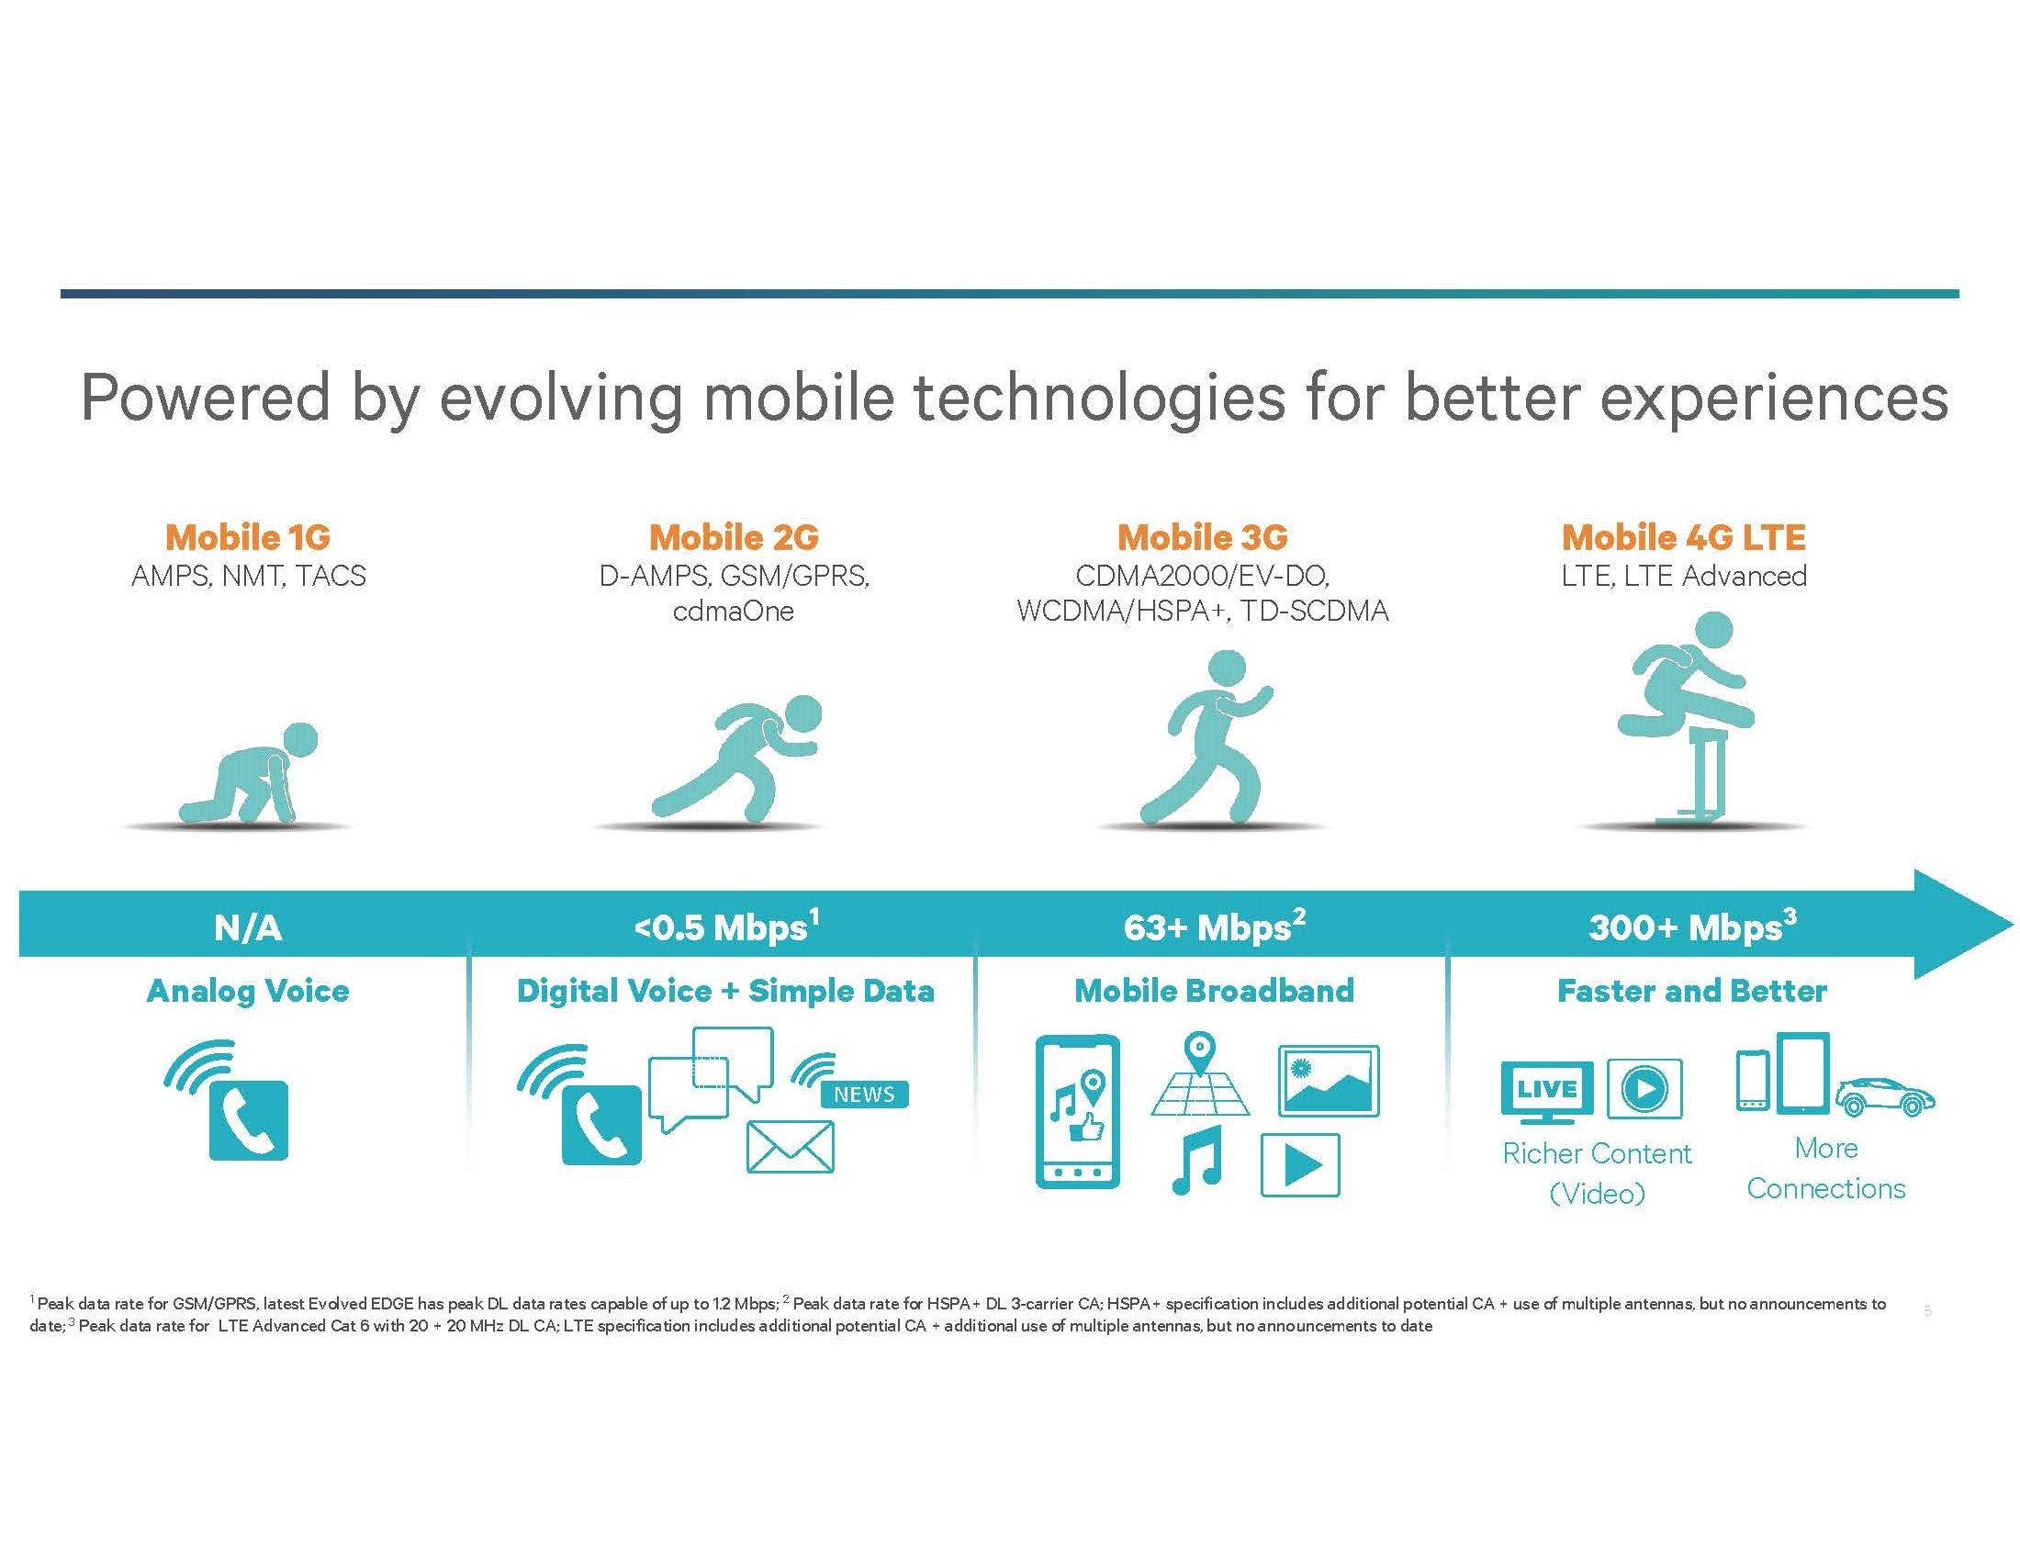
Evolution of Mobile Networks

Slide 6
Mobile OS
Android
78% Market Share
Leading Mobile OS Since Q3 2010
iOS
18.3% Market Share
2nd Leading Mobile OS Since Q4 2011
Windows OS
Blackberry OS
Symbian

Slide 7
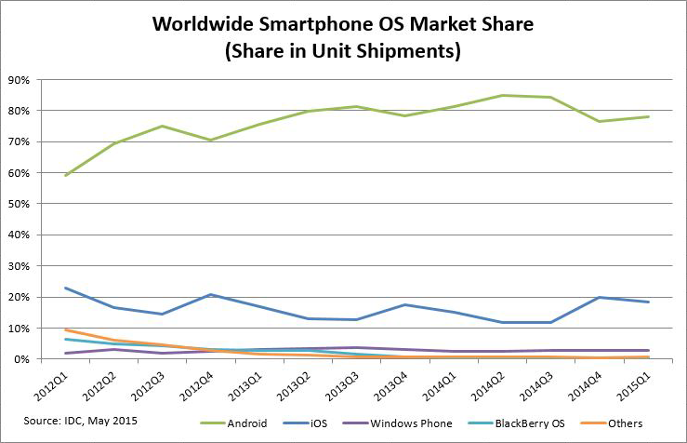
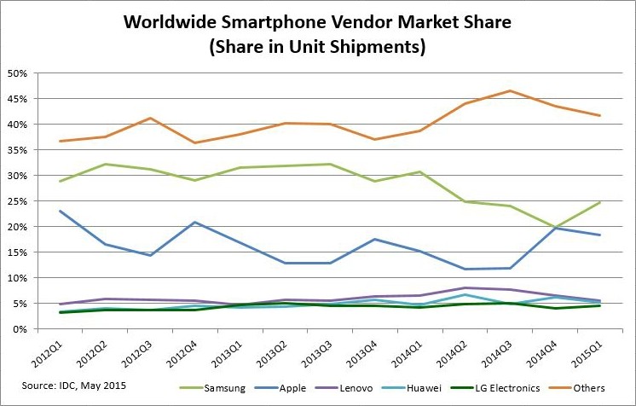
Samsung: 24.6%
Apple: 18.3%
Lenovo (Motorola): 5.6%
Huawei: 5.2%
LG Electronics: 4.6%
Others: 41.7%
Android OS: 78%
iOS: 18.3%
Windows OS: 2.7%
Blackberry OS: 0.3%
Others: 0.7%

Slide 8
Smart Phones
Smart Phones are any Mobile Phones that have added and functional features. These features can include but are not limited to PDA capabilities, Media Players, GPS Navigation, Internet Access, Email, Photo and Video Capture, Applications, Games, etc.

Slide 9
Are Smart Phones For Me?
What to look for in a Smart Phone:
What can this Smart Phone do?
Brand
OS
Size
Power
Storage
Carrier
Plans and Rates
Cost
Make Phone Calls
SMS and MMS Messaging
Send/Receive Emails
Store, Link, and Share Calendars
Play Music, Videos, Media Content
Take Photos and Videos
Store Documents and other Files
Run Applications
Host Games
Limitless Possibilities

Slide 10
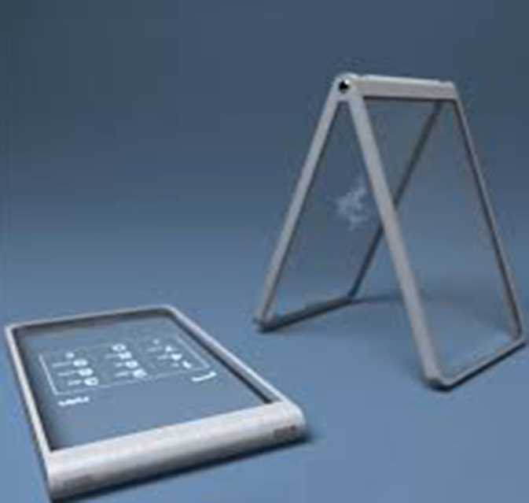
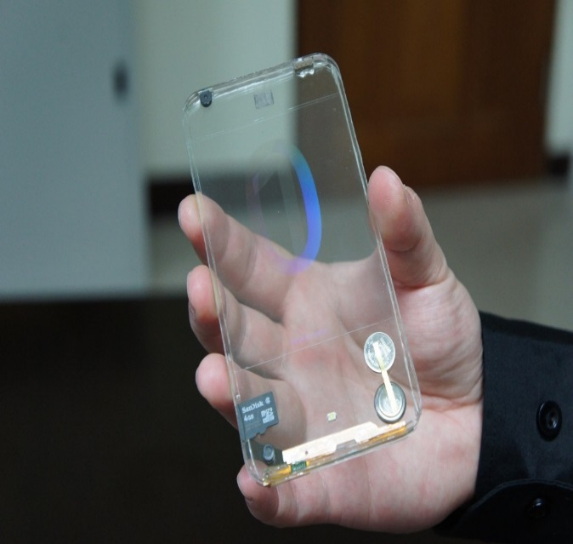
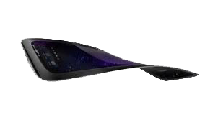
What is Next?
Transparent Cell Phones
Can a phone be made flexible?
DIY repairs and modifications
Intelligent OS
Faster more powerful components
Security Features
Transition to Wearable Smart
Technology
Human Integration?

Slide 11
Tablets
A tablet is: “A general-purpose computer contained in a touchscreen panel.” – PC Mag
Thank you PC Mag for a very detailed description!
The Truth
Tablets have evolved into portable super computers. These mobile devices are capable of powerful computing, along with access to cellular technology.

Slide 12
Is a Tablet Worth It?
Specifications and Components
Purpose and Use
Full and Mobile OS Capabilities
Regular or Mobile CPU
Interchangeable RAM
SSD Storage
Additional Storage Options
USB 2.0/3.0, SD Card
HD Video/Audio Output
Cellular and Bluetooth Technologies
Powerful Computing
Development
Personal Computing
Business Needs
Software and Applications
Expansion Capabilities
Cellular Capability
Consider Cost vs. Need

Slide 13
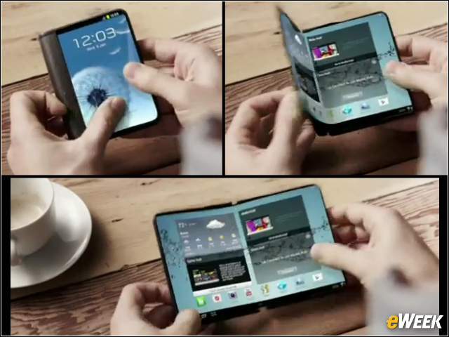
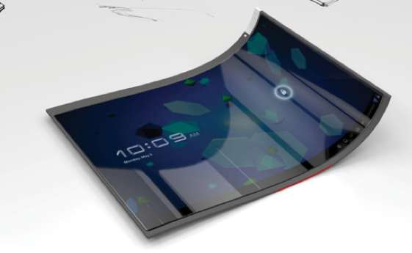
Are Tablets The Future?
Flexibility and Portability are on the horizon

Slide 14
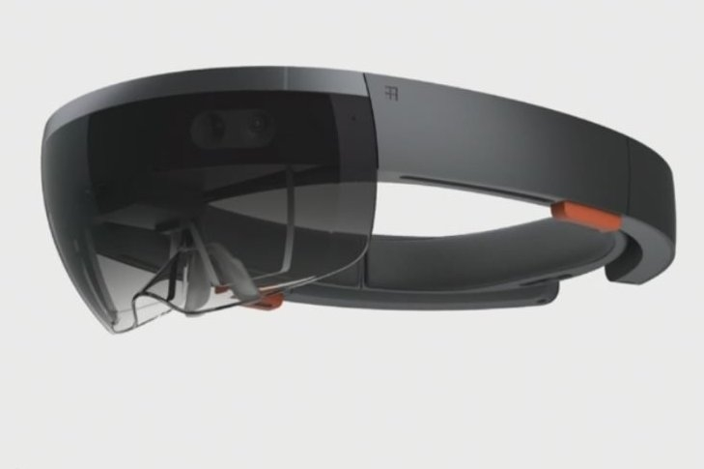
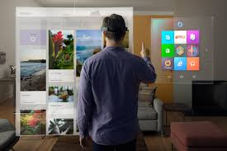
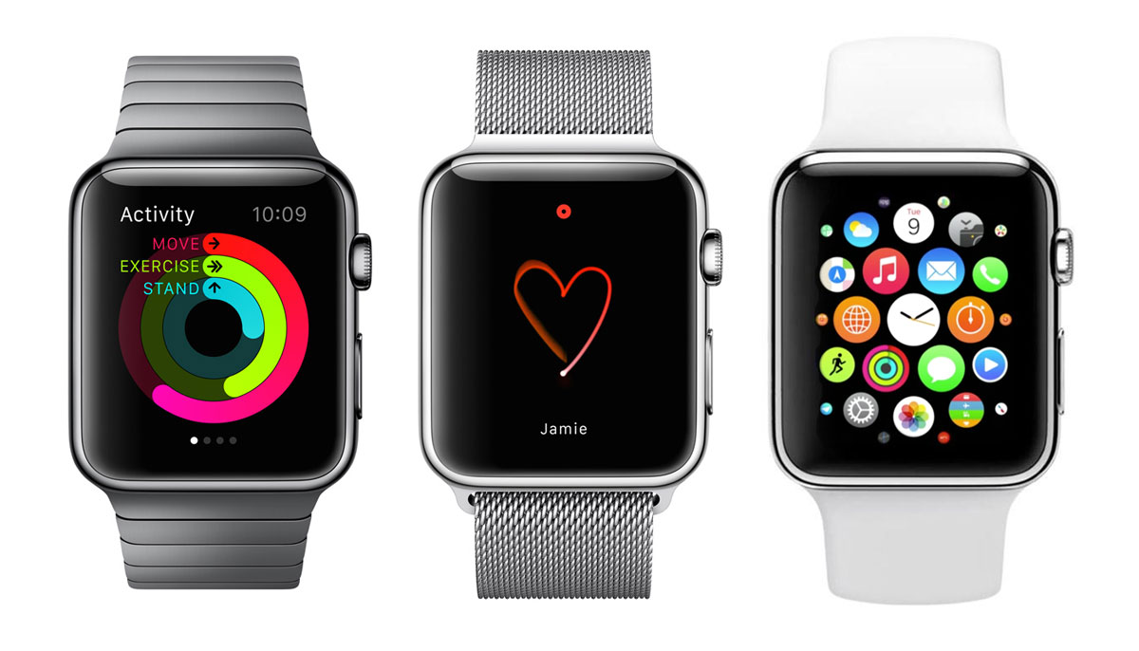
Wearable Technologies
Wearable Technologies are devices that can be worn by and often include tracking information related to health and fitness. Some devices even have small motion sensors to take photos and sync with your mobile devices.

Slide 15
Is Wearable Technology Ready?
What is Available?
Is this new technology worth it?
Fitness and Health Tracking
GPS Tracking and Navigation
Organization and Accessibility
Mobile Applications
Music and Media
Virtual Computing
Oh yeah, It can tell you the time!
Synchronize Multiple Devices
Ease of Access to Information
Fashionable
User Experience
Cost

Slide 16
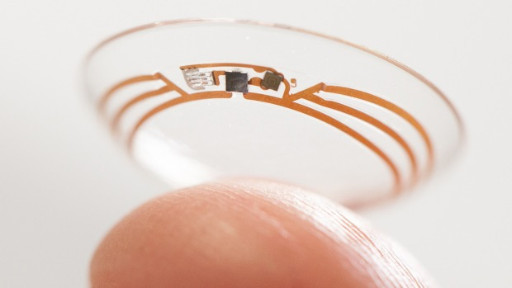
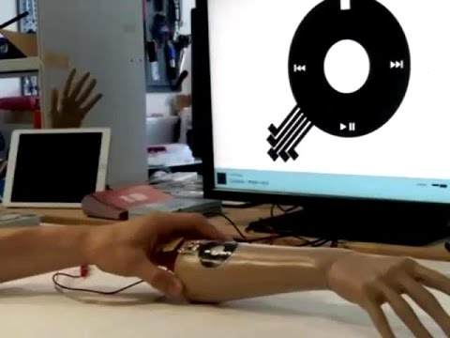
More than a watch and a pair of glasses?
Future Advancements
Training and Field Uses
Future Security Enhancements and Concerns
Endless Power
Social Media and Personal Connection
Privacy
Human Integration

Slide 17
Practical Uses and Applications
Mobile Phones
Wearable Technologies
Tablets
Phone Calls
SMS and MMS
Email and Calendar
Picture/Video/Audio Capture
Music
Web Browsing
Media Streaming
Navigation
Applications and Games
Mobile Office
Phone Calls
SMS and MMS
Email and Calendar
Picture/Video/Audio Capture
Music
Web Browsing
Media Streaming
Navigation
Applications and games
Mobile Features on a Full OS
Powerful Computer Capabilities
Phone Calls
Date and Time
Synchronization
SMS and MMS
Email and Calendar
Picture/Video/Audio Capture
Music
Web Browsing
Navigation
Light Applications

Slide 18
References
http://www.corp.att.com/attlabs/reputation/timeline/46mobile.html
http://www.privateline.com/archive/TelenorPage_022-034.pdf
Peterson, A C, Jr. Vehicle Radiotelephony Becomes a Bell System Practice. Bell Laboratories Record, 137, April, 1947
Honan, Daniel (23 Aug 2011). "How the Cell Phone Became Smart". Big Think. Retrieved 8 Sep 2011
"Nauka i zhizn" magazine, 8, 1965.
http://www.idc.com/prodserv/smartphone-market-share.jsp
http://www.smithsonianmag.com/smithsonian-institution/the-future-is-here-whats-next-for-mobile-phones-180951479/?no-ist
http://www.pcworld.com/article/2888532/idc-android-ios-again-dominate-smartphone-os-market.html
http://sourcedigit.com/1913-smartphone-os-global-market-share-data-2014/
https://www.apple.com/pr/library/2007/01/09Apple-Reinvents-the-Phone-with-iPhone.html
http://cicret.com/wordpress/
http://www.dailymail.co.uk/sciencetech/article-2693326/Googles-smart-contact-lenses-coming-eye-near-soon-Lenses-diabetics-farsighted-set-production.html
http://www.ibtimes.co.uk/wearable-iskin-silicone-controls-your-smartphone-tap-your-arm-1514961

Slide 19
Questions
Comments
Concerns

