Slide 1
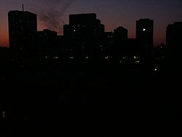
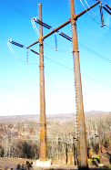
Why did my lights go out?
Dr. George Gela, BETC
June 22, 2017
BETC

Slide 2
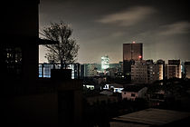
Outline
BETC
What is a “power outage”?
Planned (scheduled)? Unplanned (unscheduled)?
Large or small? Long or short?
Outages worldwide
Why do they happen?
How can outages be avoided, managed?
Reliability indices
Cost of outage
Long-term effects
Information from local utility

Slide 3
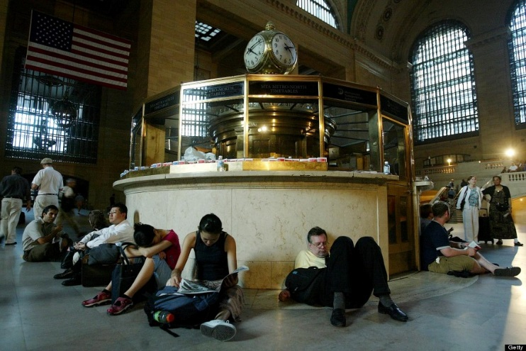
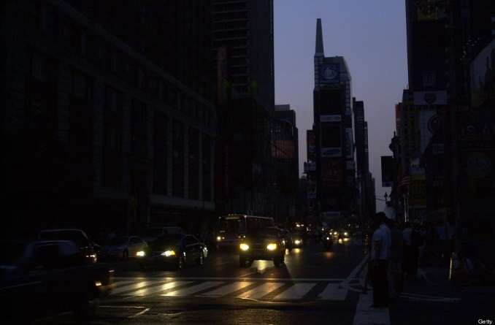
What is a “power outage”?
BETC
Definition: “Outage” … describes the state of a component when it is not available to perform its intended function due to some event directly associated with that component. An outage may or may not cause an interruption of service to consumers depending on system configuration.
New Yorkers sleep and wait for their train August 15, 2003 at Grand Central Station in New York, New York.
Duration: 7 to 50 hours, some areas about a week.
http://www.huffingtonpost.com/2013/08/14/2003-northeast-blackout_n_3751171.html

Slide 4
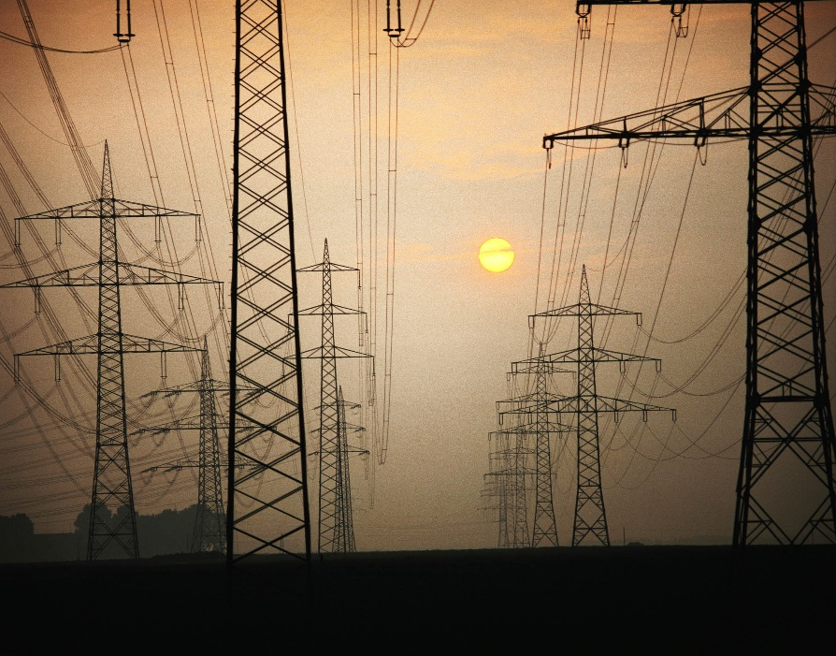
Planned (scheduled) Unplanned (unscheduled)
BETC
Scheduled outage usually does not cause an interruption of service to consumers.
Service to customers can be diverted through alternate routes (lines).
This is one reason that lines, generators, transformers, other equipment are usually NOT loaded to their maximum capacity.

Slide 5
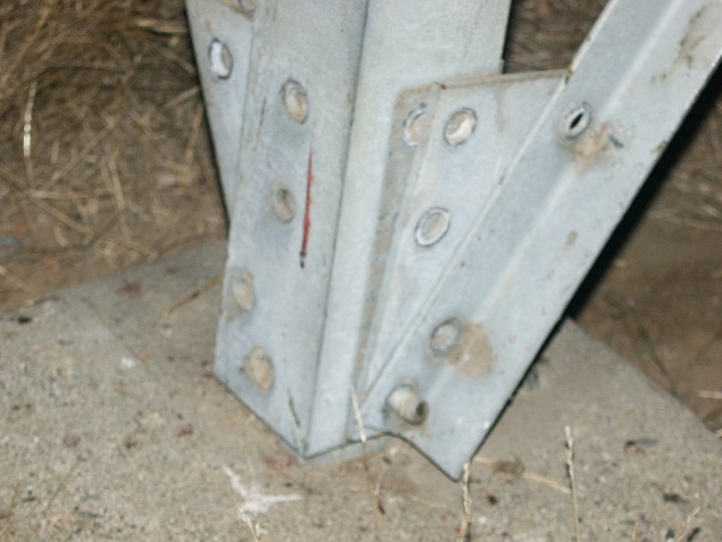
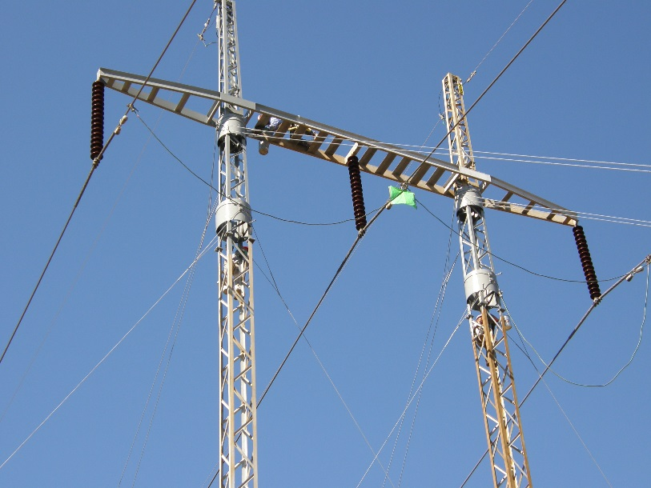
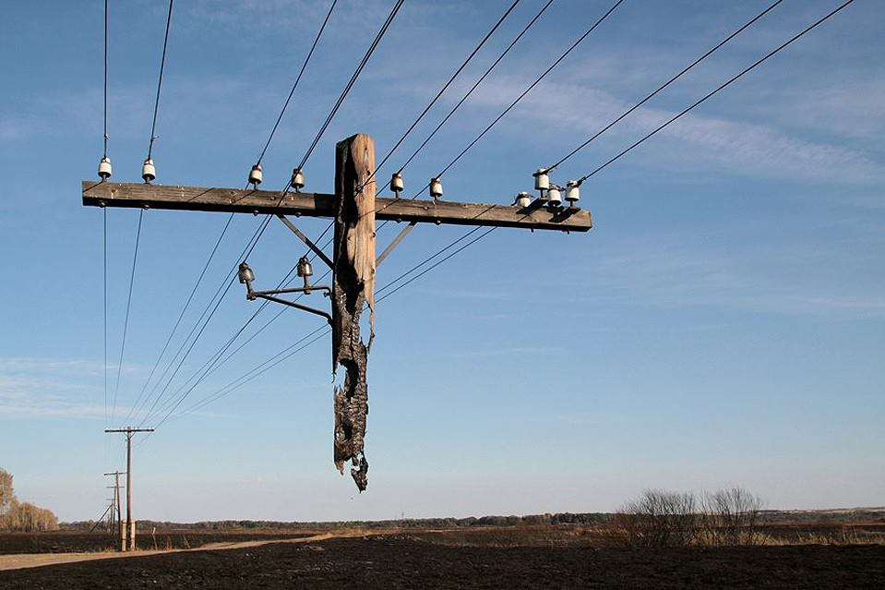
Planned (scheduled) Unplanned (unscheduled)
BETC
Examples:
Scheduled maintenance:
Probably NO interruption of service
Scheduled outage of this line, but power rerouted via other lines
Scheduled outage

Slide 6
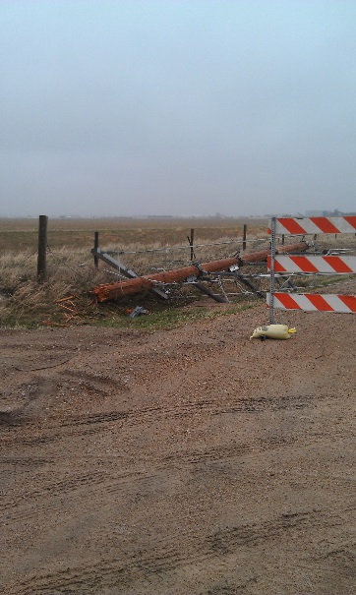
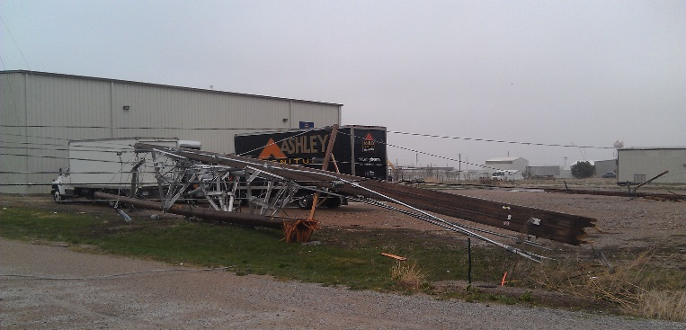
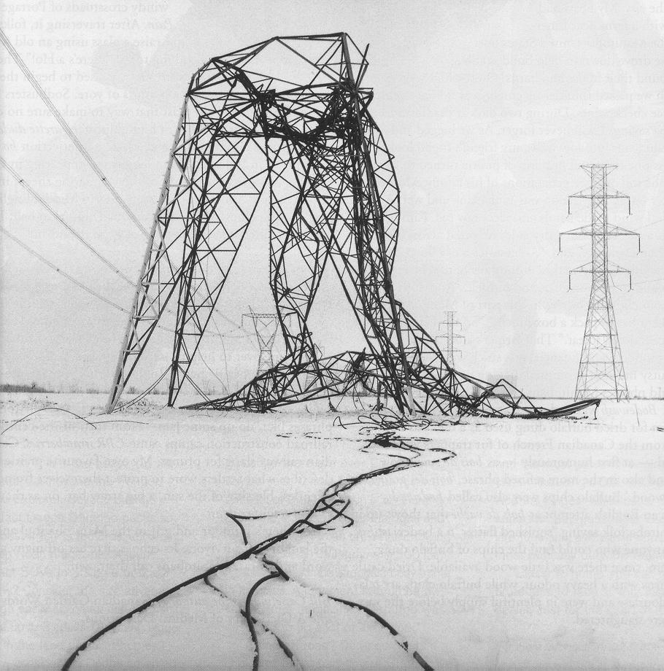
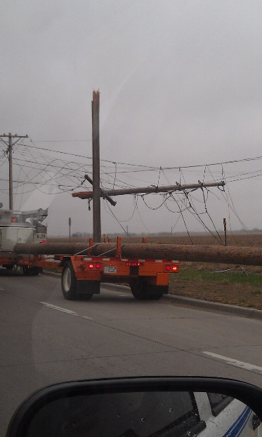
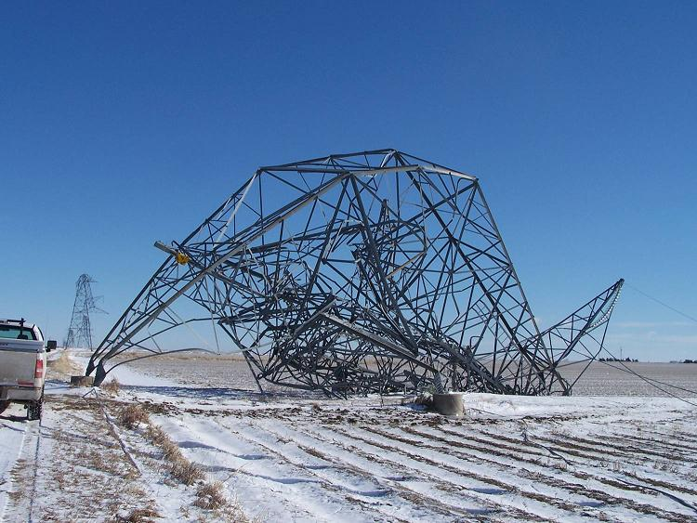
Planned (scheduled) Unplanned (unscheduled)
BETC
Examples:
Significant damage to component(s)

Slide 7
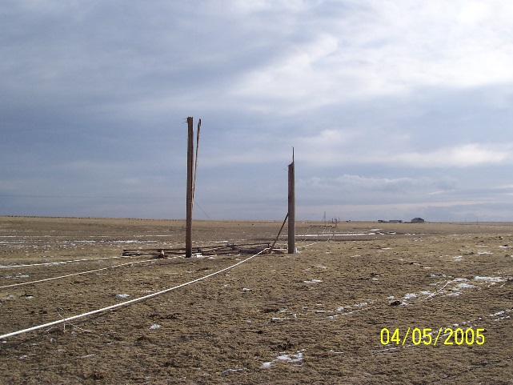
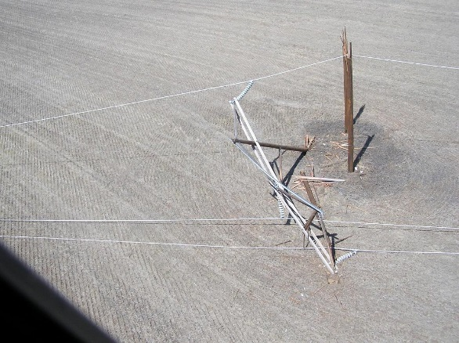
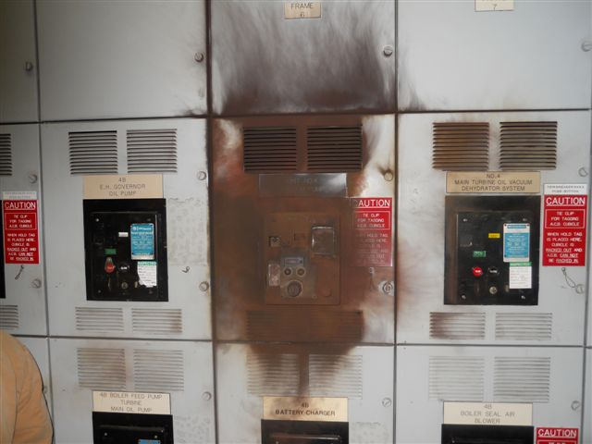
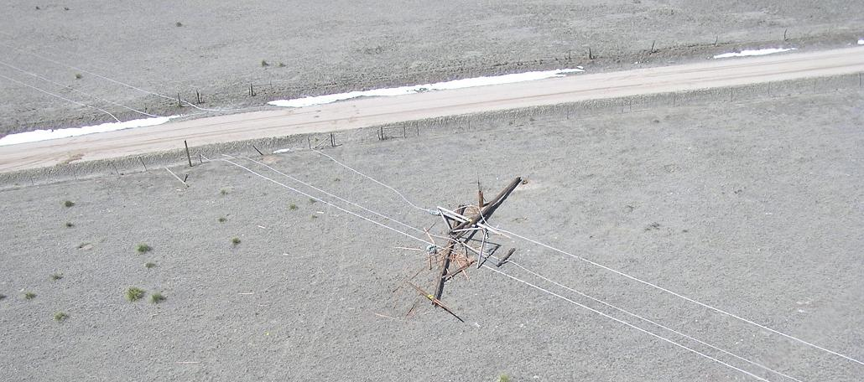
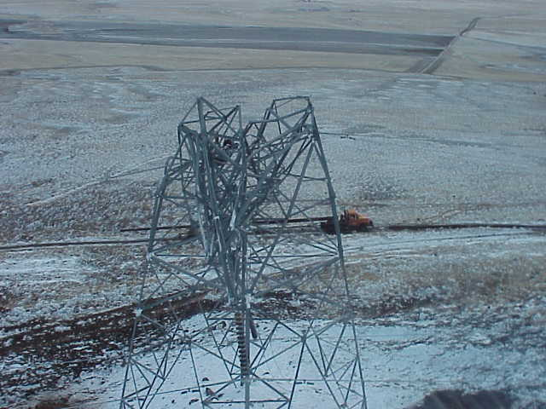
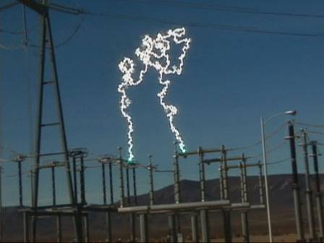
Planned (scheduled) Unplanned (unscheduled)
BETC
Examples:
Significant damage to component(s)

Slide 8
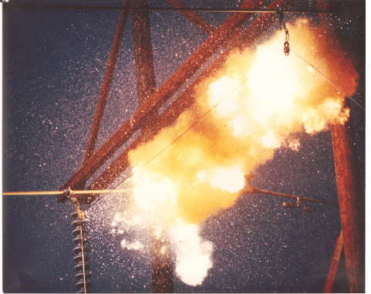
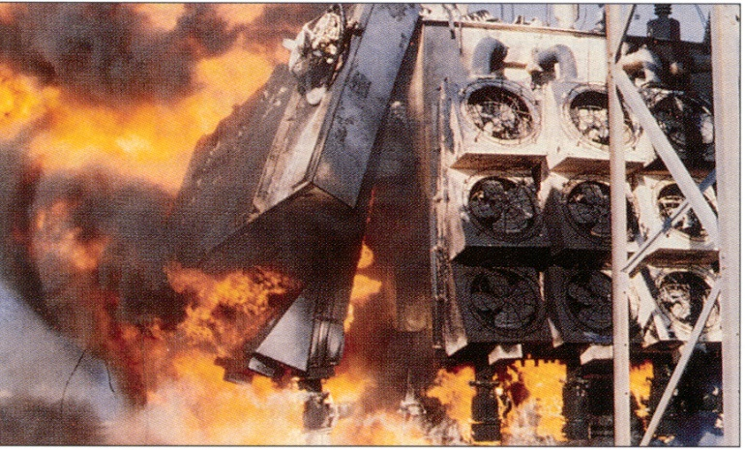
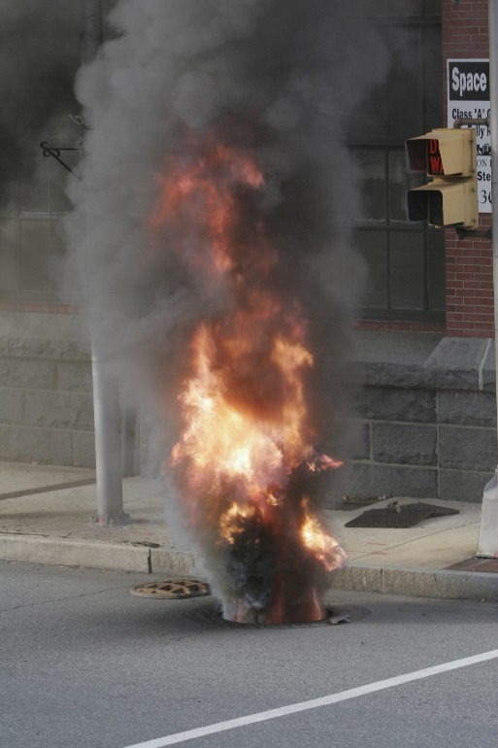
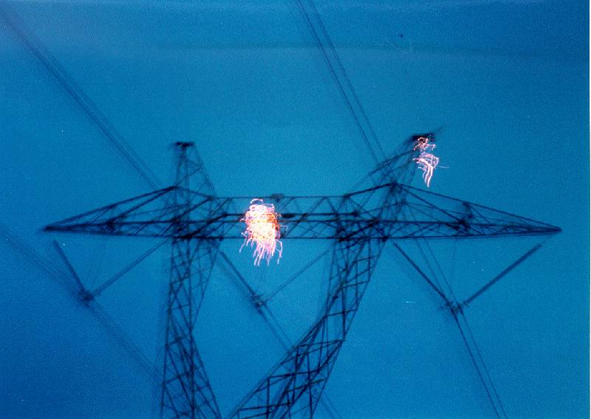
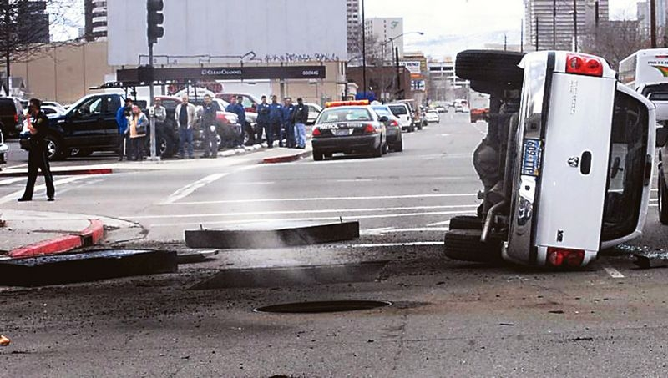
Planned (scheduled) Unplanned (unscheduled)
BETC
Examples: Significant damage to component(s)

Slide 9
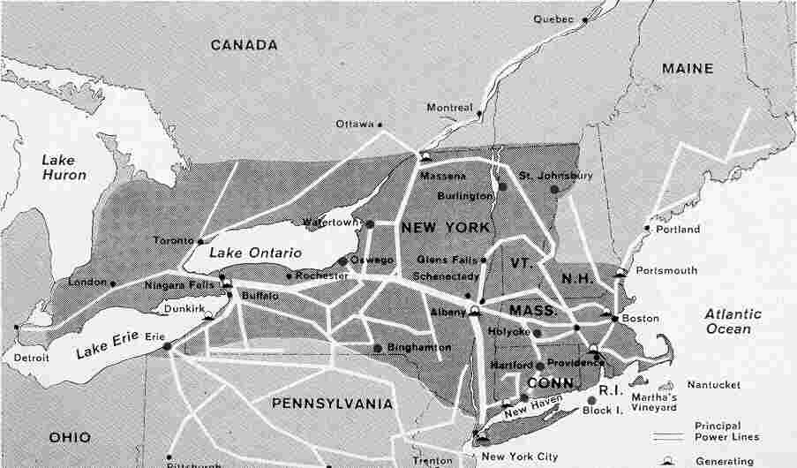
Large or small? Long or short?
BETC
1965:
Ontario in Canada; Connecticut, Massachusetts, New Hampshire, New Jersey, New York, Rhode Island, Pennsylvania, and Vermont in USA.
Over 30 million people and 80,000 square miles (207,000 km²) were left without electricity for up to 13 hours. (https://en.wikipedia.org/wiki/Northeast_blackout_of_1965 )

Slide 10
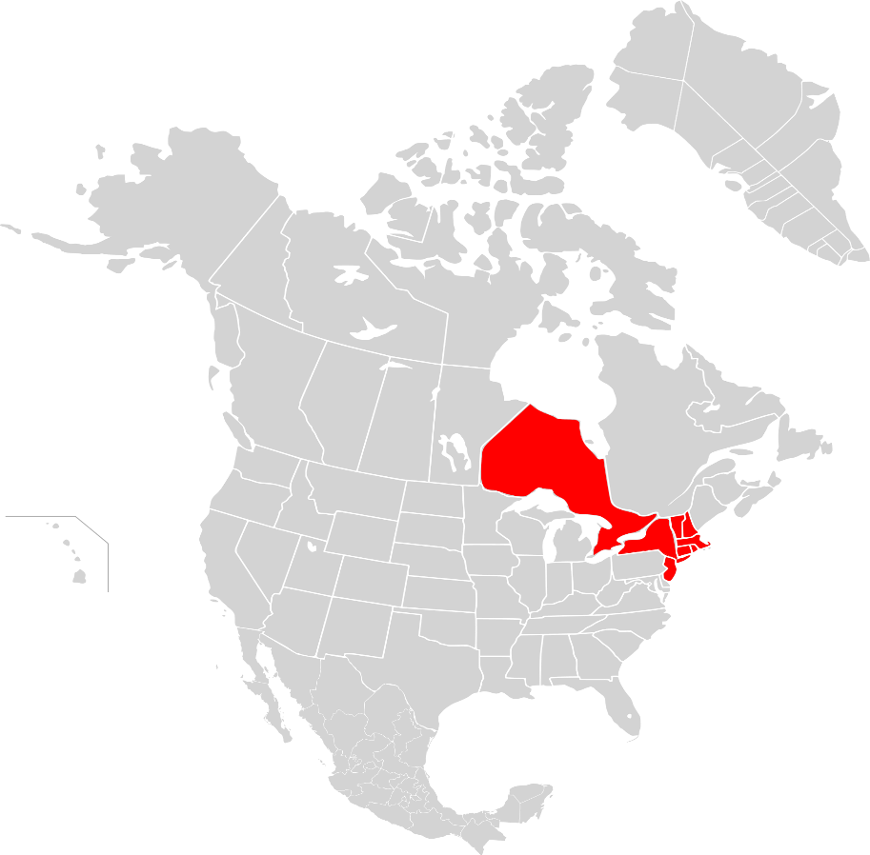
Large or small? Long or short?
BETC
2003:
7 to 50 hours
More widespread that the 1965 event
Affected some 10 million in Canada and 45 million in eight states in the USA

Slide 11
Major outages worldwide
BETC
Location | Date | People affected (millions)
USA (Northeast), Canada | 9 November 1965 | 30
Thailand | 18 March 1978 | 40
Quebec, Canada | 7 January 1998 | 2.2
Brazil (Southern) | 11 March 1999 | 97
India | J2 January 2001 | 230
USA (Northeast), Canada | 14 – 15 August 2003 | 55
Indonesia (Java-Bali) | 18 August 2005 | 100
Italy, Switzerland | 28 September 2003 | 55
Brazil, Paraguay | 10 – 11 November 2009 | 87
India | 30 – 31 July 2012 | 620
Bangladesh | 1 November 2014 | 150
Pakistan | 26 January 2015 | 140
Turkey | 31 March 2015 | 70
Sri Lanka | 13 March 2016 | 21
Kenya | 7 June 2016 | 44

Slide 12
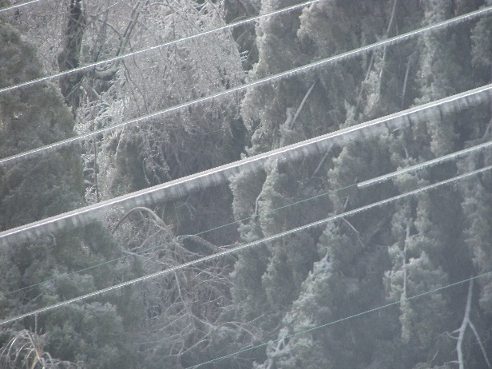
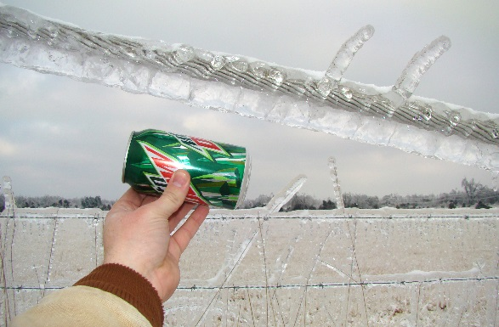
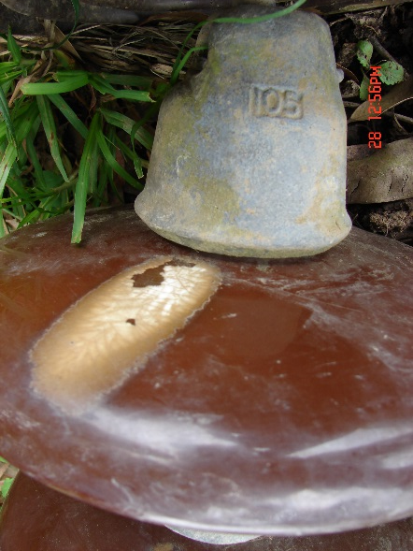
Why do outages happen?
BETC
Many varied reasons:
Weather (snow, ice, rain storms, wind, lightning)
Insulator contamination
Equipment failure
Human error
Vegetation
Wildlife Geomagnetic storms
Vandalism
Overloading, overheating
Traffic accidents
Systems operation, switching, resonance
Aging
Other?

Slide 13
Why do outages happen?
BETC

Slide 14
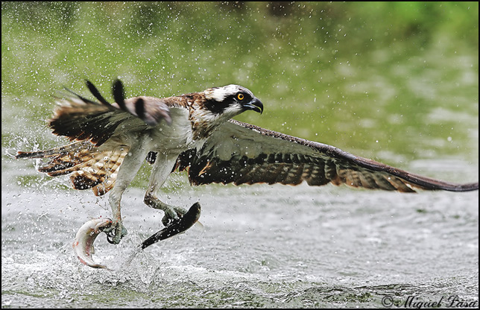
Why do outages happen?
SEATTLE –Utility officials say a falling fish knocked out power to nearly 200 customers in Seattle.
The Seattle Times reports that a Seattle City Light crew investigating the power outage Wednesday afternoon found an electrocuted fish on the ground below the power lines. They figured that one of the eagles or ospreys that routinely hunt in the nearby Duwamish River must have dropped it.
Power was out for about two and a half hours.
City Light says birds often cause power outages - 162 of them in the city last year, including two by bald eagles. Raccoons are another common culprit. But spokeswoman Connie McDougall says this is the first time she’s heard of a fish knocking out power.
McDougall says the workers who found the fish think it was a salmon, but she notes that “they’re not fish biologists.”

Slide 15
Why do outages happen?
BETC

Slide 16
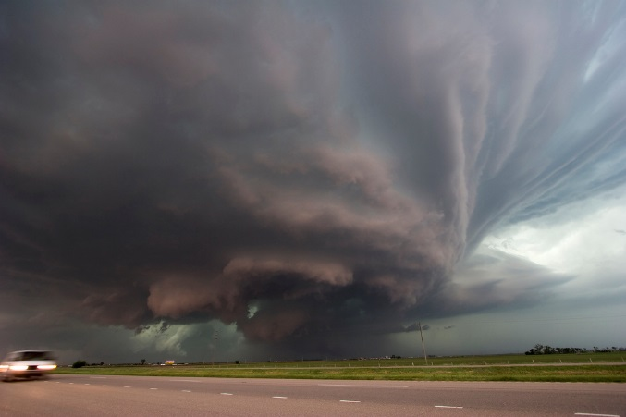
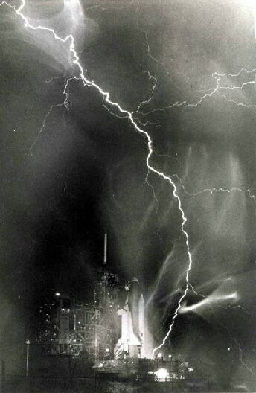
Why do outages happen?
BETC

Slide 17
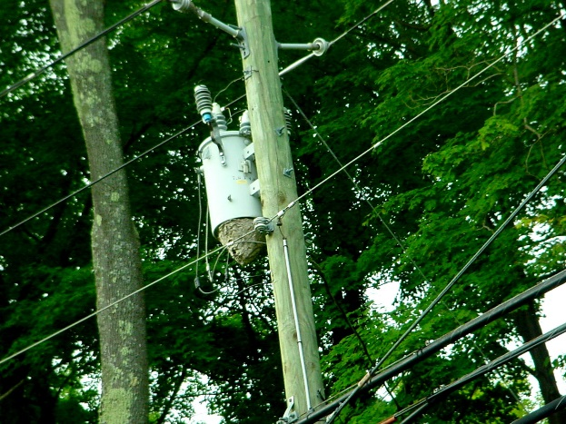
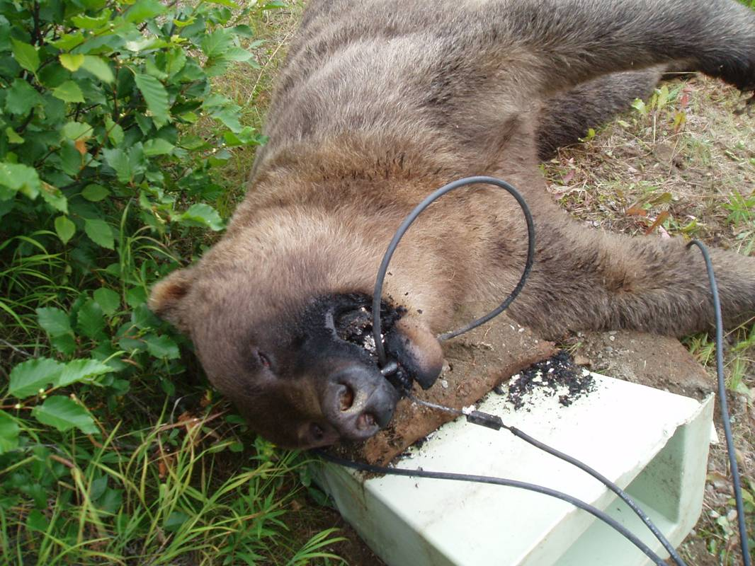
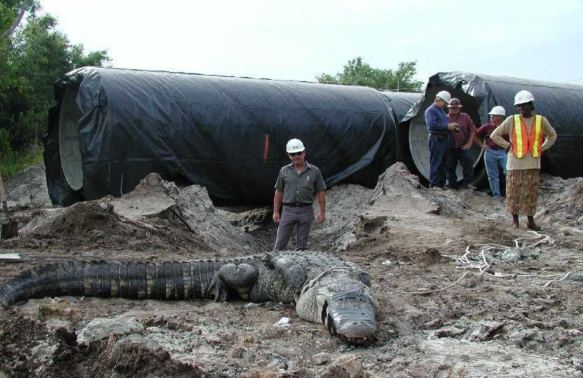
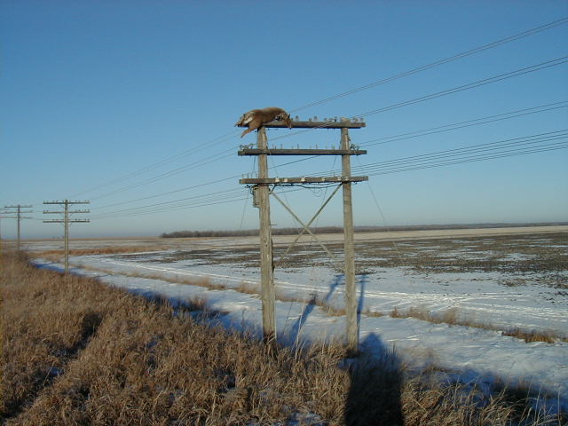
Why do outages happen?
BETC

Slide 18
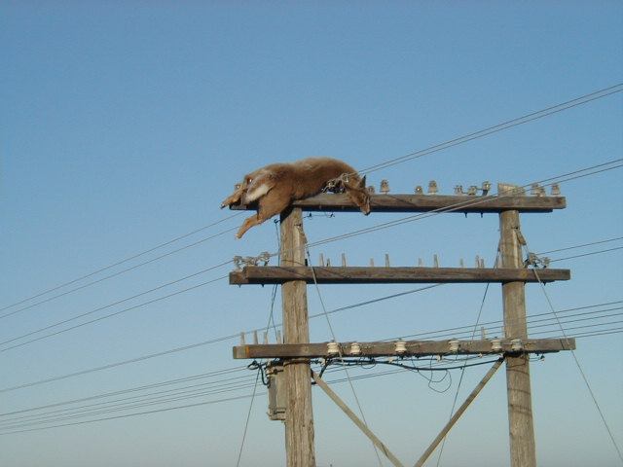
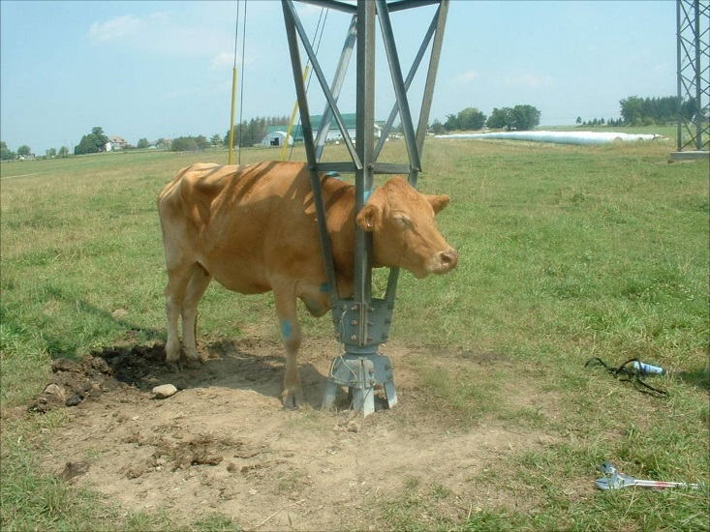
Why do outages happen?
BETC

Slide 19
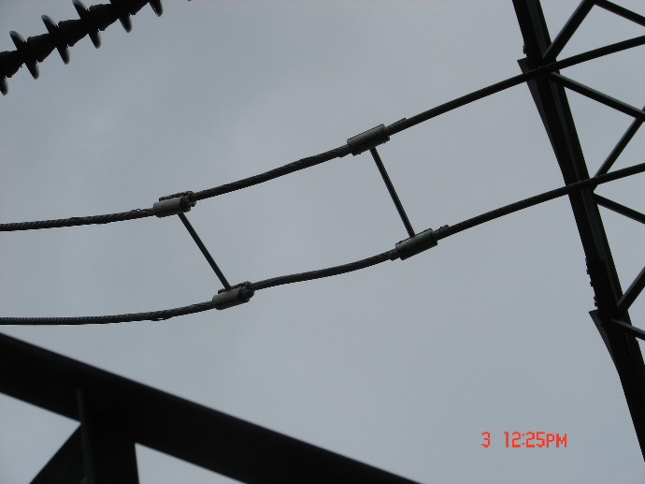
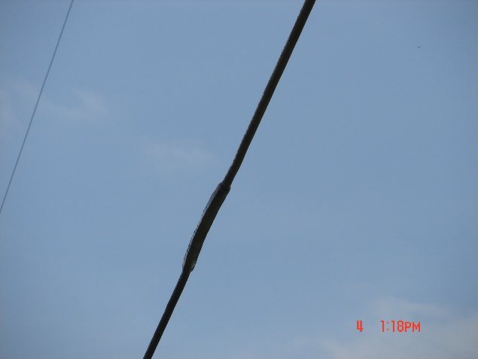
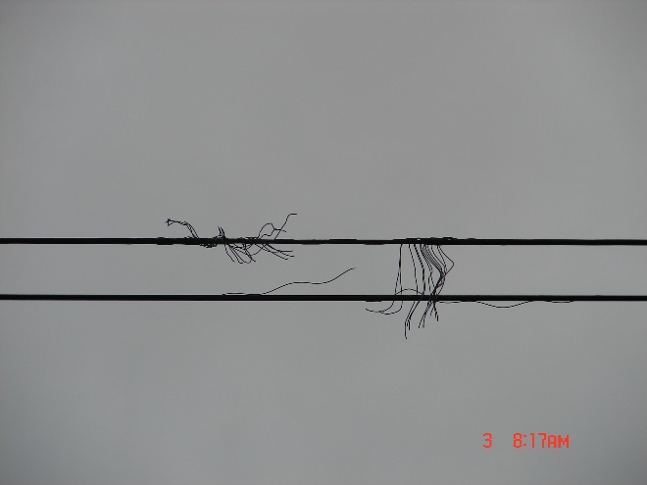
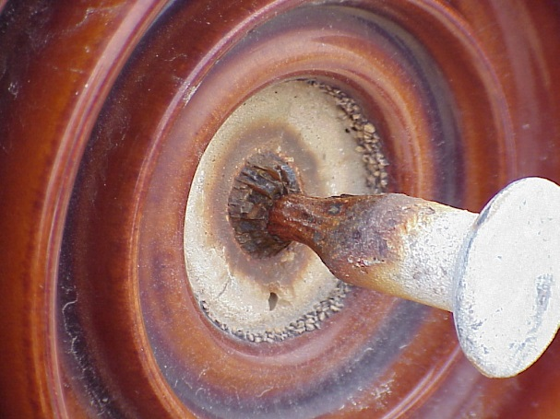
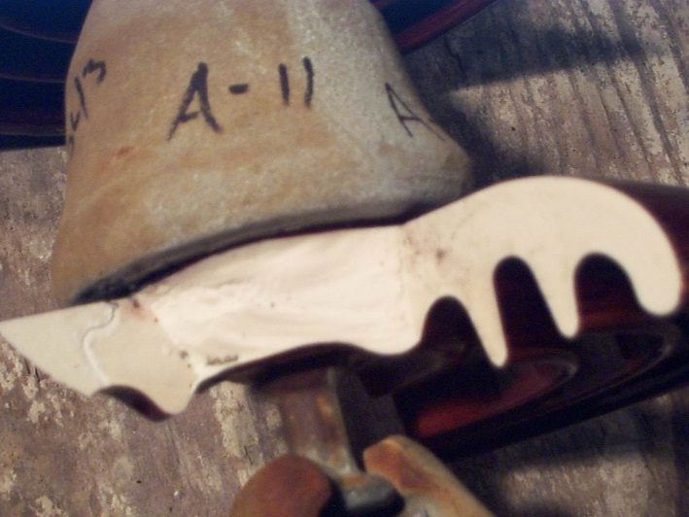
Why do outages happen?
BETC
Examples:

Slide 20
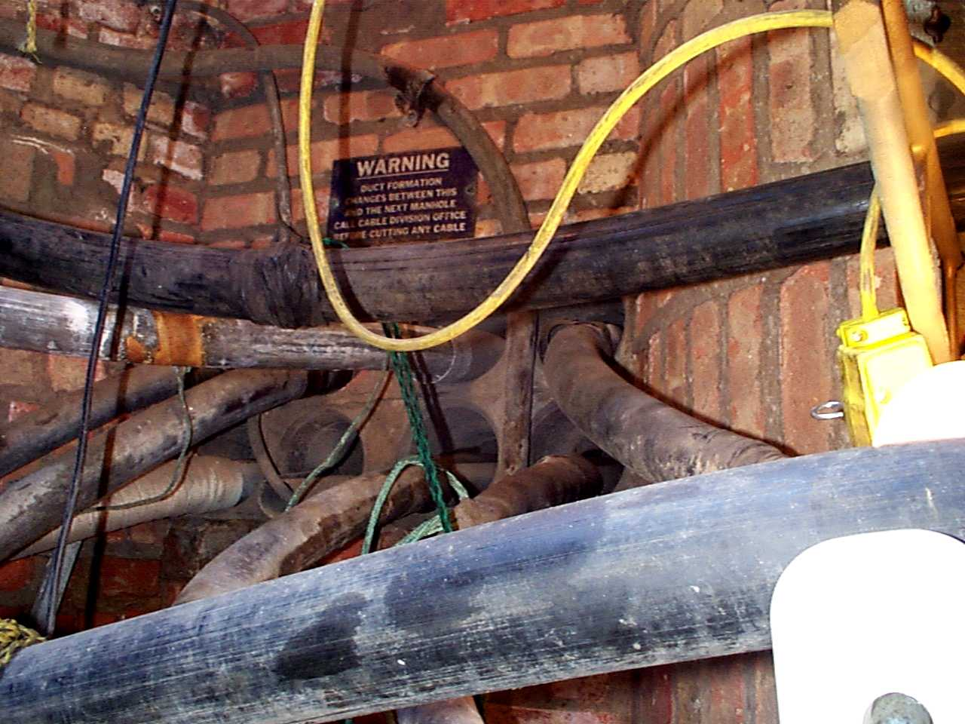
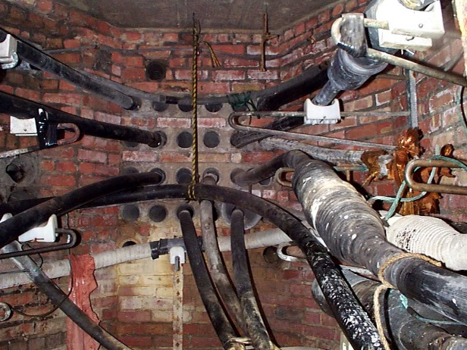
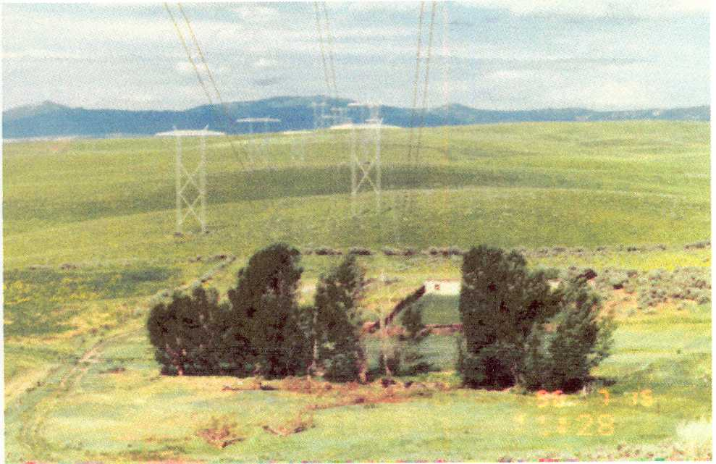
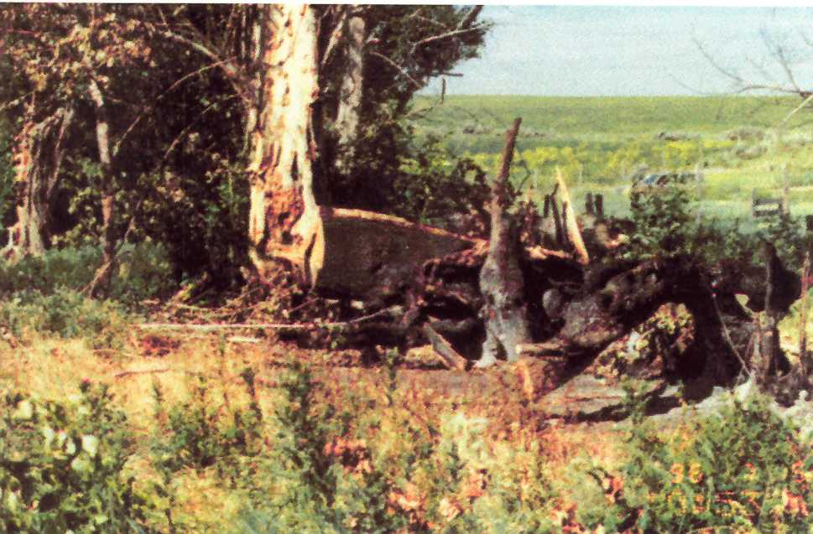
Why do outages happen?
BETC
Examples:

Slide 21
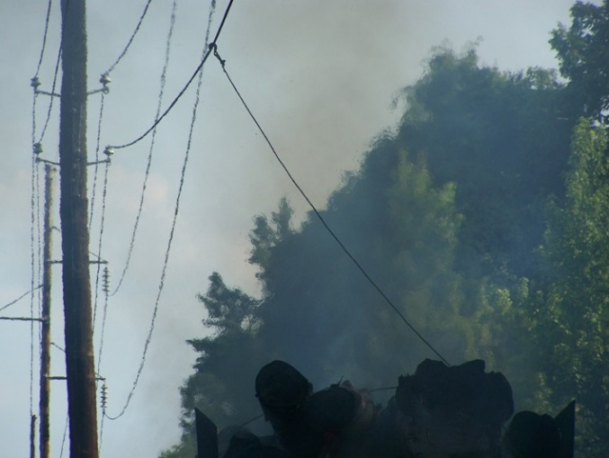
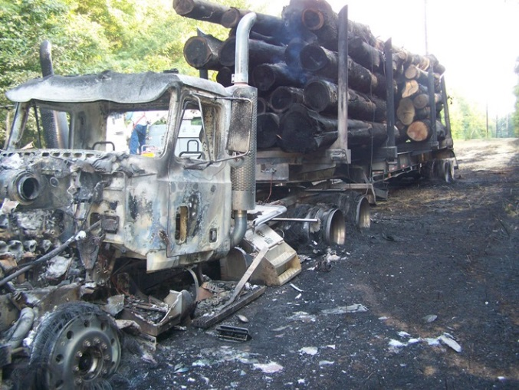
Why do outages happen?
BETC
Examples:

Slide 22
Why do outages happen?
BETC
Examples:

Slide 23
Why do outages happen?
BETC
Did UFO’s Cause the Great New York Blackout in 1965?
Maybe it was a UFO because, according to some conspiracy theorists, the big power outage in 1965 was caused by a UFO.
Here is the UFO angle and it’s relation to the Johnson White House. Never mind that it happened again in 2003 and never mind that it is acknowledged that our electric grid is antiquated and susceptible to catastrophic, large scale failure. No…it was an UFO.
Here is a summary of the whole caper. Look at these UFO reports from the late summer and fall of 1965 and analyze these UFO reports from Nov 9, 1965 yourself!
Truth or Fiction? Apparently one demonstrated part of fiction from the Great Northeast Blackout was that the birthrate in the region skyrocketed 9 months later.
https://symonsez.wordpress.com/2009/11/09/did-ufos-cause-the-great-new-york-blackout-in-1965/

Slide 24
Why do outages happen?
BETC
Outage in Lenox – Pittsfield, December 1991
Helicopter testing in Lenox – for live work
Two methods of delivery of lineman to live conductors:
Platform method
Suspension method

Slide 25
Why do outages happen?
BETC
Sparkover occurred during tests of the suspension method using the 115 kV line 1211
The 1211 line runs between two 115 kV substations
The feed to the Lenox lab taps off from about the midpoint of the line
This resulted in a low-current line-ground fault on the 115 kV line 1211
The circuit breaker at the Lenox lab operated to clear the fault, and communicated the action to terminal breakers at the ends of the line

Slide 26
Why do outages happen?
BETC
However, several years prior, communication frequency of the terminal breaker was changed
As a result, the terminal breaker(s) opened the 1211 line to clear the fault
This caused an outage in Lenox and Pittsfield that lasted a few hours.
Subsequently, the communication system was upgraded

Slide 27
How can outages be avoided, managed?
BETC
Understand your system
Analysis of failures
Inspection of assets

Slide 28
How can outages be avoided, managed?
BETC
Example: insulator flashover

Slide 29
ANALYSIS OF FAULTS BY MONTH
FOG
T-STORMS &
RAIN
FOG
CORRELATION
WITH WEATHER
DATA
Schneider 1996

Slide 30
TYPICAL PATTERN FOR POLLUTION FAILURES
FLASHOVERS
IN EARLY MORNING
HOURS
Schneider 1996

Slide 31
ADDRESSING THE REASONS FOR FAILURE ”LONG DURATION”
EMERGENCY
REPAIRS
STORMS
ACCIDENTS
TOWER COLLAPSE
STRATEGIC
PLANNING
PIN CORROSION
ROD BREAKAGE
VIBRATION DAMAGE
DEVELOP
RESTORATION
PROCEDURES
INSPECTION &
REPLACEMENT
PROGRAM
Schneider 1996

Slide 32
SAFE LIVE WORKING PRACTICES
ELIMINATE OUTAGES
DETERMINE APPROACH DISTANCES
SPECIFIC TO : STRUCTURE, BUNDLE, INSULATORS, & TOOLS
EVALUATE WITH HV TESTS
MAIN CONSIDERATION: OVERVOLTAGES
CONSIDER PROTECTIVE GAPS
INSULATION COORDINATION
Schneider 1996

Slide 33
Reliability indices (distribution)
BETC

Slide 34
Cost of outage
BETC

Slide 35
COST OF FAILURE
COULD BECOME
AVOIDED COST
EXAMPLE:
LARGE CHEMICAL PLANT
Schneider 1996

Slide 36
Long-term effects
BETC
Loss of revenue
Degradation of power quality
Customer complaints
Disruption to industrial processes, public safety (hospitals, police, fire departments, etc).
Need for back-up power sources

Slide 37
POSITIVE long-term effect: NERC, FERC, EPRI
BETC
“Following the (1965) blackout, measures were undertaken to try to prevent a repetition.
Reliability councils were formed to establish standards, share information, and improve coordination amongst electricity providers.
The task force that investigated the blackout found that a lack of voltage and current monitoring was a contributing factor to the blackout, and recommended improvements.
The Electric Power Research Institute helped the electric power industry develop new metering and monitoring equipment and systems, which have become the modern SCADA systems in use today.” (https://en.wikipedia.org/wiki/Northeast_blackout_of_1965 )
EPRI was formed in 1972. SCADA: Supervisory Control and data Acquisition

Slide 38
Outage information from local utility https://www.eversource.com/wmeco/outage/outagemap.aspx
BETC
In case of an emergency, life threatening situation, downed line or if you are in imminent danger please call 911.

Slide 39
Thank you!
BETC
Questions?

