Slide 1
Science of CCDs and applications in remote sensing
Justin Bell

Slide 2
Charge Coupled Devices
CCD chip is an array of Metal-Oxide-Semiconductor capacitors (MOS capacitors)
The capacitor is a potential well
Each “capacitor” represents a pixel
For color cameras typically 4 capacitors are needed for an output pixel
i.e. output resolution is lower than chip resolution for color
Chips based on valence states of various layered Silicon compounds
The various regions of the CCD are either oxide, boron, or phosphor compounds

Slide 3
Brief Historical Perspective
1887 Hertz observes UV rays creating a charge in electrodes
1890 Planck suggests quantized photons
1905 Einstein publishes paper on PE effect
1914 Millikan publishes experimental data supporting Einstein’s proposed model
1959 Bell Labs scientists begin work on MOS and MOSFET technology
1964 First commercial MOS released, many others were working on the same issues, multiple mergers and acquisitions including Fairchild, Philips, IBM, and Ford
1973 JPL funds scientific grade “large” CCDs
1974 Fairchild makes 100 x 100 chip used on an 8” telescope
Notes:
The company's changed but the central players were often the same Andrew Grove, Ed Snow, Bruce Deal and others published many early papers on the physics of MOS charging, and using FETs to create a shift register.
Willard Boyle and George Smith of Bell labs are more widely credited for the combination of MOS chips and shift registers into a CCD for which they earned a Nobel prize in 2009
74-79 NASA makes a portable ccd camera and pc to travel to various scopes, tons of new discoveries
79 RCA makes first LN cooled system, 320x512 gets put on a 1m scope

Slide 4
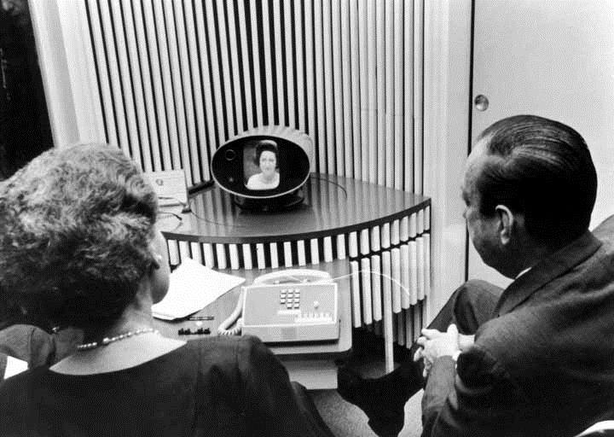
The Birth of the CCD Selfie
In 1964 Bell working with AT&T demonstrate a practical use of CCDs at the World’s Fair
The technology suffered from the limitations of manufacturing/ science at the time
Each pixel was similar to a bulb in a vintage set of holiday lights
250p at 30i fps
Sourced from [http://ethw.org]
Notes:
Screen size was about 5x5” similar to film prints at the time
250p at 30i is closer to 140p at 30 progressive fps
The picturephone required two twisted pairs of copper, two for the audio and two for the video
AT&T pulled the plug in 1973 when a new CEO was trying to beef up the bottom line

Slide 5
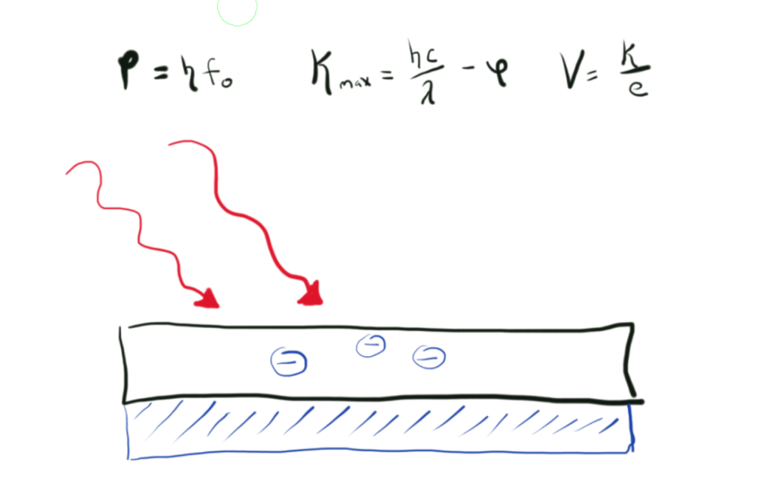
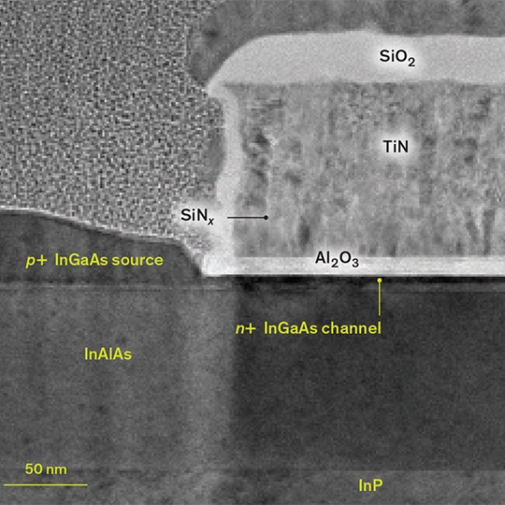
What can a CCD sensor detect?
Modern CCDs are more sensitive to high frequency light as a byproduct of the physics that allows photoelectrons to be created within the sensor material
The cutoff frequency of the photoelectric effect determines the longest wavelength a sensor can detect (around 1100 nm for modern chips)
Notes:
The p-type substrate has “holes” that can accept the free electrons.
“Doping” the silicon creates the holes. There are large pockets of “dope” near the gates
10 to the 15th holes per cm cubed
The photon and its energy are absorbed by the silicon (Si) within the CCD pixel.
This creates an electron-hole pair, which liberates a negatively charged electron and leaves behind a positive charge (i.e., positive hole).
Each photon creates an electron-hole pair.
The electrons and positive holes are then segregated within each CCD pixel – essentially stored in different areas of the pixel.
This continues as long as the CCD is collecting photons from the object that is being observed (integration)
http://spectrum.ieee.org/semiconductors/devices/the-tunneling-transistor

Slide 6
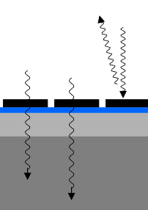
Coatings and Chip Architecture
Earliest designs had the polysilicon gates on the “front” of the chip
Reduced efficiency of the sensor
Did not allow for anti-reflective coatings
Poor response to “blues”
Later designs allowed for a thinner “P” layer and the electrodes on behind the chips n-layer
Notes:
Blue layer is silicon insulation
Light gray is N
Dark grey is P
Orange is coating , Hafnium Dioxide is an ideal anti-reflection coating though cheaper alternatives are occasionally used
Front gate designs had lower efficiency, best at reds and QE of 50%
Back gate design is best at blue-green with a wider peak topping out above 80% (some claim above 95% but this is not typical for off the shelf)
Frontside illumination has gates on the back
Backside illumination has gates on the front

Slide 7
Physics of AR Coatings
AR coatings function based on Snell’s law (and Fermat’s principle)
Some light is refracted (and transmitted) as it transitions from air to the CCD, a percentage is reflected
Using an intermediate layer with an n-value “refractive index” between the two materials reduces reflections
The reflection amount can be reduced from 1 to 2 orders of magnitude
Notes:
An AR coating is tuned to a single wavelength!
Typically 3 layers are used ordered as lowest n, highest n, then middle value.
This covers the red, blue, and green wavelengths that compose color CCDs
Reflection may be around 10% down to 2 - 0.2%
Reflection bounces off n1, hits n2 and comes back in phase for another shot at n1

Slide 8
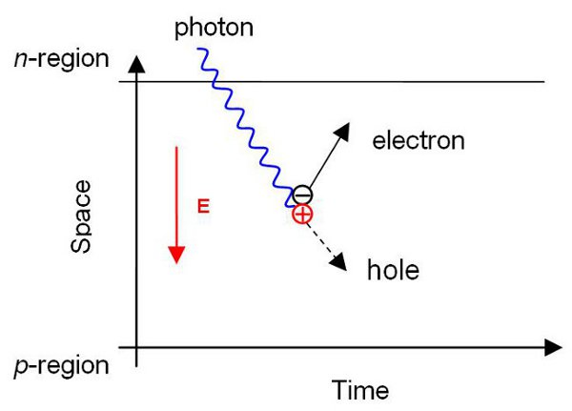
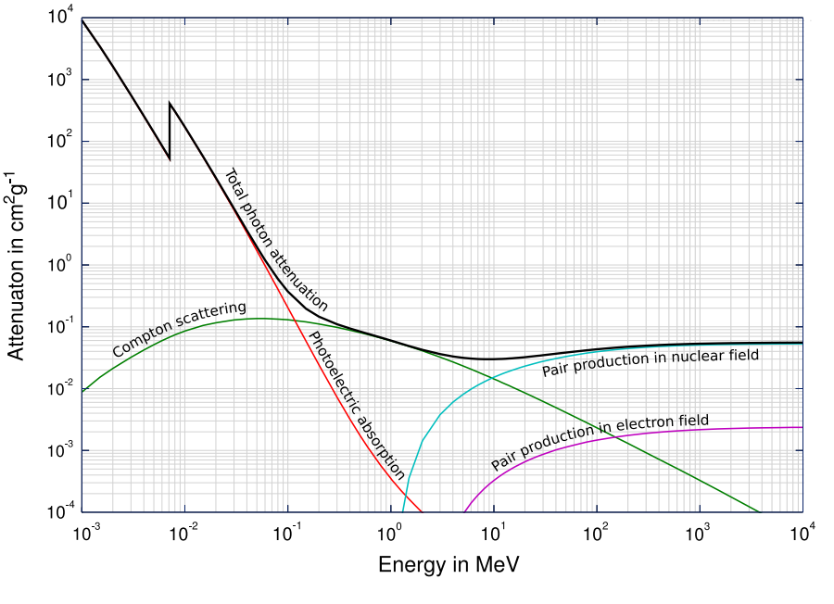
Quantum Efficiency
1.26 eV corresponds to the minimum energy of light with a wavelength to interact with Si
Beyond this point silicon becomes transparent and CCDs constructed from silicon become insensitive
The ratio of detected photons to total number of incoming photons is the quantum efficiency (wavelength dependent!)
Notes:
Human eye QE 1 at green
Film camera QE 1 a UV to near IR
PMT QE=10 almost UV to far IR
CCD = ~95% at near IR, good wide band
Doping helps shift sensitive bands of a ccd
Source: www.nuclearenergy.net

Slide 9
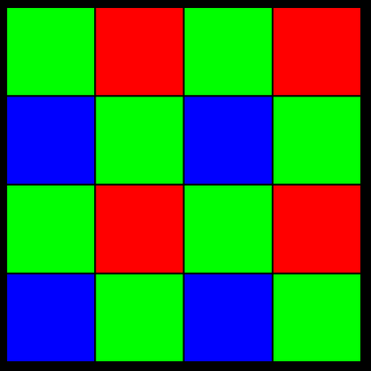
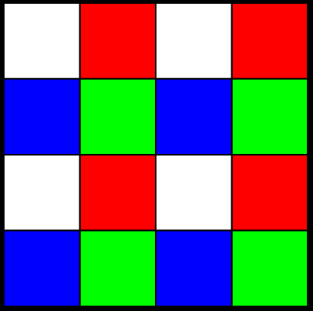
How do “photons” get out of the chip?
A CCD chip outputs data using a serial shift register
Commonly this is referred to as a “bucket brigade”
The electrons are pushed down the columns as a sheet
The grey row (output or shift register) is shifted to an amplifier and A/D converter
[www.nobelprize.org/nobel_prizes/ physics]

Slide 10
Pixel Perfect
CCD’s are sized by a number of pixels in length and width, such as 512 x 512 pixels
This does not count “overscan strips” rows outside of the effective area, overscan strips are used for self calibration of darkness
This also neglects the output register
The aluminum junctions used in the gates were prone to failure
Creating dead shorts in regions of the chip
Limited safe size to 512 x 512 or less
Doped polysilicon comes along allowing front-side illumination and reducing current leaks
Sizes increase to 800 x 800 by the 90s
Photolithography is developed and improved over the next decade
high dope areas around junctions can be made
Substrate gets thinner by a factor of 30
Sizes up to 9000 x 9000 become feasible in scientific sensors
Larger arrays are made by framing multiple chips (dead zones in between)
Notes:
The aluminum junctions used in the gates were prone to failure, creating dead shorts in regions of the chip, which mucked up the charge transfer efficiency of the nearby pixels
This limited safe size to 512x512 or less
In 1980s TI developed polysilicon gates, this allows the larger sizes 800x800 in the 90s
Doped poly silicon substrates helped prevent shorts in the non gate areas around this time
Photolithography techniques are developed and doping practices are improved

Slide 11
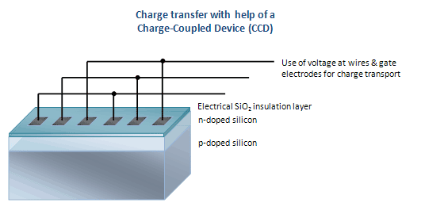
Charge Transfers and Efficiency
If a pixel were 98% efficient
after being shifted 10 rows 18% of the signal is lost
After 35 rows 50% would be lost
This put a limit on the size of early chips
Electrons to the far left may get left behind when two channels are at +5V
Notes:
It is easier to fill the potential well (bucket) than to empty it, trapping surfaces at gate boundaries due to Si lattice defects
Electrons get stuck at the semiconductor/insulator interface 100-200 thousand for scientific CCDs
The electrical current in the presence of the lateral electric field is prone to drift (right hand rule, the electrons curve out)
For science wells
If the gate voltage is dropped to slowly the charge sticks in that well and two pixels get merged (saturates one row)
If the voltage is dropped to fast the charge leaves the bulk and goes back to the surface and recombines. LOTS of charge is lost when the initial gate is “grounded”

Slide 12
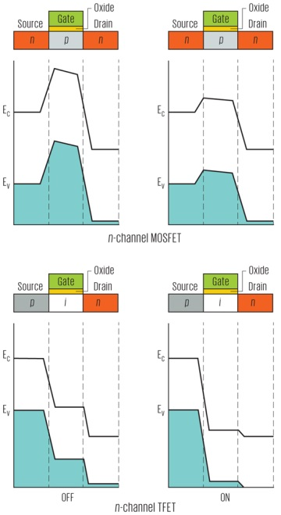
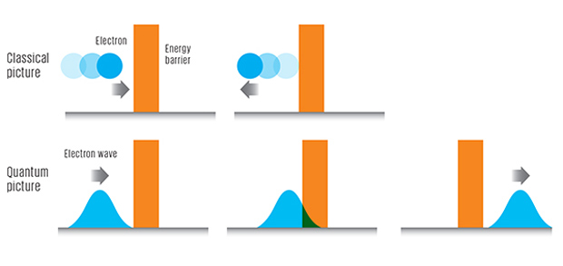
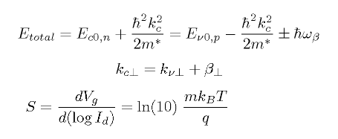
Additional Charge Transfer Issues
Because this is proportional to number of shifts, more loss occurs further away from output register
Used with permission of Rahim Esfandyarpour
Notes:
Readout noise goes down with slow read times, but gives more time for electrons to escape the well

Slide 13
The Output Register Dumps into an Amp
An integrating capacitor measures
constant reset voltage
pixel charge
“sense” reset voltage
Amps turn up everything, e even the noise
Imperfect amps create heat and noise as well
Shift register and one amp is more ideal than a row of amps
Digitization means digitizer noise
MIT/ Lincoln Laboratory Journal Vol 16 No 2 p 393

Slide 14
Additional Features
Windowing
Windowing removes a section of the CCD area from the measurement
Helpful when dark currents or supersaturation occur in images
Binning
During binning arrays of pixels are treated as one
Increases signal per effective pixel
Interline Pixels
Interline transfers have a parallel set of inactive pixels
Allows you to shoot with both barrels then parallel readout
Anti-bloom
There is an extra set of gates which act as a voltage drain
If a potential well gets full (saturated) the overflow goes down the drain, not down the row of pixels
Less active area
Lower resolution
SNR gets complex
Less well depth
Notes:
Frame transfer CCDs – A detector that includes two adjacent CCDs. After an exposure the charge in the active chip is transferred to the inactive chip. A new integration can begin immediately.
Orthogonal transfer CCDs – A relatively new CCD type where pixel charges can be transferred horizontally as well as vertically. In all other CCDs, charges are transferred vertically from row to row until they reach the output register.

Slide 15
Noise Factors In CCDs
Dark Current – Thermally generated electrons are measured identically to target electrons
Scientific cameras have cooling factors to reduce dark currents
Electronic heat pumps can bring cameras to 30C below ambient temperature, lower temperatures require refrigerant
Dark currents place limitations on astronomy and thermography cameras
Bias – electronic noise from the chip and controls
Some bias is needed to keep from getting negative numbers in results
Quantum Effects / Transfer Efficiency
Some electrons become misplaced during register shifts
Early CCDs were so inefficient, if they were as large as modern CCDs all of the signal would have been lost before the register had emptied
UV strike anomaly

Slide 16
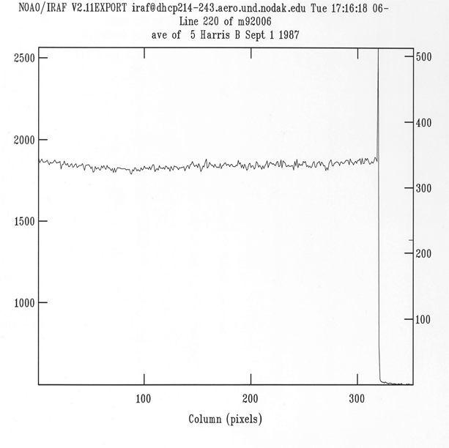
Bias Noise
The overscan region counts the bias noise
Commercial cameras do this adjustment automatically
Scientists make inferences manually
Bias frames can also be taken by setting a 0.00 second exposure
In a histogram, this sets the edge to zero
Notes:
Bias would not occur if insulation was perfect on internal wiring and there were no inducted or coupled charges

Slide 17
Dark Current
Dark frames indicate the general thermal electron noise as well as identify “hot pixels”
Hot pixels must be neglected during spectroscopic or thermography work
Hot pixels indicate an internal fault, cold pixels may indicate a failure

Slide 18
Flat Dark, Dark Flats
“Flats”
“Darks”
An image taken of an illuminated target
Settings are adjusted to keep from saturating the image
Dust shows up as spots or donuts
Allows correction for a dirty lens or sensor
Image taken “with the lens cap on”
Taken at the same settings as the typical shot
Allows correction for the typical heating of the sensor from reads and shifts

Slide 19
Flat-dark Example
Dust donuts & Vignette
Scientists must correct for bias, dark currents, and flat-field effects
A clean lens is needed for a pretty picture, but not for scientific accuracy
Off the shelf cameras may or may not account for bias
Data set from Paul Hardersen PhD
SNR = N* / √ (N* + n_{pix} (1 + n_{pix}/n_{b})(N_{S} + N_{D} + N_{R}² + G²σ²))
Notes:
The (1 + n_{pix}/n_{b}) term provides a measure of the noise incurred as a result of any error introduced in the estimation of the background level on the CCD image.
n_{b} is the total number of background pixels used to estimate the mean background level. Smaller values of n_{b} will introduce larger errors as they are poorer estimates of the sky.
G²σ² is a term that accounts for the error introduced by the digitization noise within the A/D converter. This term cannot be neglected if the CCD gain value is large.
σ_{f}² is an estimate of the 1σ error introduced within the A/D converter and has a typical value of ~0.289.
N_{S} – The number of photons/pixel from the background sky.
N_{D} – The total number of dark current electrons per pixel.
N_{R}² – The total number of electrons per pixel resulting from the read noise. This term is squared because it behaves like shot noise and not Poisson-like noise.
N* -- The signal from the source that you are observing.
n_{pix} – The number of pixels used for the SNR calculation.
Important point – The SNR is proportional to √t and not to t.

Slide 20
Staying on Target
Pointing Accuracy
Image Stabilizers
Gyros
Gravity gradients
Inertial dampeners
If target or camera is moving, some form of pattern recognition is needed to account for this (degrees of overlap)
Software looks for a fixed point, integrates frames, and adjusts final count for motion
Works with multiple short exposures, not feasible for long exposures
Only works with if there’s an anchor in frame

Slide 21
Applications

Slide 22
RIT's Cryogenic Star Tracking Attitude Regulation System
RIT's prototype represents a step toward a fully cryogenic optical detector that someday could improve the sensitivity of NASA's deep-space cameras
Uses new CMOS chips that are stable at lower temperatures
https://phys.org/news/
Notes:
Low temp performance is good for dark currents
Faster tracking, see more stars
Star tracking cameras are on satellites, space stations, and rockets for guidance and attitude control
System must quickly and accurately compare view of sky to star charts

Slide 23
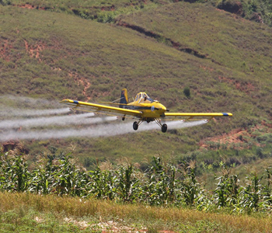
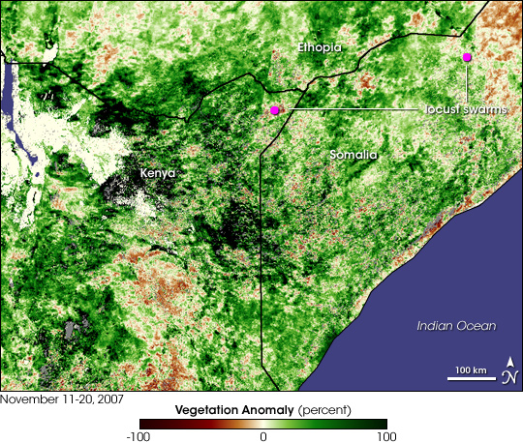
A Plague of… __
The swarms observed in Kenya and Somalia contained between 40 and 80 million locusts per sq km
Swarms of locusts can migrate more than 130 km/day
One flank of an average swarm can destroy 2,500 peoples worth of food in a day
Spraying is costly and disastrous to the surrounding area (especially bees)
https://www.nasa.gov/ & https://earthobservatory.nasa.gov/
Notes:
Jesse Allen NASA, Seelan UND
SPOT satellite sees the issue, other satellite clusters like INSAT or COSPAS handle emergency response communications

Slide 24
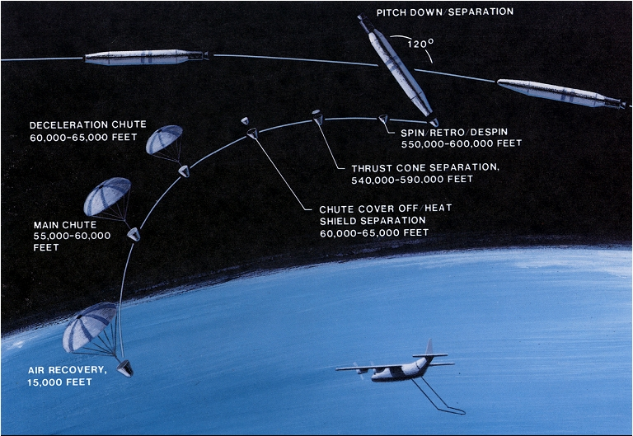
Certainly not “spy” satellites
Legacy Method
New Technology
Corona missions
Low success rate (lost film)
Inconvenient timing
Mission ends when out of film
Digital photos can be sent through communications satellites directly to the intelligence community and forward to an FOB or the field
Image resolution now available at roughly the cm/pixel level
Old cameras could see a mine, new resolutions can tell copper from uranium
Notes:
If urgent data is needed, not all film is used, if all film is used data collection is slow. Is slow either way
Image from wikipedia via the NRO
Loss was nearly 75% early on, later the system had 2 rolls of film so you could get two uses of one sat
Losses were for various reason, bad controls, bad cameras, failed launch or retrieval
Water landings ruining film etc
Copper vs uranium in Remote Sensing and Applications Vol 5 P 27

Slide 25
Soil and Watershed Erosion
Water channels shift seasonally and with major storms
Soil erosion along coastal areas can be monitored with GIS data and mapping
Watersheds can be monitored for size and level indicating need for maintenance or to warn of flooding
Notes:
Image from Division of Geodetic Engineering, model to detect and predict watersheds requiring maintenance

Slide 26
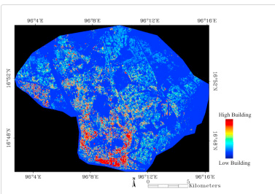
Industrialization and Urban Sprawl / Decline
“Building Classifications in Yangon City” by Sritarapipat & Takeuchi
The growth of economic areas and the impact on the suburbs is mapped using Near-IR data and 3D data on building heights from stereoscopic images
This is used to plan urban development and develop energy plans
Notes:
Number of lights on at night helps determine how many of the buildings are empty and which areas are dying out

Slide 27
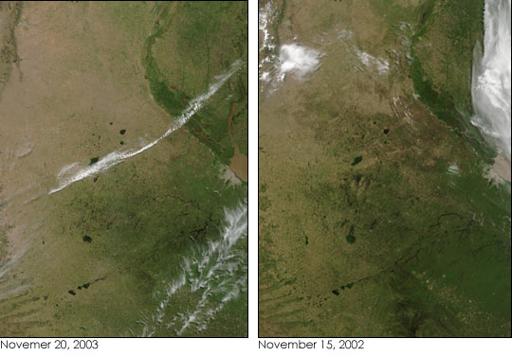
Crop Output / Sustainability
In areas such as India and Brazil spectral analysis is done to determine soil types, identify crop growth rates, and soil exhaustion
“Space Informatics for Sustainable Development” edited by S. Murai, R.B. Singh (1999)

Slide 28
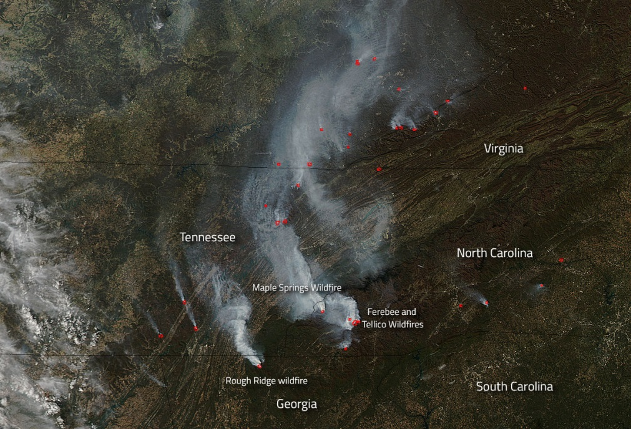
Wildfire Monitoring
Heat and smoke detection to detect fires in remote areas
Signal to noise and false alarms means a fire may grow before spotting (still faster)
Satellites that detect sudden heat spikes are also great for spotting ICBM launches
New methods also assess soil condition of post-fire areas (washout/ erosion)
Notes:
Images from NASA

Slide 29
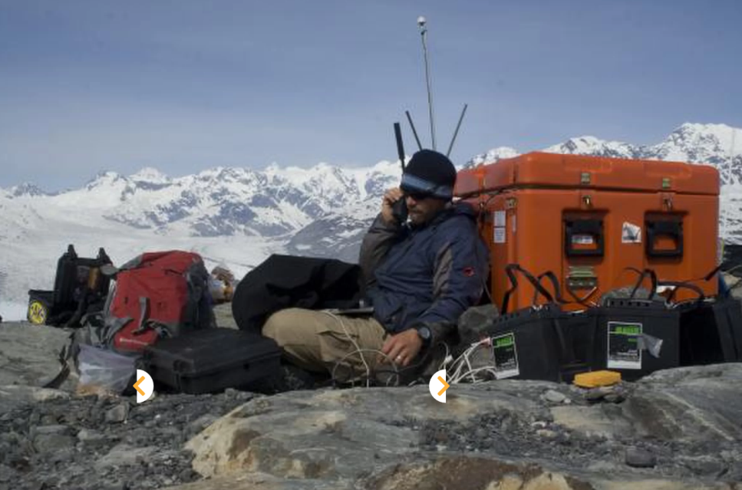
Iceberg, dead ahead!
Ice shelf breaks are detected by local seismic stations
If possible the berg is sited and coordinates provided
Berg is tracked and maps ocean flow, melting rate, and for intersects with shipping lanes

Slide 30
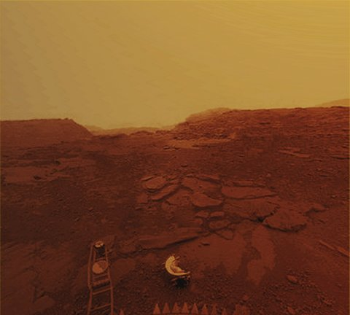
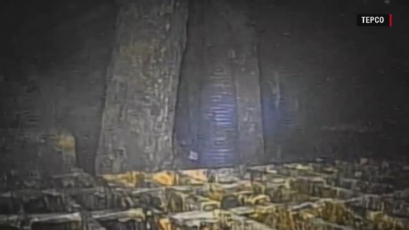
Visualizing Hazardous Environs
Surface of Venus (Venera Lander)
Inside Fukishima Reactor
From CNN.com

Slide 31
Everyday Autonomy
Self driving cars use an array of CCDs for multispectral stereoscopic vision
Fast- high res cameras needed for object recognition and tracking

Slide 32
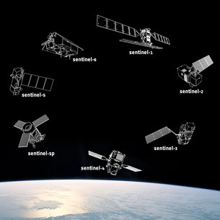
ESA Sentinel Weather
Provides
day-night radar imagery
Sub meter optical imagery
Atmospheric monitoring
Oceanographic data
Tracks sea levels, storms, and allows prediction of extreme climate events
Covers globe using multiple orbit types

Slide 33
Myriads of Others
Wildlife tracking of herds, field based cameras
Endoscopic cameras and other medical devices
Microscopy (100,000 ISO chips)
Security systems (back tracking crowd patterns - Boston bomber)
Earthquake predictions (plate motion and ground swell)
Volcano predictions
Deep sea explorations
Consumer “gimmicks” like the webcam fridge

Slide 34
Wait There’s More
Predicting sales volume by counting cars in the lot
Levying building taxes or fines based on new construction or tree cutting activities
Monitoring oil spills
Observing “shy” animal species
Guidance systems for UAVs
Solar storms – prediction and analysis
Algae blooms – signs of ocean health and air quality
Mapping the sea floor
Tracking invasive species
Providing traffic alerts
Notes:
Polar bears and some chimps act differently when they know they are observed
It is not sound science to observe during mating seasons as presence may change behavior we wish to study

Slide 35
Questions?
Justin Bell
jbell@ieee.org

