Slide 1
Industrial Power Converters
Committee Meeting
Portland, Oregon - USA
September 25th, 2018

Slide 2
Agenda
Call to order
Introduction of members in attendance
Approval of 2017 minutes (http://sites.ieee.org/ipcc/minutes) and Agenda
Officers Report
Subcommittee Reports
  Transactions
  Fellows and Award Nominations
  Standards
  Special Activities
Unfinished Business
  None
New Business
  Inactive/honorary members
  More formal involvement with APEC
  Open the floor for additional motions
Announcements
  Prize Paper Award Distribution
  Promotions for IAS sponsored conferences (ICPE-ECCE,
  Request for volunteers for ECCE2019
Adjournment

Slide 3
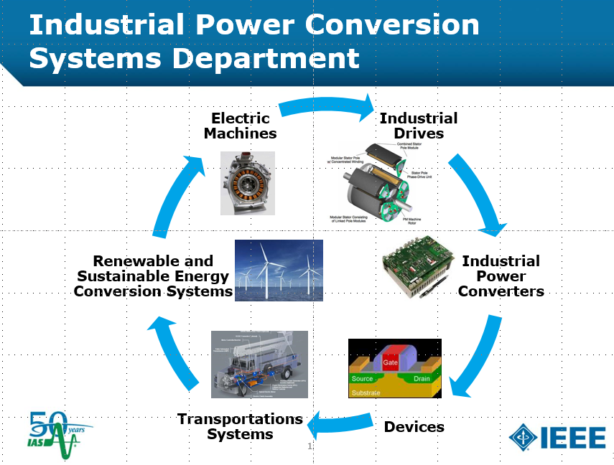

IPCC Chairman Report
Grant Pitel
The Role of IPCC within IEEE/IAS
IAS sponsored +120 young people (grad and undergrad chapters members and award winners) to attend the Annual Meeting.
Acknowledge members attending the Sunday Chapters and Membership Workshop.
We are a committee within IPCSD specializing in power conversion.
Maintain a network of active volunteers.
Provide technical oversite at conferences,
journals, and standards.
Collect input from members through
meetings and make recommendations.
Spearhead new initiatives through
special committees

Slide 4
IPCC Chairman Report
Grant Pitel
Membership
Membership roster is at 374
Detailed roster and attendance statistics started in 2014
138 new members through IPCC annual meetings and online registration form.
26 new members in 2017
Spread the word to friends, colleagues, and students.
IPCC roster is an essential resource for finding volunteers for ECCE and forming committees.

Slide 5
IPCC Chairman Report
Grant Pitel
ECCE 2018
Overview of Chairman and Vice Chairman responsibilities
Celebrating 10 Years!

Slide 6
IPCC Chairman Report
Grant Pitel
ECCE 2018
IPCC tracks have routinely had the largest number of submission.
This this year IPCC manages 1/3 of all conference submissions.
Stats on the review process
  1788 Total Submissions
  TRACK E, 292 Submissions, 94 Oral Sessions, 76 Poster Sessions
  TRACK F, 311 Submissions, 110 Oral Sessions, 93 Poster Sessions
Improved review structure. Evenly shared workload between IAS and PELS.
We need to engaged and provide value for exhibitors.
  Product feedback
  Expected product needs
  Educate yourself on new features or improvements on products you already own
  Sales leads

Slide 7
Reports from subcommittees
Transactions
IPCC Transactions Chair
Pericle Zanchetta

Slide 8
Reports from subcommittees
Transactions
missing

Slide 9
IAS transactions
IPCC special issue on the IA transactions
Call for IPCC special issue TIA 2019
Topic: ?
Guest Editors: ?
Call for Papers: May 1st, 2019
Deadline for papers submission: Dec. 31st, 2019

Slide 10
Reports from subcommittees
Fellow and awards nomination
IPCC Fellow and Awards Committee Chair
Po-tai Cheng
Andrew W. Smith Outstanding Young Member Achievement Award (Deadline: March 15)
Outstanding Young Member Service Award (Deadline: March 15)
Distinguished Service Award (Deadline: March 15)
Outstanding Achievement Award ( Deadline: March 15)
Kliman Award (Deadline: June 1)
IAS Distinguished Lecturers (Deadline: March 31)
IEEE Fellow (Deadline: March 1)

Slide 11
Reports from subcommittees
Fellow and awards nomination
IEEE IAS Andrew W. Smith Outstanding Young Member Award (Deadline: March 15)
Established in 1996, renamed in 2009 and 2015.
Recognizes outstanding achievement and contribution to the profession through involvement in IEEE IAS activities by an IAS member less than 35 years of age.
Prize: $2,500, Plaque and travel expenses to attend an IAS sponsored conference for presentation and recognition.
Eligibility: Nominees must be age 35 or less at the specified award nomination due date. To be considered as a nominee, a one page form must be completed describing IAS activities and associated contributions made by the nominee. The form must be submitted and received by the IAS President before the specified due date of March 15. Self nomination is not permitted for this award.
Basis for Judging: Outstanding contribution to the profession in the form of IEEE/IAS activities such as (but not limited to) authorship of technical papers, IAS chapter leadership, IAS committee work, conference leadership, and standards working groups.

Slide 12
Reports from subcommittees
Fellow and awards nomination
IEEE IAS Andrew W. Smith Outstanding Young Member Award
2017 Xu She
2016 David C. Mazur
2015 Tiefu Zhao
2014 Bin Lu
2013 Akshay Kumar Rathore
2012 Zhi Gao
2011 no recipient
2010 Dr. Wei Qiao
2009 Dr. Ayman M. EL-Rafaie

Slide 13
Reports from subcommittees
Fellow and awards nomination
IAS Outstanding Young Member Service Award (Deadline: March 15)
Recognizes outstanding service and contribution to the profession through involvement in IEEE IAS activities by an IAS member less than 35 years of age.
Prize: $2,500, Plaque and travel expenses to attend an IAS sponsored conference for presentation and recognition. Funded by the IEEE Industry Applications Society.
Eligibility: Nominees must be less than age 35 at the specified award nomination due date. To be considered as a nominee, a one page form must be completed describing IAS activities and associated contributions made by the nominee. The form must be submitted and received by the IAS President before the specified due date of March 15. Self nomination is not permitted for this award.
Basis for Judging: Outstanding contribution to the profession in the form of IEEE/IAS activities such as (but not limited to) authorship of technical papers, IAS chapter leadership, IAS committee work, conference leadership, and standards working groups.

Slide 14
Reports from subcommittees
Fellow and awards nomination
IAS Outstanding Young Member Service Award (Deadline: March 15)
2017 Megha Tak
2016 Christina P. Malliou

Slide 15
Reports from subcommittees
Fellow and awards nomination
IAS Outstanding Achievement Award (Deadline: March 15)
Honors an individual who has made an outstanding contribution in the application of electricity to industry in accordance with the scope of the IEEE Industry Applications Society.
Prize: $5,000 and engraved statuette, Funded by the IEEE Industry Applications Society.
Basis for Judging: Any of the following criteria apply: invention in the field as exemplified by issued patents; contribution to the general engineering or scientific basis of the technologies found within the scope of the IAS; executive or managerial contribution in the organization or operation of enterprises as associated with the scope of the IAS. Self nomination is not permitted for this award.

Slide 16
Reports from subcommittees
Fellow and awards nomination
IAS Outstanding Achievement Award (Deadline: March 15)
2017 Bram Ferreira
2016 Seung-Ki Sul
2015 Pragasen Pillay
2014 Thomas A. Nondahl, Longya Xu
2013 Muhammad H. Rashid
2012 no recipient
2011 Dr. Thomas Jahns
2010 Dr. Tomy Sebastian

Slide 17
Reports from subcommittees
Fellow and awards nomination
IAS Distinguished Service Award (Submission Deadline is March 15)
Recognizes an individual for dedication and service to the IEEE Industry Applications Society.
Prize: $5,000 and Plaque, Funded by the IEEE Industry Applications Society.
Basis for Judging: Exceptional administrative, managerial and leadership achievement; proposal and/or implementation of innovative new Society programs; dedication to the growth and advancement of the Society and/or its geographic and technical entities. Self nomination is not permitted for this award.

Slide 18
Reports from subcommittees
Fellow and awards nomination
IAS Distinguished Service Award
Year Award Recipient
2016 Barry Brusso
2015 Carlton Speck
2014 Louie J. Powell
2013 H. Landis (Lanny) Floyd
2012 William D. Greason
2011 Robert Lorenz

Slide 19
Reports from subcommittees
Fellow and awards nomination
IAS Distinguished Lecturer (Deadline: March 31)
Nominator and Cadidate contact informations
One page BIO of the Candidate with a colour photo in the upper left corner and contact email address
List of the lecture topics with the titles and short abstracts ( max. 600 characters each)

Slide 20
Reports from subcommittees
Fellow and awards nomination
IEEE Fellow (Deadline: March 1)
Any person, including non-IEEE members, is eligible to serve as a nominator. The following are exceptions: Members of the IEEE Board of Directors, members of the IEEE Fellow Committee, IEEE Society/Technical Council Fellow Evaluating Committee Chairs, members of IEEE Society/Technical Council Fellow Evaluating Committee reviewing the nomination, or IEEE Staff.
The nominator is responsible for preparing the IEEE Fellow Grade Nomination Form.
The nominator is responsible for soliciting at least five, but no more than eight, references capable of assessing the nominee’s contributions. References must be IEEE Fellows.
There is the option of soliciting no more than three endorsements capable of supporting the nomination. Any person, including non-IEEE members, may submit an endorsement. The following individuals are ineligible to serve as endorsements: members of the IEEE Board of Directors, members of the Fellow Committee, members of the IEEE Society/Technical Council Fellow Evaluating Committee reviewing the nomination or IEEE Staff. In addition, a nominator may not serve as an endorser for a nomination he/she is submitting.

Slide 21
Standards Chair
Yuri Khersonsky
Reports from subcommittees
Standards Chair
Work Group N^{o.} P1709
Work Group Name Recommended Practice for 1 to 35 kV
Medium Voltage DC Power Systems on Ships
Chair Yuri Khersonsky
Vice Chairs Norbert Doerry, Terry Ericsen
Secretary Joseph Piff
Participants See WG roster
WG Policies & Procedures S&S master P&P 17 March 2014
Progress toward deliverables Published 17 June 2010
Timeline Revised 1709 approved by RevCom
Projected publication: spring 2019
Future Meetings No update
Of Note SASB expiration 31 December 2020
PAR expiration 31 December 2021

Slide 22
Reports from subcommittees
Special Activities
Special Activities Chair
Yongsug Suh
Main purpose
  To enhance the collaboration between IPCC and regional power electronics societies in the world
Strategies
  To boost the participation of IPCC members in ECCE Asia and ECCE Europe conferences
Actions
  Had IAS IPCSD & IEEJ-IAS (Japan) collaboration meeting during IPEC 2018 – ECCE Asia (Niigata, Japan / May 21, 2018)
  Nominated IPCC members for technical programs of ICPE 2019 – ECCE Asia (Korea) -> Organized session chairs, Tutorials, Topic chairs
  Continue to promote the participation of IPCC members in ECCE Asia and ECCE Europe conferences

Slide 23
IPCC Prize Paper Awards for ECCE 2017
Stefano Bifaretti
IAS transactions
IPCC prize paper awards
Notes:
23

Slide 24
IPCC ECCE Paper Award
Committee
Stefano Bifaretti, Transaction co-Chair, University of Rome Tor Vergata, Italy
Andrea Formentuni, University of Nottingham , UK
Babak Parkhideh, University of North Carolina , USA
Dong Dong, GE Global Research, USA
Huang-Jen Chiu, NTUST, Taiwan
Jiangbiao He, GE Global Research, USA
Luca Solero, University Roma Tre, Italy
Liang Du, Temple University, USA
Santanu Mishra, IIT-Kanpur, India
Vivek Agarwal, IIT-Bombay, India
Xiaonan Lu, Argonne National Laboratory, USA
Xiongfei Wang, Aalborg University, Denmark
Zheyu Zhang, The University of Tennessee, USA

Slide 25
IAS transactions
IPCC prize paper awards
First IPCC Prize Paper Award
Paul Sochor, Hirofumi Akagi, Nadia M. L. Tan
Low-Voltage-Ride-Through Control of a Modular
Multilevel SDBC Inverter for Utility-Scale
Photovoltaic Systems

Slide 26
IAS transactions
IPCC prize paper awards
Second IPCC Prize Paper Award
Diego Pérez-Estévez, Jesús Doval-Gandoy,
Alejandro G. Yepes, Óscar López, Fernando Baneira
Improved Resonant Current Controller for
Grid-Tied Converters

Slide 27
IAS transactions
IPCC prize paper awards
Third IPCC Prize Paper Award
Zewei Shen, Dong Jiang, Jianan Chen, Ronghai Qu
Differential-Mode and Zero Sequence Circulating Current Reduction for Paralleled Inverters with Modified Zero-CM
PWM Algorithm

Slide 28
IAS transactions
IPCC prize paper awards 2018
Prize Paper Award Consideration
ECCE 2018 Portland papers submitted for IEEE Transactions Review
by Nov. 15, 2017, will be considered for Prize Paper Awards
(announced at ECCE 2019 in Baltimora, Maryland)

Slide 29
IAS transactions
IPCC prize paper awards 2018
Selection Procedure
Remember to submit your ECCE 2018 paper before November 15, 2018 to be included in the award evaluation
The 6-10 papers with the highest score from the first IAS Transaction review will go in final ballot
The Co-Chair will select an award committee and each member will score each paper
The score from the committee members will be averaged to obtain the final list

Slide 30
IAS-PELS Sponsored 2019 Conferences

Slide 31
IAS-PELS sponsored 2019 conferences
APEC 2019

Slide 32
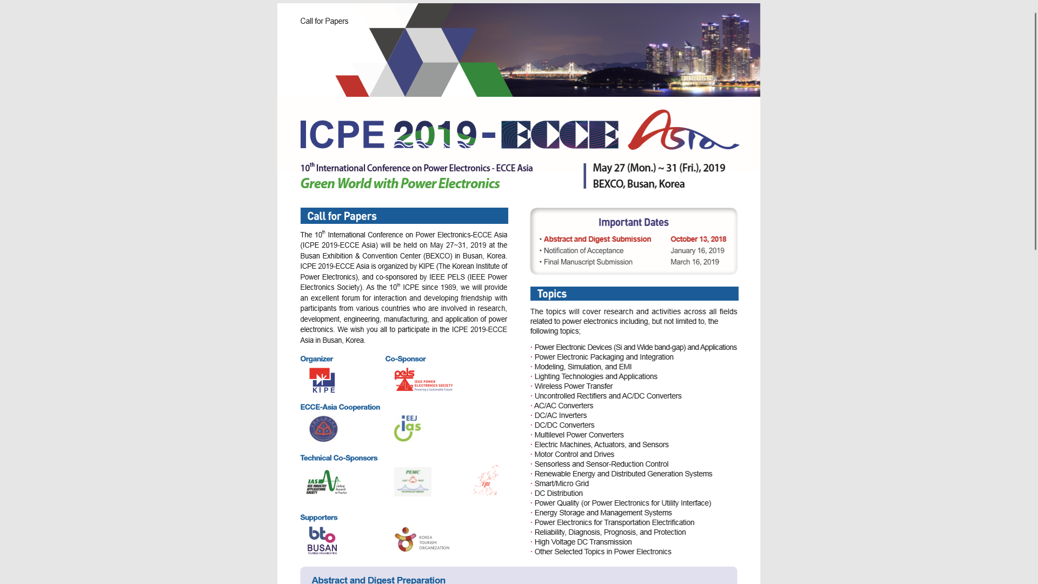
IAS-PELS sponsored 2019 conferences
ICPE 2019 – ECCE Asia

Slide 33
IAS-PELS sponsored 2019 conferences
EPE 2019 – ECCE Europe

Slide 34
IAS-PELS sponsored 2019 conferences
IEMDC 2019

Slide 35
IAS-PELS sponsored 2019 conferences
SDEMPED 2019

Slide 36
IAS-PELS sponsored 2019 conferences
INDEL 2019

Slide 37
IPCC Officers and Subcommittee Chairs

Slide 38
IPCC Officers
Active Officers for 2018
Dr. Grant Pitel – chair
Prof. Luca Solero – vice-chair
Dr. Xiaonan Lu – secretary
Prof. Pericle Zanchetta – past chair

Slide 39
IPCC Officers
Special Activity Chair and Liaison Officers
Special Activity Chair for 2018
Prof. Yongsug Suh
Liaison Officers for 2018
1) Prof Junichi Itoh (Japan) – Asian Liaison
2) Vacant
1) Dr. Petar Grbovic (Germany) – European Liaison
2) Vacant
Submit nomination To the committee chair by November 15th gpitel@magna-power.com

Slide 40
IPCC Officers
Editorial Officers for 2018
Prof. Pericle Zanchetta – Transactions chair
Prof. Stefano Bifaretti – Transactions co-chair
Fellow and Awards Subcommittee Chair
Prof. Po-Tai Cheng
Standards Subcommittee Chair
Dr. Yuri Khersonsky

Slide 41
ECCE 2019

Slide 42
Planning of ECCE 2019
Tutorial suggestions/proposals for ECCE 2019
Volunteers and subjects:
Submit proposals to the committee chair by November 15th gpitel@magna-power.com

Slide 43
Planning of ECCE 2019
Topic chairs and session chairs needed for ECCE 2019
Business cards collected for candidate topic chairs and session chairs. Names and email addresses will be collated.

Slide 44
See you all next year!

