Slide 1
IEEE-HKN
Induction Ceremony
[Alpha Omega] Chapter
[Date]

Slide 3
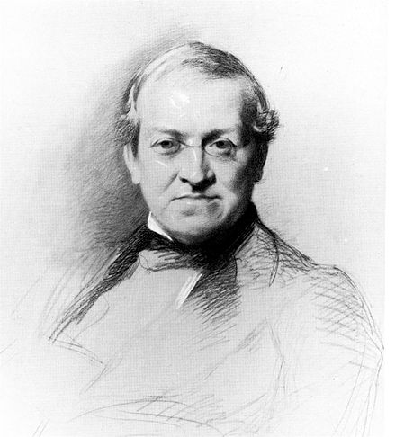
Sir Charles Wheatstone

Slide 4
Candidate Attendance
Please stand and turn your room lighting up.
Please unmute your connection and be prepared to respond when addressed.

Slide 5
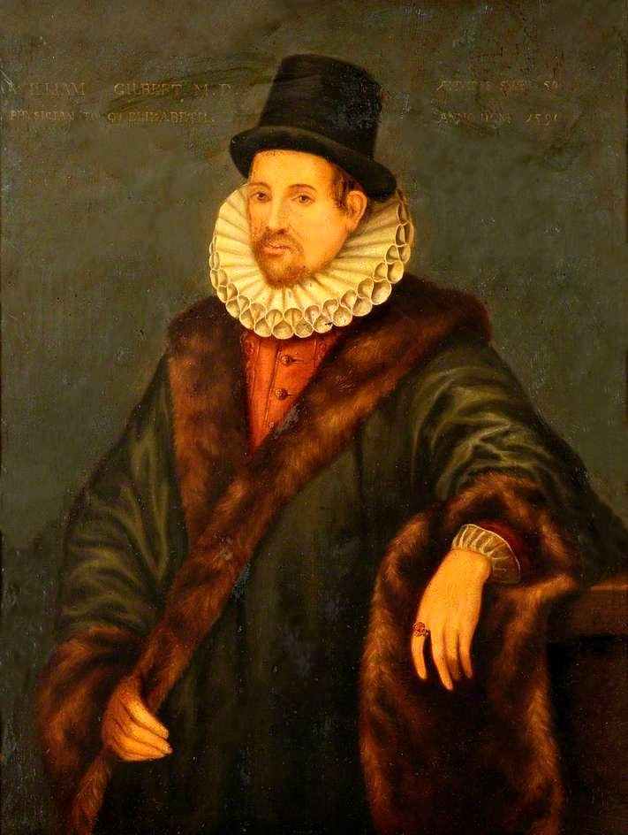
William Gilbert

Slide 6
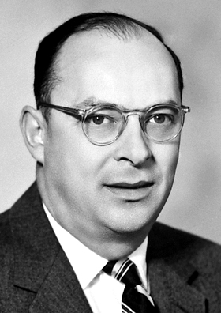
John Bardeen

Slide 7
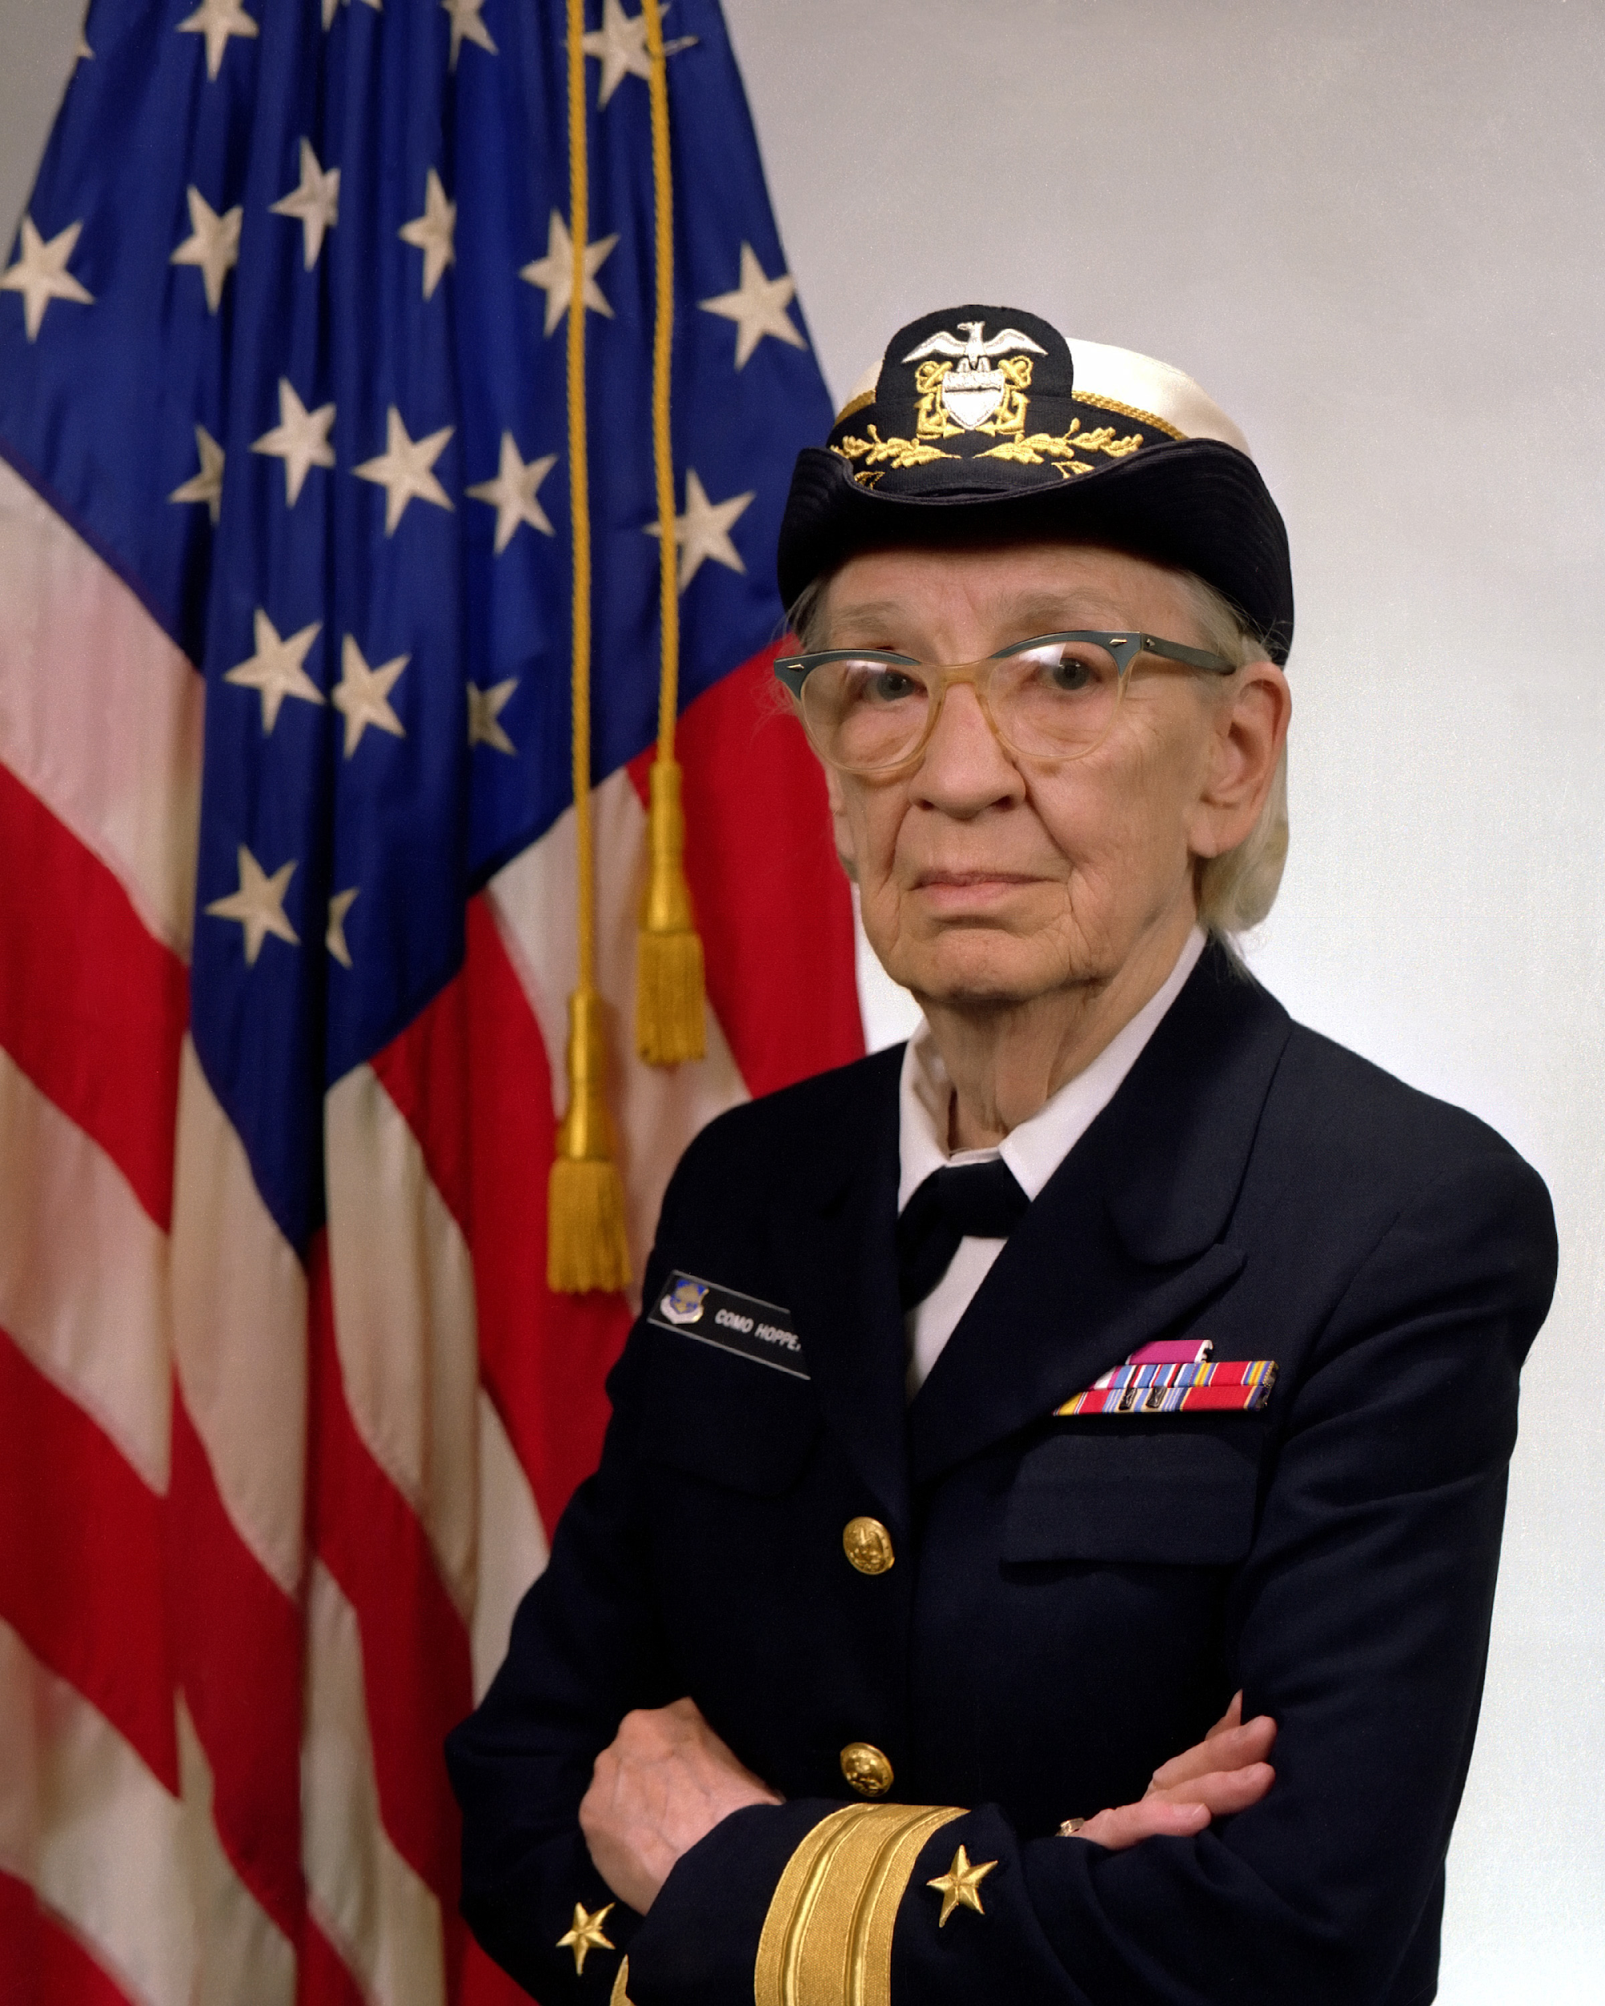
Adm. Grace Hopper

Slide 8
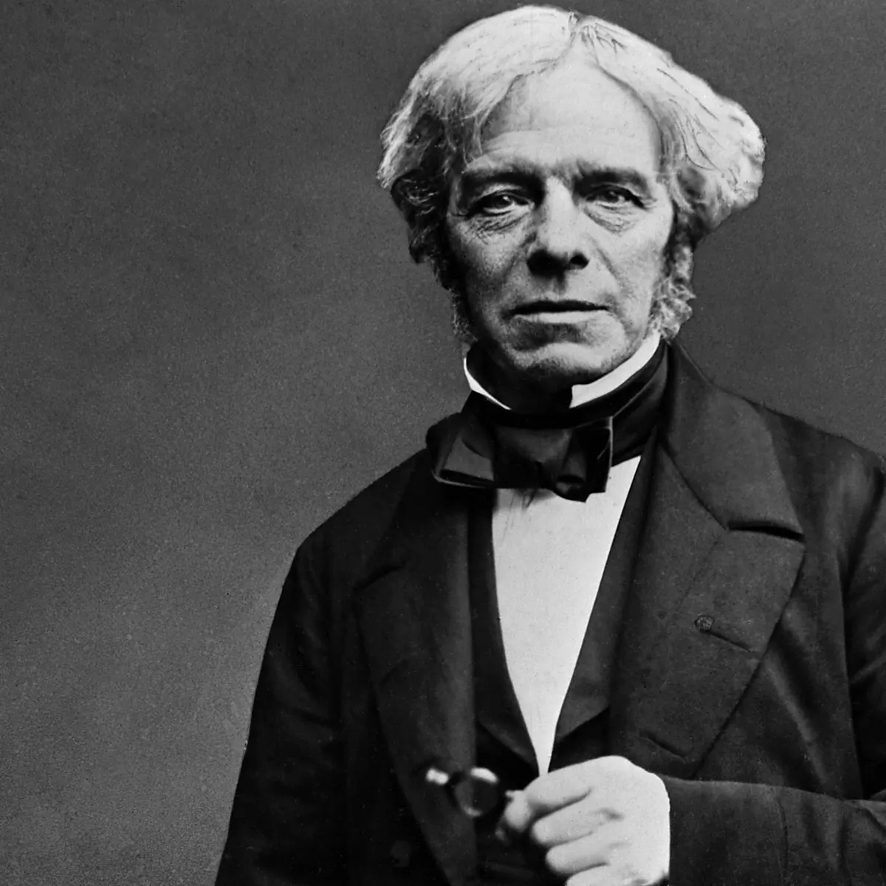
Michael Faraday

Slide 9
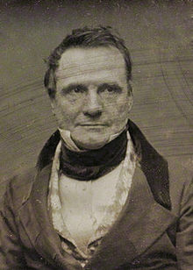
Charles Babbage

Slide 10
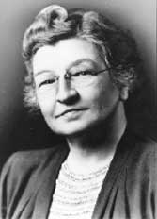
Edith Clarke

Slide 12
The Caduceus

Slide 13
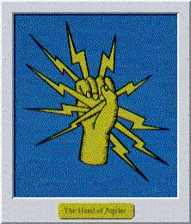
The Hand of Jupiter

Slide 14
The Band of Silver

Slide 15
The Wheatstone Bridge

Slide 16
The Wheatstone Bridge

Slide 17
The Wheatstone Bridge

Slide 18
Η Λ Ε Κ Τ Ρ Ο Ν
Eta
Lambda
Epsilon
Kappa
Tau
Rho
Omicron
Nu
The Ribbon

Slide 19
Η Λ Ε Κ Τ Ρ Ο Ν
Eta
Lambda
Epsilon
Kappa
Tau
Rho
Omicron
Nu
The Ribbon

Slide 21
IEEE-HKN
Virtual Induction Ceremony
Please be sure to sign and return your Signature Form to mbenson@ieee.org.

Slide 22
