Slide 1
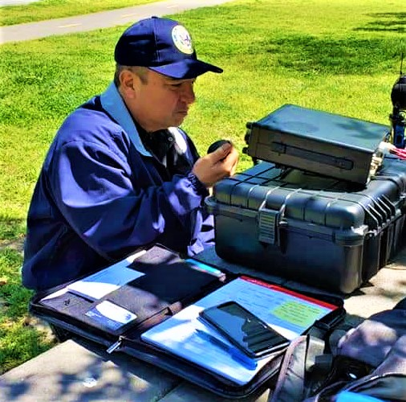
Software Defined Radio – SDR Phil Bautista, AA5EX
Notes:
Welcome to this presentation on Software Defined Radio or “SDR”. My name is Phil Bautista, call sign AA5EX

Slide 2
Agenda
Speaker Introduction
Topic Introduction
SDR – Definition
SDR – Demonstration
Useful Links
Speaker Contact for Q&A
Notes:
Our agenda today will start with a speaker introduction, topic introduction, followed by demonstrations of two different types of SDR’s. At the end if the presentation there will be some useful links and my contact information to answer any questions you may have on this topic.

Slide 3
Phil Bautista – FCC Callsign “AA5EX”
Amateur Extra Class Radio Licensee
Amateur Radio Emergency Services - ARES
Assistant Emergency Coordinator (AEC)
Emergency Operations Center (EOC)
Travis County ARES Officer
Weekly Training Voice Net
Notes:
My name is Phil Bautista with the Federal Communication Commission callsign of Alpha Alpha Five Echo X-ray. I am an amateur extra class radio operator. As a member of the Amateur Radio Emergency Services or ARES in Travis County, Texas (where I live), I serve as an Assistant Emergency Coordinator or AEC with the duty assignment of the Emergency Operations Center at the Combined Transportation, Emergency and Communications Center in Austin, TX, our state’s capitol. As an officer, I provide weekly training during our voice nets each Sunday evening over the air.

Slide 4
Software Defined Radio - SDR
Definition:
A software-defined radio (SDR) system is a radio communication system which uses software for the modulation and demodulation of radio signals. An SDR performs significant amounts of signal processing in a general-purpose computer, or a reconfigurable piece of digital electronics.
Notes:
An SDR is defined as a communication system using software to perform the functions of the radio as opposed to discrete hardware components.

Slide 5
Software Defined Radio
The SDR Concept
The IEEE defines a software-defined radio as a “radio in which some or all of the physical layer functions are software-defined.” Physical-layer functions include, but are not limited to, tuning, antenna diversity, down conversion, synchronization, modulation and demodulation.
In other words, an SDR is to a physical transceiver what a Virtual Machine (VM) is to a physical server. The properties of an SDR can be modified dynamically similar to the way a VM can dynamically alter RAM, #CPU’s, disk space and peripherals.
Notes:
The IEEE defines an SDR as a “radio in which some or all of the physical layer functions are software-defined”. Comparing an SDR to a conventional transceiver is like comparing a physical computer to a virtual machine in which the functionality can be dynamically controlled without physical modification.

Slide 6
Conventional Radio vs. SDR
Conventional radio systems - Composed mostly of hardware, and as such cannot easily be re-configured.
SDR is a wireless communication system with the ability to reconfigure by changing the software used to implement functions typically done by hardware in a conventional radio.
In an SDR transmitter, software is used to implement different types of modulation procedures, while analog-to-digital converters (ADCs) and digital-to-analog converter (DACs) are used to change from one type of signal into another. Typically, an SDR receiver uses an ADC to change the analog signals from the antenna into digital signals that are processed using software on a general-purpose processor.
Notes:
A conventional radio consists of mostly discrete hardware with external controls and output whereas an SDR uses software running on the general purpose hardware to provide the same functionality as the discrete hardware for modulation, and conversion of signals to and from analog and digital sources and outputs.

Slide 7
Software Defined Radio
The Holy Grail for software radio designers is a device with the antenna connected directly to an analog-to-digital (A/D) converter, as shown in Figure 1(a). In this idealized implementation, the radio signal immediately is digitized and there are no hardware-specific components. In other words, one hardware platform handles all frequencies and all airlink standards.
Notes:
Show here is a simplified block diagram for the ideal software defined radio, achievable in theory but not in practice.

Slide 8
Software Defined Radio
The receiver of Figure 1(a) cannot be realized in practice. The A/D converter does not have infinite bandwidth or infinite dynamic range, and all A/D converters have poor noise figures. Contemporary land-mobile-radio receivers employ a bandpass filter and low noise amplifier (LNA) in front of a conventional superheterodyne downconverter, as shown in Figure 1(b).
Notes:
In actuality, a practical SDR requires additional components such as filters and amplifiers as shown in this expanded block diagram.

Slide 9
The Traditional Transceiver
A traditional HF/UHF/VHF transceiver has many dials, knobs and switches and lacks a waterfall display but may have analog meters
Notes:
Looking at the front panel of a traditional transceiver we see an assorted array of discrete button, knobs, switches and single purpose displays for such things as current frequency selection and signal strength.

Slide 10
Current Production SDR
Here is an image of a current model of SDR manufactured by Flex Radio in Austin, TX.
- Note – There is no display, dials or knobs on the radio
Notes:
The front panel of an SDR has no such buttons, dials, switches, meters or displays.

Slide 11
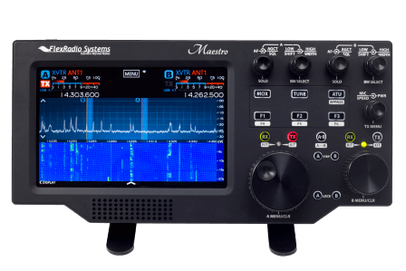
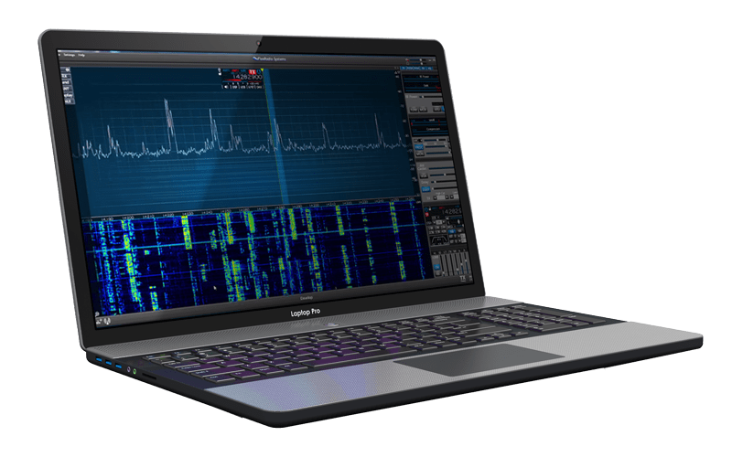
SDR Controls and Display
The display and controls for the SDR transceiver are provided by
Connecting it to a computer
Using a specially designed front panel (additional cost)
Notes:
The controls and outputs of an SDR are performed and displayed using a browser window from a computer or tablet as shown on the left. There are specially designed controllers that are wi-fi enabled which can perform the same functions as the browser window and computer such as the one shown on the right.

Slide 12
Traditional Transceiver vs. SDR
Comparing a traditional transceiver with the current SDR offering from Flex Radio
Notes:
Comparing a traditional transceiver on the left to an SDR on the right we can see the drastic differences in physical appearance.

Slide 13
SDR Controls and Display – Rec/Xmit
Notes:
The controls of an SDR as well as the signals received over the selected spectrum are shown as displayed in the window of a computer or tablet. Note that multiple signals can be displayed across a selected spectrum of frequencies as well as a historic trace of reception over time.

Slide 14
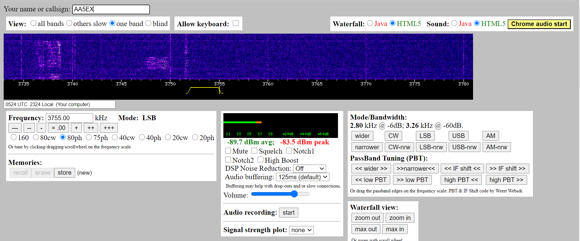
Web SDR Controls and Display (Rec)
Notes:
A web based SDR used for receive only is show here. Similar to the SDR transceiver it shows received signals over time in the selected frequency spectrum.

Slide 15
http://www.websdr.org/
Notes:
Here is a list of some web based SDR’s available free of charge and without the requirement for an FCC license.

Slide 16
SDR – Software Defined Radio
Demo
https://youtu.be/zIpEx9Mr-Jc
Notes:
Let’s login to a web based SDR receiver and see what we can hear.

Slide 17
SDR – Alternatives
Web Accessible Transcievers -RemoteHams http://remotehams.com/
PC/Phone/Tablet Transceiver -EchoLink https://secure.echolink.org/
Notes:
Let’s login to a web based SDR receiver and see what we can hear.

Slide 18
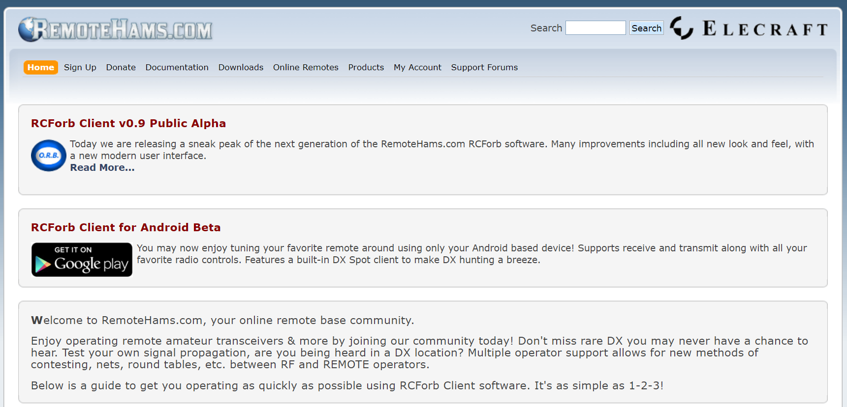
RemoteHams – http://remotehams.com/
Web based listing of Amateur Radios accessible over the internet
Notes:
Let’s login to a web based SDR receiver and see what we can hear.

Slide 19
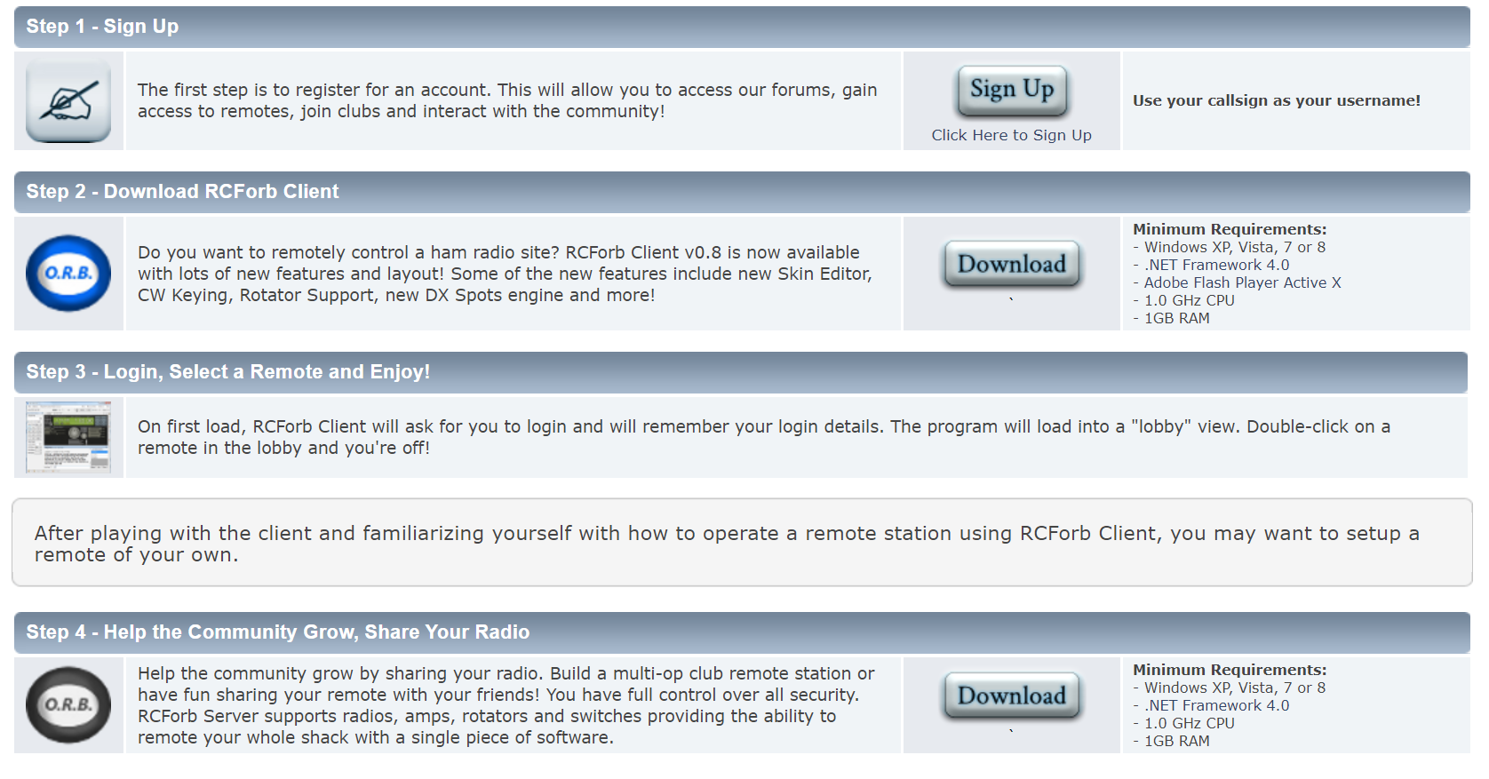
RemoteHams – Steps to Use
Notes:
Let’s login to a web based SDR receiver and see what we can hear.

Slide 20
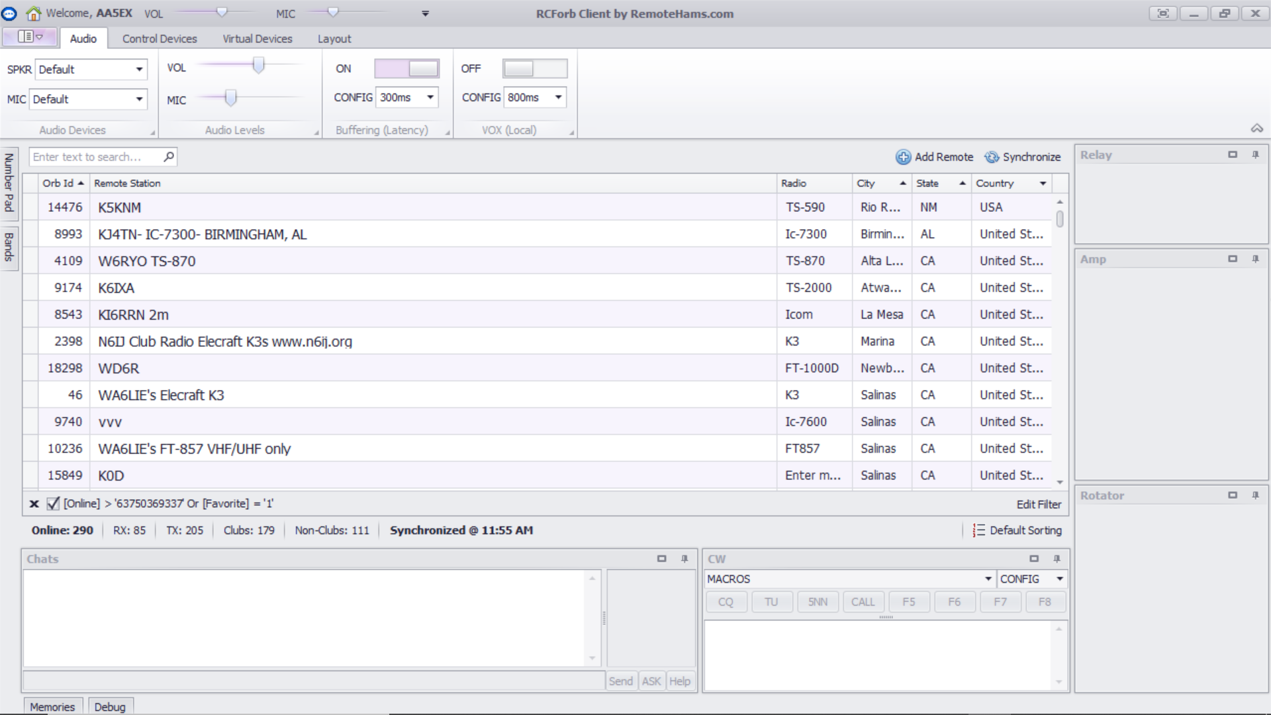
RemoteHams – List of Stations
Notes:
Let’s login to a web based SDR receiver and see what we can hear.

Slide 21
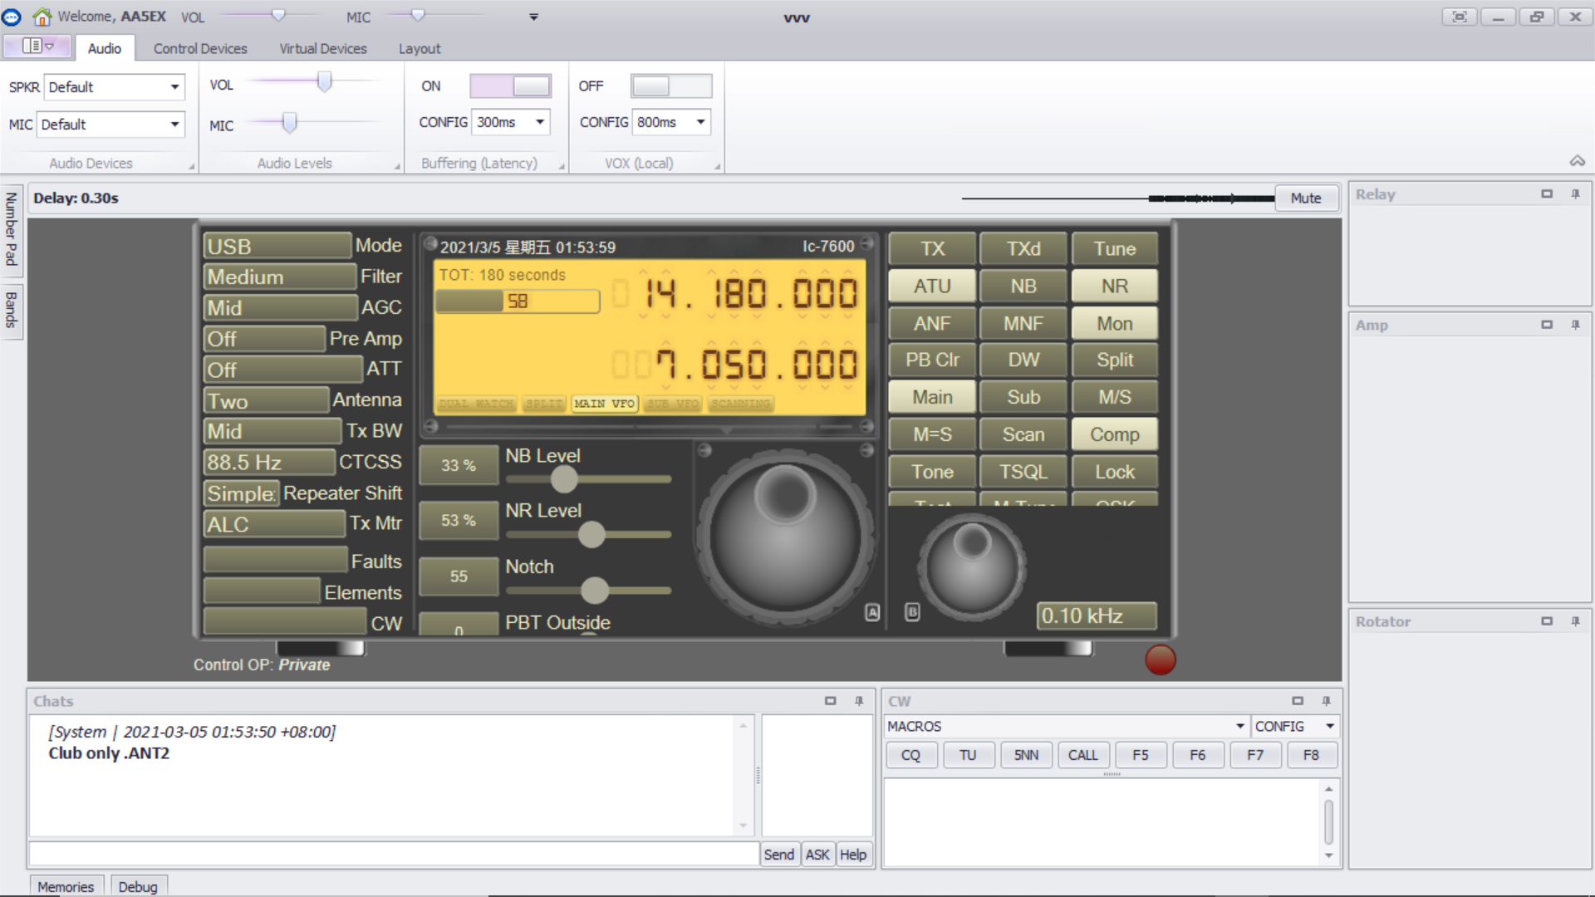
RemoteHams – Control of a Station
Notes:
Let’s login to a web based SDR receiver and see what we can hear.

Slide 22
RemoteHams - Requirements
Download the application
Install the Client
Upload “Official Copy” of FCC license for transmit
Open the application
Select a station
May require permission from the owner to control or transmit
Notes:
Let’s login to a web based SDR receiver and see what we can hear.

Slide 23
Echolink – Logged In
Opening screen
Allows for searching (magnifying glass)
Previous stations (QSOs)
Notes:
Let’s login to a web based SDR receiver and see what we can hear.

Slide 24
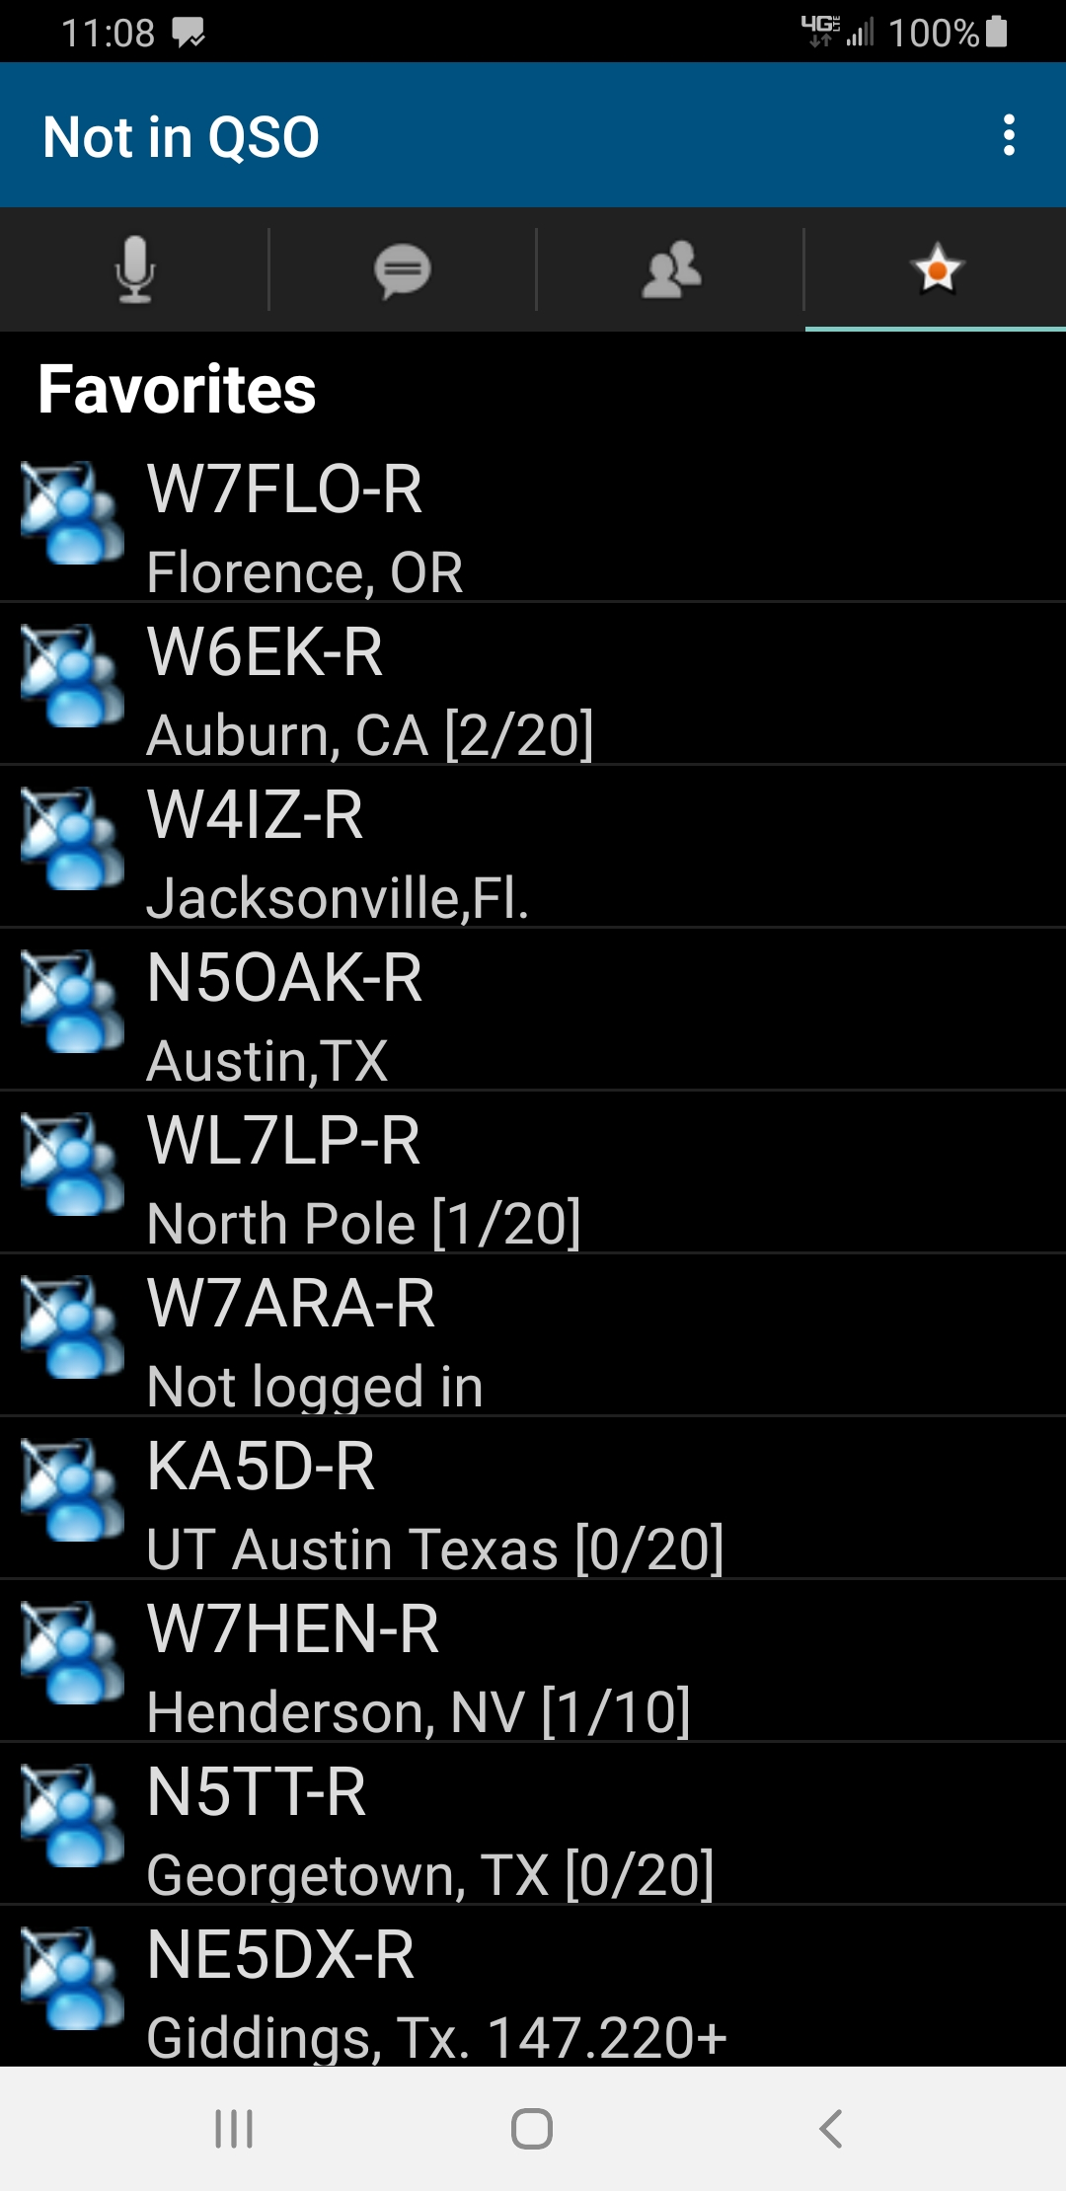
Echolink – Station List
Showing a list of stations online
Notes:
Let’s login to a web based SDR receiver and see what we can hear.

Slide 25
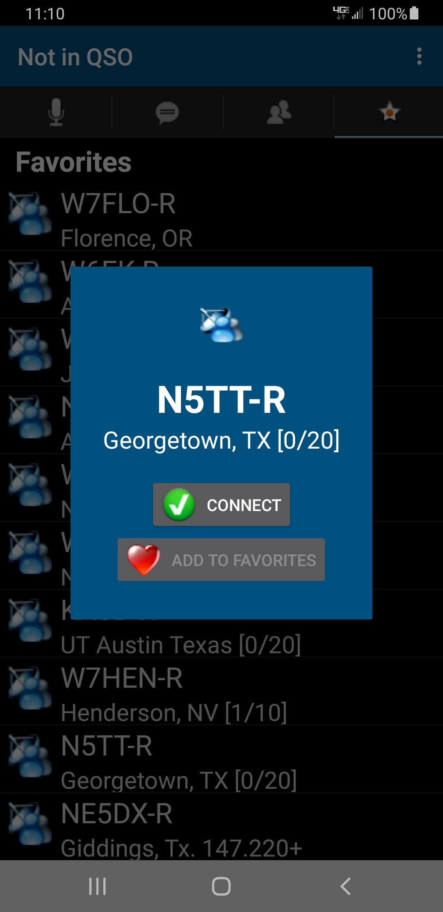
Echolink – Connecting
Connecting to a node (N5TTR)
Shows no other connections [0/20]
Shows location, Georgetown, TX
Notes:
Let’s login to a web based SDR receiver and see what we can hear.

Slide 26
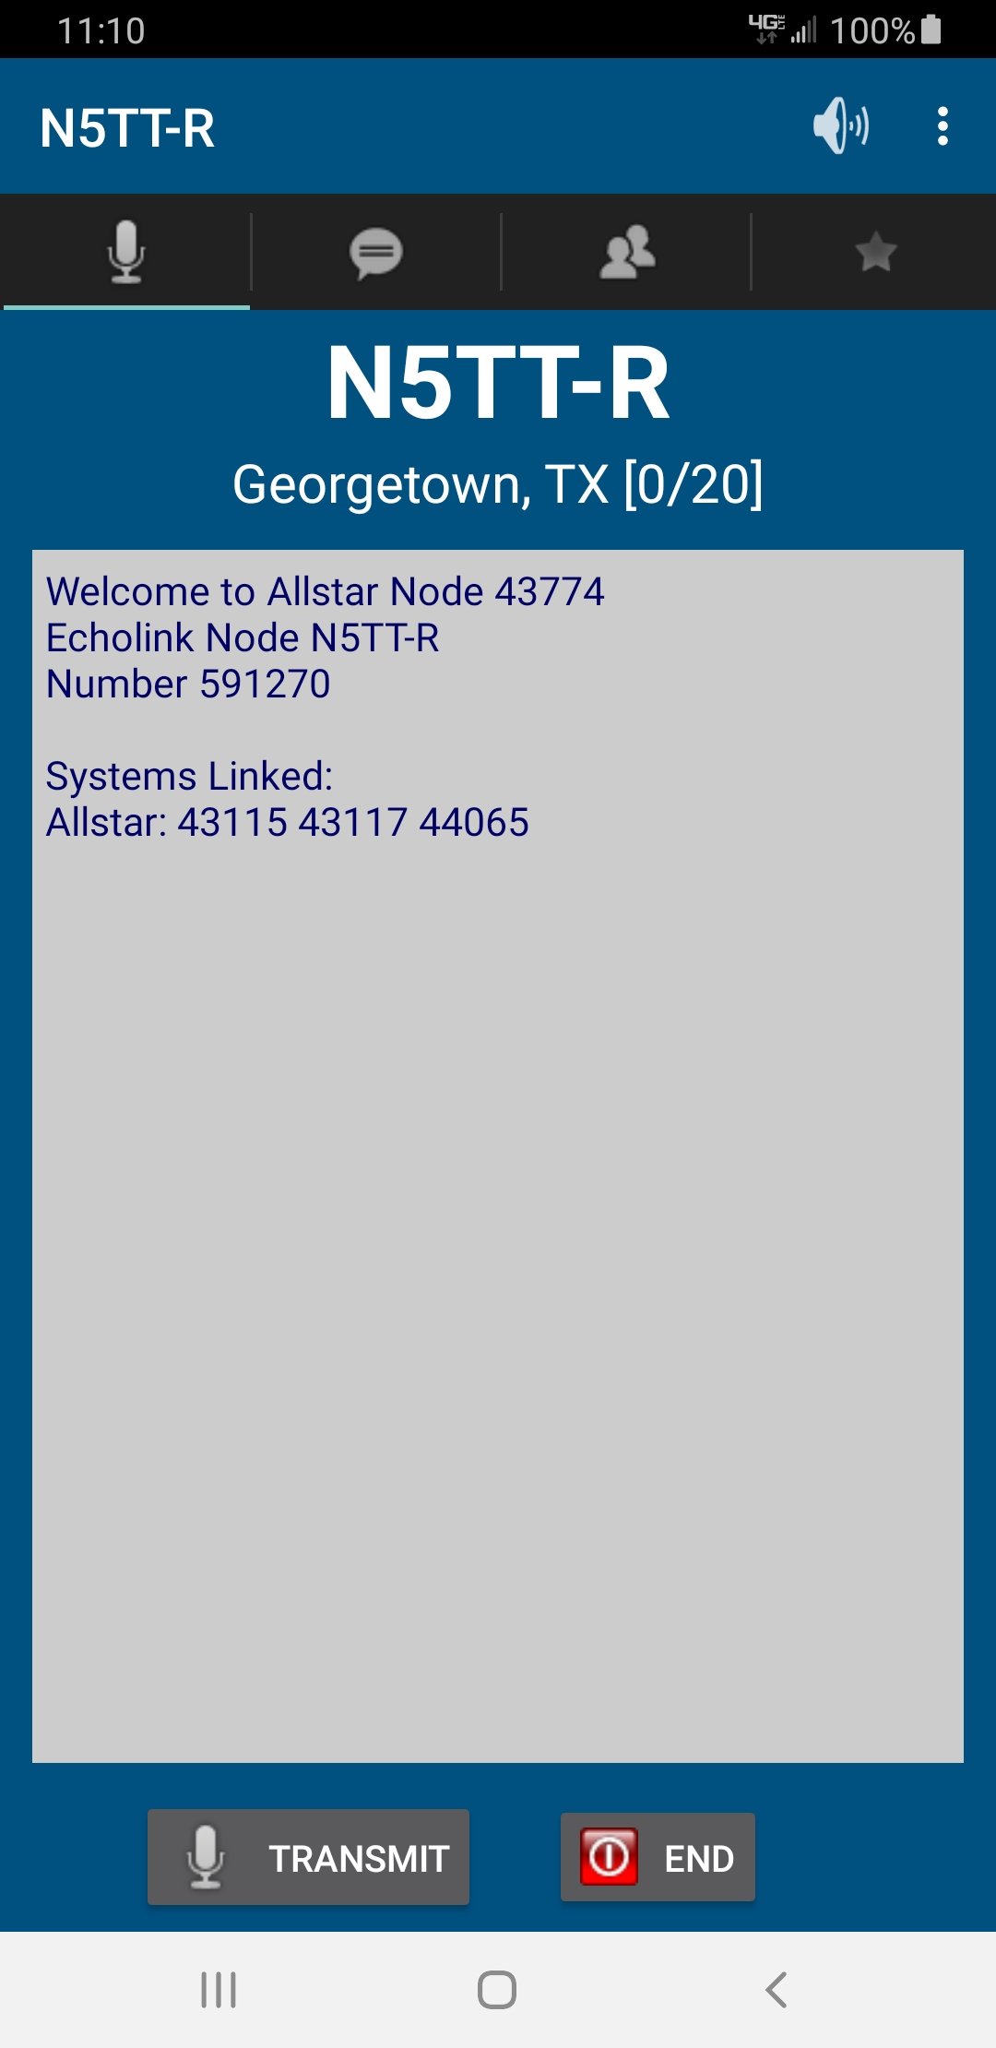
Echolink - Connected
Showing connected to N5TT-R
Echolink Node Number (591270)
Allstar nodes also connected
43115
43117
44065
Currently in “Receive” mode
Able to “Transmit”
“TRANSMIT” button shown
Notes:
Let’s login to a web based SDR receiver and see what we can hear.

Slide 27
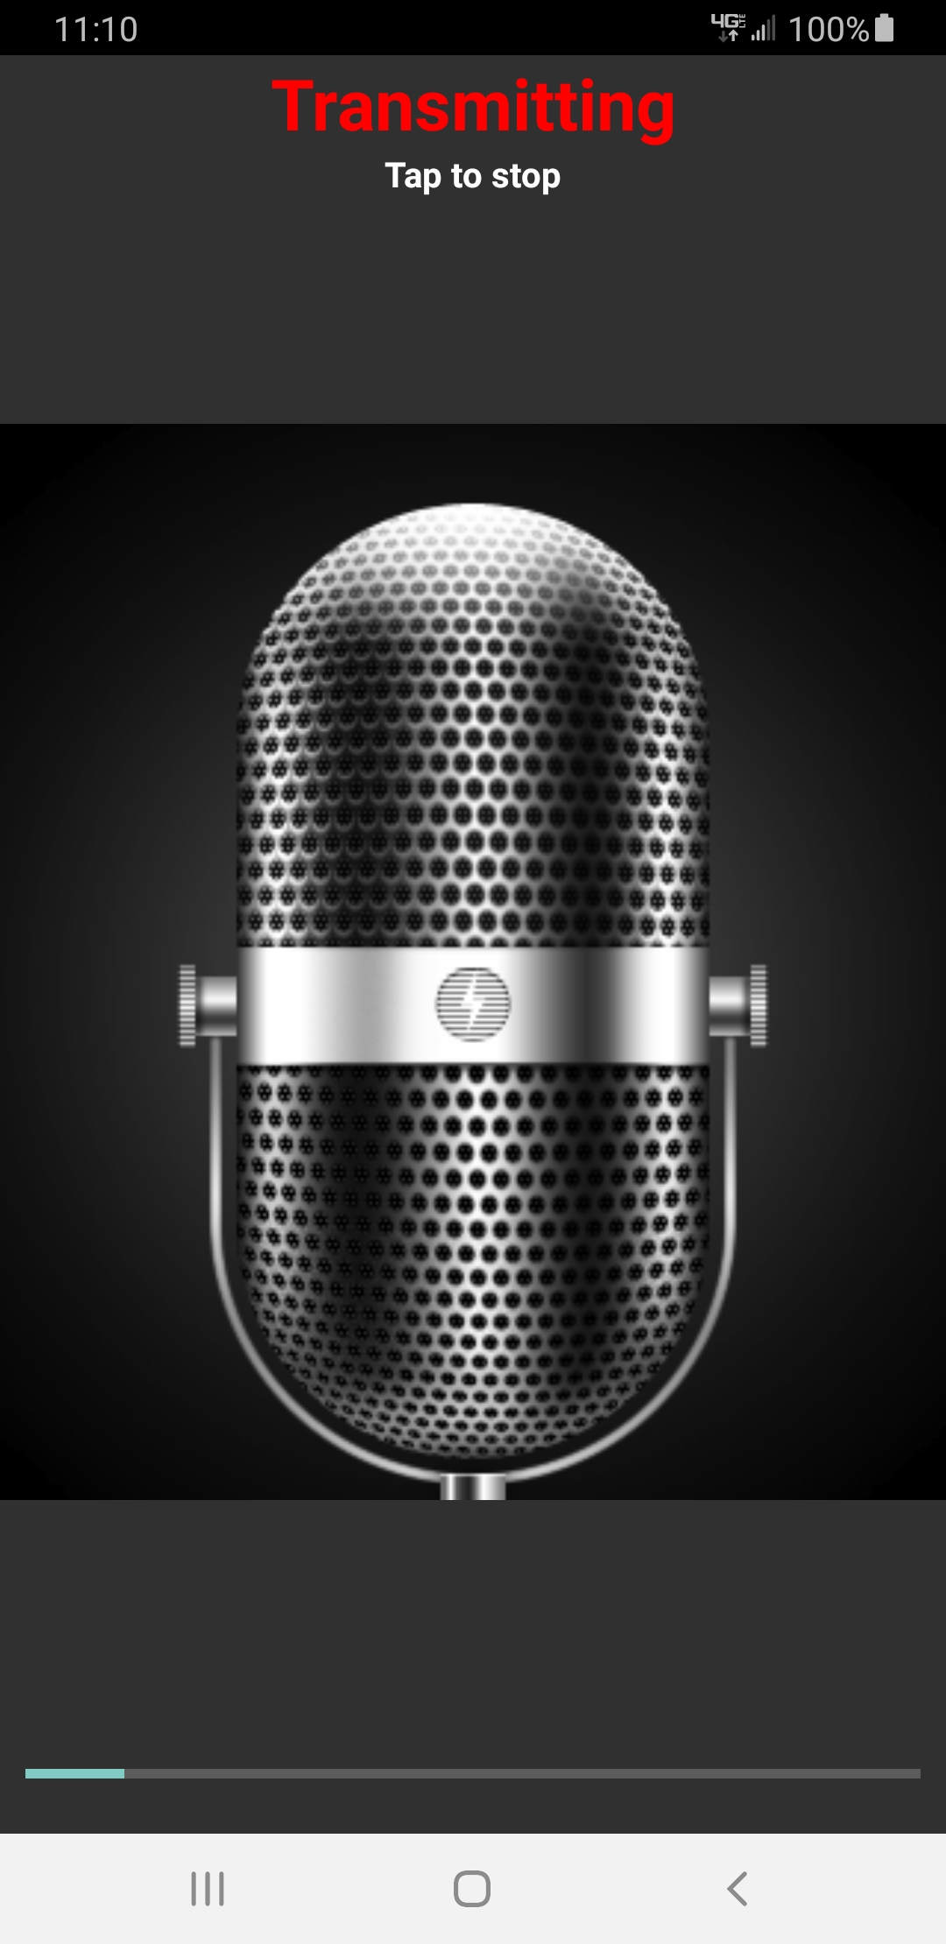
Echolink - Transmitting
Shown currently transmitting
Tap microphone image to stop transmitting
Notes:
Let’s login to a web based SDR receiver and see what we can hear.

Slide 28
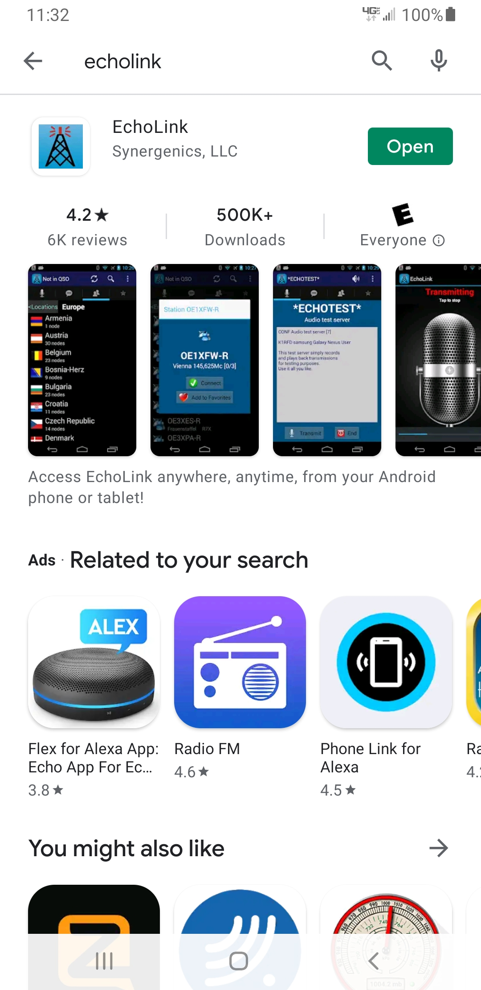
Echolink - Requirements
Any FCC Amateur Call Sign
Download the application
“Register” with an email address
Respond to email from EchoLink
Upload “Official Copy” of FCC license
Receive confirmation from EchoLink
Open application and use EchoLink
Notes:
Let’s login to a web based SDR receiver and see what we can hear.

Slide 29
Useful Links for Software Defined Radio
Web SDR’s – http://www.websdr.org/
http://websdr.k3fef.com:8901/
http://69.27.184.62:8901/
http://sdr.n4but.com/
http://na5b.com:8901/
Featured SDR – Flex Radio
https://www.flexradio.com/
SDR Wiki
https://en.wikipedia.org/wiki/Software-defined_radio
Notes:
Here is a list of a couple of SDR’s, a remote control application for Ham radio operators and a link to the SDR Wiki.

Slide 30
Questions?
Notes:
If you have any questions on this presentation or its contents, please feel free to email me at kilo gulf five uniform foxtrot echo at gmail.com or for more information on my involvement in Amateur Radio see my QRZ page listed below my email address.

Slide 31
Thank you !
Phil Bautista – AA5EX
KG5UFE@GMAIL.COM
https://www.qrz.com/db/AA5EX
Notes:
Thank you for attending this session on SDR and don’t forget to register for the upcoming IEEE Rising Stars conference for 2021 at the URL listed on this page.

Slide 32
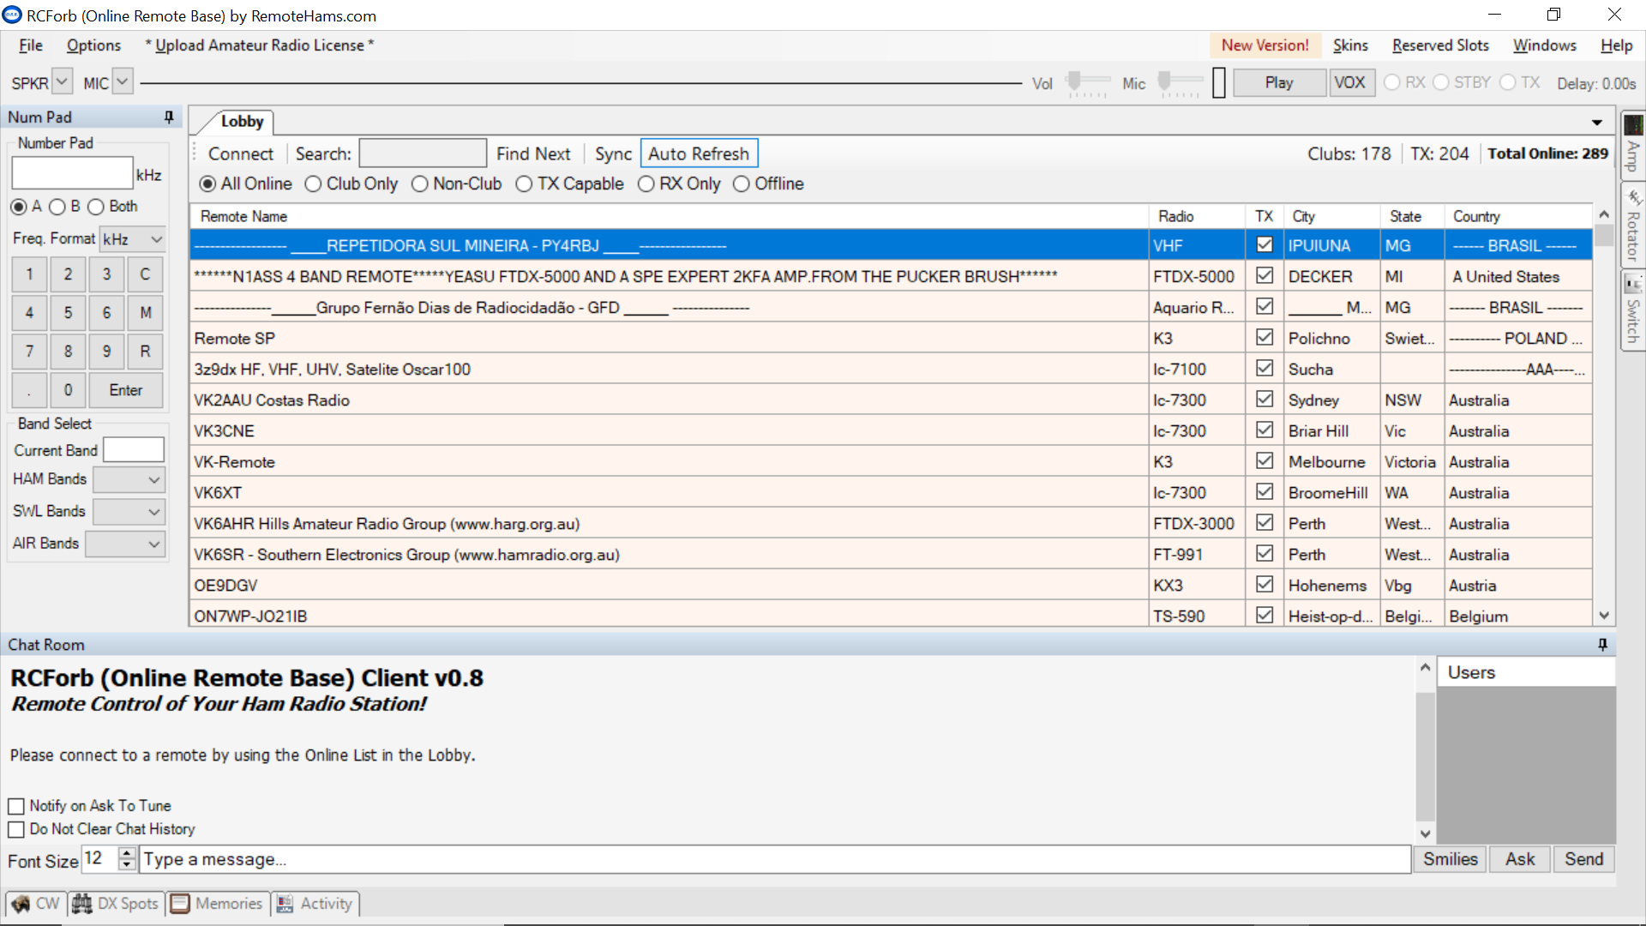
RemoteHams – http://remotehams.com/
RemoteHams application – Listing of stations
Notes:
Let’s login to a web based SDR receiver and see what we can hear.

