Slide 1
Tier1 Group
Design. Build. Remodel.

Slide 2
Introduction
Some Facts
Ageing in Place
Considerations
Technologies
Designing To Current And Future Requirements
Goals
Living Conditions
Research
Collaborate w/ Health Resource
Develop The Plan

Slide 3
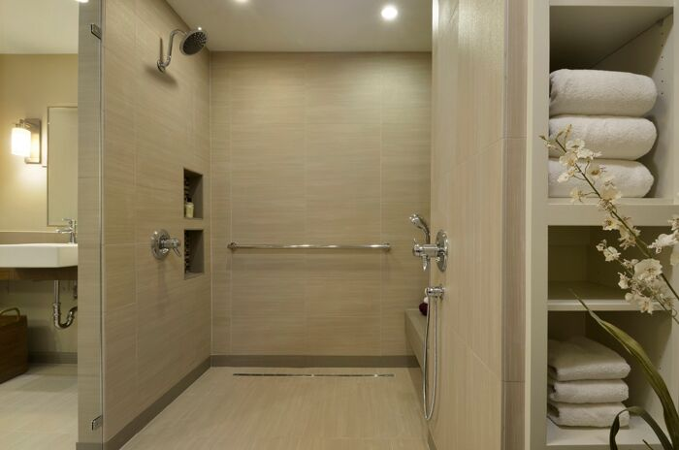
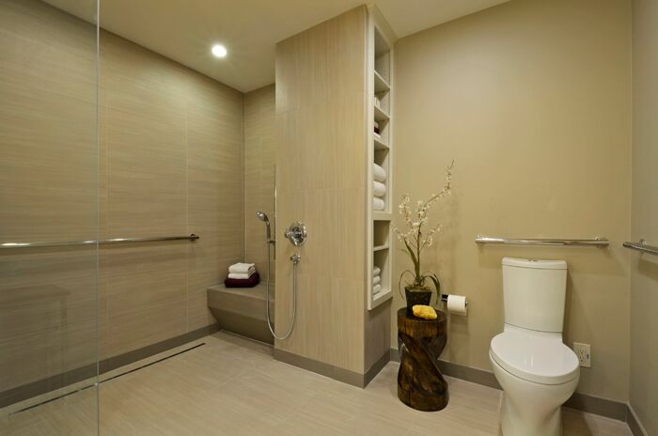
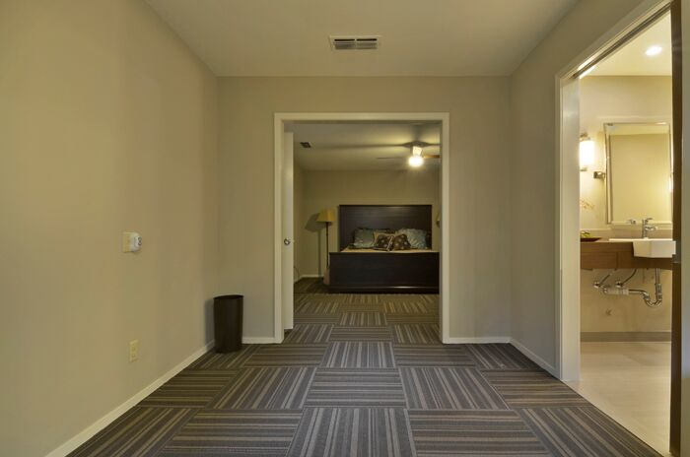
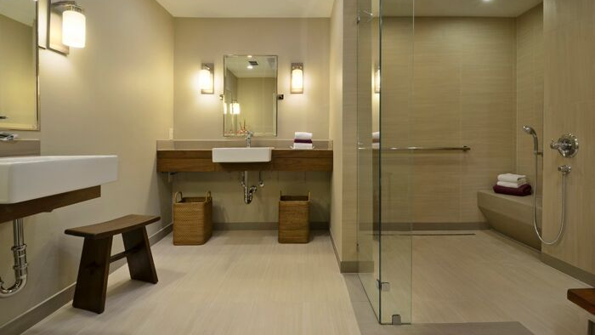
Universal Design
Why is it important?
Listening/Communication
Why is this important to design?

Slide 4
Design
Take all factors into consideration
  What are the factors?

Slide 5
Goals
Short Term
Long Term
The “What-If’s”
Finances
Family
Independence

Slide 6
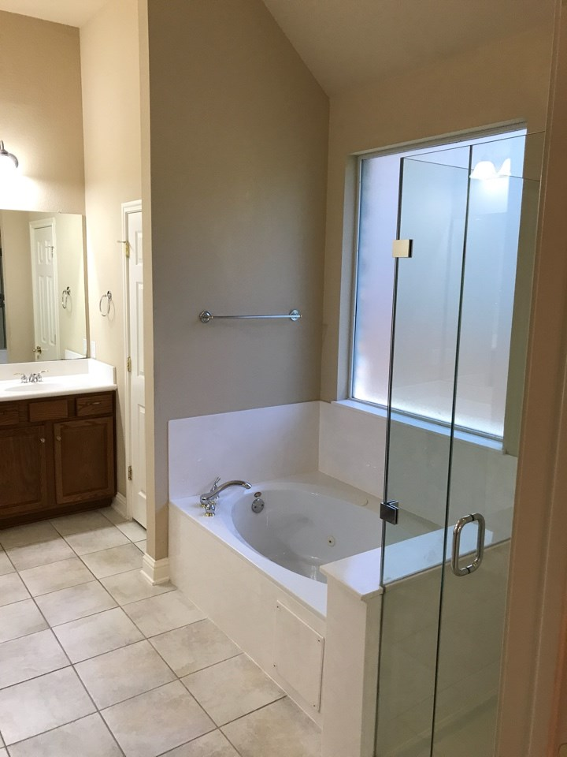
Living Conditions
Current
Future

Slide 7
Research
Current Health Environment
Stroke
Handicap
Disabilities
Ageing in place

Slide 8
Collaborate w/ Health Resource
Who
  Nursing Specialist
  Doctor
  Knowledge Experts
  Ageing In Place Design Specialists

Slide 9
Develop The Plan
Develop Preliminary plans
Develop Preliminary scope work
Identify specification
Identify finishes
Identify components

Slide 10
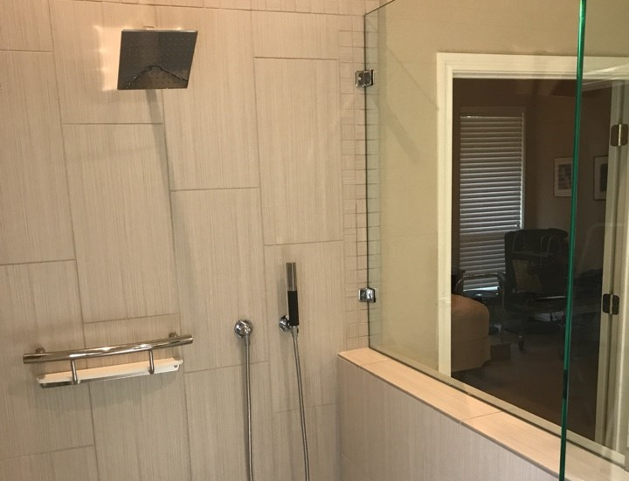
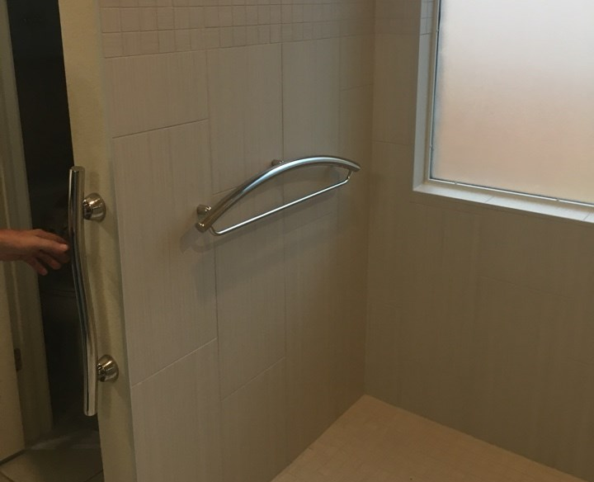
Understanding Materials/Systems
Materials
  Functionality of Components (Tile, Grab Bars, Switches, Handles, Transitions)
Systems
  Functionality of Systems (Lighting, HVAC, Plumbing, Venting)
    Track & Motion Lighting

Slide 12
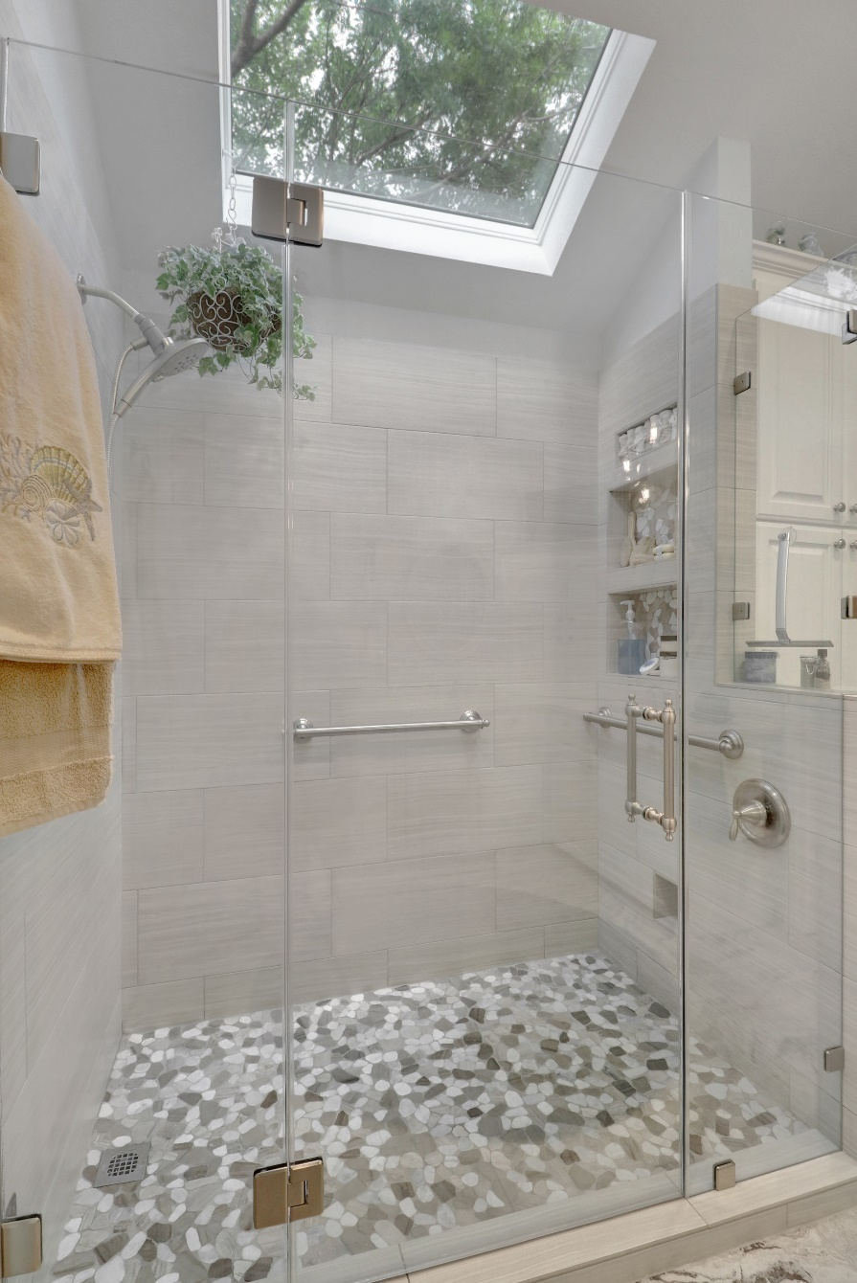
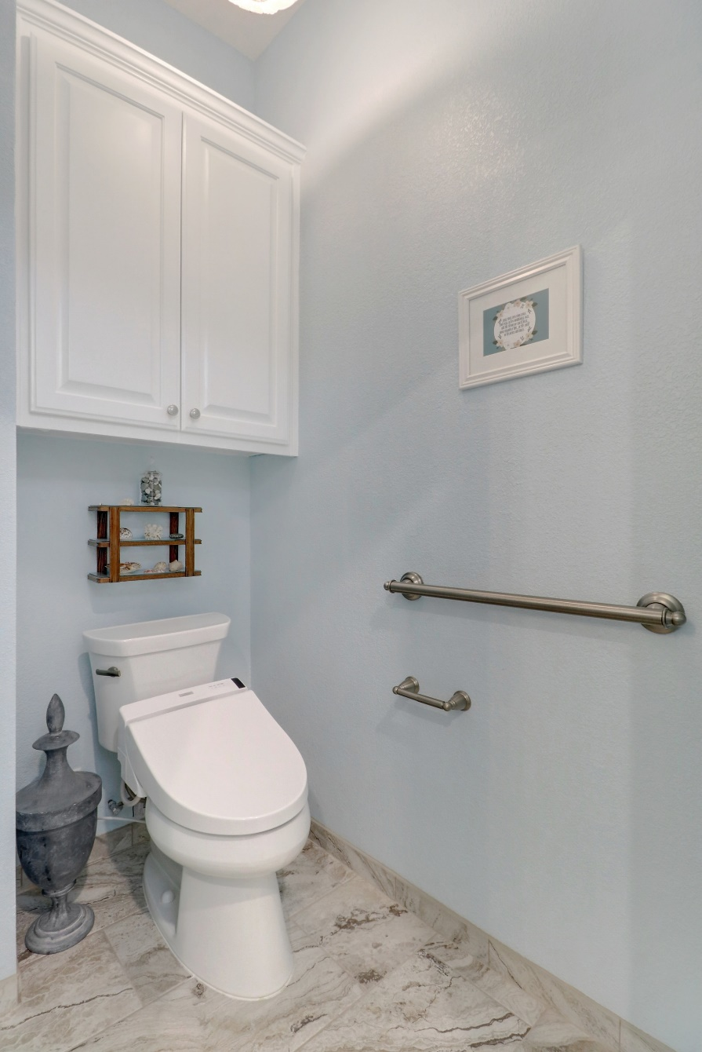

Slide 13
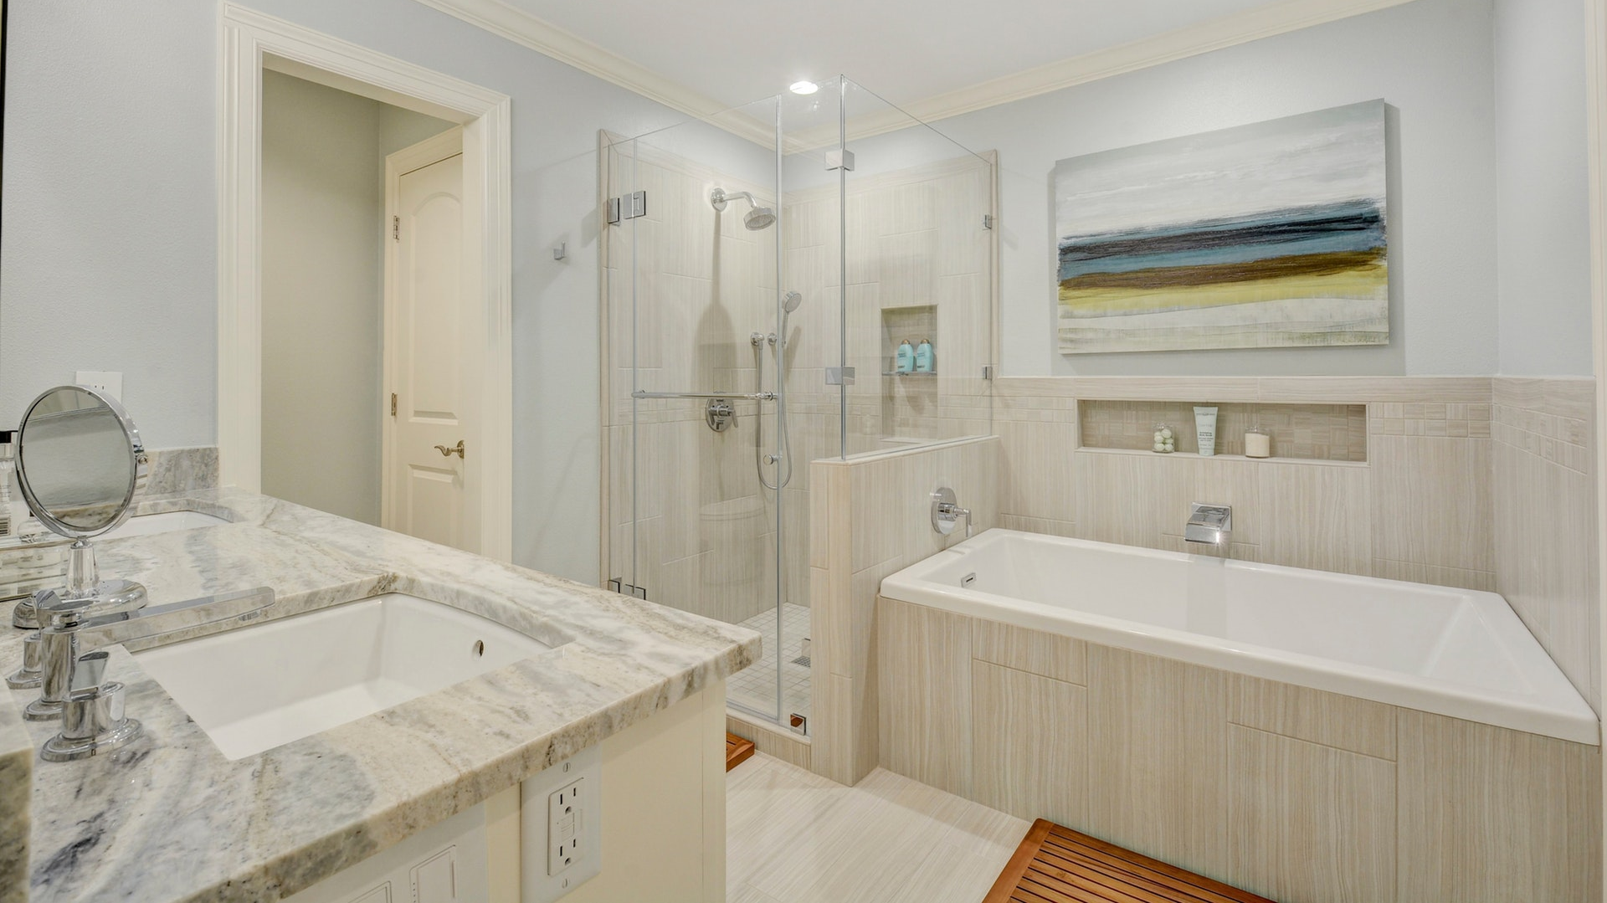

Slide 14
Contact us!
Visit our website at T1Build.com
Call us! 512-986-8306

