Slide 1

IEEE Silicon Valley June 8, 2015 TI Auditorium
Recent progress in physics and technology of oxide based resistive switching memory
Yoshio Nishi
Philip Wong and Simon Wong
Electrical Engineering, Stanford SystemX Alliance
Stanford University
Stanford, California 94305-4070, USA

Slide 2
Emerging Memories
current
STT-MRAM
PCM
RRAM
CBRAM
Spin torque transfer magnetic random access memory
Phase change memory
Resistive switching random access memory
Conductive bridge random access memory
Random access, non-volatile, no erase before write

Slide 3
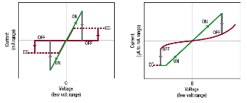
On-Off Switching of RRAM
Unipolar switching
Bipolar Switching

Slide 4
Metal Oxide RRAM (IEDM/VLSI/ISSCC)
Compiled by PhilipWong et al )
 | NiO IEDM 2004 [1] | Cu_{x}O IEDM 2005 [2] | Cu: MoO_{x} IEDM 2006 [3] | Ti:NiO IEDM 2007 [4] | TaO_{x} IEDM 2008 [5] | HfO_{x} IEDM 2008 [6] | NiO VLSI 2009 [7] | HfO_{x} IEDM 2009 [8] | TiON IEDM 2009 [9] | Ta₂O₅/ TiO_{x} VLSI 2010 [10] | WO_{x} IEDM 2010 [11] | WO_{x} IEDM 2010 [12] | GeO/HfON IEDM 2010 [13] | ZrO_{x}/ HfO_{x} IEDM 2010 [14] | N:AlO_{x} VLSI 2011 [15] | HfO_{x}/ AlO_{x} VLSI 2011 [16] | TiO₂/ Al₂O₃ VLSI 2011 [17] | TaO_{x}/ Ta₂O₅ VLSI 2011 [18] | Hf/HfO_{x} IEDM 2011 [19] | Hf/HfO_{x} IEDM 2012 [20] | Graphene/HfO_{x} IEDM 2012 [21] | Ni/HfO_{x} IEDM 2012 [22] | TiON/SiO₂ IEDM 2012 [23] | TaO₂ O_{5-δ} /TaO_{x} VLSI 2012 [24] | TiO_{x}/ Ta₂O₅ VLSI 2012 [25] | WO VLSI 2012 [26] | Al₂O₃/HfO₂/Hf VLSI 2012 [27] | Nb₂O₅ /NbO₂ VLSI 2012 [28] | TaO₂ O_{5-δ} /TaO_{x} IEDM 2011 [29] | TaO₂ O_{5-δ} /TaO_{x} IEDM 2012 [30] | HfO_{x} IEDM 2012 [31] | ISSCC 2013 [32] | AlOx/WOx VLSI 2013 [33] | TaOx/ TiO2 VLSI 2013 [34] | TiO₂/Al₂O₃ IEDM 2013 [35] | TaON IEDM 2013 [36] | TaOx/ TiO₂ IEDM 2013 [37] | Ta₂O₅ IEDM 2013 [38] | DSA TiOx/ HfOx IEDM 2013 [39] | CuTe/ Insulator ISSCC 2014 [40]
2D/3D Geometry | 2D Planar | 2D Planar | 2D Planar | 2D Planar | 2D Planar | 2D Planar | 2D Planar | 2D Planar | 2D Planar | 2D Planar | 2D Planar | 2D Planar | 2D Planar | 2D Planar | 2D Planar | 2D Planar | 2D Planar | 2D Planar | 2D Planar | 2D Planar | 2D Planar | 2D Planar | 2D Planar | 2D Planar | 2D Planar | 3D Vertical | 2D Planar | 2D Planar | 3D Vertical | 3D Vertical | 3D Vertical | 3D Planar | 2D Planar | 2D Planar | 2D Planar | 2D Planar | 3D Vertical | 3D Vertical | 2D Planar | 2D Planar
SwtchTyp | Uni | Bi | Bi | Uni | Bi | Bi | Uni | Bi | Uni | Uni | Bi | Bi | Bi | Bi | Bi | Uni | Bi | Bi | Bi | Bi | Bi | Bi | Uni | Bi | Bi | Bi | Bi | Bi | Bi | Bi | Bi | N/A | Bi | Bi | Bi | Uni | Bi | Bi | Bi | Bi
Structure | 1T-1R | 1T-1R | 1R | 1T-1R | 1T-1R | 1T-1R | 1R | 1T-1R | 1T-1R | 1T-1R | 1R | 1T-1R | 1R | 1R | 1T-1R | 1R | 1T-1R | 1R | 1T-1R | 1T-1R | 1T-1R | 1T-1R | 1T-1R | 1T-1R | 1R | 1R | 1T-1R | 1S-1R | 1R | 1R | 1R | 1S-1R | 1T-1R | 1D-1R | 1R | 1R | 1R | 1R | 1R | 1S-1R
Cell Area (μm²) | ~0.2 | ~0.03 | ~25 | ~0.49 | ~0.25 | ~0.1 | 0.0023 (48nm) | 0.0009 (30nm) | 0.19 | ~3 | 8.1E-5 (9nm) | 0.0036 (60nm) | 11300 | 0.0025 (50nm) | 1 | ~6000 | 0.0029 (54nm) | ~9000 | 0.0001 (10nm) | 0.0016(40nm) | 1 | 0.0014 | 0.0308 | 0.0324 | 0.0029 | 0.001 | 0.0035 | 0.0225 | ~30nm (height) | N/A | ~4 | 0.000576 (24 nm) | 0.0324 (.18um) | 10000 | 0.0016 (40nm) | 0.0009 (30nm) | 0.2 | ~0.008 | .00011(12nm Via) | 0.004374 (27 nm)
Speed | ~5us | ~50ns | ~10ns | ~5ns | ~10ns | ~5ns | 180ns | ~300ps | ~10us | ~1us | ~1us | ~50ns | ~20ns | ~40ns | N/A | ~30ns | ~10ns | ~10ns | ~10ns | ~10ns | N/A | ~50ns | ~100us | N/A | ~10ns | ~50ns | ~10ns | ~10us | ~1us | ~1us | ~100ns | 230 us (Chip) | 100ns | 50ns | 10ns | N/A | ~1us | N/A | 100ns | 2 us (Chip)
DC Peak Voltage | <3V | <3V | <2V | <3V | <2V | <1.5V | <2V | <2.5V | <4V | <3V | <4V | <3V | <3V | <2V | <2V | <2.5V | <3V | <2.5V | <1.5V | <1.5V | <2.5V | <4.5V | <2.5V | <3V | <4V | <3V | <2V | <2V | <5V | <3.5V | <3.5V | N/A | N/A | <6.5V | <2V | <5V | <6V | <1V | <2.5V | <6.5V
DC Peak Current | ~2mA | ~45μA | ~0.5mA | ~100μA | ~17μA | ~25μA | ~90μA | ~200 μA | ~150 μA | ~200 μA | ~1μA | ~1mA | ~100nA | ~50μA | ~50nA | ~1mA | ~20μA | ~30μA | ~50 μA | ~25μA | ~200μA | ~200pA | ~60μA | ~80μA | ~50μA | ~400μA | ~500nA | ~800μA | ~80μA | ~1μA | ~50μA | N/A | N/A | ~100μA | ~1μA | ~800μA | ~0.1μA | ~100μA | ~1mA | N/A
HRS/LRS Ratio | >10 | >10 | >10 | >90 | >10 | >1,000 | >25 | >1000 | >20 | >100 | >10 | >10 | >700 | >10 | >100 | >1000 | >10 | >100 | >10 | >10 | >10 | >10 | >100 | >1000 | >10 | >10 | >10 | >10 | N/A | >20 | >10 | N/A | >10 | >10⁵ | >100 | >100 | >10 | 8 | >10 | N/A
Endurance | 10⁶ | 600 | 10⁶ | 100 | 10⁹ | 10⁶ | 7x10³ | 10¹⁰ | 10⁶ | 10⁵ | 200 | 10⁶ | 10⁶ | 10⁶ | 10⁵ | 10⁶ | N/A | 10¹² | 5x10⁷ | 10⁷ | N/A | 10⁵ | 10⁶ | N/A | N/A | 6x10² | 10⁷ | 10⁶ | 10² | 10⁷ | 10⁸ | N/A | 10⁷ | 10¹² | N/A | 15 | 10¹⁰ | 10⁶ | 10⁷ | N/A
Retention | 300h@ 150℃ | 30h@ 90℃ | 28h@ 85℃ | 1000h@ 150℃ | 3000h@ 150℃ | 10h@ 200℃ | N/A | 28h@ 150℃ | 1000h@150℃ | 120h@ 100℃ | 280h T=N/A | 2000h@150℃ | 3h@ 125℃ | 28h@125℃ | 28h@ 125℃ | 28h@ 150℃ | 100h@ 150℃ | 3h@ 200℃ | 30h@ 250℃ | 3h@ 200℃ | 27h@ 100℃ | 10yr@85℃ | 400h@ 150℃ | 100h@ 150℃ | 20@ 150℃ | N/A | 3h@250℃ | N/A | N/A | 2.8@ 85℃ | 28h@ 125℃ | N/A | 100h@85℃ | 0.27h@RT | 168h@ 125℃ | 300h@ 300℃ | 2.8h@RT | 2.8h@85℃ | 12h@ 125℃ | N/A
Notes:
To view then entire table, play in slideshow mode and click to advance slide. It will show the entire table. The green arrow shows you where the motion begins, and the red arrow shows where it ends.
----- 11/22/2013 re-organized by Henry
----- 12/27/2013 IEDM 2013 data added by Henry
----- 05/10/2014 ISSCC 2014 data added by Henry
[1] I. G. Baek, et al. Highly scalable nonvolatile resistive memory using simple binary oxide driven by asymmetric unipolar voltage pulses, IEDM 2004. p.587
[2] A. Chen, et al. Non-volatile resistive switching for advanced memory applications, IEDM 2005, p.746
[3] D. Lee, et al. IEDM 2006, p.1
[4] K. Tsunoda, et al. Low power and high speed switching of Ti-doped NiO ReRAM under the unipolar voltage source of less than 3 V, IEDM 2007, p.767
[5] Z. Wei, et al. Highly reliable TaOx ReRAM and direct evidence of redox reaction mechanism, IEDM 2008, p.293
[6] H. Y. Lee, et al. Ti buffer layer in robust HfO2 based RRAM, IEDM 2008, p.297
[7] B. Lee et al. NiO resistance change memory with a novel structure for 3D integration and improved confinement of conduction path, VLSI 2009, p. 28
[8] Y. S. Chen, et al. Highly Scalable Hafnium Oxide Memory with Improvements of Resistive Distribution and Read Disturb Immunity, IEDM 2009, pp. 95-98.
[9]Y. H. Tseng, et al. High Density and Ultra Small Cell Size of Contact ReRAM (CR-RAM) in 90nm CMOS Logic Technology and Circuits, IEDM 2009, pp. 99-102.
[10] Y. Sakotsubo, et al. A New Approach for Improving Operating Margin of Unipolar ReRAM using Local Minimu m of Reset Voltage. VLSI 2010.
[11] C. Ho, et al. 9nm Half-Pitch Functional Resistive Memory Cell with <1uA Programming Current Using Thermally Oxidized Sub-Stoichiometric WOx Film, IEDM 2010, pp.436-439
[12] W. C. Chien, et al. A forming-free WOx resistive memory using a novel self-aligned field enhancement feature with excellent reliability and scalability, IEDM 2010, pp. 440–443
[13] C.-H. Chang, et al. High Performance Ultra-Low Energy RRAM with Good Retention and Endurance, IEDM 2010, pp. 448-451
[14] J. Lee, et al. Diode-less nano-scale ZrOx/HfOx RRAM device with excellent switching uniformity and reliability for high-density cross-point memory applications, IEDM 2010, pp. 452–455
[15] W. Kim, et al. Forming-free nitrogen-doped AlOx RRAM with sub-uA programming current, VLSI 2011, pp. 22–23
[16] X.A. Tran, et al. High Performance Unipolar AlOy/HfOx/Ni based RRAM Compatible with Si Diodes for 3D Application, VLSI 2011, pp. 44-45
[17] J. Yi, et al. Highly Reliable and Fast Nonvolatile Hybrid Switching ReRAM Memory Using Thin Al2O3 Demonstrated at 54nm memory Array, VLSI 2011, pp. 48-49
[18] Y.-B. Kim, Bi-layered RRAM with unlimited endurance and extremely uniform switching, VLSI 2011, pp. 52–53
[19] B. Govoreanu, 10x 10 nm2 Hf/HfOx crossbar resistive RAM with excellent performance, reliability and low-energy operation, IEDM 2011, pp. 729–732.
[20] Y. Y. Chen, et al. Understanding of the Endurance Failure in Scaled HfO2-based 1T1R RRAM through Vacancy Mobility Degradation, IEDM 2012
[21] H. Y. Chen, et al. Electrode/Oxide Interface Engineering by Inserting Single-Layer Graphene: Application for HfOx–Based Resistive Random Access Memory, IEDM 2012
[22] X. P. Wang, et al. Highly Compact 1T-1R Architecture (4F2 Footprint) Involving Fully CMOS Compatible Vertical GAA Nano-Pillar Transistors and Oxide-Based RRAM Cells Exhibiting Excellent NVM Properties and Ultra-Low Power Operation, IEDM 2012
[23] W. C. Shen, et al. High-K Metal Gate Contact RRAM (CRRAM) in Pure 28nm CMOS Logic Process, IEDM 2012
[24] T. Ninomiya, et al. Conductive Filament Scaling of TaOx Bipolar ReRAM for Long Retention with Low Current Operation, VLSI, 2012
[25] H. D. Lee, et al. Integration of 4F2 Selector-less Crossbar Array 2Mb ReRAM Based on Transition Metal Oxides for High Density Memory Applications, VLSI, 2012
[26] W. C. Chien, et al. Multi-Layer Sidewall WOx Resistive Memory Suitable for 3D ReRAM, VLSI 2012
[27] L. Goux, et al. Ultralow sub-500nA operating current high-performance TiN\Al2O3\HfO2\Hf\TiN bipolar RRAM achieved through understanding-based stack-engineering, VLSI, 2012
[28] S. Kim, et al. Ultrathin (<10nm) Nb2O5/NbO2 Hybrid Memory with Both Memory and Selector Characteristics for High Density 3D Vertically Stackable RRAM Applications, VLSI 2012
[29] I. G. Baek, et al. Realization of Vertical Resistive Memory (VRRAM) using cost effective 3D Process, IEDM 2011
[30] S. G. Park, et al. A Non-Linear ReRAM Cell with sub-1μA Ultralow Operating Current for High Density Vertical Resistive Memory (VRRAM), IEDM 2012
[31] H. Y. Chen, et al. HfOx Based Vertical Resistive Random Access Memory for Cost-Effective 3D Cross-Point Architecture without Cell Selector, IEDM 2012
[32] T.-Y. Liu, et al. A 130.7mm2 2-Layer 32Gb ReRAM Memory Device in 24nm Technology, ISSCC 2013
[33] T. L. Song Reliability Significant Improvement of Resistive Switching Memory by Dynamic Self-adaptive Write Method, VLSI 2013
[34] C. -W. Hsu Self-Rectifying Bipolar TaOx/TiO2 RRAM with Superior Endurance over 1012 Cycles for 3D High-Density Storage-Class Memory, VLSI 2013
[35] B. Govoreanu, et al. Vacancy-Modulated Conductive Oxide Resistive RAM (VMCO-RRAM): An Area-Scalable Switching Current, Self-Compliant, Highly Nonlinear and Wide On/Off-Window Resistive Switching Cell, IEDM 2013
[36] M.-C. Hsieh, et al. Ultra High Density 3D Via RRAM in Pure 28nm CMOS Process, IEDM 2013
[37] C. -W. Hsu, et al. 3D Vertical TaOxTiO2 RRAM with over 103 Self-Rectifying Ratio and Sub-μA Operating Current, IEDM 2013
[38] E. Cha, et al. Nanoscale (~10nm) 3D vertical ReRAM and NbO2 threshold selector with TiN electrode, IEDM 2013
[39] Y. Wu, et al. First Demonstration of RRAM Patterned by Block Copolymer Self-Assembly, IEDM 2013
[40] R. Fackenthal, et al. A 16Gb ReRAM with 200MB/s and Write and 1GB/s Read in 27nm Technology, ISSCC 2014

Slide 5
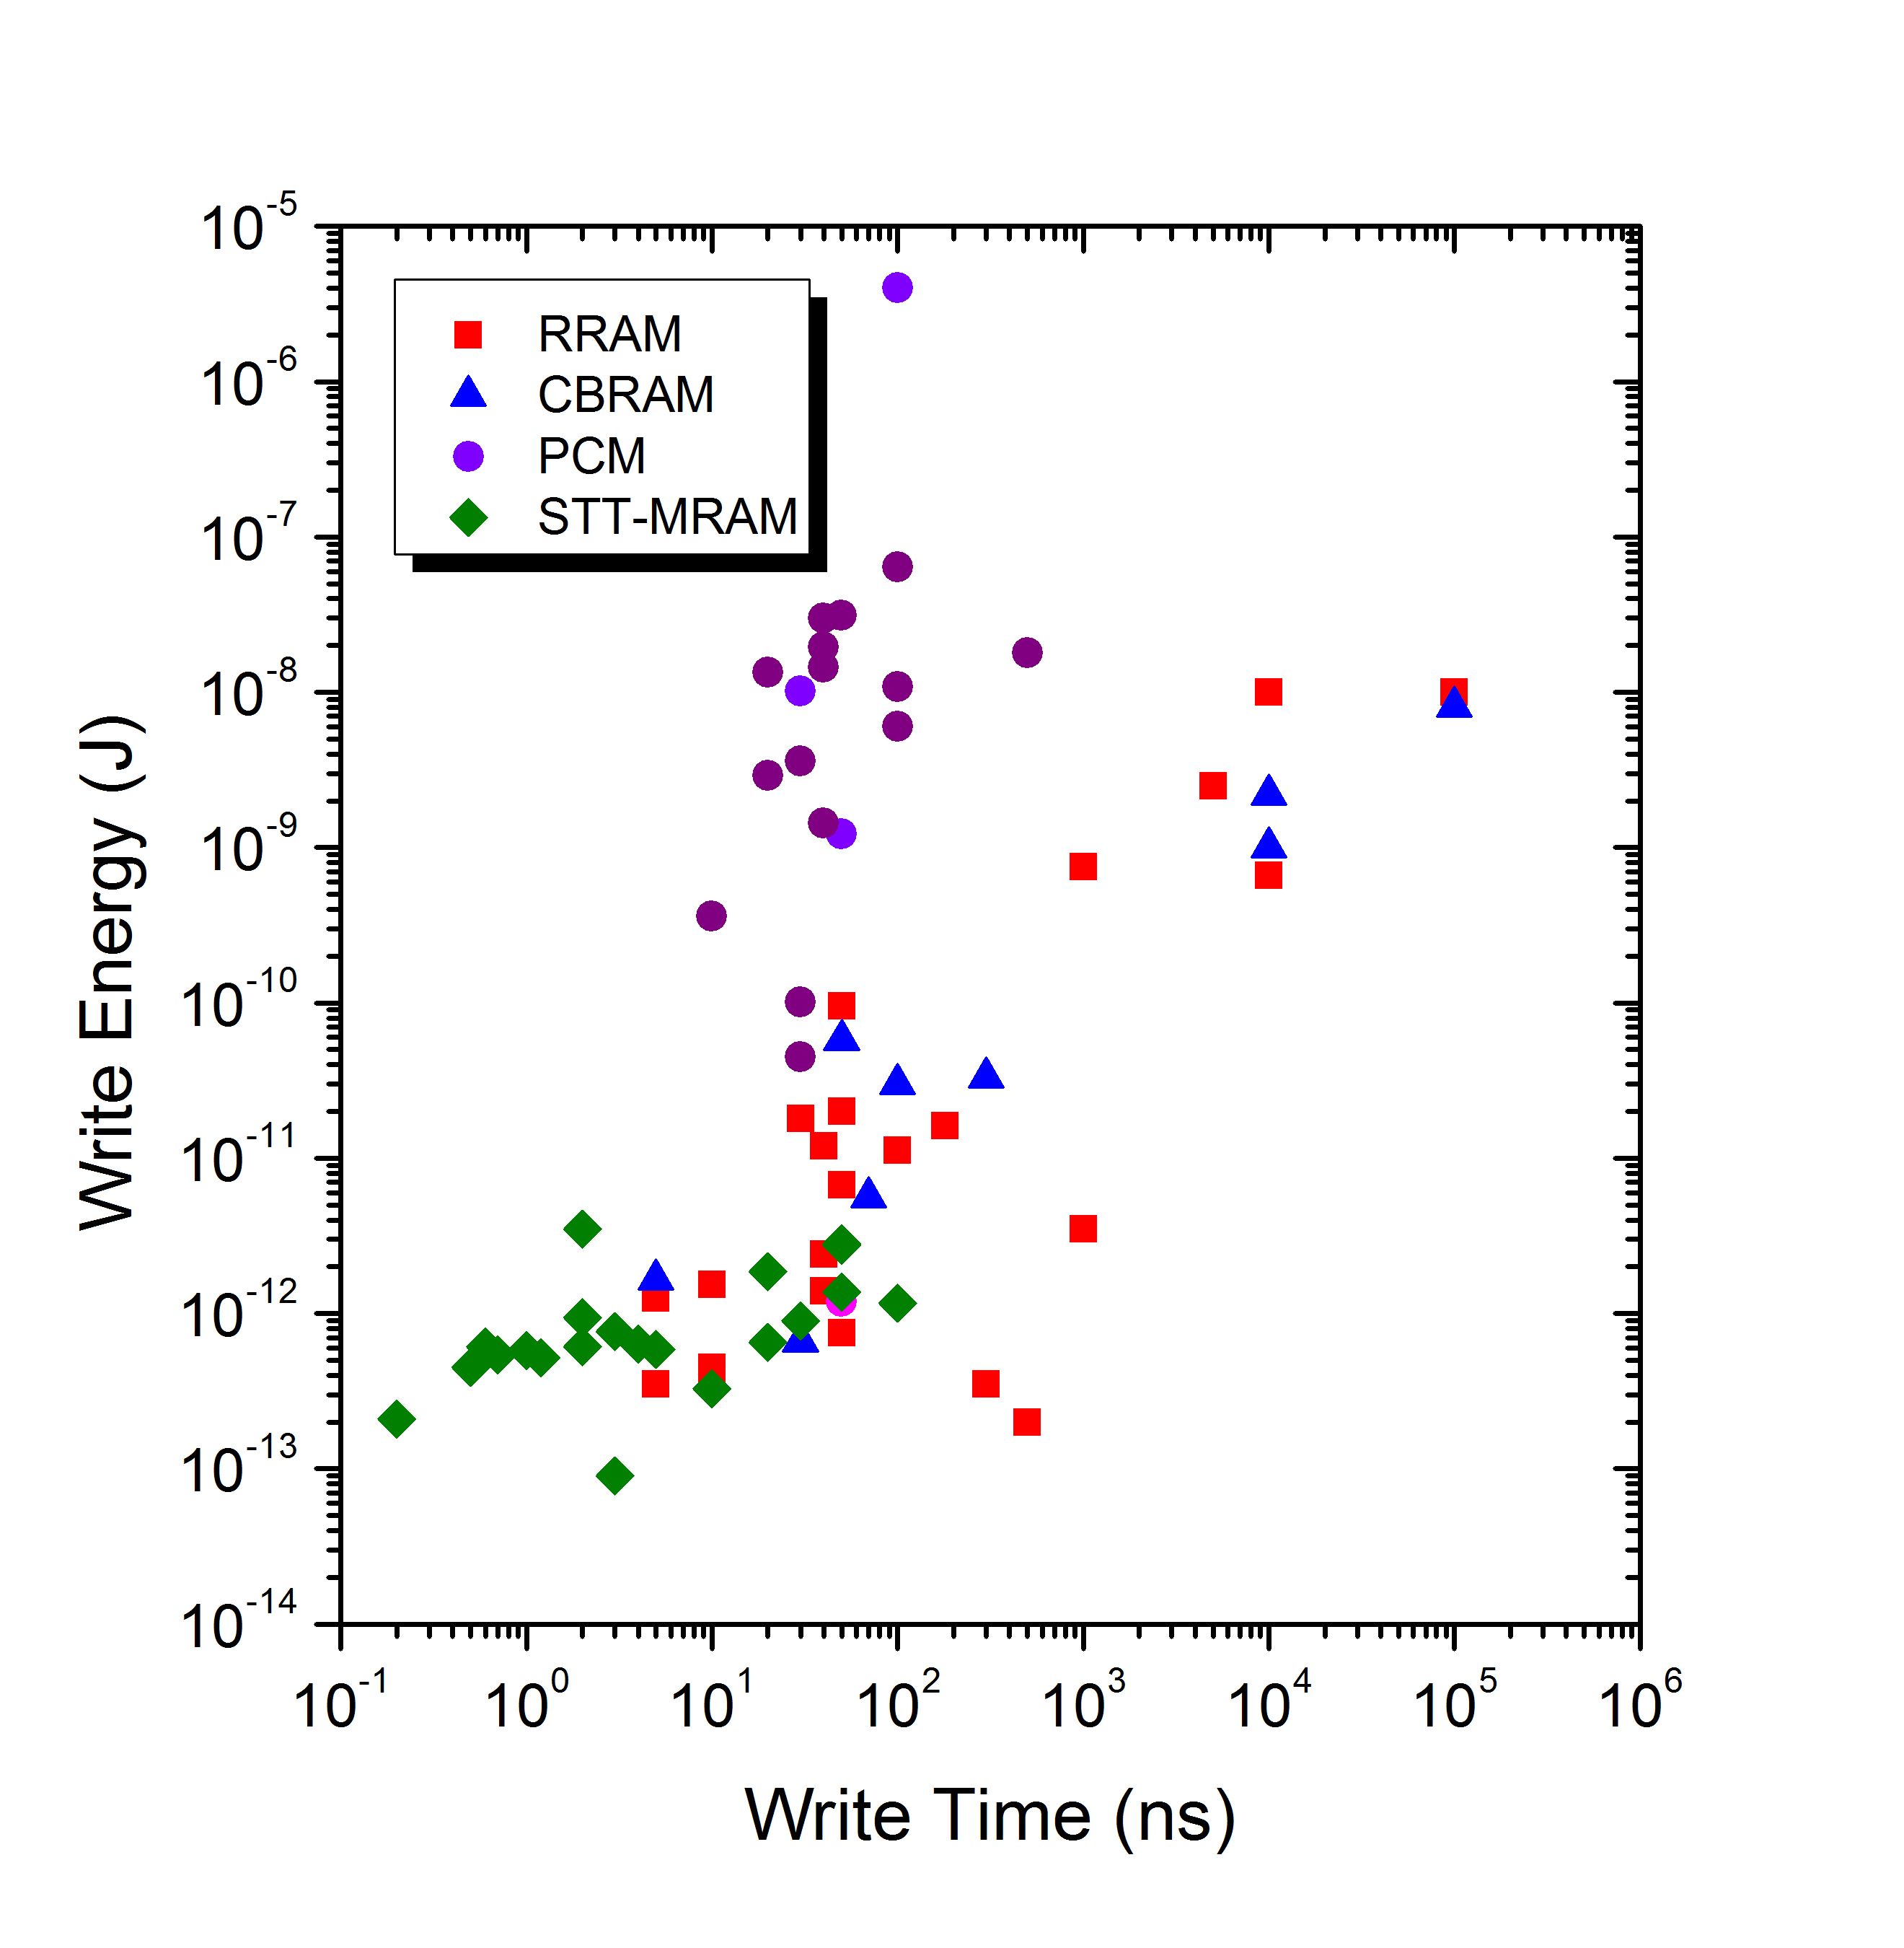
Energy vs Speed Trade-Off @ Device Level
Speed limited by physics
Nothing faster than STT-MRAM
Good corner
https://nano.stanford.edu/stanford-memory-trends
Notes:
For RRAM and CBRAM, the energy (reset is the larger of the two energies of set and reset) for reset is mostly consumed during the time when the pulse is on and the device is still at the LRS. Therefore the longer the write time, the larger the energy and the relationship is linear (the data on the plot also has a slope of 1), and the write energy is simply a function of the resistance of the memory at LRS. Energy = power * time. So, the reset mechanism is mainly related to the power dissipation in the device irrespective of the device area (the different data points are for different device areas). For RRAM and CBRAM, to lower the energy, you want to use a large voltage pulse to get the smallest pulse width you can get away with.
For PCM, the write energy does not have a strong dependence on the write time because the write time (reset) is determined by the minimum melt quench time and the dynamic resistance of the cell (which is inversely proportional to the cell area). The various energy for the different data points are simply due to the difference device areas of the devices.
For STT-MRAM, the switching time tau is proportional to 1 / [(V_p/V_0) – 1], and the switching energy is equal to V_p^2*tau/R.
For faster switching, current larger than I_co is needed (I_co vs log t curve goes up quickly for t < 1 ns), and V_p has to increase. For larger V_p, the energy has to increase. For smaller V_p, the switching time increases, and the net result is that the switching energy decreases slightly (almost constant, depending on the switching direction) for longer write times.

Slide 6
Write Energy Scaling @ Device Level
PCM: Proportional to area
Draw a line for NAND and NOR in the energy plot
Draw a line for wire energy
RRAM & CBRAM: Material and resistance values
STT-MRAM Proportional to area
NAND
Good corner
https://nano.stanford.edu/stanford-memory-trends
Notes:
the series of data points for PCM at 180 nm node do point out that materials and device design do make a difference of about 100X. I referred to it in slide 22 (there I only say 10X because the low hanging fruits have already been picked).

Slide 7
Memory Chip Capacity
This is the editable version
128G, Samsung, Sandisk, Micron, (ISSCC)
8G, Samsung
(ISSCC)
16G,
Micron/Sony
(ISSCC)
64M, Unity (ISSCC)
1G, Samsung
(ISSCC)
32G, Sandisk/Toshiba
(ISSCC)
64M, Toshiba
(ISSCC)
1G, Hynix
(VLSI)
8M, Infineon,
Qualcomm,
TDK-Headway,
(VLSI)
64M, Elpida
(ISSCC)
1M, Fudan
(VLSI)
4M, Sony
(ISSCC)
8M, Infineon
(ISSCC)
https://nano.stanford.edu/stanford-memory-trends
Notes:
[64M, Unity (ISSCC)] Chevallier, C.J.; Chang Hua Siau; Lim, S.F.; Namala, S.R.; Matsuoka, M.; Bateman, B.L.; Rinerson, D., "A 0.13µm 64Mb multi-layered conductive metal-oxide memory," Solid-State Circuits Conference Digest of Technical Papers (ISSCC), 2010 IEEE International , vol., no., pp.260,261, 7-11 Feb. 2010, doi: 10.1109/ISSCC.2010.5433945
[1M, Fudan Univ (VLSI)] Wang, M.; Luo, W.J.; Wang, Y.L.; Yang, L.M.; Zhu, W.; Zhou, P.; Yang, J. H.; Gong, X.G.; Lin, Y.Y.; Huang, R.; Song, S.; Zhou, Q. T.; Wu, H.M.; Wu, J.G.; Chi, M. H., "A novel CuxSiyO resistive memory in logic technology with excellent data retention and resistance distribution for embedded applications," VLSI Technology (VLSIT), 2010 Symposium on , vol., no., pp.89,90, 15-17 June 2010, doi: 10.1109/VLSIT.2010.5556182
[4M, ITRI (ISSCC)] Shyh-Shyuan Sheu; Meng-Fan Chang; Ku-Feng Lin; Che-Wei Wu; Yu-Sheng Chen; Pi-Feng Chiu; Chia-Chen Kuo; Yih-Shan Yang; Pei-Chia Chiang; Wen-Pin Lin; Che-He Lin; Heng-Yuan Lee; Pei-Yi Gu; Sum-Min Wang; Chen, F.T.; Keng-Li Su; Chen-Hsin Lien; Kuo-Hsing Cheng; Hsin-Tun Wu; Tzu-Kun Ku; Ming-Jer Kao; Ming-Jinn Tsai, "A 4Mb embedded SLC resistive-RAM macro with 7.2ns read-write random-access time and 160ns MLC-access capability," Solid-State Circuits Conference Digest of Technical Papers (ISSCC), 2011 IEEE International , vol., no., pp.200,202, 20-24 Feb. 2011, doi: 10.1109/ISSCC.2011.5746281
[4M, Sony (ISSCC)] Otsuka, Wataru; Miyata, K.; Kitagawa, M.; Tsutsui, K.; Tsushima, T.; Yoshihara, H.; Namise, T.; Terao, Y.; Ogata, K., "A 4Mb conductive-bridge resistive memory with 2.3GB/s read-throughput and 216MB/s program-throughput," Solid-State Circuits Conference Digest of Technical Papers (ISSCC), 2011 IEEE International , vol., no., pp.210,211, 20-24 Feb. 2011, doi: 10.1109/ISSCC.2011.5746286
[256k, Panasonic (IEDM)] Wei, Z.; Takagi, T.; Kanzawa, Y.; Katoh, Y.; Ninomiya, T.; Kawai, K.; Muraoka, S.; Mitani, S.; Katayama, K.; Fujii, S.; Miyanaga, R.; Kawashima, Y.; Mikawa, T.; Shimakawa, K.; Aono, K., "Demonstration of high-density ReRAM ensuring 10-year retention at 85°C based on a newly developed reliability model," Electron Devices Meeting (IEDM), 2011 IEEE International , vol., no., pp.31.4.1,31.4.4, 5-7 Dec. 2011, doi: 10.1109/IEDM.2011.6131650
[64M, Elpida] http://techon.nikkeibp.co.jp/english/NEWS_EN/20120126/203992/
[8M, Panasonic (ISSCC)] Kawahara, A.; Azuma, R.; Ikeda, Y.; Kawai, K.; Katoh, Y.; Tanabe, K.; Nakamura, T.; Sumimoto, Y.; Yamada, N.; Nakai, N.; Sakamoto, S.; Hayakawa, Y.; Tsuji, K.; Yoneda, S.; Himeno, A.; Origasa, K.; Shimakawa, K.; Takagi, T.; Mikawa, T.; Aono, K., "An 8Mb multi-layered cross-point ReRAM macro with 443MB/s write throughput," Solid-State Circuits Conference Digest of Technical Papers (ISSCC), 2012 IEEE International , vol., no., pp.432,434, 19-23 Feb. 2012, doi: 10.1109/ISSCC.2012.6177078
[4M, TSMC (ISSCC)] Meng-Fan Chang; Che-Wei Wu; Chia-Cheng Kuo; Shin-Jang Shen; Ku-Feng Lin; Shu-Meng Yang; Ya-Chin King; Chorng-Jung Lin; Yu-Der Chih, "A 0.5V 4Mb logic-process compatible embedded resistive RAM (ReRAM) in 65nm CMOS using low-voltage current-mode sensing scheme with 45ns random read time," Solid-State Circuits Conference Digest of Technical Papers (ISSCC), 2012 IEEE International , vol., no., pp.434,436, 19-23 Feb. 2012, doi: 10.1109/ISSCC.2012.6177079
[2M, Hynix (VLSI)] Hyung Dong Lee; Kim, S. G.; Cho, K.; Hwang, H.; Choi, H.; Lee, J.; Lee, S. H.; Lee, H. J.; Suh, J.; Chung, S.; Kim, Y. S.; Kim, K. S.; Nam, W. S.; Cheong, J. T.; Kim, J. T.; Chae, S.; Hwang, E.; Park, S. N.; Sohn, Y. S.; Lee, C. G.; Shin, H. S.; Lee, K.J.; Hong, K.; Jeong, H. G.; Rho, K. M.; Kim, Y. K.; Chung, S.; Nickel, J.; Yang, J. J.; Cho, H. S.; Perner, F.; Williams, R.S.; Lee, J. H.; Park, S.K.; Hong, S., "Integration of 4F2 selector-less crossbar array 2Mb ReRAM based on transition metal oxides for high density memory applications," VLSI Technology (VLSIT), 2012 Symposium on , vol., no., pp.151,152, 12-14 June 2012, doi: 10.1109/VLSIT.2012.6242506
[32G, Sandisk/Toshiba (ISSCC)] Tz-yi Liu; Tian Hong Yan; Scheuerlein, R.; Yingchang Chen; Lee, J.K.; Balakrishnan, G.; Yee, G.; Zhang, H.; Yap, A.; Ouyang, J.; Sasaki, T.; Addepalli, S.; Al-Shamma, A.; Chin-Yu Chen; Gupta, M.; Hilton, G.; Joshi, S.; Kathuria, A.; Lai, V.; Masiwal, D.; Matsumoto, M.; Nigam, A.; Pai, A.; Pakhale, J.; Chang Hua Siau; Xiaoxia Wu; Yin, R.; Liping Peng; Jang Yong Kang; Huynh, S.; Huijuan Wang; Nagel, N.; Tanaka, Y.; Higashitani, M.; Minvielle, T.; Gorla, C.; Tsukamoto, T.; Yamaguchi, T.; Okajima, M.; Okamura, T.; Takase, S.; Hara, T.; Inoue, H.; Fasoli, L.; Mofidi, M.; Shrivastava, R.; Quader, K., "A 130.7mm2 2-layer 32Gb ReRAM memory device in 24nm technology," Solid-State Circuits Conference Digest of Technical Papers (ISSCC), 2013 IEEE International , vol., no., pp.210,211, 17-21 Feb. 2013, doi: 10.1109/ISSCC.2013.6487703
[16G, Micron/Sony (ISSCC)] Fackenthal, R.; Kitagawa, M.; Otsuka, W.; Prall, K.; Mills, D.; Tsutsui, K.; Javanifard, J.; Tedrow, K.; Tsushima, T.; Shibahara, Y.; Hush, G., "19.7 A 16Gb ReRAM with 200MB/s write and 1GB/s read in 27nm technology," Solid-State Circuits Conference Digest of Technical Papers (ISSCC), 2014 IEEE International , vol., no., pp.338,339, 9-13 Feb. 2014
doi: 10.1109/ISSCC.2014.6757460

Slide 8
Demonstrated Performance Metrics
(not on the same sample)
Size < 10nm X 10nm
Programming Voltage < 2V
Programming Current < 1μA (0.2nA)
Programming Time < 10ns (0.3ns)
On/Off Ratio > 10³ (10⁶)
Endurance > 10⁶ (10¹²)
Retention > 10 years at 85^{O}C
Demonstrated Array 32Gb

Slide 9
Performance Tradeoff
In general,
Programming Current ↓ , Programming Time ↑
Programming Current ↓ , On/Off Ratio ↓
Programming Current ↓ , Retention ↓
Programming Current ↓ , Endurance ?

Slide 10
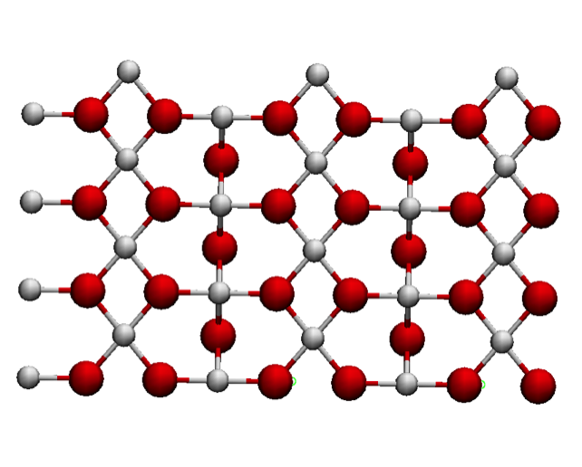
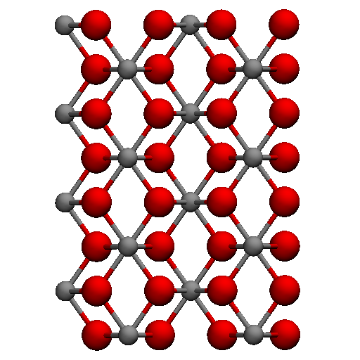
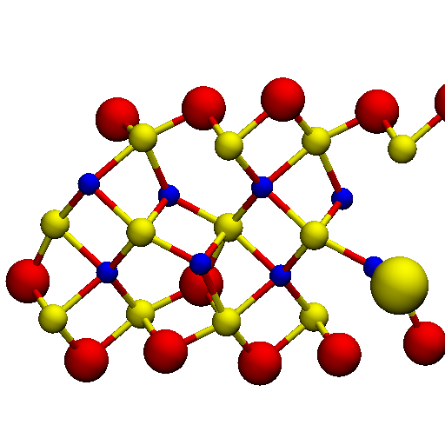
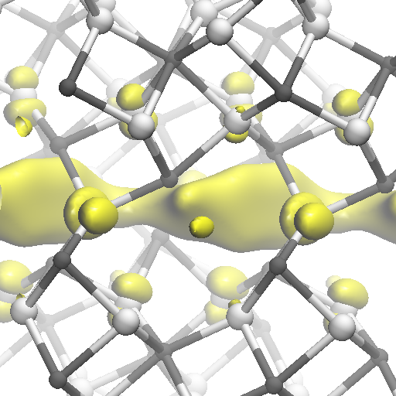
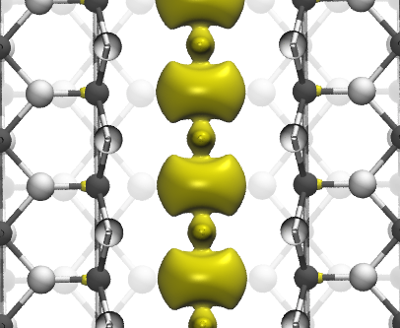
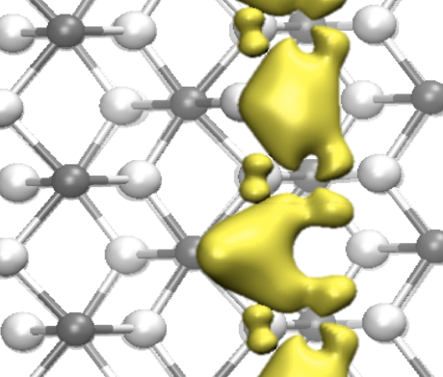
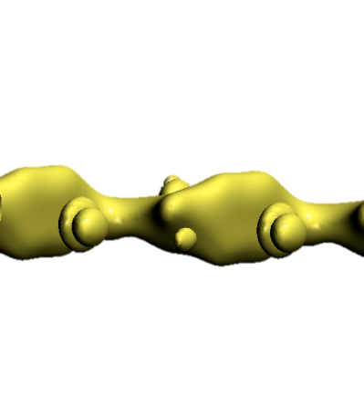
Conductive Filaments in TiO₂, HfO₂ and Al₂O₃
TiO₂
HfO₂
Al₂O₃
V_{o}
Ti
Hf
V_{o}
V_{o}
O
Al
O
S. Park et al., EDL 2011
K. Kamiya et al., APL 2013
K. Kamiya et al., PRB 2013
M. Yang et al., JJAP 2013

Slide 11
Stability of Vacancies
S. G. Park, Stanford University Thesis

Slide 12
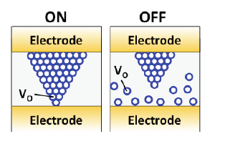
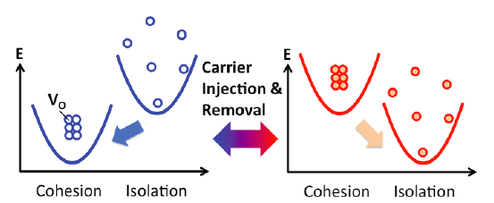
Charge Trapping – Filament Instability
K.Kamiya, M.Y. Yang, S.G. Park, B. Magyari-Köpe, Y. Nishi, M. Niwa, and K. Shiraishi, APL 2012

Slide 13
Atomistic Filament to Macroscopic Current Path for forming
Oxygen vacancy randomly distributed
Smaller atomistic conductive channel formations under e-field, which is one o f the two energetically stable states
Percolation path is created as atomistic channels increased
Macroscopic conductive path (percolation path) grows until tunneling starts between the tip of the conductive path and the electrode

Slide 14
Switching Modeling
Initial (Insulator)
On (LRS)
Off (HRS)
V_{o}
Electro forming
Reset
Set
Vacancies in random
V_{o} ordered domains
Disruption of V_{o} ordering
V_{o} concentration Increases locally → V_{o} are ordered. (LRS)
Thermal heating by high current density → V_{o} diffuse out (HRS)
The resistance of each state might be determined by the amount of vacancy ordered domains. (It doesn’t have to be Magneli phase.)

Slide 15
Challenges
Scalability
Uniformity / Reliability
Array Architecture

Slide 16
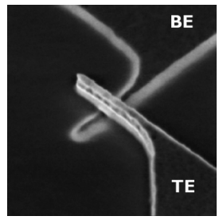
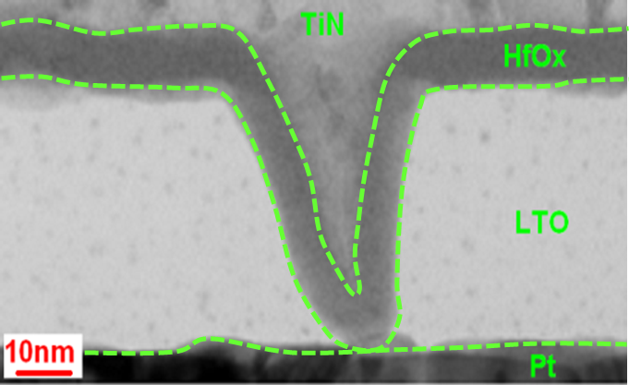
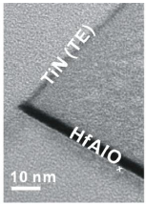
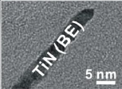
Recent Advances in RRAM Scaling
Potential Device Size
RRAM << NAND Flash
2D => 3D?
10 nm
X
10 nm
B.Govoreanu et al., IEDM 2011.
1 nm X 3 nm
Tip
Z. Zhang et al., EDL 34, 2013.
K.-S. Li et al., VLSI 2014.
46

Slide 17
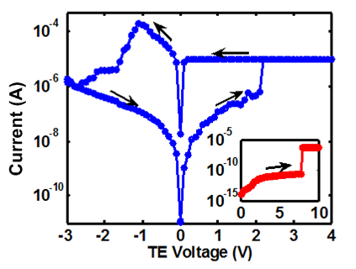
Sub-10 nm RRAM – Characteristics
Electrical results commensurate with typical reported RRAM
Z. Zhang, Y. Wu, H-S. P. Wong, S.S. Wong, EDL, p. 1005, Aug 2013

Slide 18
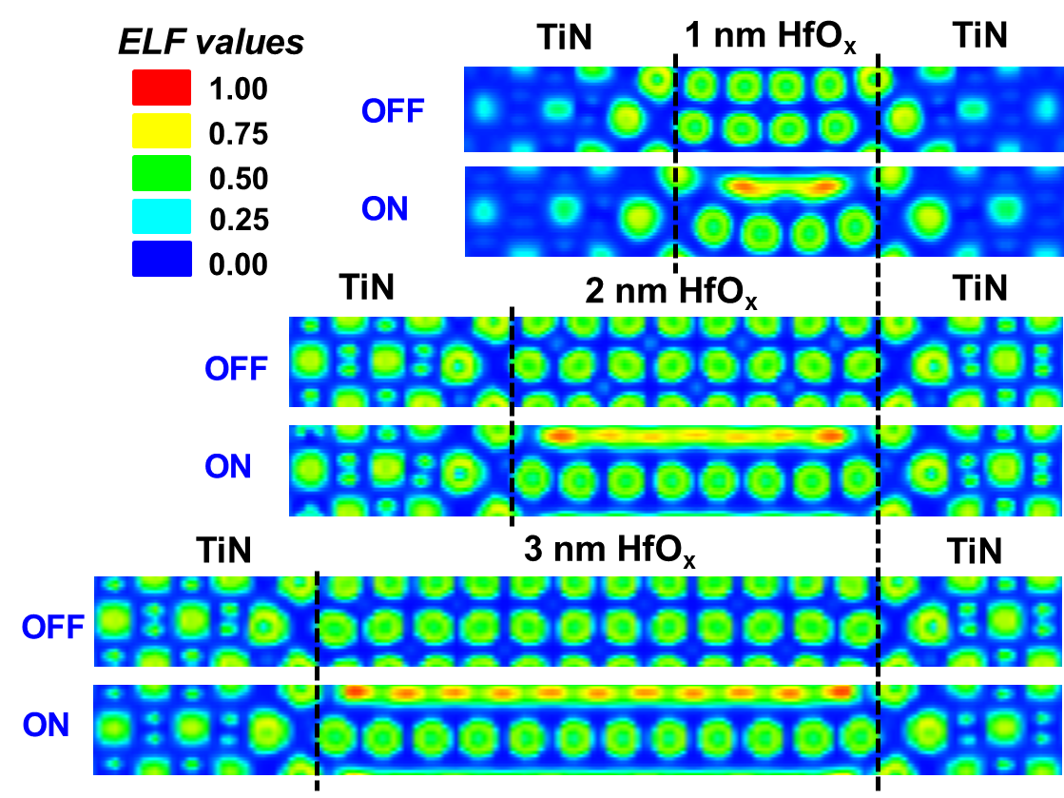
DFT ab-initio modeling indicating charge localization (Off State) and charge delocalization (On state), followed by NEGF simulation
54
L. Zhao et al, 2014 IEDM
Notes:
Here DFT calculations provide us some insights about this question. From the results, we can see that in the OFF state the wavefunctions are localized in the oxide layer. While in the ON state a delocalized conductive path is formed between the 2 electrode. This tells us that our atomic model is good for order-of-magnitude estimation of RRAM resistance.

Slide 19
Calculated I-V Characteristics
ON state
OFF state
ON state: linear I-V, Ohmic behaviors
OFF state: non-linear I-V, exponentially dependent on t_{OX}
L. Zhao et al, 2014 IEDM
55
Notes:
Now let’s see what NEGF calculations will tell us. First we can obtain these I-V characteristics of the devices.
In ON state, we see linear I-V which implies Ohmic behaviors. This is expected because in ON state we have a metallic filament formed.
In OFF state, on the other hand, we observe nonlinear I-V characteristics. And the resistance is exponentially dependent on tox. This is also expected because the tunneling gap is the dominating factors in OFF state currents. The tunneling or hopping conduction through this gap usually has a exponential dependence on tox, to the 1st order.

Slide 20
ON/OFF Ratio Exponentially Dependent on t_{OX}
Calculated On- and Off- State Resistances and the On/Off Ratio
L. Zhao et al , 2014 IEDM
Notes:
With these I-V characteristics we can derive the resistances and ON/OFF ratios of these devices.
Since Roff changes exponentially with tox, and Ron changes much slower in this interval, the ON/OFF ratio is also exponentially depedent on tox.
Now we have this ON/OFF ratios for our atomic model, we still needs to consider the effects of device area for real applications.

Slide 21
2 nm- and 5 nm-HfO_{x} Similar
2 nm
5 nm
Resistance
Distributions
L. Zhang etal, 2014 IEDM
60

Slide 22
Challenges
Scalability
Reduction of Forming Voltage
Uniformity / Reliability
Array Architecture

Slide 23
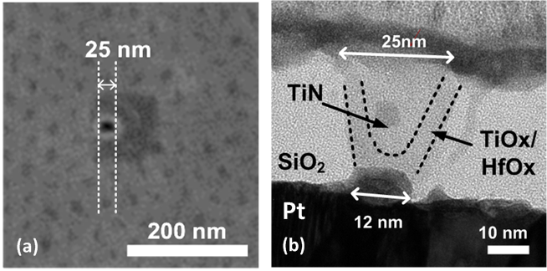
Bi-Layer RRAM
Y. Wu, et al., IEDM, 2013
Notes:
(a) Top-view SEM picture of bi-layer TiOx/HfOx oxide RRAM device with after hole etching; (b) HRTEM image of the cross-section of the bi-layer oxide RRAM.

Slide 24
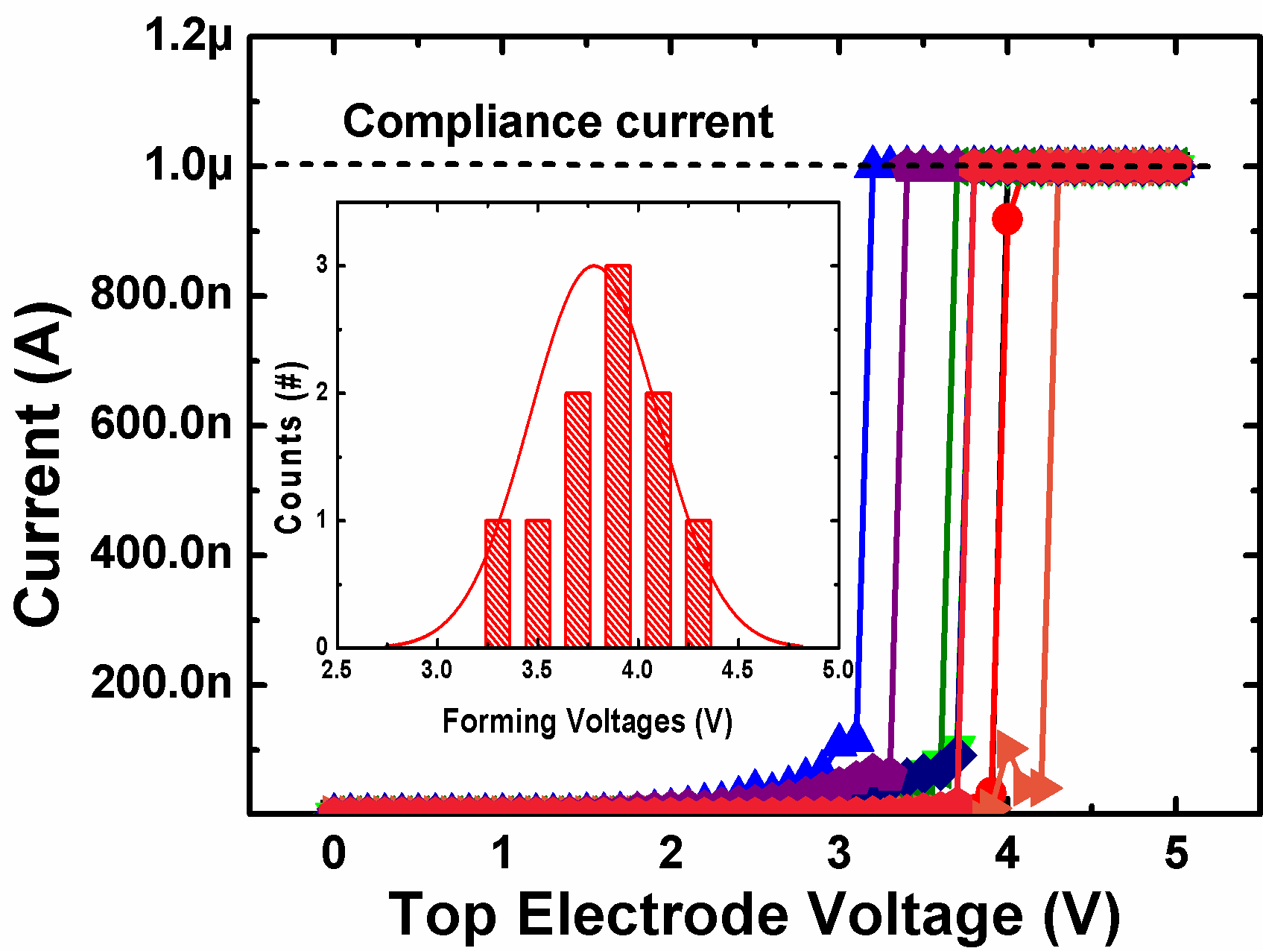
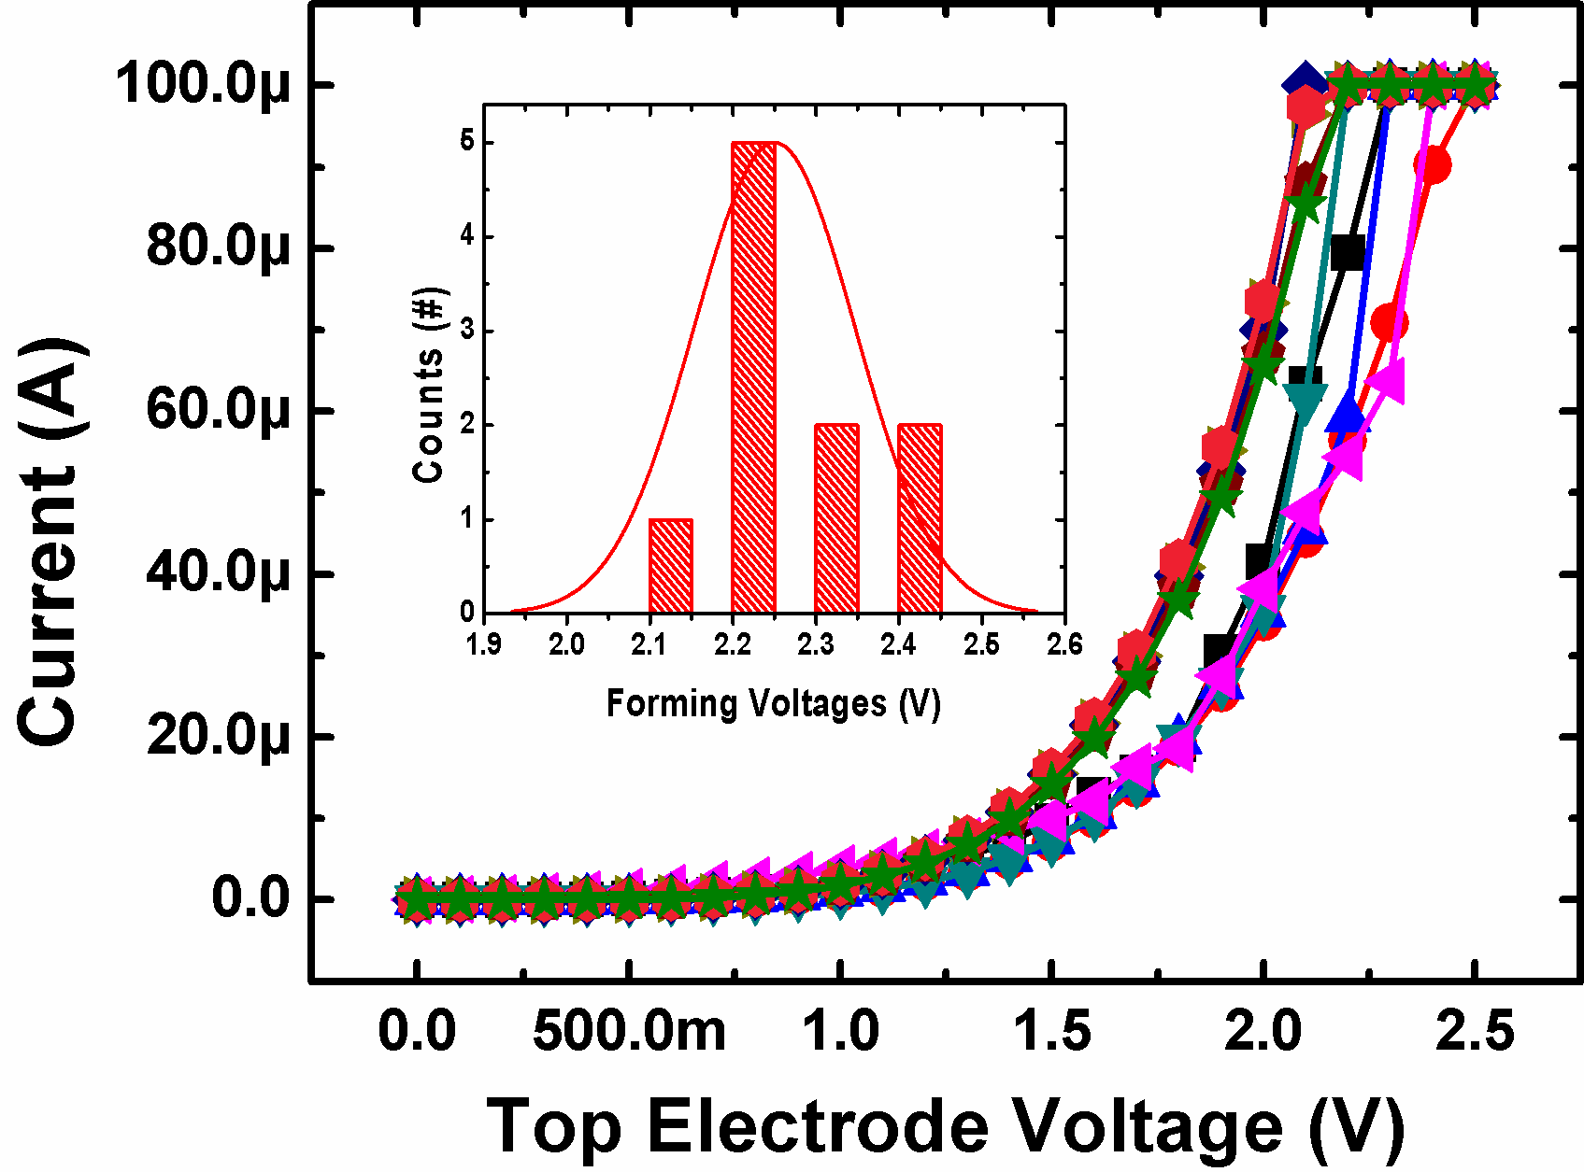
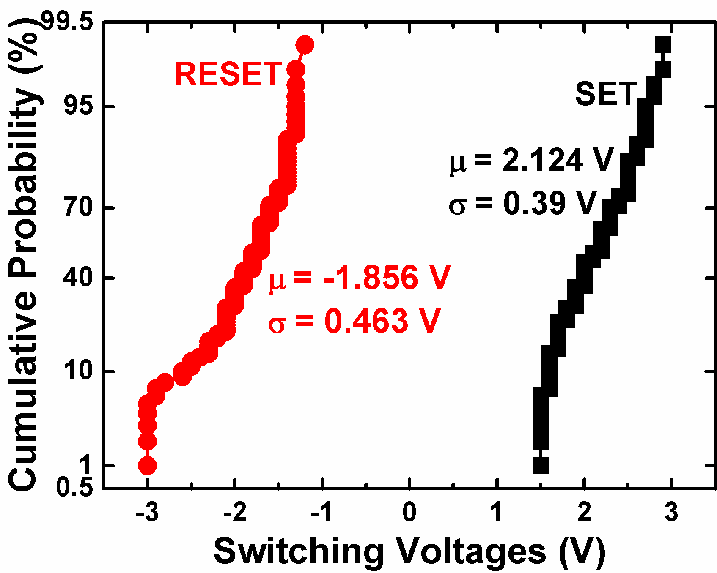
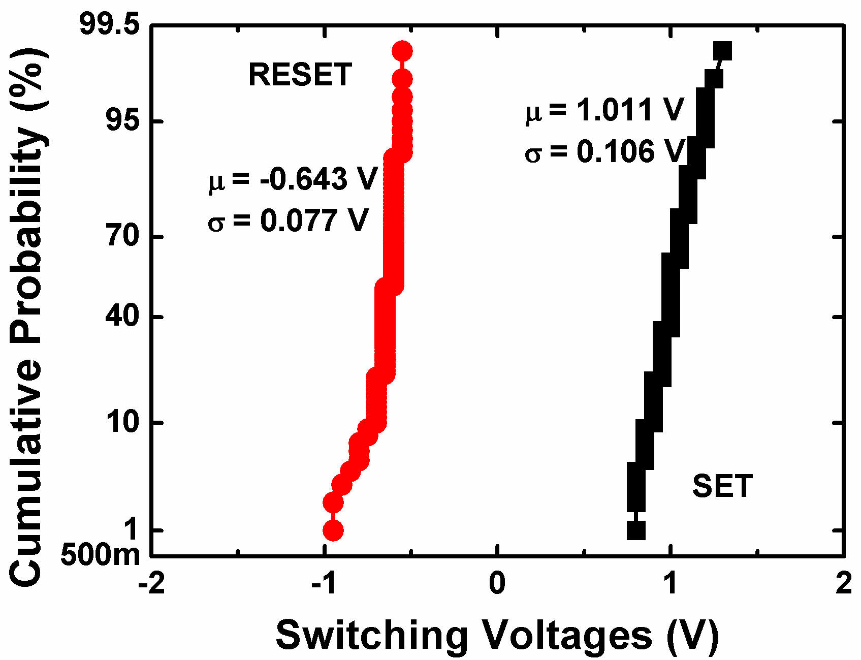
≈10 nm RRAM Characteristics
4nm HfO_{X}
2.5nm TiO_{X} / 1.5nm HfO_{X}

Slide 25
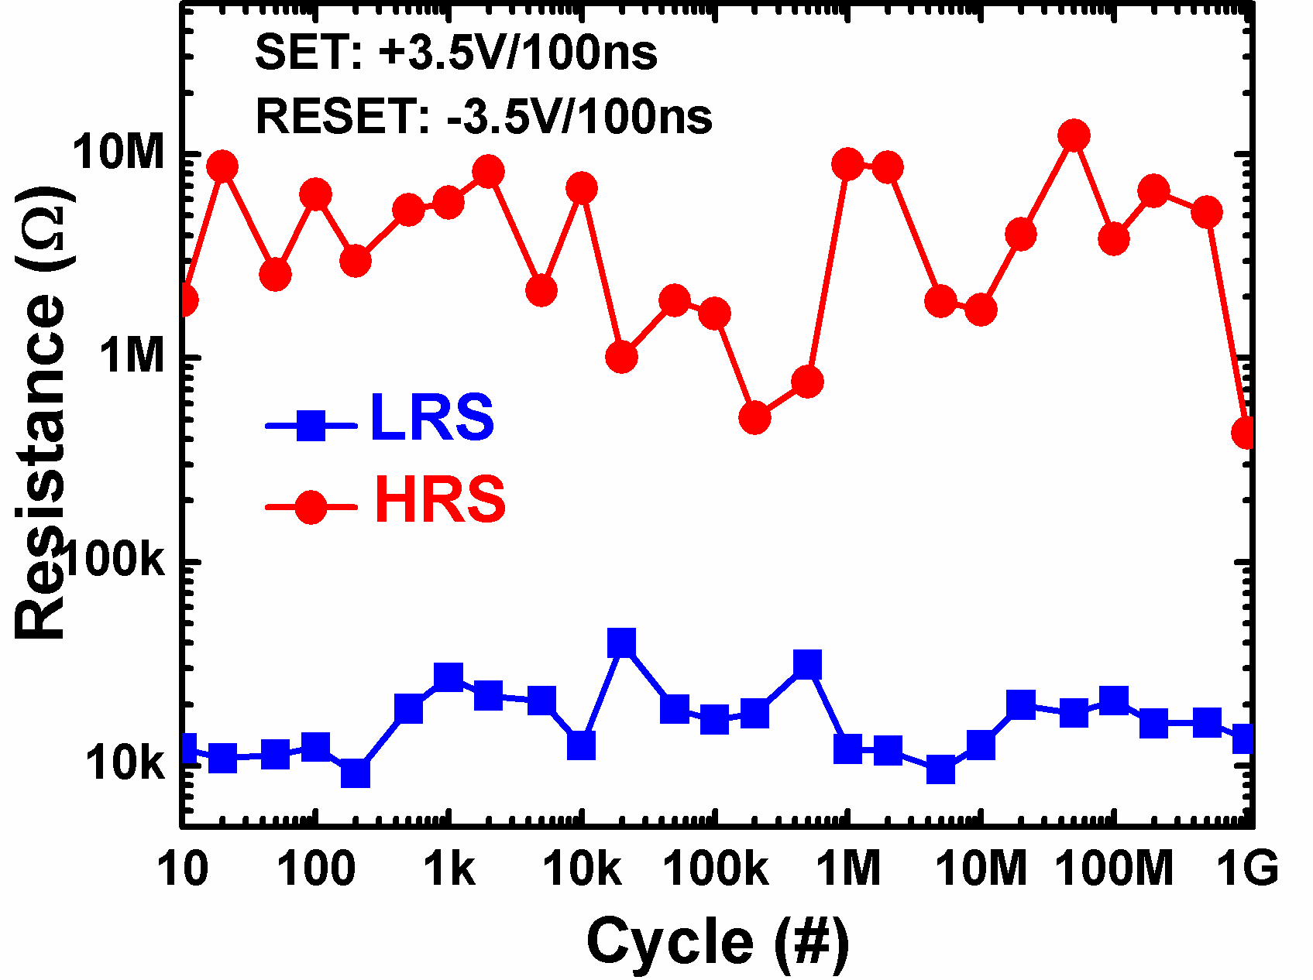
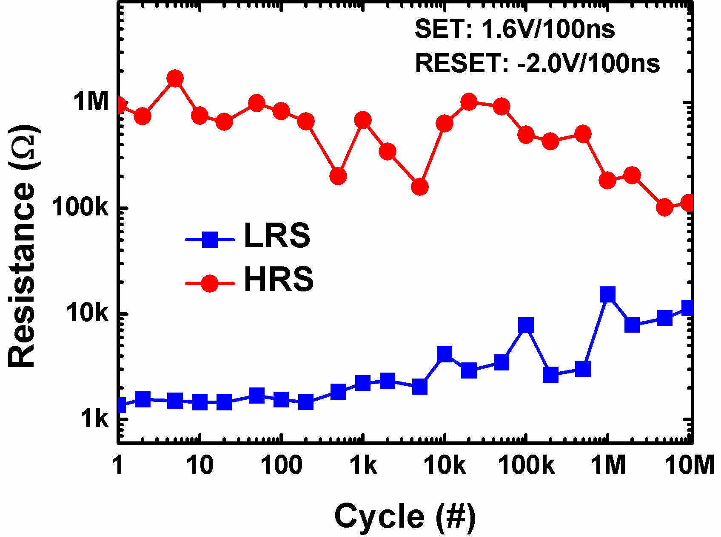
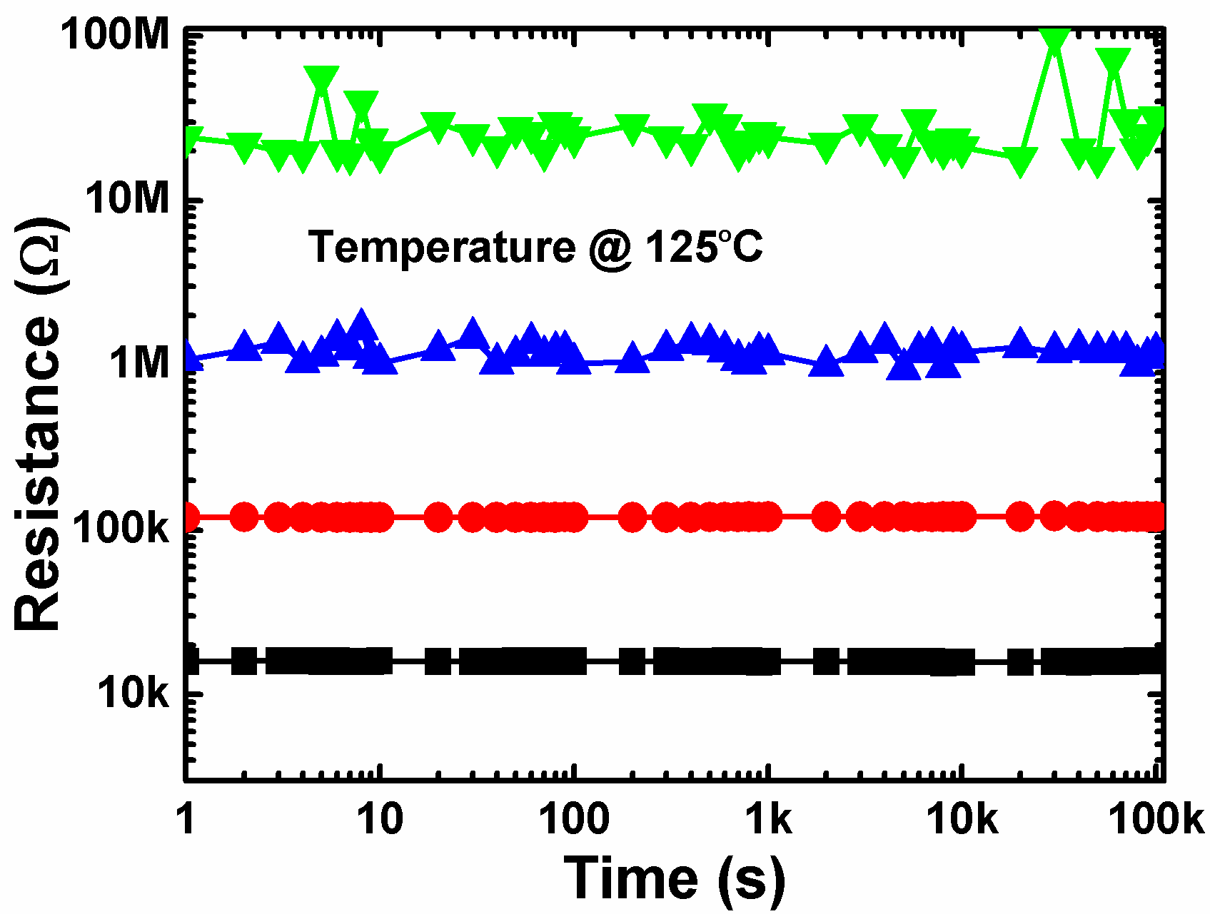
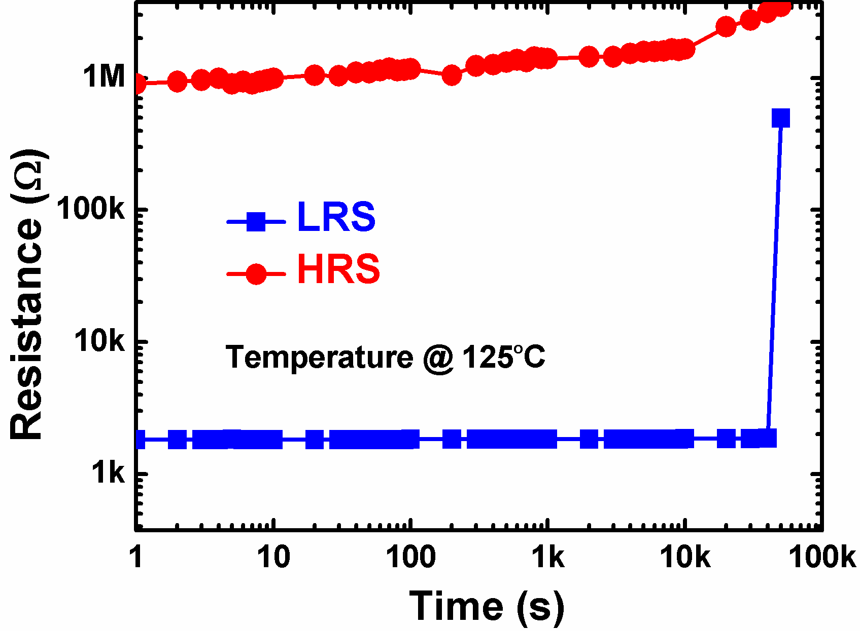
≈10 nm RRAM Characteristics
4nm HfO_{X}
2.5nm TiO_{X} / 1.5nm HfO_{X}

Slide 26
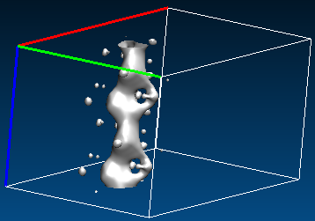
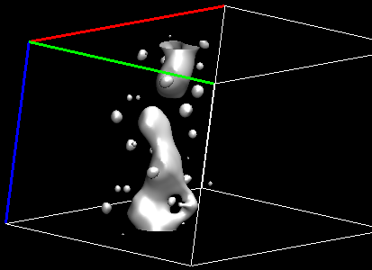
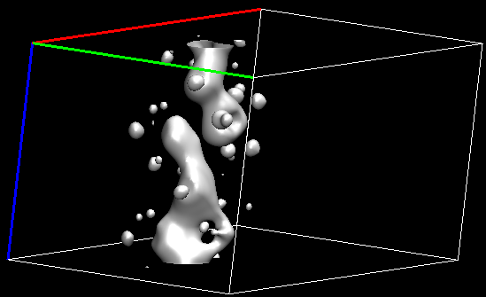
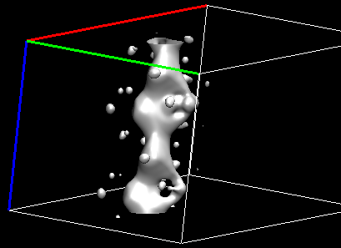
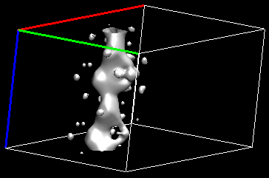
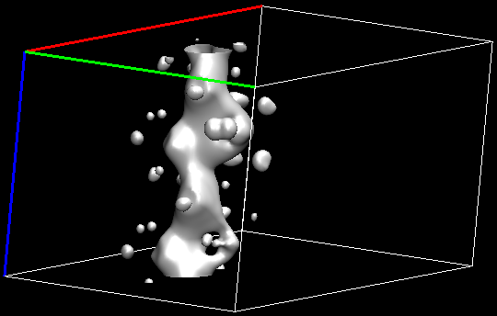
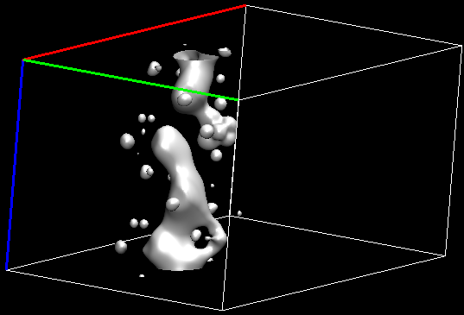
HfO₂ Partial Charge Density: Dopant + Filament
Isosurface: 0.1 e/Å³.
Undoped
L. Zhao, S. Ryu, A. Hazeghi, D. Duncan, B. Magyari-Köpe, and Y. Nishi, VLSI 2013.
Al
Si
Zr
Ta
W
Ni

Slide 27
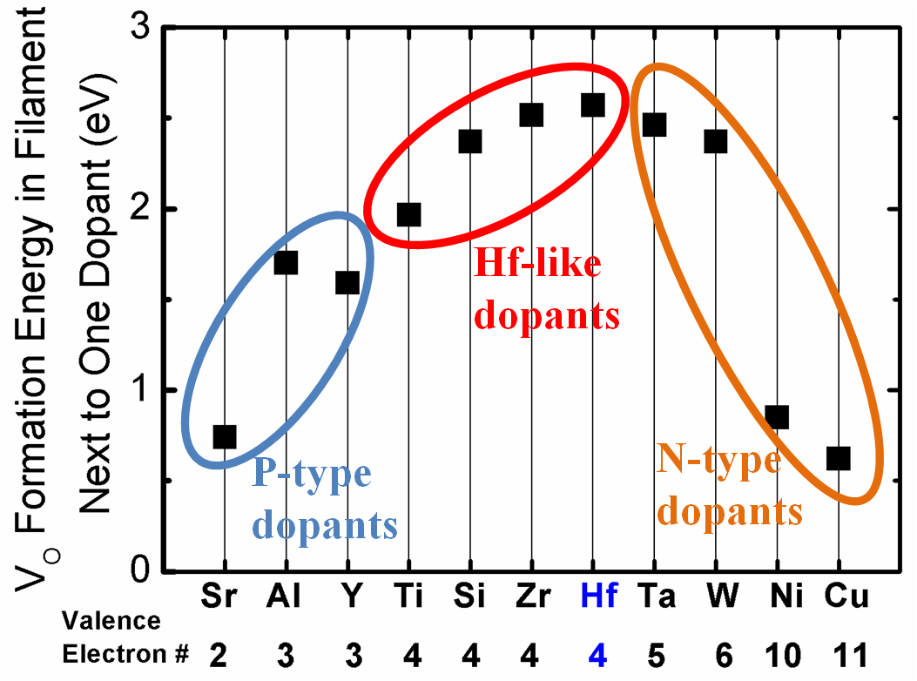
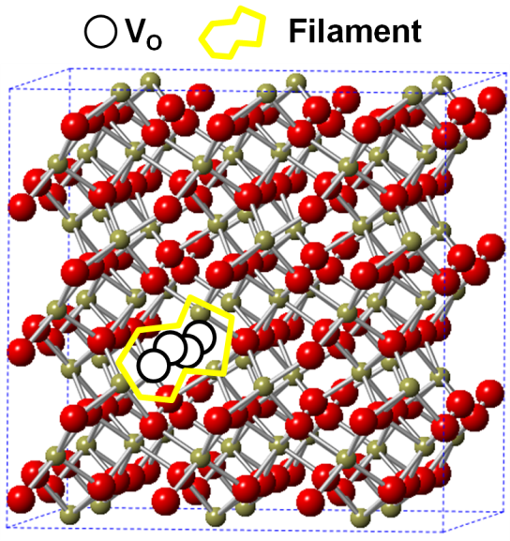
HfO₂ Vacancy Formation Energy: Dopant + Filament
L. Zhao, S. Ryu, A. Hazeghi, D. Duncan, B. Magyari-Köpe, and Y. Nishi, VLSI 2013.
Dopant

Slide 28
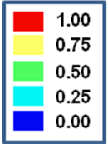
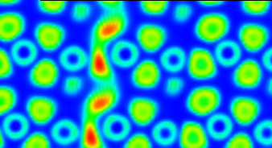
HfO₂ Doping: Experiments and Theory
L. Zhao, S. Ryu, A. Hazeghi, D. Duncan, B. Magyari-Köpe, and Y. Nishi, VLSI 2013.
Undoped
4.03 e²⁰ cm⁻³
8.06 e²⁰ cm⁻³

Slide 29
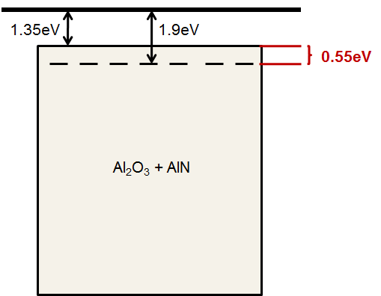
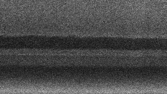
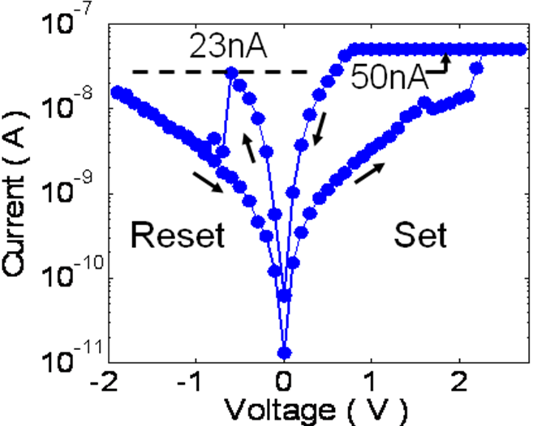
Al/N:AlOx/Al RRAM
W. Kim, et. al., Symp. VLSI Technology, p. 22 – 23, 2011
Cross-section View
Ti
Al (M6)
Al (TE)
Al
N-doped AlO_{x}
Al
N-doped AlO_{x} (RCF) / Al (BE)
SiO2
Notes:
30nm(BE)/10nm(RCM)/20nm(TE)
350 FGA for 30min, no effect on RRAM performance

Slide 30
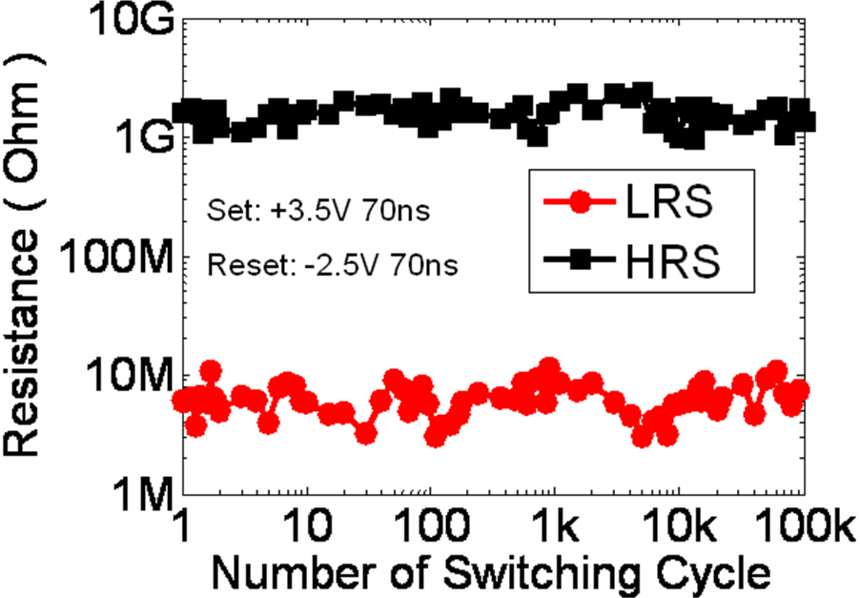
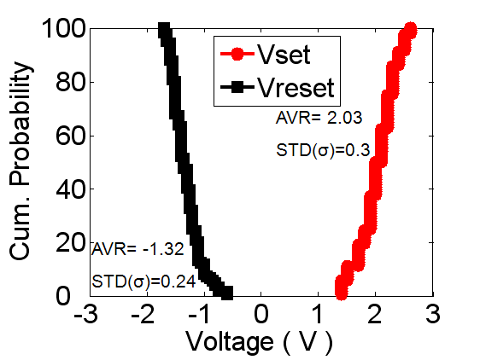
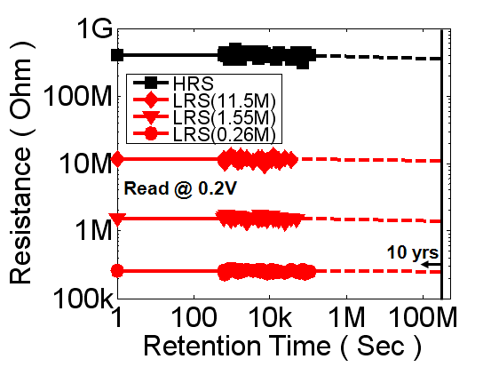
Al/N:AlOx/Al RRAM
125^{O}C

Slide 31
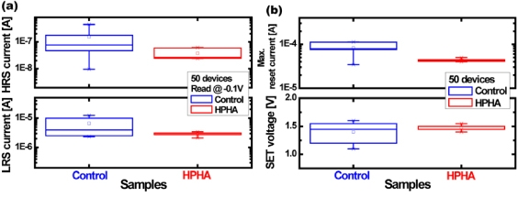
Hydrogen Doping in HfO₂
Seonghyun Kim et al 2012 Nanotechnology 23 325702 doi:10.1088/0957-4484/23/32/325702

Slide 32
Challenges
Scalability
Uniformity / Reliability
Array Architecture

Slide 33
Recent Progress – Prototype Chips
RRAM
CBRAM
32G, Sandisk/Toshiba (ISSCC)
16G, Micron/Sony (ISSCC)
64M, Unity (ISSCC)
64M, Elpida
4M, Sony (ISSCC)
8M, Panasonic (ISSCC)
4M, TSMC (ISSCC)
4M, ITRI (ISSCC)
2M, Hynix (VLSI)
1M, Fudan
Univ (VLSI)
256k, Panasonic (IEDM)
Notes:
[64M, Unity (ISSCC)] Chevallier, C.J.; Chang Hua Siau; Lim, S.F.; Namala, S.R.; Matsuoka, M.; Bateman, B.L.; Rinerson, D., "A 0.13µm 64Mb multi-layered conductive metal-oxide memory," Solid-State Circuits Conference Digest of Technical Papers (ISSCC), 2010 IEEE International , vol., no., pp.260,261, 7-11 Feb. 2010, doi: 10.1109/ISSCC.2010.5433945
[1M, Fudan Univ (VLSI)] Wang, M.; Luo, W.J.; Wang, Y.L.; Yang, L.M.; Zhu, W.; Zhou, P.; Yang, J. H.; Gong, X.G.; Lin, Y.Y.; Huang, R.; Song, S.; Zhou, Q. T.; Wu, H.M.; Wu, J.G.; Chi, M. H., "A novel CuxSiyO resistive memory in logic technology with excellent data retention and resistance distribution for embedded applications," VLSI Technology (VLSIT), 2010 Symposium on , vol., no., pp.89,90, 15-17 June 2010, doi: 10.1109/VLSIT.2010.5556182
[4M, ITRI (ISSCC)] Shyh-Shyuan Sheu; Meng-Fan Chang; Ku-Feng Lin; Che-Wei Wu; Yu-Sheng Chen; Pi-Feng Chiu; Chia-Chen Kuo; Yih-Shan Yang; Pei-Chia Chiang; Wen-Pin Lin; Che-He Lin; Heng-Yuan Lee; Pei-Yi Gu; Sum-Min Wang; Chen, F.T.; Keng-Li Su; Chen-Hsin Lien; Kuo-Hsing Cheng; Hsin-Tun Wu; Tzu-Kun Ku; Ming-Jer Kao; Ming-Jinn Tsai, "A 4Mb embedded SLC resistive-RAM macro with 7.2ns read-write random-access time and 160ns MLC-access capability," Solid-State Circuits Conference Digest of Technical Papers (ISSCC), 2011 IEEE International , vol., no., pp.200,202, 20-24 Feb. 2011, doi: 10.1109/ISSCC.2011.5746281
[4M, Sony (ISSCC)] Otsuka, Wataru; Miyata, K.; Kitagawa, M.; Tsutsui, K.; Tsushima, T.; Yoshihara, H.; Namise, T.; Terao, Y.; Ogata, K., "A 4Mb conductive-bridge resistive memory with 2.3GB/s read-throughput and 216MB/s program-throughput," Solid-State Circuits Conference Digest of Technical Papers (ISSCC), 2011 IEEE International , vol., no., pp.210,211, 20-24 Feb. 2011, doi: 10.1109/ISSCC.2011.5746286
[256k, Panasonic (IEDM)] Wei, Z.; Takagi, T.; Kanzawa, Y.; Katoh, Y.; Ninomiya, T.; Kawai, K.; Muraoka, S.; Mitani, S.; Katayama, K.; Fujii, S.; Miyanaga, R.; Kawashima, Y.; Mikawa, T.; Shimakawa, K.; Aono, K., "Demonstration of high-density ReRAM ensuring 10-year retention at 85°C based on a newly developed reliability model," Electron Devices Meeting (IEDM), 2011 IEEE International , vol., no., pp.31.4.1,31.4.4, 5-7 Dec. 2011, doi: 10.1109/IEDM.2011.6131650
[64M, Elpida] http://techon.nikkeibp.co.jp/english/NEWS_EN/20120126/203992/
[8M, Panasonic (ISSCC)] Kawahara, A.; Azuma, R.; Ikeda, Y.; Kawai, K.; Katoh, Y.; Tanabe, K.; Nakamura, T.; Sumimoto, Y.; Yamada, N.; Nakai, N.; Sakamoto, S.; Hayakawa, Y.; Tsuji, K.; Yoneda, S.; Himeno, A.; Origasa, K.; Shimakawa, K.; Takagi, T.; Mikawa, T.; Aono, K., "An 8Mb multi-layered cross-point ReRAM macro with 443MB/s write throughput," Solid-State Circuits Conference Digest of Technical Papers (ISSCC), 2012 IEEE International , vol., no., pp.432,434, 19-23 Feb. 2012, doi: 10.1109/ISSCC.2012.6177078
[4M, TSMC (ISSCC)] Meng-Fan Chang; Che-Wei Wu; Chia-Cheng Kuo; Shin-Jang Shen; Ku-Feng Lin; Shu-Meng Yang; Ya-Chin King; Chorng-Jung Lin; Yu-Der Chih, "A 0.5V 4Mb logic-process compatible embedded resistive RAM (ReRAM) in 65nm CMOS using low-voltage current-mode sensing scheme with 45ns random read time," Solid-State Circuits Conference Digest of Technical Papers (ISSCC), 2012 IEEE International , vol., no., pp.434,436, 19-23 Feb. 2012, doi: 10.1109/ISSCC.2012.6177079
[2M, Hynix (VLSI)] Hyung Dong Lee; Kim, S. G.; Cho, K.; Hwang, H.; Choi, H.; Lee, J.; Lee, S. H.; Lee, H. J.; Suh, J.; Chung, S.; Kim, Y. S.; Kim, K. S.; Nam, W. S.; Cheong, J. T.; Kim, J. T.; Chae, S.; Hwang, E.; Park, S. N.; Sohn, Y. S.; Lee, C. G.; Shin, H. S.; Lee, K.J.; Hong, K.; Jeong, H. G.; Rho, K. M.; Kim, Y. K.; Chung, S.; Nickel, J.; Yang, J. J.; Cho, H. S.; Perner, F.; Williams, R.S.; Lee, J. H.; Park, S.K.; Hong, S., "Integration of 4F2 selector-less crossbar array 2Mb ReRAM based on transition metal oxides for high density memory applications," VLSI Technology (VLSIT), 2012 Symposium on , vol., no., pp.151,152, 12-14 June 2012, doi: 10.1109/VLSIT.2012.6242506
[32G, Sandisk/Toshiba (ISSCC)] Tz-yi Liu; Tian Hong Yan; Scheuerlein, R.; Yingchang Chen; Lee, J.K.; Balakrishnan, G.; Yee, G.; Zhang, H.; Yap, A.; Ouyang, J.; Sasaki, T.; Addepalli, S.; Al-Shamma, A.; Chin-Yu Chen; Gupta, M.; Hilton, G.; Joshi, S.; Kathuria, A.; Lai, V.; Masiwal, D.; Matsumoto, M.; Nigam, A.; Pai, A.; Pakhale, J.; Chang Hua Siau; Xiaoxia Wu; Yin, R.; Liping Peng; Jang Yong Kang; Huynh, S.; Huijuan Wang; Nagel, N.; Tanaka, Y.; Higashitani, M.; Minvielle, T.; Gorla, C.; Tsukamoto, T.; Yamaguchi, T.; Okajima, M.; Okamura, T.; Takase, S.; Hara, T.; Inoue, H.; Fasoli, L.; Mofidi, M.; Shrivastava, R.; Quader, K., "A 130.7mm2 2-layer 32Gb ReRAM memory device in 24nm technology," Solid-State Circuits Conference Digest of Technical Papers (ISSCC), 2013 IEEE International , vol., no., pp.210,211, 17-21 Feb. 2013, doi: 10.1109/ISSCC.2013.6487703
[16G, Micron/Sony (ISSCC)] Fackenthal, R.; Kitagawa, M.; Otsuka, W.; Prall, K.; Mills, D.; Tsutsui, K.; Javanifard, J.; Tedrow, K.; Tsushima, T.; Shibahara, Y.; Hush, G., "19.7 A 16Gb ReRAM with 200MB/s write and 1GB/s read in 27nm technology," Solid-State Circuits Conference Digest of Technical Papers (ISSCC), 2014 IEEE International , vol., no., pp.338,339, 9-13 Feb. 2014
doi: 10.1109/ISSCC.2014.6757460

Slide 34
Experimental Calibration
https://nano.stanford.edu/model.php
Experiment & model
5 DC switching cycles
Pulse measurement & model
[Jiang 2014 submitted]
Notes:
DC Fitting
a. Measure a large number (no less than 100) of experimental DC switching cycles from hardware. Pt/HfOx(1.69 nm)/TiOx(4.97 nm)/TiN devices are fabricated and tested for verification.
b. Sum currents at the same voltages at the same resistance states and calculate the mean I-V switching curve, shown in red curve in Fig. 2(a). We’ve compared the average I-V switching curve with the mean I-V switching curve, which shows using the mean I-V switching curve is more reasonable to reflect RRAM abrupt SET process.
c. The fitting is performed in MATLAB, where the total difference between the average switching curve data and model curve data is minimized.
Pulse Fitting
Data for pulse fitting is acquired by applying different pulse amplitudes (Fig. 3(b)) and different pulse widths with certain initial resistance values [2]. We found pulse fitting is important and necessary for the following reasons,
In a memory system, memory cells are written by a write-and-verify scheme using a series of pulses [7]. Tracking memory system performance is especially important in the case of cell disturbance, storage failure recovery, etc.
Filament evolution generally happens on a nanosecond timescale. Accessing RRAM may take less than 10ns, which requires the modeling of nanosecond RRAM device behavior.
Considering the nanosecond time scales of filament formation, DC switching fitting requires ~10⁹ calculation per sweep with uniform time steps. At larger time steps, simulations inaccurately reflect the dynamics of the filament. As observed from experimental data in Fig. 3 (b), resistance tends to saturate after a certain elapsed time. Thus DC fitting may not capture the switching dynamics in the sub-100nsec regime.
[Jiang 2014] Jiang Z, Yu S, Wu Y, Engel J.H., Guan X and Wong H-SP, “Verilog-A Compact Model for Oxide-based Resistive Random Access Memory(RRAM)”, SISPAD (submitted), 2014
[Yu 2012] Yu S, Gao B, Fang Z, Yu H, Kang J and Wong H-SP, "A neuromorphic visual system using RRAM synaptic devices with Sub-pJ energy and tolerance to variability: Experimental characterization and large-scale modeling," Electron Devices Meeting (IEDM), vol., no., pp.10.4.1,10.4.4, 10-13, (2012)

Slide 35
1T1R RRAM Array
One-Transistor-One-RRAM (1T1R)
Based on MOSIS deep-submicron lambda rule
(F)
3λ
2λ
RRAM
NMOS
Selection device
Control I_{c}
(F)
3λ
RRAM
4λ
12λ
RRAM cell size
= 36λ²
= 4F²
Bit Line
NMOS size > 48λ²
BL₁
BL₂
BL_{N}
Word Line
WL₁
WL₂
SL₁
Source Line
SL₂
WL_{M}
SL_{M}

Slide 36
Challenges for Cross-Point RRAM Array
Read
Set
Leaky paths also contribute to SA current
Hard to control R_{L} by controlling I_{c}
V_{SET}
V_{READ}
½ V_{SET}
I_{c1}
V_{UNSEL}
or floating
½ V_{SET}
GND
Sense Amplifiers
Selected cell : full V_{SET}
Unselected cells: ≤ ½ V_{SET}

Slide 37
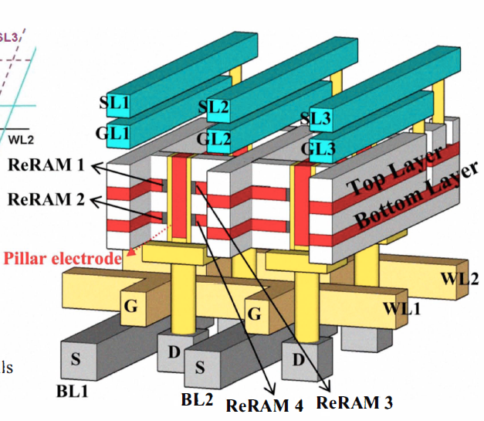
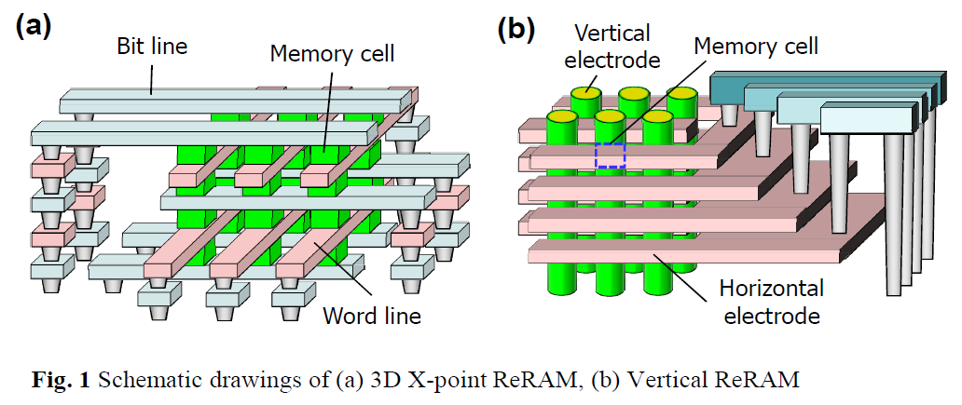
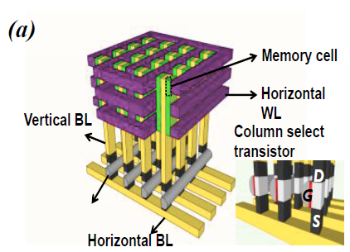
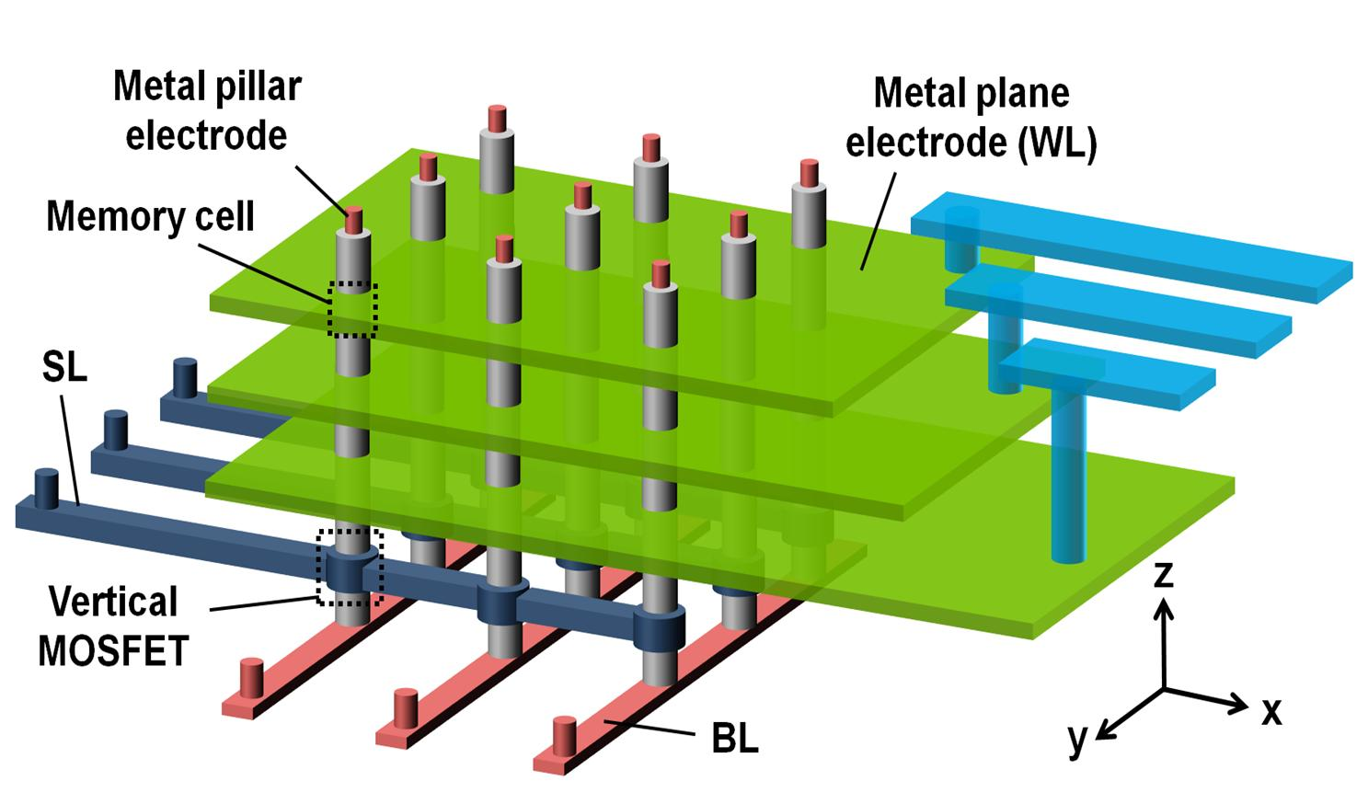
3D RRAM Architectures
I. G. Baek, et al., IEDM, 2009 & 2011 (Samsung)
W.-C. Chien , et al., VLSIT, 2012 (Macronix)
H.-Y. Chen, et al., IEDM, 2012 (Stanford/PKU)
L. Zhang, et al., IMW, 2013 (IMEC)
Notes:
Since 2009, several of 3D RRAM concepts have been reported including Samsung in IEDM 2011, Maronix in VLSI 2012, our group in IMDM 2012 and IMEC in IMW 2013.
All of these architecture are aimed to deliver high density NVM chips in the future.
in this talk, we will go through the details of this architecture.

Slide 38
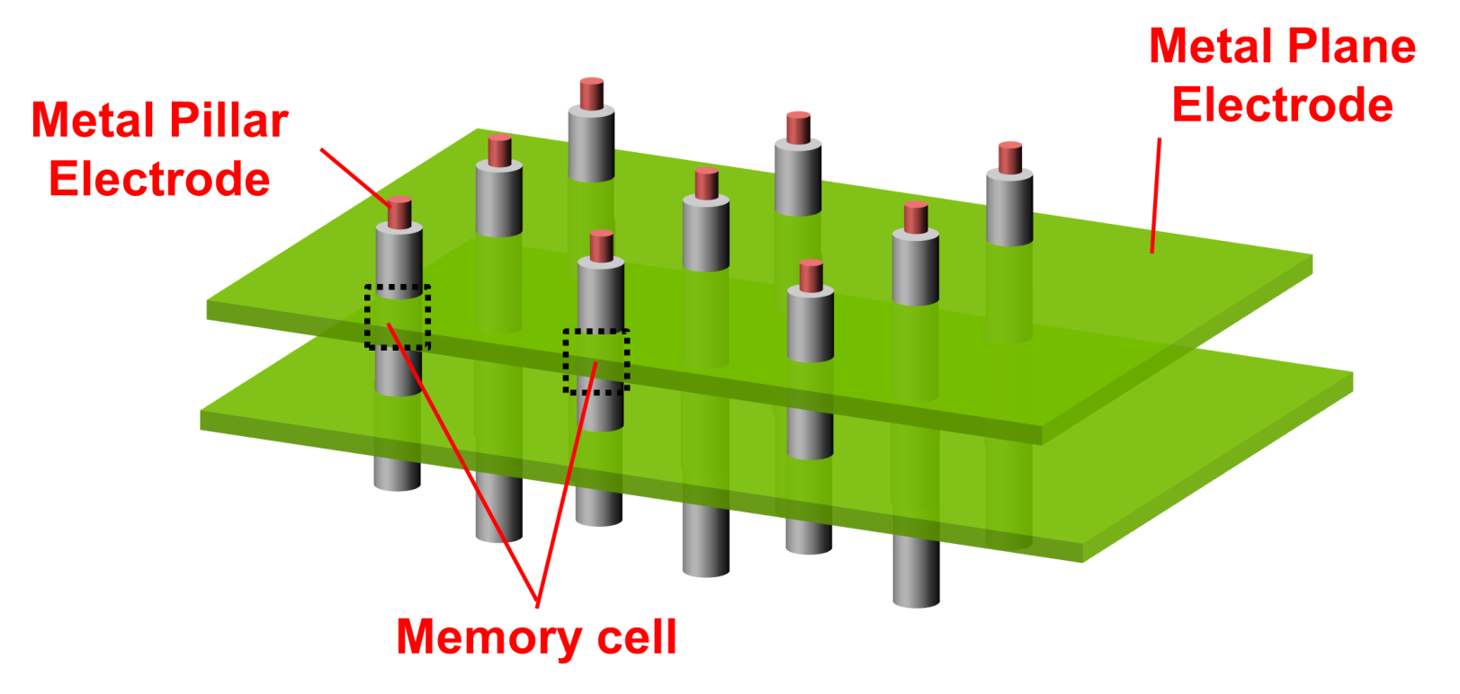
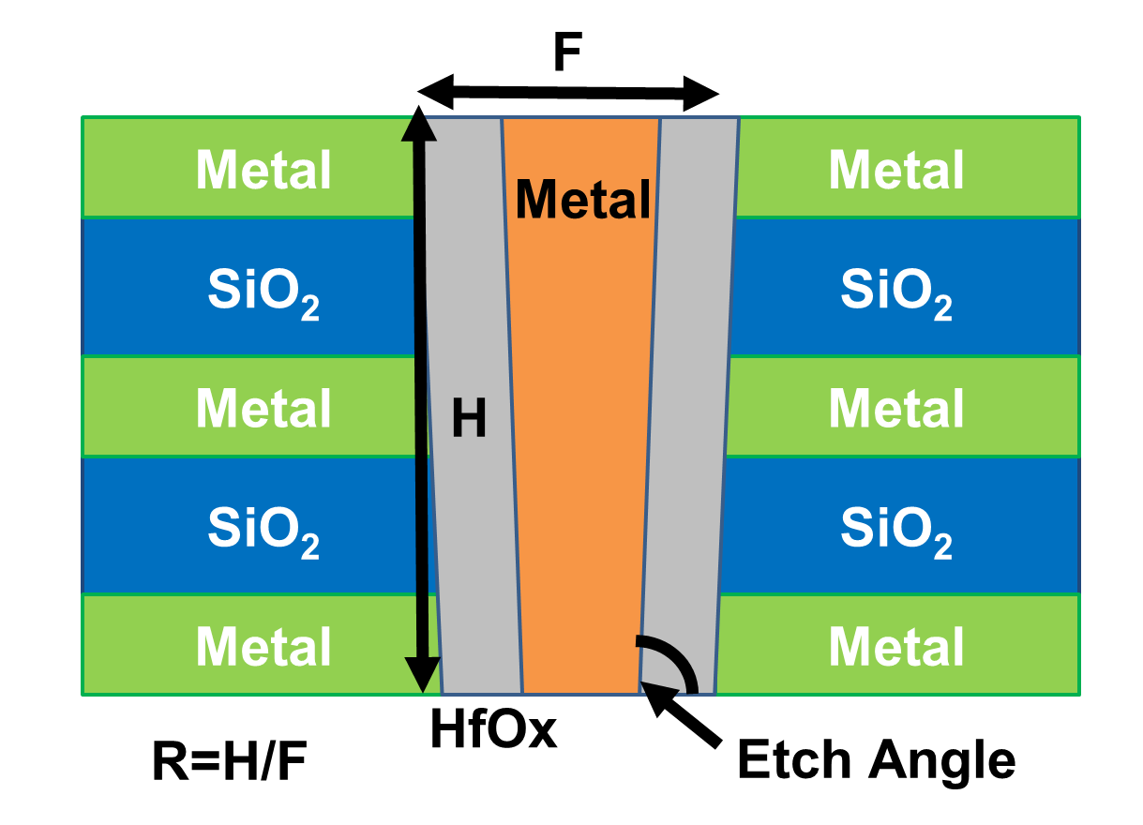
Technology Requirements of 3D RRAM
Notes:
Non-linear selector ← no space in 3D cube
Low resistance BL pillar ← noise margin
Low resistance WL plane ← noise margin
Scalable stack height ← etch aspect ratio
On-pitch select transistor

Slide 39

3D Cross-Point Using Metal Planes
Each Vertical RRAM Cell is randomly accessible in the array
Vertical Transistor
H.-Y. Chen et al., IEDM, 2012
Notes:
But in order to achieve cell random access, additional line selectors necessary. Please note that we still don’t need cell selector in memory array region.
For the x-y plan selection, We propose using a vertical transistor to serve as bit-line selector, whose gate is controlled by the select-line. Next, we propose to use metal plane as word line to achieve selection in the z direction. In doing so, Each Vertical RRAM Cell is randomly accessible in the array!
*Emphasize the selector-less

Slide 40
Device Cross-Section
S. Yu, H.-Y. Chen et al., Symp. VLSI Tech. 2013

Slide 41


3D RRAM Switching Characteristics
Reset current: 30 µA ~ 50 µA
Similar characteristics among the top, bottom, and control cells
Notes:
The data collected from 3 structures are presented. the black line with square is the data collected from the single cell in one-layer structure. The blue and red lines with triangle are the data collected from top and bottom cells in double-layer structure respectively .
The RESET current ranges from 30 to 50 uA. The three samples show similar IV characteristics.

Slide 42


3D RRAM Reliability Performance
Endurance >10⁸ cycles
Retention >10⁵s @125ºC
H.-Y. Chen et al., IEDM, 2012
Notes:
Reliability Performance is shown in this slide. The device can switch over 10^8 cycles. And it can maintain its state for over 10^5 seconds measured at 125 degree C.

Slide 43
What we understood by now..
Reset process is the most energy consuming process
Reset current is almost linearly proportional to set current, i.e. smaller set compliance results in smaller reset current How much can we reduce power by vertical scaling
LRS is determined by set current compliance, and seems less dependent on device cross-sectional area under constant set compliance…filamentary nature
HRS is inversely proportional to device cross-sectional area…uniformly distributed leakage current in 2D
Charge injection and trapping determine thermodynamic stability of vacancy filament and diffusion
Bilayer structure, i.e. switching layer and vacancy sourcing layer seems promising, and oxygen/vacancy migration mechanism becomes clearer through kinetic modeling.

Slide 44
Summary
Recent progress in understanding of resistive switching mechanisms reviewed
Scalability up to 2nm thick switching layer is demonstrated resulting in stable operation and improved forming process and endurance
A variety of cell architectures proposed, and demonstrated
Extended endurance and selector choice remain research challenges

Slide 45
NMTRI Program Focus at Stanford
Model fundamental physics of RRAM to
- improve basic understanding including endurance failure mechanism
- explore new device concepts
Conduct experiments to
- study scalability
- reduce/eliminate forming
- improve uniformity and repeatability of switching behavior
- improve endurance and retention
Study array architectures to
- project ultimate packing density
- understand challenges in selector design
- devise innovative circuit techniques

Slide 46
Acknowledgements
Support of
Industrial Sponsors of NMTRI
DARPA 3D-IC Program
IARPA Trusted IC Program
SRC
Many fellowships
Contributions of many PhD students and post-doc researchers

