Slide 1

Phase I Funding Fall 2019
University of Texas at San Antonio
IEEE CTS Conference:
Mariafernanda Amaya - Chair IEEE
Brandyn Campos - Vice Chair IEEE
Brenda Carrillo - Treasurer IEEE
Aaron Moreno- Chair RAS
Gilbert Noriega- Chair PES
IEEE UTSA Student Branch
Faculty Adviser: Dr. Paul Morton paul.morton@utsa.edu
Fall 2019: August 26, 2019 - December 13, 2019

Slide 2
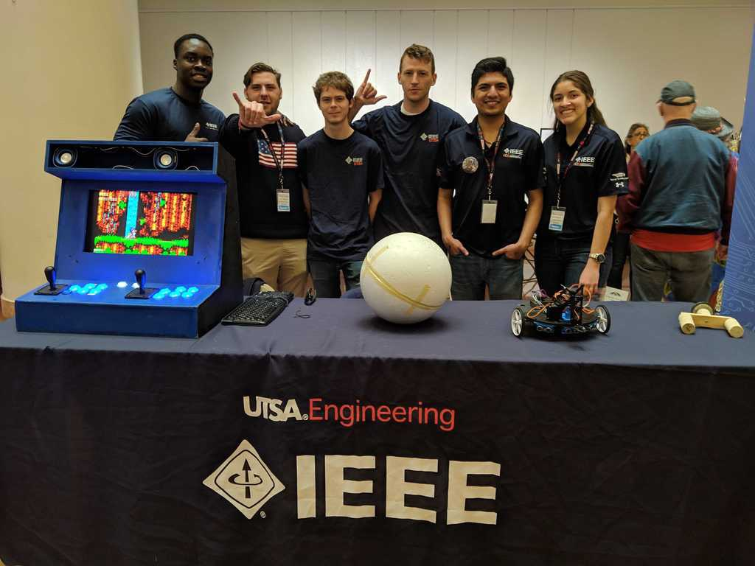



UTSA Branch Overview
IEEE Student Body
160 Members
Branch Officers:
Mariafernanda Amaya - Chair (1 term), Digital Designer (2 terms), Junior Officer (1 term)
Brandyn Campos - Vice Chair (1 term), Events Coordinator (2 terms)
Brenda Carrillo - Treasurer (1 term), Secretary (2 terms)
Aaron Moreno - RAS Chair (1 term)
Jeffrey Duano- RAS Vice Chair (1 term)
Gilbert Noriega- PES Chair (1 term)
Emmanuel Oluga - Secretary (1 term)
Joshua Barron - Events Coordinator (Summer 2019)
Juan Ramirez - Operations Manager (Summer 2019)
John Widner - Webmaster (1 term)
Junior Officers:
Fabricio Zuniga
Zeke Brott
IEEE UTSA Student Branch
The University of Texas at San Antonio
Kappa Upsilon Chapter
Fall 2019

Slide 3
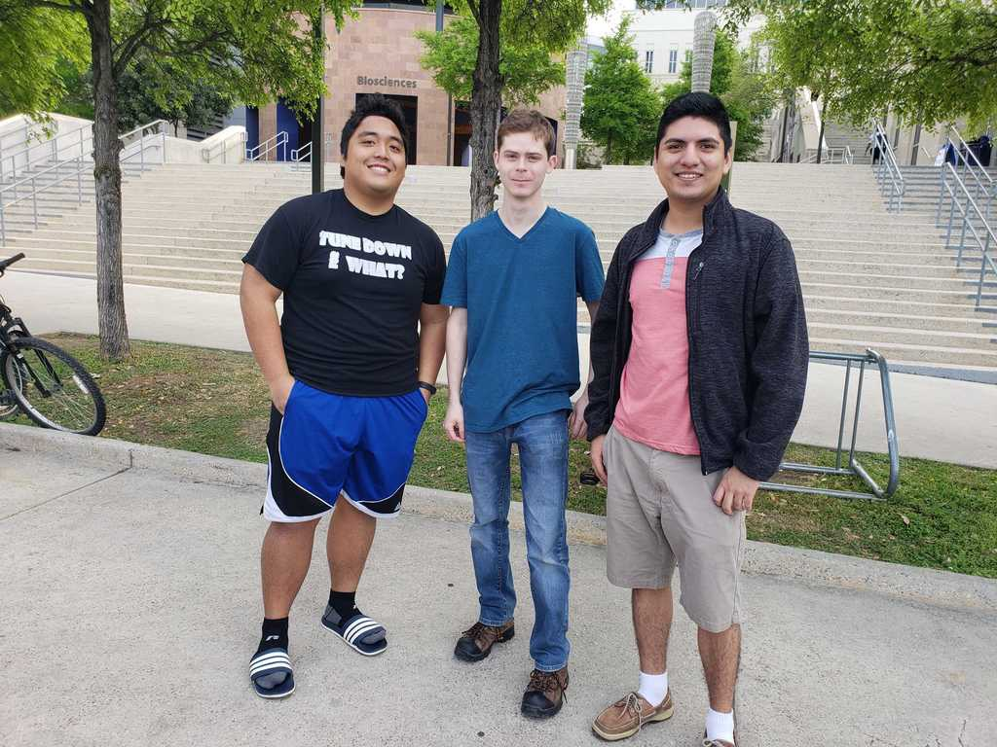
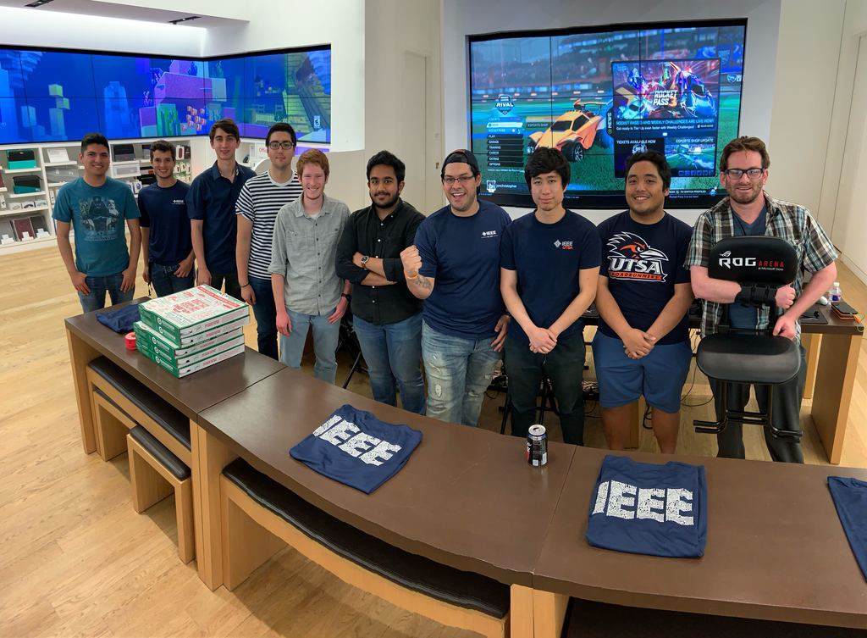
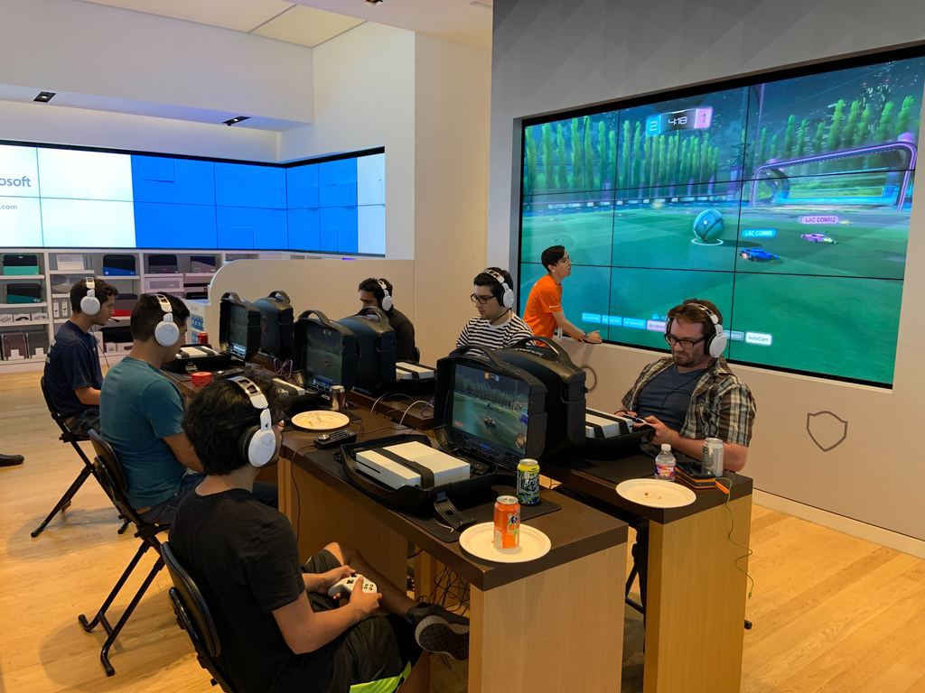
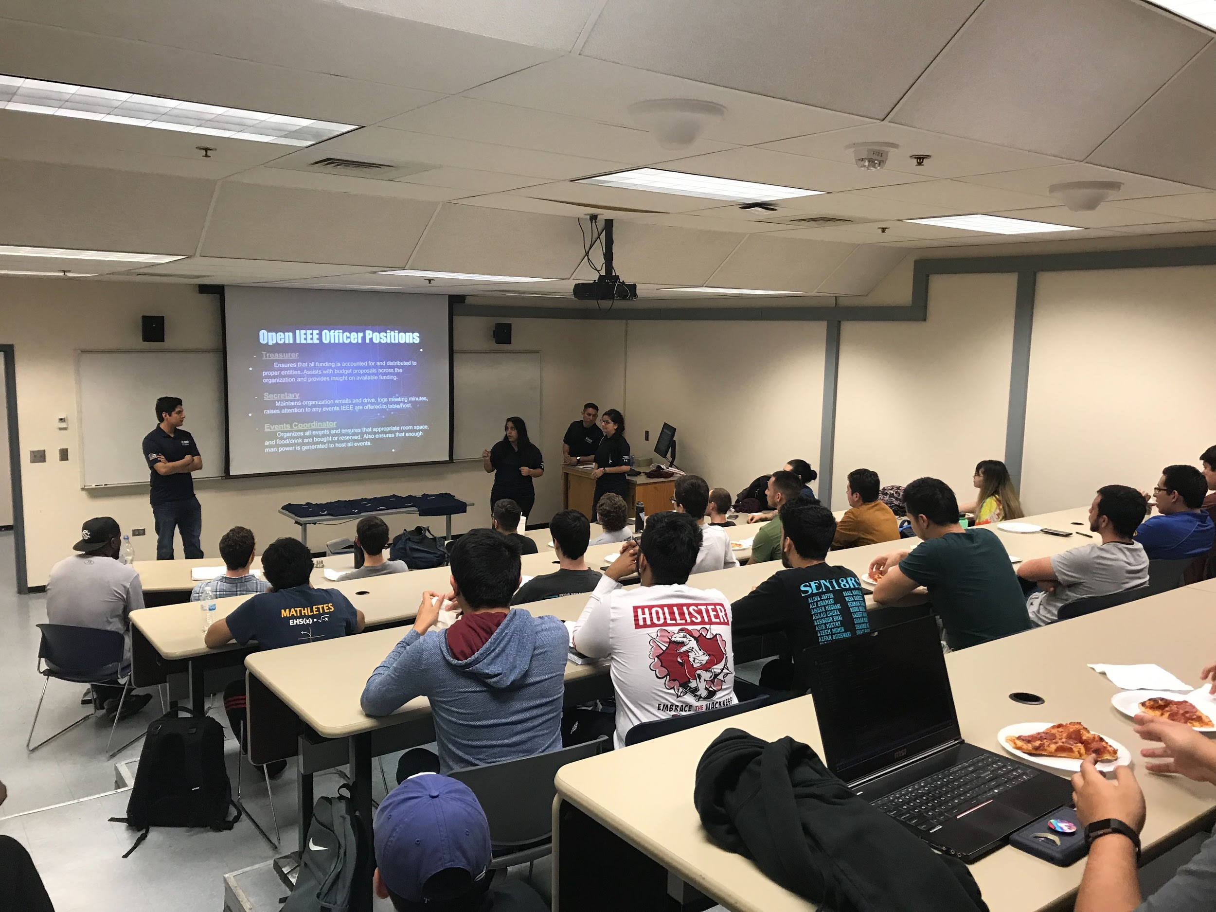
Past Funding
R5 Competition
Frag-a-Thon
General
Meetings

Slide 4
Past Funding
Event | Description | Amount
R5 | Pizza Fundraiser R5 Competition | ≈ $1,100
Social Engagement | Monthly Meetings Game Night & Frag-a-Thon Speaker Events | ≈ $250
Workshops | ROS Python Open CV | ≈ $250

Slide 5
Branch Goals
Requested amount for Phase I 2019: $1000
Further grow our membership at UTSA
Battle Bots
Networking Week
  Two speakers everyday for a week
  Dinner at the end of the week
Toyota Tour

Slide 6
Branch Society Goals
PES
Startup Laboratory Equipment
Workshops
RAS
R5 Robotics Competition
R5 Circuit Design Competition

Slide 7
Proposal
Society | Description | Amount
PES | Power Electronics HIL Teaching Laboratory by OPAL-RT TECHNOLOGIES | $500
RAS | Monthly Meetings R5 Robotics Competition R5 Circuit Design | $300
IEEE | Monthly Meetings Social Engagement New projects | $200

Slide 8
IEEE CTS Fall 2019
Any Questions?
IEEE Student Organization Branch
The University of Texas at San Antonio

